Slide 1
Notes:
Paul introduces the Rosebud Institute and bio, Christine bio…. Keep it short

Slide 2
Notes:
Paul talk about Orson Wells and inspiration for the name

Slide 3
Notes:
Christine – here’s how I got involved,

Slide 4
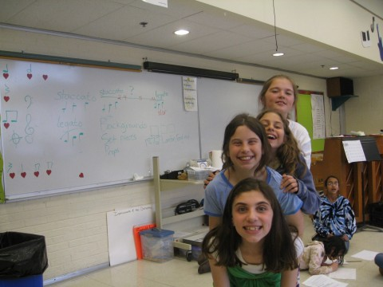
Notes:
Christine – started working w/ RBI, working with students, etc.

Slide 5
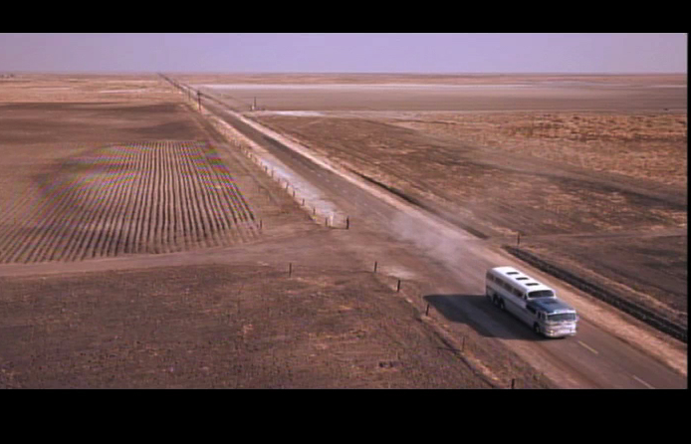
Notes:
Paul – quick breakdown of Motion Media Language and how it informs how we relate to screen-based media
So we think it’s important not only to understand, but to create original screen media

Slide 6
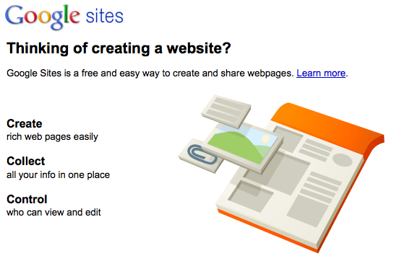
Notes:
Christine – ePortfolio introduction stuff, important to learn to be literate in other aspects – show, share, distribute work by means of an ePortfolio. Show who you are, what you’re doing – living breathing resume

Slide 7
Notes:
more

Slide 8
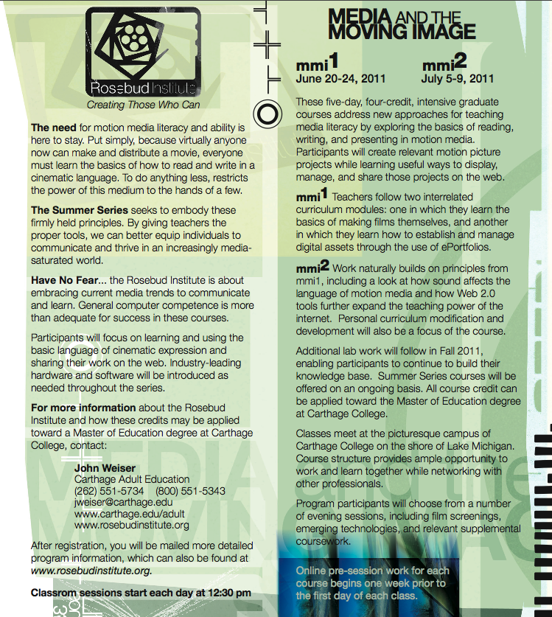
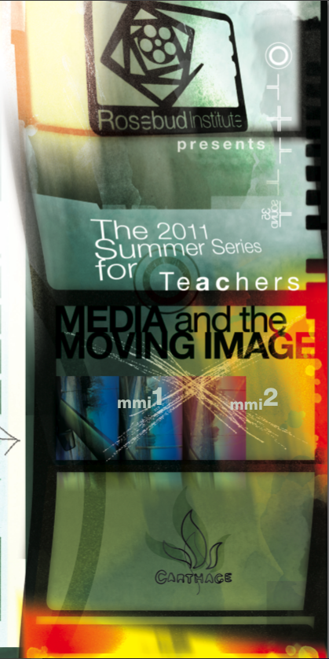
Notes:
Paul – we came up with a summer series for teachers, with the idea that teachers who learn these skills will be able to teach them to their students. 2-prong approach…

Slide 9
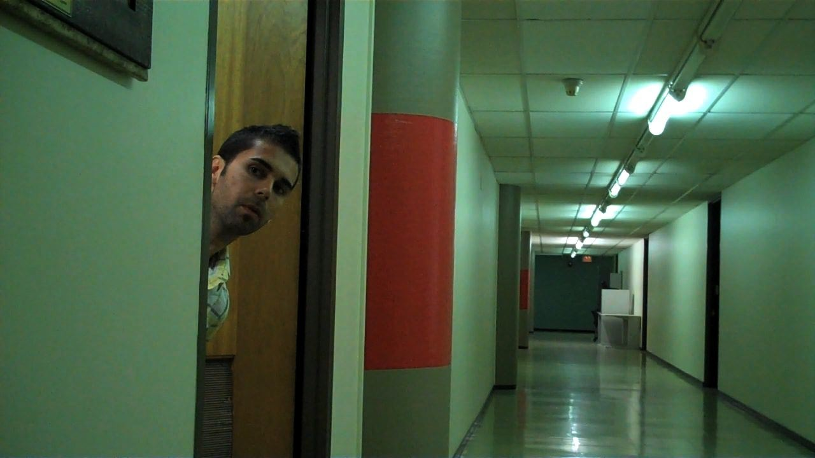
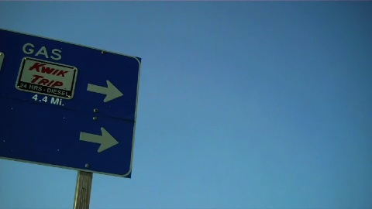
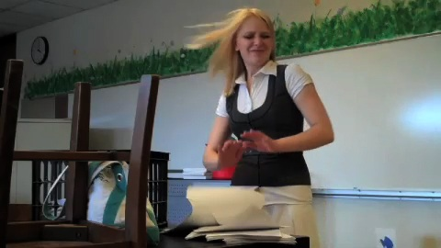
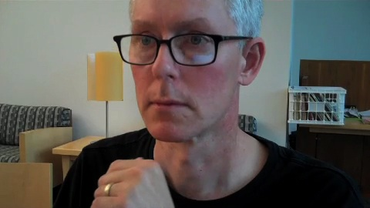
Notes:
Paul – important to learn the basics of motion media and then they learn to distribute their original films through their eportfolio sites.

Slide 10
http://rosebudinstitute.blogspot.com/
Notes:
Paul – put them online for the graduate students to view and receive feedback from…

Slide 11
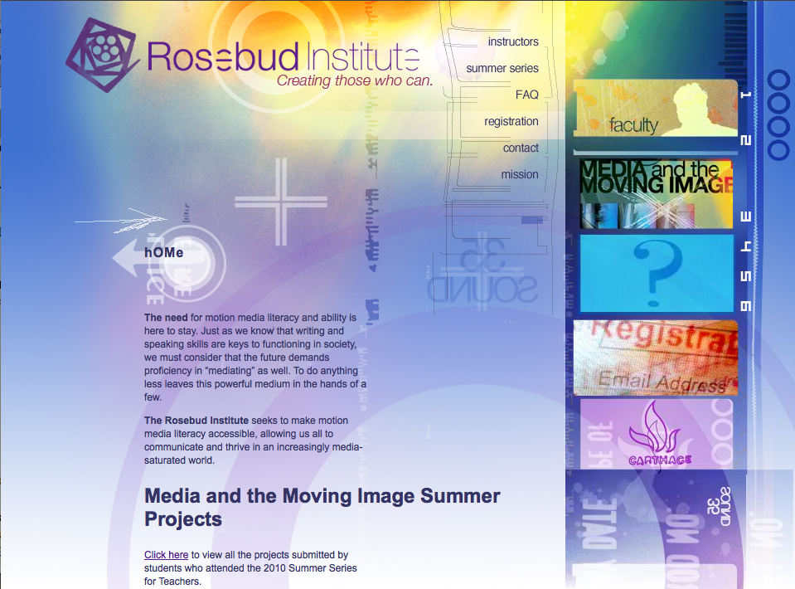
Notes:
…And now Christine starts blathering on again – connecting together with ePortfolios, learning to … at the end of the week they were much more screen literate.

Slide 12
Insert ePortfolio screenshots here
Notes:
Christine – talk about the ePortfolio results

Slide 13
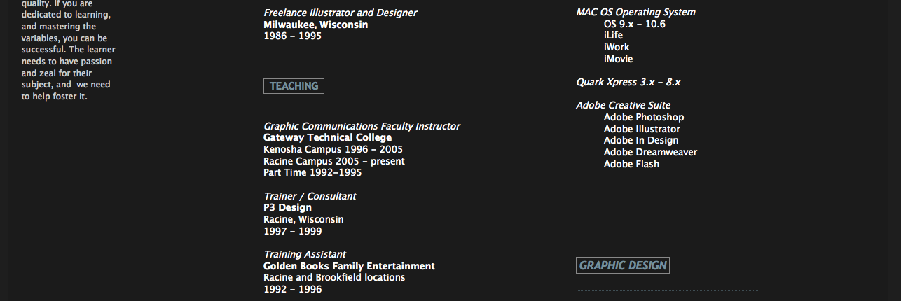
Notes:
C - more

Slide 15
Notes:
And Christine’s arm

Slide 16
“I'm getting a lot of ideas that I can take back to the classroom.”
“The ePortfolio portion of the course was also inspiring.”
“I learned more technology in this one week than I've learned in my whole life. It's been an amazing class.”
“I think it's interesting that every single person in this class is going to do something different with what they've learned once they leave. ”
Notes:
C – positive feedback and comments from students… switch to Paul to talk about Crude.

Slide 18
Notes:
Reset slide to… DTS
We decided to move on and expand into other areas – undergraduate students at Carthage in business, education, etc.
Refined the program and offered to high school students

Slide 19
Notes:
Collaborative work with another teacher to pilot this program… thought it would be condensed and paired down, but because of teacher buy in and going through the program, students had a lot of pre-work material, continual feedback,

Slide 20
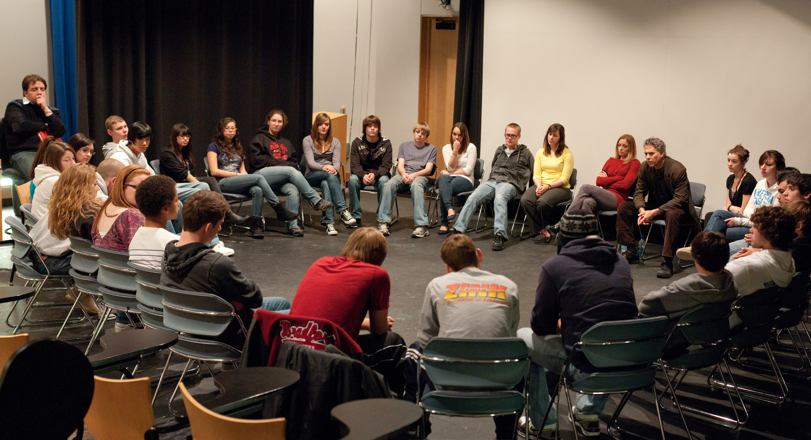
Notes:
P-Introduce concept of screen literacy here, distinction between DTS and digital story telling, screen media bootcamp, applicable to these students in sociology

Slide 22
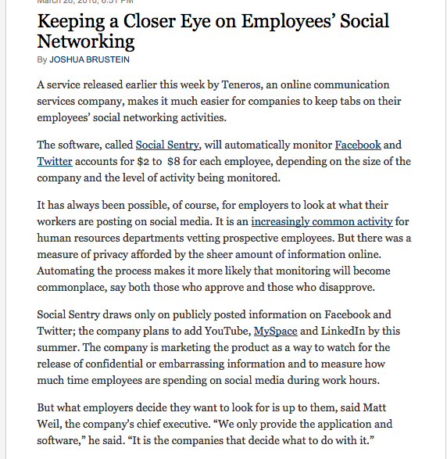
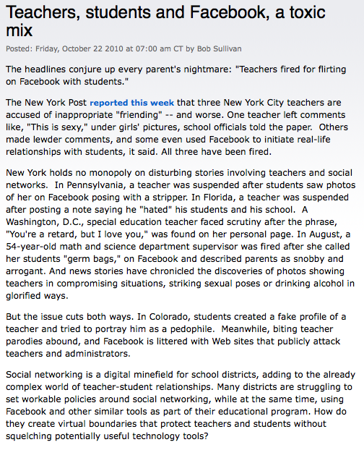
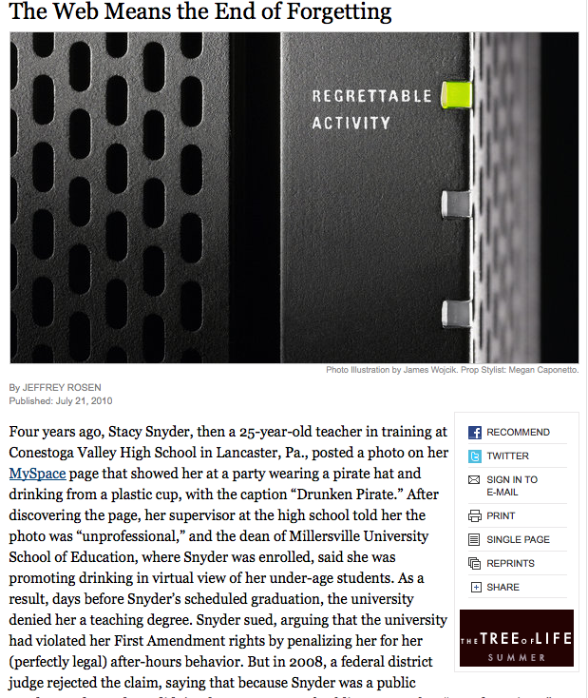
Notes:
C – talk about social media, online appropriateness, etc. similar v. different working with students v. adults

Slide 23
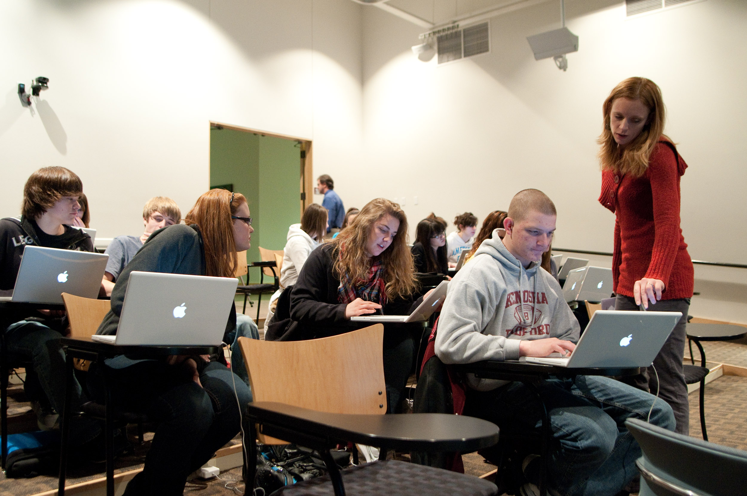
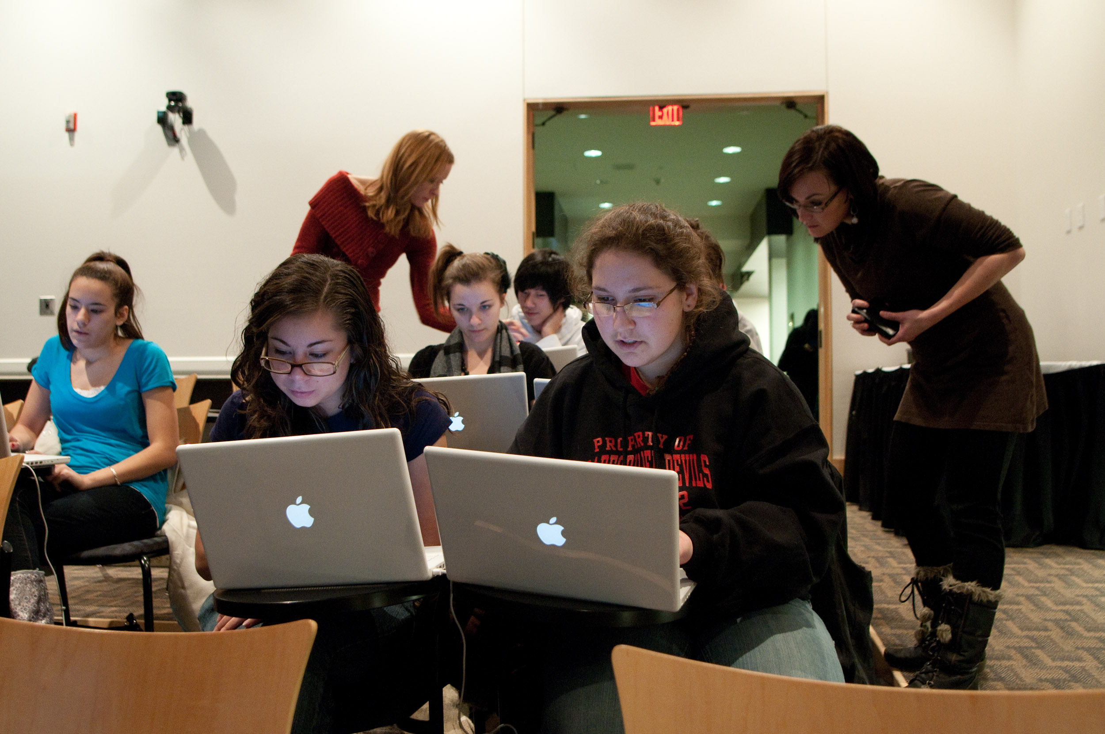
Notes:
C – talk about ePortfolio stuff on that day

Slide 24
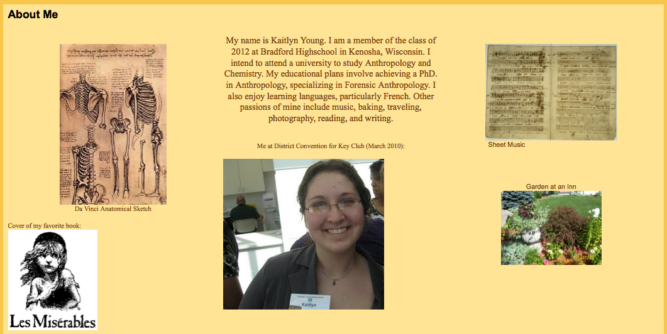
Notes:
examples

Slide 25
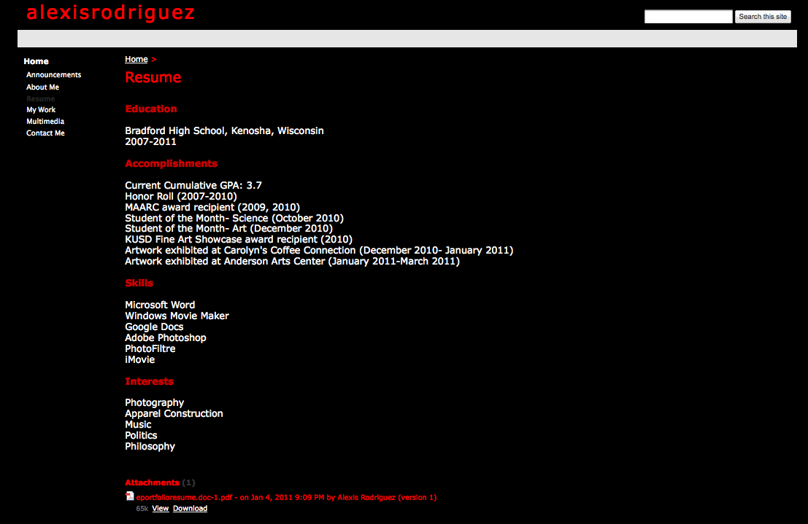

Slide 26
Insert excerpt of eP film

Slide 27
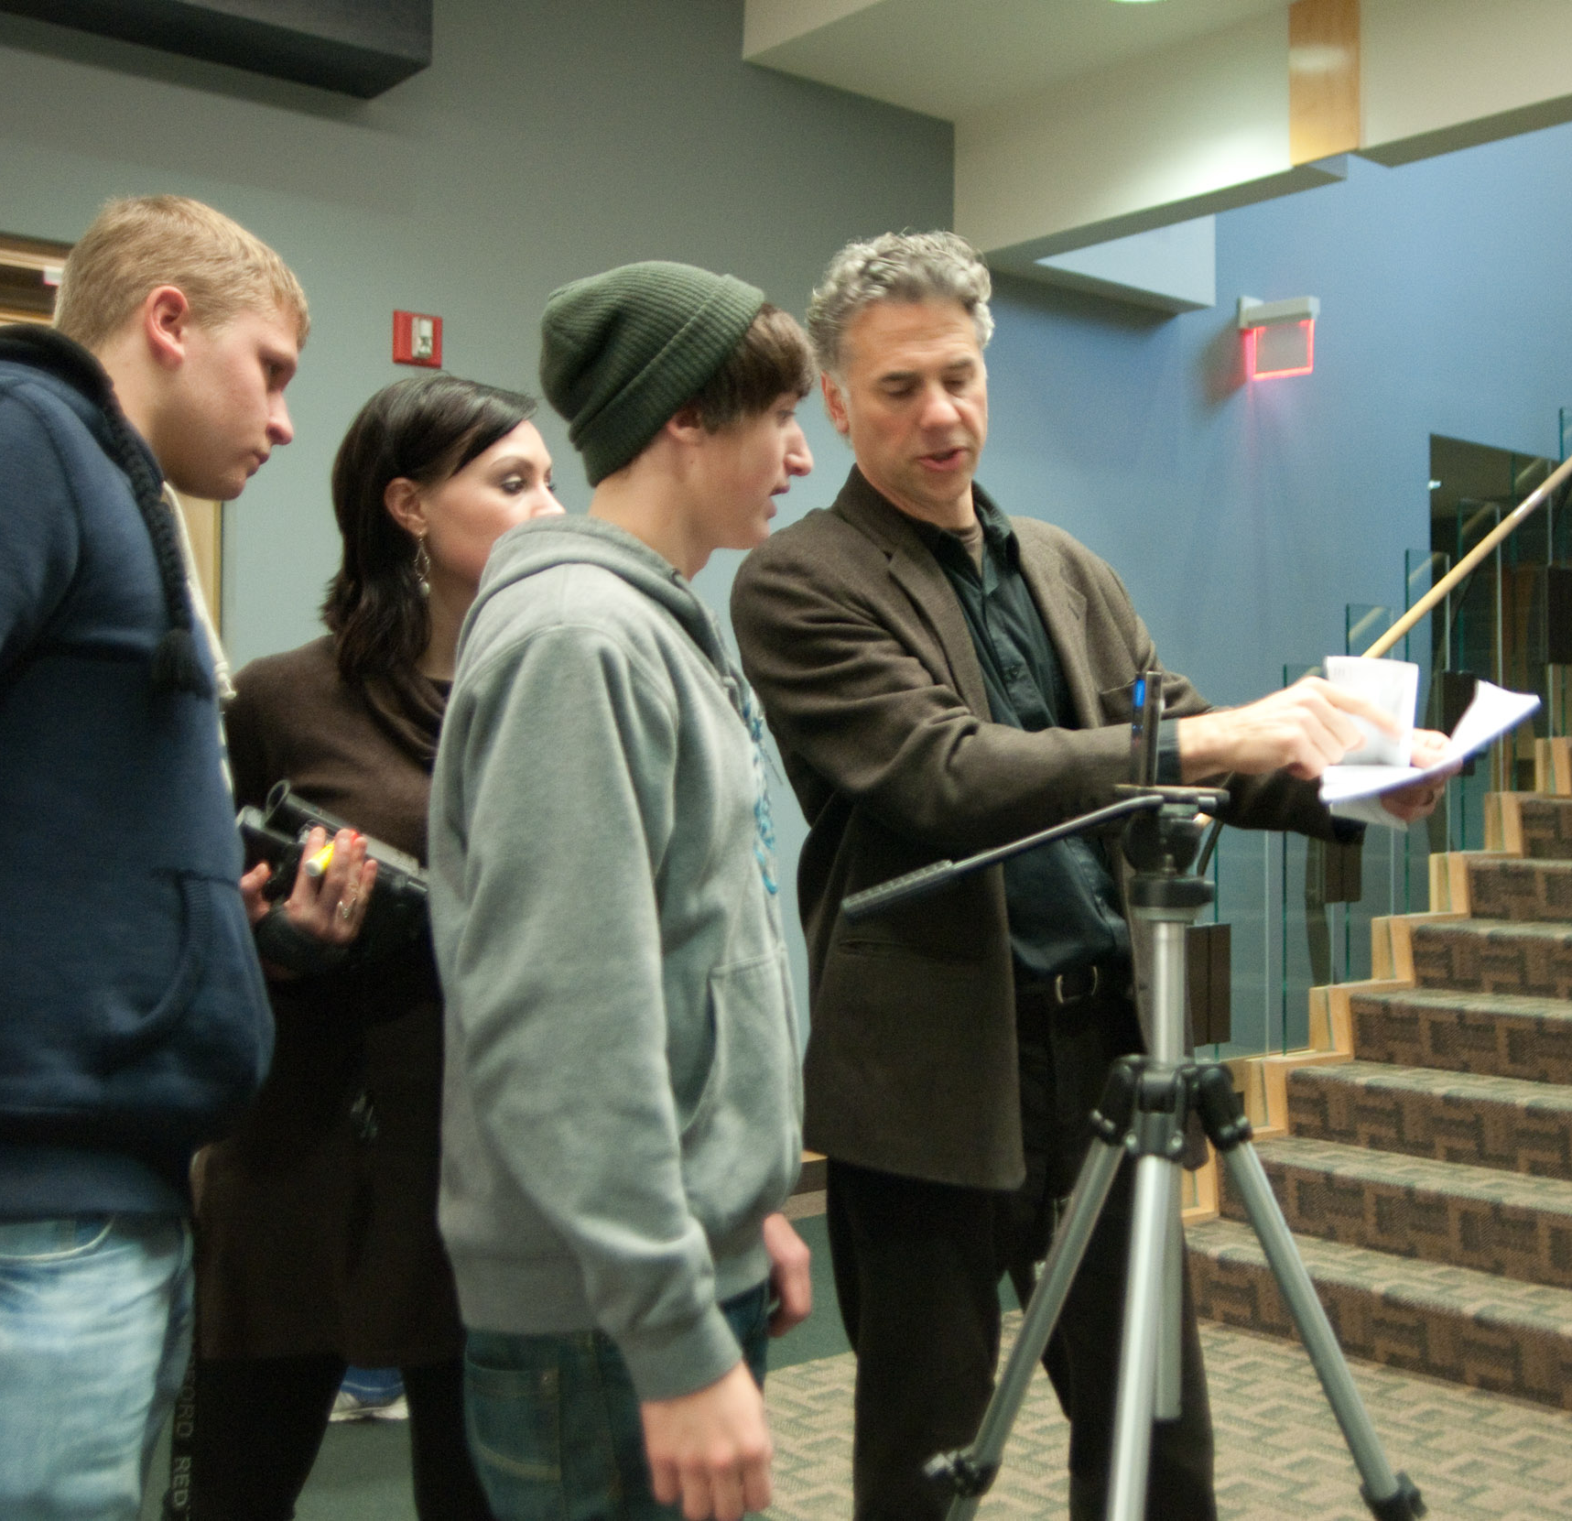
Notes:
Film side – gravitate much more easily towards understanding motion media literacy, no fear of technology

Slide 28
Silent Shorts Film Festival
Notes:
Leading to something, authentic audience vector, showing your work is important, not art in a vacuum – teaches the difference and separation of public from personal
Made the event a big deal, important, more ownership by elevating the level of importance via immediate audience

Slide 29
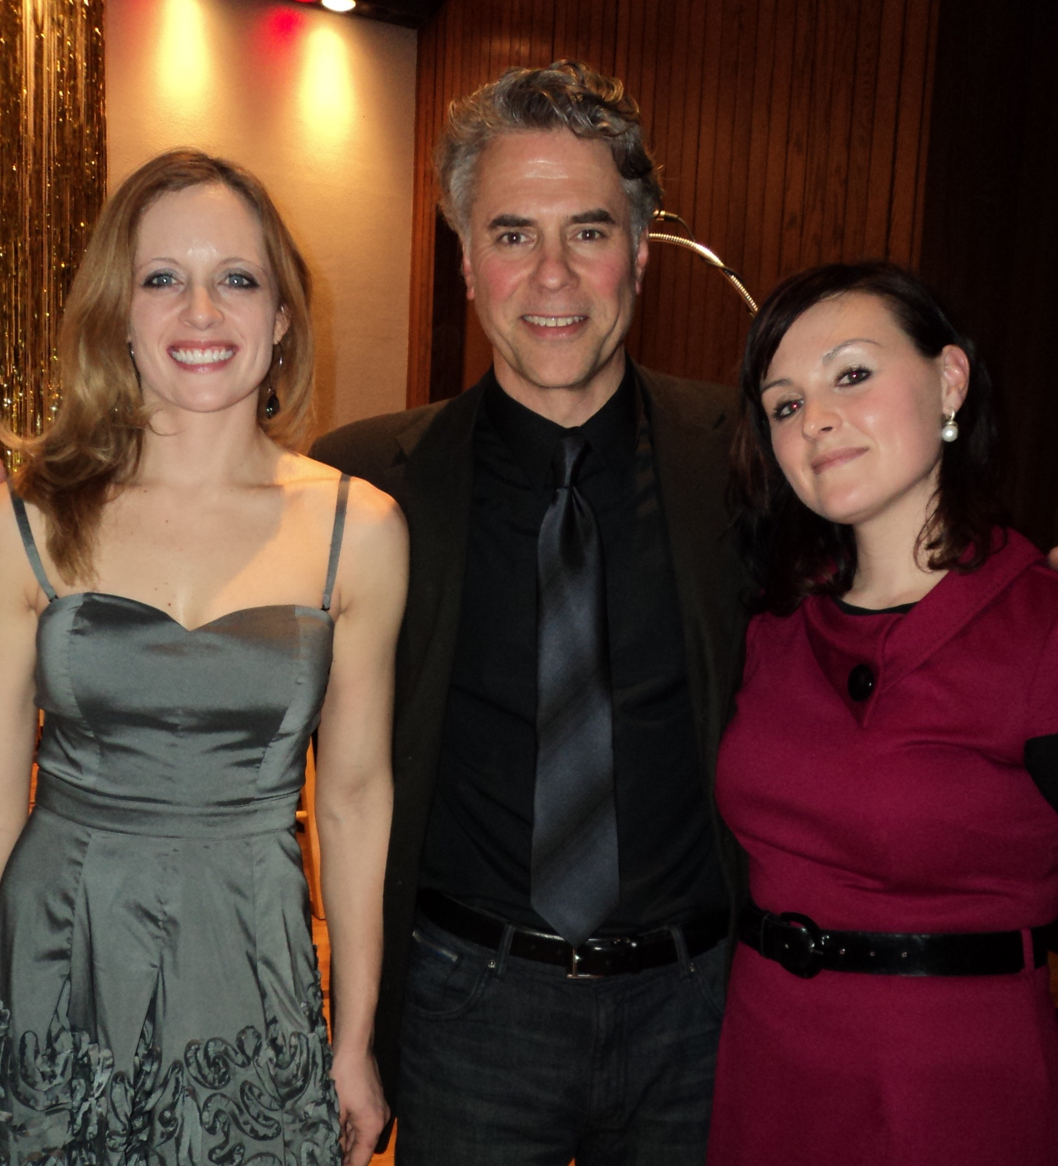

Slide 30
Notes:
Currently gathering resources, success so far is exciting – at any level, strips away the entertainment aspect of screen media, creating cognizant, aware, consumers and creators of screen media. Also talk about camp stuff, exploring other avenues to especially expand the DTS framework. Accessibility, eliminating fear of technology
Retaining pr professionals and interns to promote

Slide 33
Contact
Paul Chilsen Christine Wells
paul@rosebudinstitute.org christine@rosebudinstitute.org
Notes:
Whatever, contact page

