Slide 1
BACKCHANNEL CONVERSATIONS WITH
Melissa Woo (@mzyw)
Shannon Smith (@Smithstorian)
March 15, 2011
Copyright Shannon Smith, Melissa Woo, 2011. This work is the intellectual property of the authors. Permission is granted for this material to be shared for non-commercial, educational purposes, provided that this copyright statement appears on the reproduced materials and notice is given that the copying is by permission of the author. To disseminate otherwise or to republish requires written permission from the authors.

Slide 2
Follow…
… Colleagues
… Campus Community
… Higher Ed Community
… Others of Interest
Notes:
Twitter isn’t just reading about what other people are having for lunch.
The value of Twitter comes from the aggregation over time of snippets of information about...
your staff
your campus community
the wider higher education community
your other interests.
Understanding who, what and how to follow will go a long way towards deriving value from Twitter.

Slide 3
Exchanging business cards is soooo last century…
Notes:
Activity:
Ask participants at each table to exchange Twitter aliases and follow each other.

Slide 4
… do you know who’s reading your tweets?
It’s 2 am…
Public tweets
Protected tweets
Direct messages (DM)
Notes:
You can choose different levels of visibility of your tweets.
If you set up your account to be publicly visible, your tweets will be visible to everyone and appear on the public timeline. Anyone who follows you will be able to read what you tweet.
If you set up your account to protect your tweets, then you have to approve another person's request to follow you before that person can see your tweets.
Direct messages are private messages that you send to people who follow you. You cannot send a DM to someone you don't follow on Twitter.
Activities:
Demonstrate difference between the types of tweets.
Have participants send DMs to each other.

Slide 5
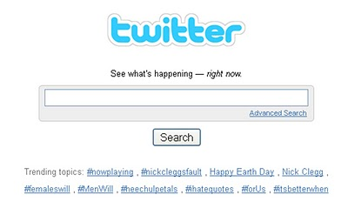
#hashtags
Notes:
Hashtags are an important means of "tagging" tweets on specific topics so that others can follow the topic more easily.
Use hashtags that have been established for given specific topics or try starting your own to see if it becomes popular!
Note that some people (Melissa is one of them) will occasionally use hashtags as a means of emphasis or as a side/parenthetical remark instead.
A particularly effective way to follow hashtags of interest are to combine hashtags with search engines.
Activity:
Go to search.twitter.com and type #mwrc11 to follow the main hashtag for this conference.

Slide 6
Retweeting
Share information
Create and follow memes
Notes:
Retweeting is a way of copying and resending information from a tweet of a person you follow in order to redistribute the information to your followers.
By retweeting, you're helping to broaden distribution of information that you think should be shared.
Activities:
Demonstrate retweeting.
Ask participants to retweet if they see something worth

Slide 7
Twitter Tools
Web-based
Mobile
Supplementary tools
Tie-ins with other social networking services
Notes:
There are a lot of different ways you can use Twitter. Here are just a few...
Official web interface at twitter.com
Web-based clients
Tweetdeck (www.tweetdeck.com)
Mobile clients
Official iPhone, Android Twitter clients
Twydroid
Supplementary tools
Photos/videos - Twitpic, yfrog
URL shorteners - TinyURL, bit.ly, goo.gl
Tie-ins with other social networking services
Facebook
Foursquare
... and more

Slide 8
Use of Twitter in Operations
Communicate operational issues
Keep finger on the pulse of the organization and campus
Gain insights from others outside the organization
Notes:
How Melissa uses Twitter in operations...
We have an automated feed from our Service Status web page to a Twitter account (@itstatus).
For better or worse, I often hear about service issues via our staff on Twitter before the official escalation/notification process reaches me.
Many of our staff are on Twitter, and it helps me keep in touch with them. This is especially important because our central IT organization is split over 10 buildings on campus.
I can also see what our campus community is saying about our services - though be careful of what you ask for...
There are so many colleagues outside of our campus that I follow who post great snippets of information, links to interesting sites, and act as valuable sounding boards.
Activities:
Follow someone of interest... look under the "who to follow" section of your Twitter web page.
Consider following @MiamiCIO - Debra Allison (MWRC11 program committee chair)

Slide 9
Use of Twitter in Teaching and Learning
Increase communication with students
Engage students in discussions with each other
Network with others in your discipline
Notes:
Using Twitter in T&L ...
Isn’t only about the dreaded “backchannel”
Activity:
Get involved with “buzzwords”
use www.twitterfall.com
www.twistori.com
www.twittervision.com
Activities:

Slide 10
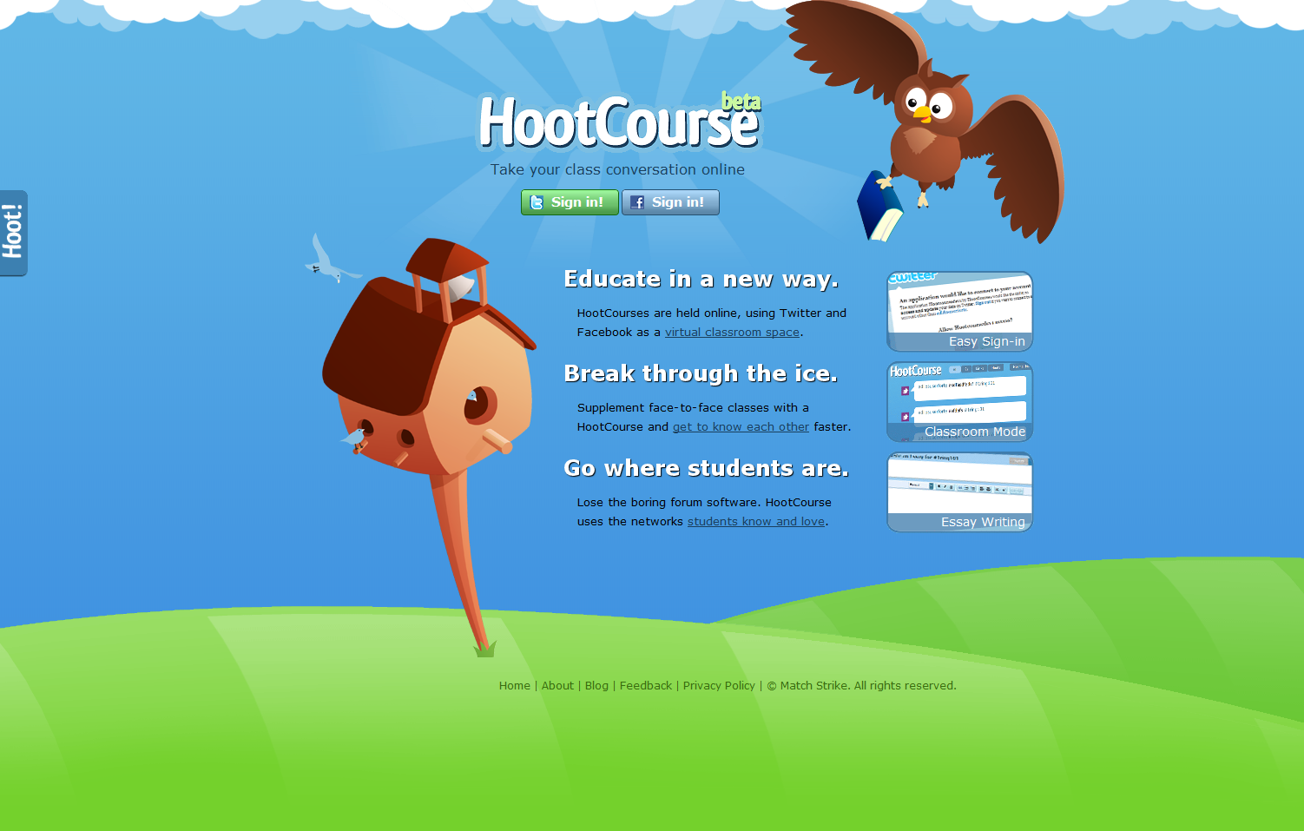
Notes:
Thousands of creative uses – Google “Twitter in the classroom”
Learning how to use Twitter can be a humbling experience, and it takes a little time to get comfortable with it, but don’t give up. Ask a colleague for help, practice with your friends and family, and before you know it you’ll be a Twitterati!

Slide 11
THANK YOU @mzyw @Smithstorian @educause

