Slide 1
From Generation “ME” to Generation “US”
Barb Braun & Colleen Corbett
Washington University in St. Louis

Slide 2

EUREKA!!! We found it!

Slide 3
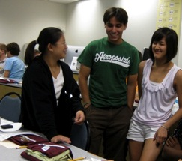
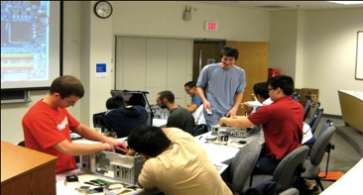
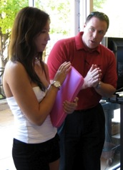
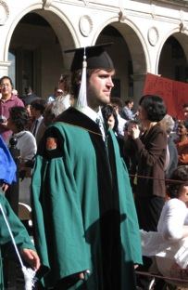
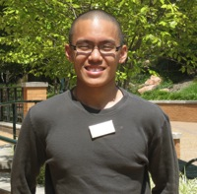
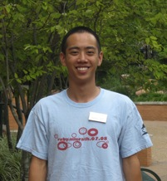
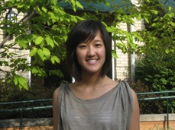
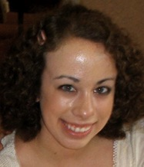
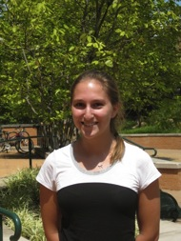
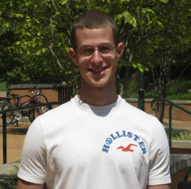
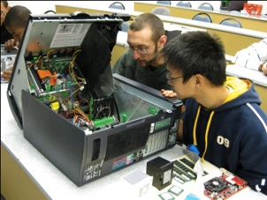
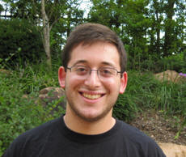
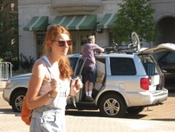
Who is this Generation Me?

Slide 4
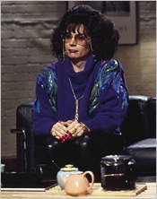
Talk Among Yourselves…
Hmm…what’s it been like for me to work with these “Generation ME students”

Slide 5
….and….

Slide 6


Slide 7
Washington University in St. Louis
Medium sized, independent University
50 states and 120 nations represented in our students and faculty
Center of St. Louis, Missouri
Admit approximately 1650 freshmen annually from an applicant pool over 25,000

Slide 8
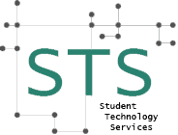
Student Technology Services
Our History
Our Customer
Our Services
Our Programs

Slide 9
Student Technology Services
Our Mission: To enhance the student experience by advocating for a technology-rich environment that is essential to the successful learning and enjoyable living of our students.

Slide 10

Our Formula for Success!
If we provide MEANINGFUL EXPERIENCES
With a MENTORING ENVIRONMENT
While MANAGING EXPECTATIONS,
We’ll have UNBELIEVABLE SUCCESS!
ME³ = US

Slide 11
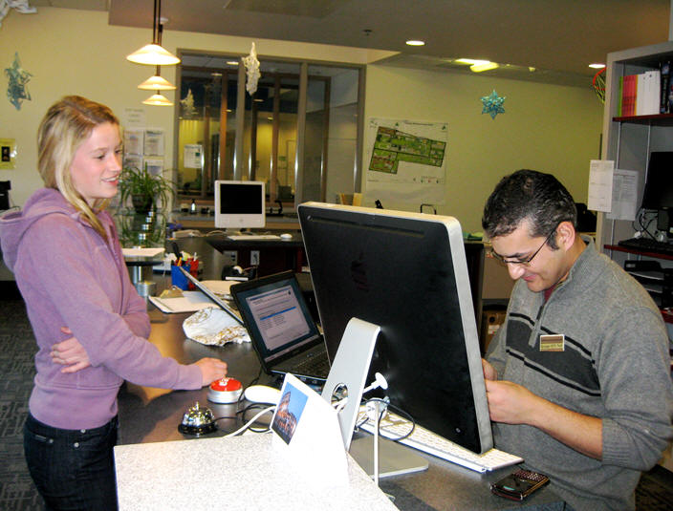
MEANINGFUL EXPERIENCES

Slide 12
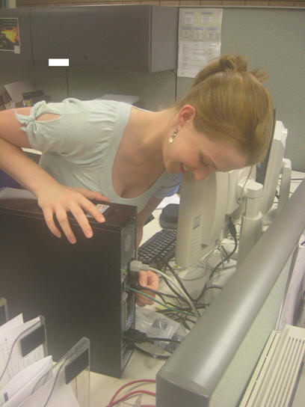
MEANINGFUL EXPERIENCES

Slide 13
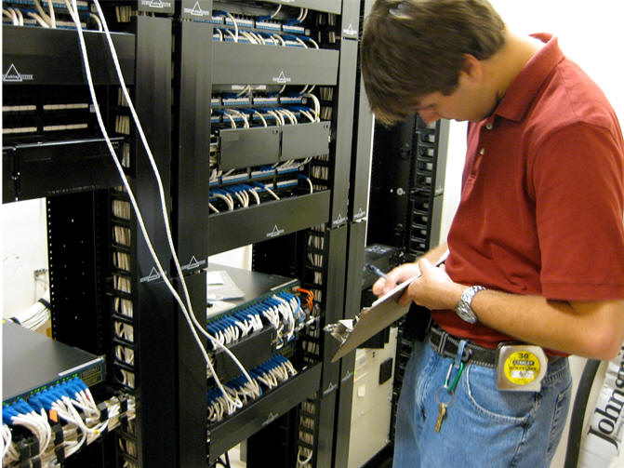
MEANINGFUL EXPERIENCES

Slide 14
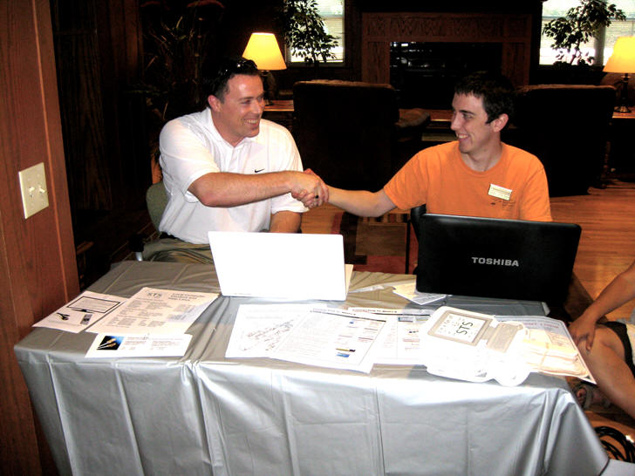
MENTORING ENVIRONMENT

Slide 15
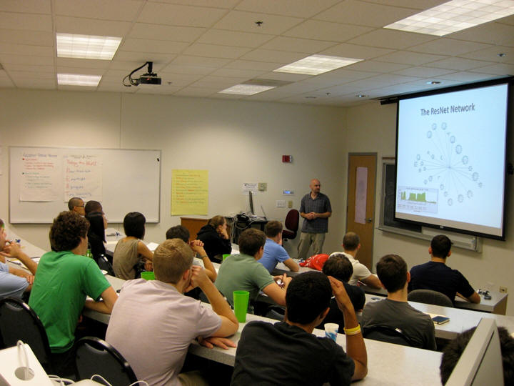
MENTORING ENVIRONMENT

Slide 16
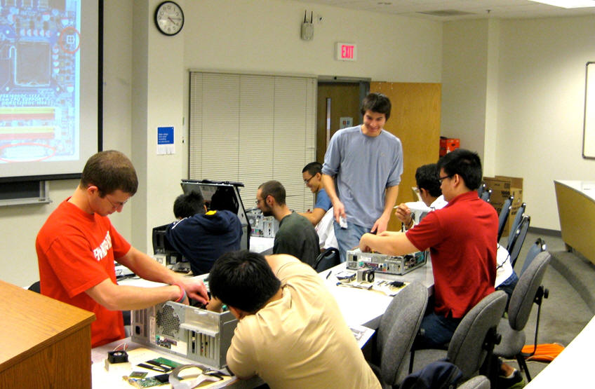
MENTORING ENVIRONMENT

Slide 17
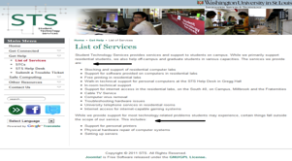
MANAGING EXPECTATIONS

Slide 18
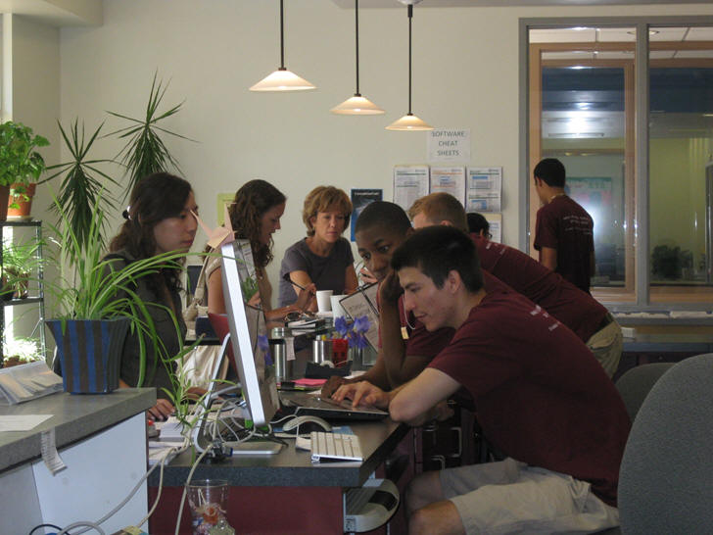
MANAGING EXPECTATIONS

Slide 19
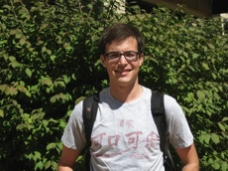
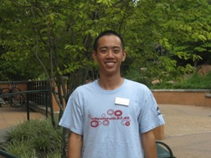
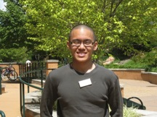
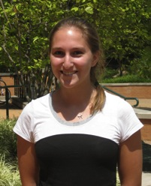
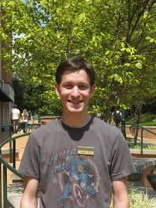
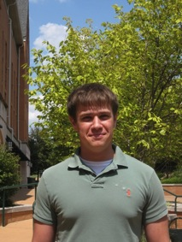
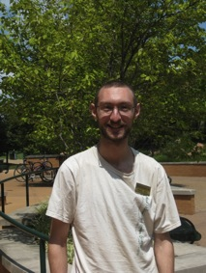

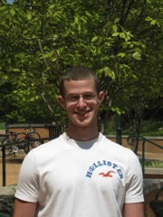
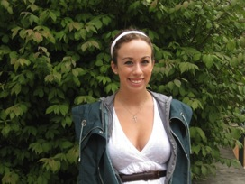
MANAGING EXPECTATIONS

Slide 20
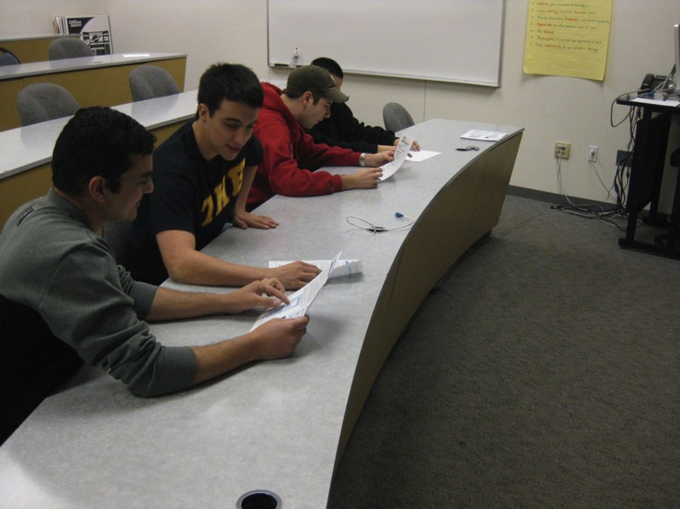
MANAGING EXPECTATIONS

Slide 21
UNBELIEVABLE SUCCESS
A
D
V
I
S
E
F
U
N
C
O
A
C
H
B
A
L
A
N
C
E
R
E
S
P
E
C
T
L
I
S
T
E
N
P
A
S
S
I
O
N

Slide 22
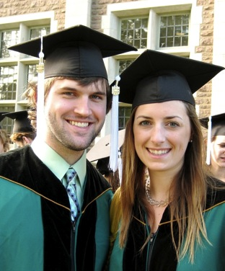
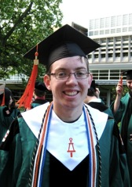
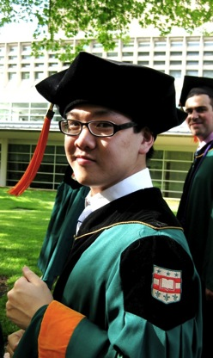
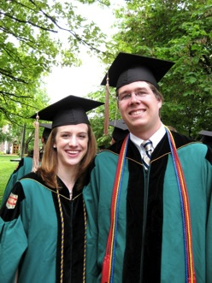
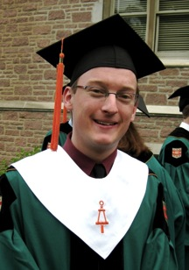
UNBELIEVABLE SUCCESS

Slide 23
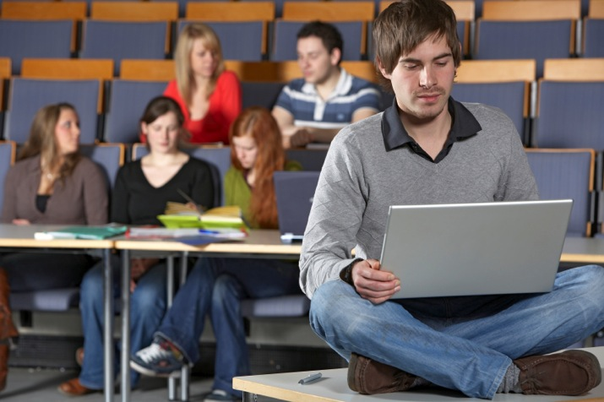
And now a word from our sponsors!
Watch the video from our students by visiting our STS site!
If this link will not open, you may visit http://sts.wustl.edu/educause.mov

Slide 24

Our Contact Information
Barb Braun, Director
barb.braun@wustl.edu
314.935.7597
Colleen Corbett, STaRS Program Supervisor
ccorbett@wustl.edu
314.935.3353

