Slide 1
Breaking Down Barriers &
Building Bridges Improves
Customer Satisfaction & Efficiency
Wendy Woodward | March 15, 2011
Copyright Wendy Woodward 2011. This work is the intellectual property of the author. Permission is granted for this material to be shared for non-commercial, educational purposes, provided that this copyright statement appears on the reproduced materials and notice is given that the copying is by permission of the author. To disseminate otherwise or to republish requires written permission from the author.

Slide 2
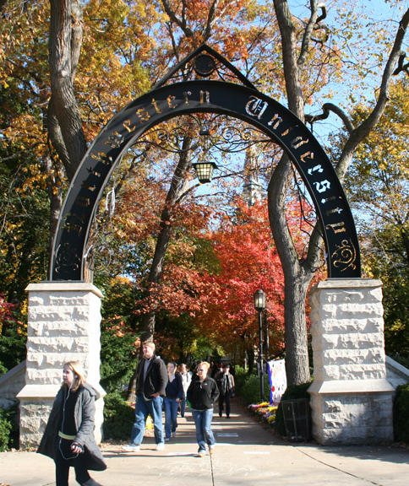
Northwestern University
  Carnegie Classification RU/VH (R1)
  Private
  3 campuses (Evanston, Chicago, Qatar)
  12 schools and colleges
  19,000 students; 10,500 faculty and staff members
  Highly decentralized IT support model

Slide 3
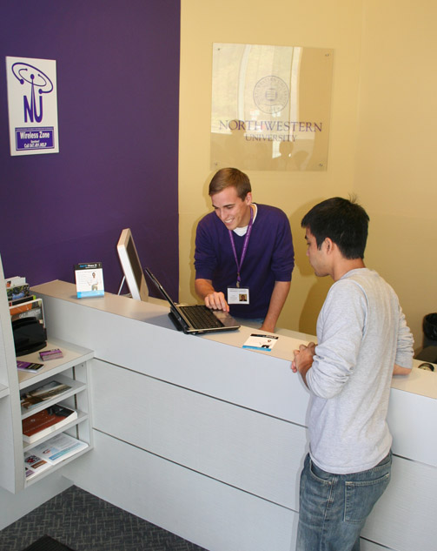
The Central IT Organization
250 staff members, 100 student staff
Administration and Finance
Technology Support Services
Academic & Research Technologies
Management Systems
Cyberinfrastructure
Information System Security/ Compliance
Business Intelligence

Slide 4
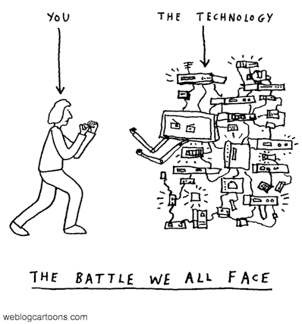
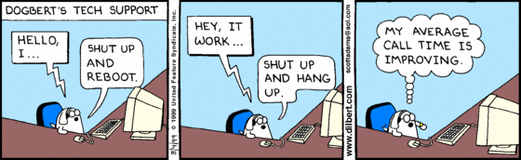
Opportunities
  Disparate help desks and incident tracking systems
    Inefficient processes
    Increased costs
    Customer confusion
  Outdated Remedy system
    Other ticketing systems
  Inconsistent ITIL adoption

Slide 5
Opportunities
  Various service delivery models
    SLA = Service Like Always?
  Increasing accountability to business stakeholders
    Transparency

Slide 6
University IT Strategic Initiative
Integrate the various University technology service points to facilitate a stable, robust, efficient, and customer-focused support environment, including convenient Web-based assistance and performance metrics for all information technology services and systems.
Provide a single point of contact for technology-related support that can be leveraged to optimize the support experience, improving response time and communication.

Slide 7
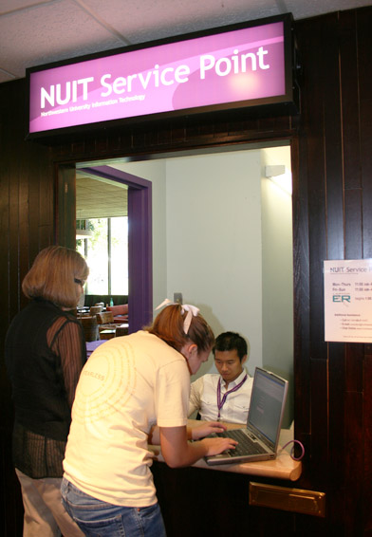
Benefits of a Unified Solution
Streamlined access to IT support resources, self-help, and knowledge articles
Enhanced customer services through ticket status availability and integrated request handling
Systematic infrastructure management and control to support service reliability
Process control, automation, and reporting capabilities

Slide 8
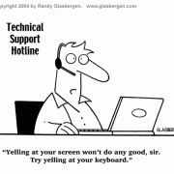
Breaking Down Barriers
  Consultant-engaged
  Executive commitment to process improvement
  Relocate staff positions to service desk team

Slide 9
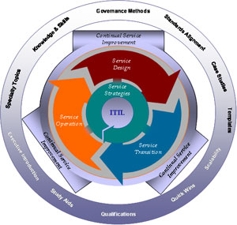
Building Bridges
  Core management team committed to unification
  Collaborative RFP for service management tool
    HP Service Manager
  ITIL adoption
    Training
    Process owners/ champions identified
  SLA / OLA development
  Knowledge sharing
    ACD, Wiki, chat

Slide 10
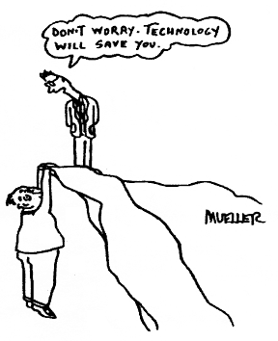
Challenges
  Software not a perfect fit
  Staff
    Change is scary
    Vacancy
  Resource constraints
    Limited budget
    Other system launches
  CIO transition

Slide 11
Successes
  1-HELP is the front door
  Customers empowered to enter requests via Web and track progress
  Increased visibility into IT service delivery (leads to accountability)
  Backend IT staff THRILLED!
  Cost reduction
    Staff realignment
    Other tracking systems retired
  New customers lining up to join the service model

Slide 12
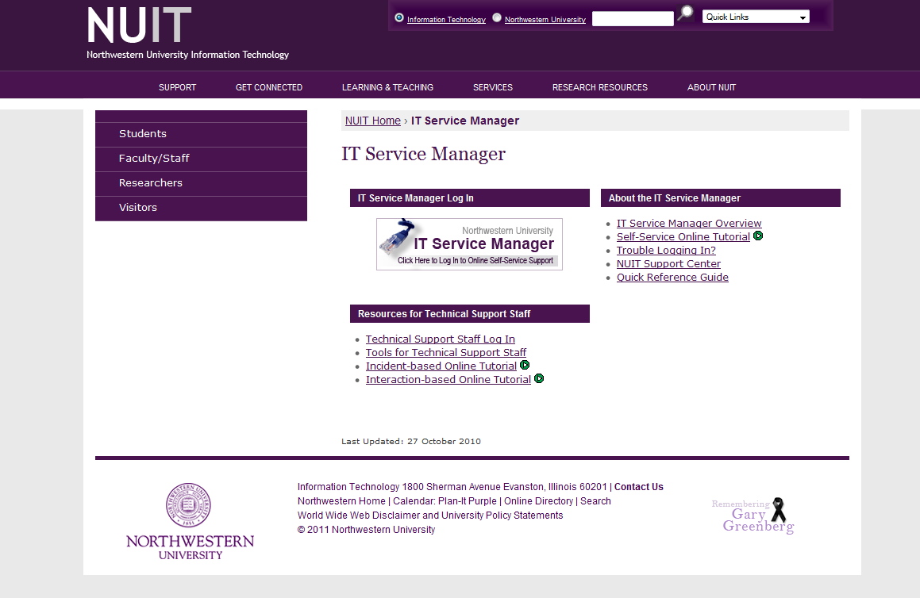

Slide 13
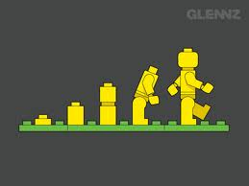
The Future
  Continue the journey
  Integrate other enterprise system or school level support
  Increased efficiencies

Slide 14
Thank you!
Questions?

