Slide 1
Investigating How Students REALLY Use IT
Christopher Cooley & David Stack | March 16, 2011
University of Wisconsin-Milwaukee

Slide 2
Copyright Board of Regents of the University of Wisconsin System 2011. This work is the intellectual property of the Board of Regents of the University of Wisconsin System. Permission is granted for this material to be shared for non-commercial, educational purposes, provided that this copyright statement appears on the reproduced materials and notice is given that the copying is by permission of the author. To disseminate otherwise or to republish requires written permission from the author.

Slide 3
Please Note:
“Up Close” images of students using IT facilities have been removed from this archived version the presentation, hence it’s spare look.

Slide 4
Impetus
Studying Students: The Undergraduate Research Project at the University of Rochester
Nancy Fried Foster and Susan Gibbons (Eds) 2007
Notes:
Available in hardcopy from American Library Association (Item Number: 978-0-8389-8437-) http://www.alastore.ala.org/detail.aspx?ID=2322
or as a free download at: http://www.ala.org/ala/mgrps/divs/acrl/publications/digital/Foster-Gibbons_cmpd.pdf

Slide 5
collaborators
ProF. Thomas Malaby “Making virtual Worlds”
Christopher cooley - Doctoral student
Shawn KERR - undergraduate
Notes:
Available in hardcopy from American Library Association (Item Number: 978-0-8389-8437-) http://www.alastore.ala.org/detail.aspx?ID=2322
or as a free download at: http://www.ala.org/ala/mgrps/divs/acrl/publications/digital/Foster-Gibbons_cmpd.pdf

Slide 6
Funding support
“ED Tech fee” is 2% of Student tuition
Notes:
http://www4.uwm.edu/acad_aff/policy/ed-tech/uits-ethnographic-study.pdf
UWM Educational Technology Fund Policies and Procedures: http://www4.uwm.edu/acad_aff/policy/edtechpolicy.cfm

Slide 7
Facilities
This was a study of students not facilities
Nevertheless:
Notes:
http://www4.uwm.edu/acad_aff/policy/ed-tech/uits-ethnographic-study.pdf
UWM Educational Technology Fund Policies and Procedures: http://www4.uwm.edu/acad_aff/policy/edtechpolicy.cfm

Slide 8
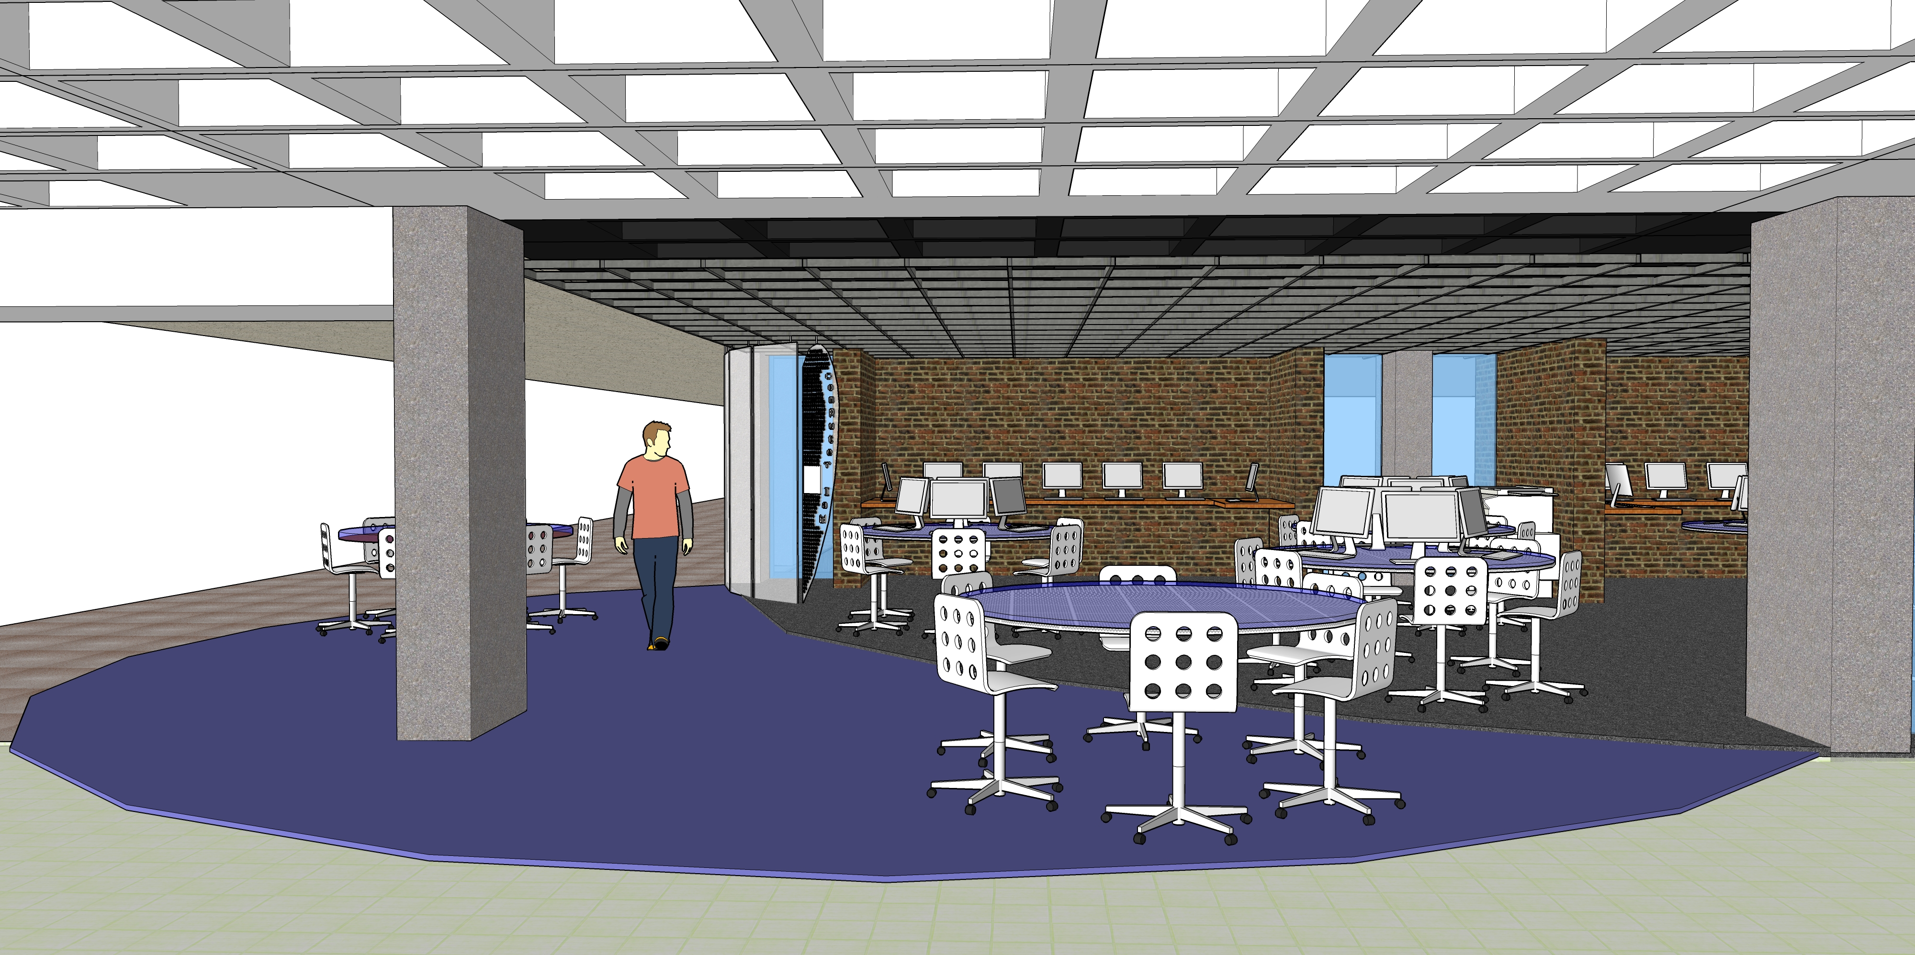
UNION Computer Lab
Notes:
Campus Computer Labs: https://www4.uwm.edu/uits/services/campus/ccls/

Slide 9
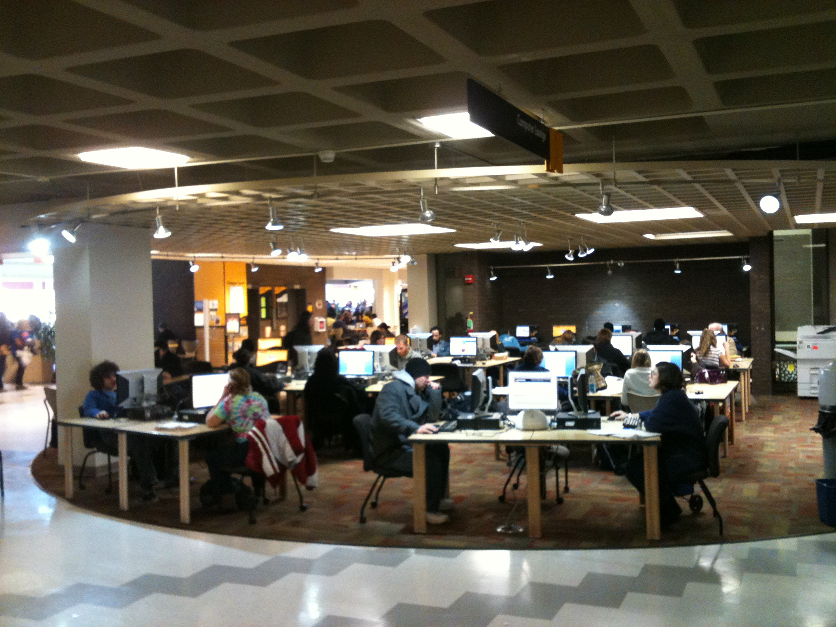
UNION Computer Lab

Slide 10
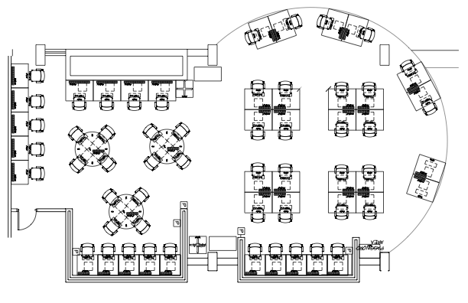
UNION Computer Lab

Slide 11
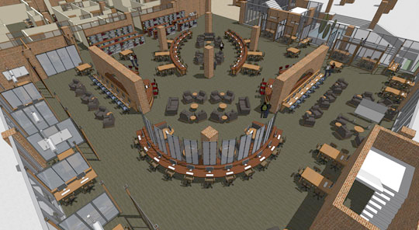
Library Learning commons

Slide 12
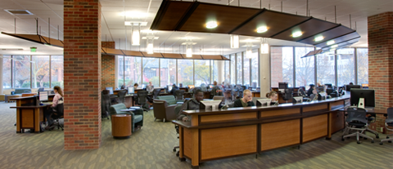
Library Learning commons

Slide 13
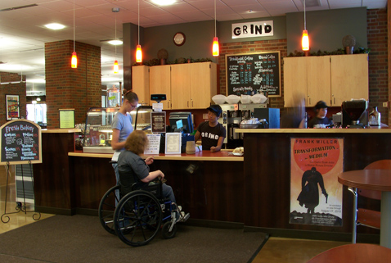
Library Learning commons

Slide 14
Discussion of the research Findings
This portion of the presentation did not have any slides.
Please contact cjcooley@uwm.edu or david@uwm.edu

Slide 15
Positive outcomes for IT:
- Lots of “Buzz” on campus
- provost & dean funding for follow-up
- presentation to it Policy Committee
- presentation at campus it brown bag
- interest on the part of EcaR

Slide 16
Budget for summer 2010:
- One month faculty buyout
- 2 months wages for fieldwork
- $3k in undergraduate student wages
- Conference travel expenses in-kind support:
- Project shepherding from CIO Office
- hr processing by IT Dept and faculty college
- Generation of email lists and Enrollment stats

Slide 17
LESSONS Learned by IT:
- “Beard the lion in his den”
- It’s not always easy to buy faculty
- Unit of measure (course, month)
- competing research interests
- HR processes for academic appointments
- perception by other campus departments

Slide 18
Resources
“Studying Students” is Available in hardcopy from American Library Association (Item Number: 978-0-8389-8437-) http://www.alastore.ala.org/detail.aspx?ID=2322 or as a free download at: http://www.ala.org/ala/mgrps/divs/acrl/publications/digital/Foster Gibbons_cmpd.pdf
Proposal for the initial study: http://www4.uwm.edu/acad_aff/policy/ed-tech/uits-ethnographic-study.pdf
UW-Milwaukee’s Educational Technology Fund Policies and Procedures: http://www4.uwm.edu/acad_aff/policy/edtechpolicy.cfm
UW-Milwaukee’s Campus Computer Labs: https://www4.uwm.edu/uits/services/campus/ccls/

