Slide 1
Leadership: Pass It On
Robert Baird
Alex Breen
James Quisenberry
Chuck Thompson
March 15, 2011

Slide 2
Pre-Presentation Administrivia
Copyright Robert Baird, Alex Breen, James Quisenberry, Chuck Thompson, 2011. This work is the intellectual property of the authors. Permission is granted for this material to be shared for non-commercial, educational purposes, provided that this copyright statement appears on the reproduced materials and notice is given that the copying is by permission of the author. To disseminate otherwise or to republish requires written permission from the authors.

Slide 3
Preparing, Comparing, Sharing
Notes:
Describe a time when you observed good (or bad) leadership.
Pair up, introduce yourselves, and take turns comparing your definitions. We’ll only take two minutes for this.
Voluntell your definitions

Slide 4
Starting Point
Notes:
http://www.cic.net/Home/Projects/Technology/ProfDevelopment/ITLeaders.aspx
http://www.cic.net/
http://morassociates.com/
“In an effort to better prepare leaders for 21st century challenges within their respective IT organizations as well as higher education in general, the CIC Chief Information Officers (CIOs) instituted the Information Technology Leaders Program (ITLP) in the spring of 2007. Since that time, more than 100 IT staff from CIC universities are ITLP graduates.”

Slide 5
Spreading the Word

Slide 6
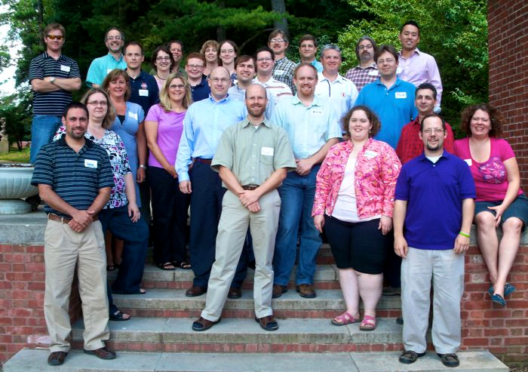
Participants

Slide 7
Participant Units

Slide 8
Topics

Slide 9
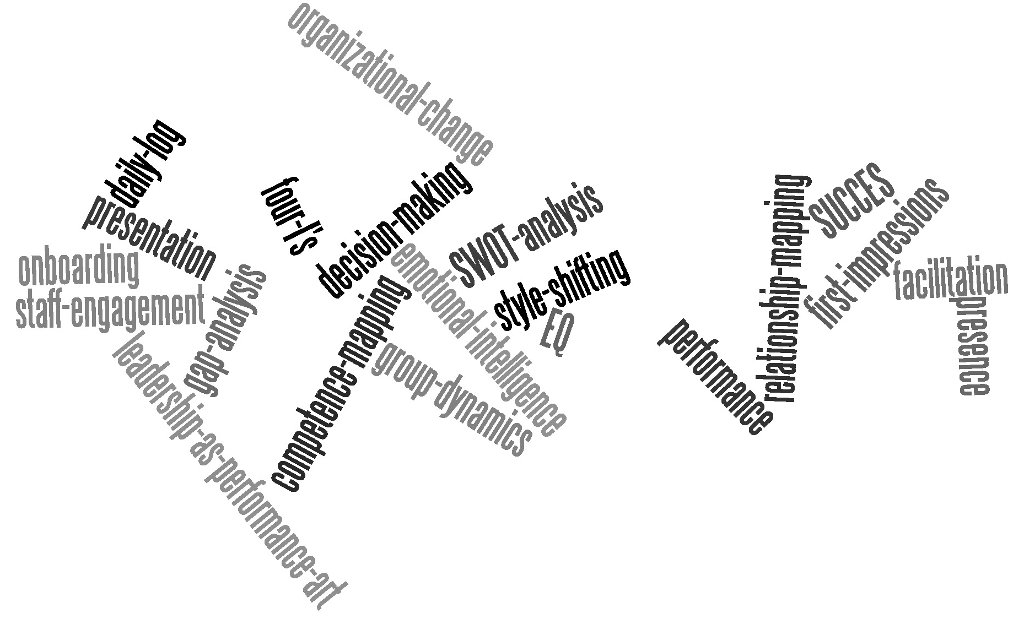
Topics (But Wait)

Slide 10
Location, Location, Location
Notes:
It is important to get away from campus. Do not make it easy to run back to work.

Slide 11
Workshop Format
Coaching
Major Topic Sessions
Reflection (I-Time)
Leadership Moments
Networking Time
Plus/Delta
Projects

Slide 12
Coaching
Notes:
Coaching can (and should) be done even without the rest of the program.
Thanks to all of our coaches.

Slide 13
Major Topic Session Format
Engagement
Presentation
Discussion
Engagement
Exercises
Breakouts
Engagement

Slide 14
Engagement

Slide 15
Projects
Presentation to Council of Deans
In-Between Session Work
Required Networking
Outside Comfort Zone
Use Skills Learned
Facilitator Learning
Notes:
Project idea inspired by final exercise of 2007 EDUCAUSE Leadership Program.

Slide 16
Workshop Feedback
Networking opportunities
“Not just lectures”
Immediately usable toolkit
New perspectives beyond leadership
Endorsed by Council of Academic CIOs
Over 1/3 of participants assisting for 2011

Slide 17
Discuss
What interests you?
What do you want more details about?
What ideas for improvement came to mind?

Slide 18
Plus/Delta
Plus
participants do the workshop
participants help facilitate later sessions
have group have goals wanting to change and coaches work to help accomplish
graduation requirements
Delta
need more wireless mics
graduation requirements
Notes:
What did you like about the presentation?
What would you change about the presentation?
NOTE: This slide was completed during the session.

