Slide 1
Librarian and Instructional Technologist:
A Natural Pairing
With a diminishing budget and a hiring freeze, K-State Salina embraced the emerging trend of a combined position that pairs library services and instructional technology.
This budget friendly position was created to meet the increased research needs brought about by a new university vision, graduate program, and the need for onsite instructional technology assistance and training.

Slide 2

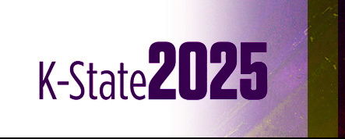
Why Change Was Needed…
New Population of Students
  The K-State Salina started its first ever Graduate Program in the Fall of 2011. A student population that had yet to be seen on this small Midwestern campus.
New University Initiative
  University wide goal to be a Top 25 Research Institute by 2025 meant more need for research assistance for Faculty and Students, adding to the pressure of already stretched library services.
  Historically this campus had been a technical school where faculty had workforce experience rather than educational research experience.
Existing Needs not being met
  A state-wide hiring freeze made rehiring a vacated Instructional Technologist difficult, meaning this large need was not being met.

Slide 3

Research…
Faculty Needs
  A faculty survey revealed that assistance for research and instructional technology was a large perceived need
Campus Needs
  A push to add online classes
  The goal of becoming a top 25 research institution meant increased research for undergrad students as well, putting more strain on library services.
Candidate with the right skill set
  Could a candidate with the combined skill set be found in the candidate pool?

Slide 4


National Trends in Library Science and Instructional Design and Technology…
Combined Degree Programs
  Many universities have combined Library Science and Instructional Technology Degrees
    Emporia State University, Emporia KS
    University of Missouri, Columbia, MO
    Kutztown University, Kutztown, PA
Combined Library and Technical Assistance Centers
  Kansas State University, Manhattan, KS
  Georgia College, Milledgeville, GA

Slide 5


Benefits and Challenges…
Benefits
  Cost Savings
  One Stop Shop for faculty and student research and technical needs
  Better focus on different library populations
Challenges
  Differing Customer Service Ideals between Library Service and Instructional Technology
  Getting faculty to adjust to a new point person and a new process
  Splitting time adequately between the two sets of job duties
Always a Silver Lining
  Graduate program just began in the Fall of 2011, allowing this part of the job to be slowly integrated.

Slide 6
Lisa Craft
Faculty and Graduate Services Librarian
Kansas State University – Salina
Salina, KS

