Slide 1
Measuring the Present The Answer Key Don Padgett, University of Notre Dame
27 Mar 2012

Slide 2
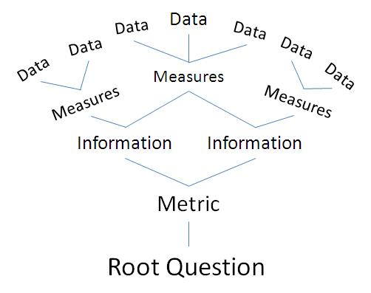
Data
Data
Data
Data
Measures
Data
Measures
Data
Measures
Information
Information
Metric
Root Question
Notes:
The TREE diagram is a stalwart tool for describing the design of metrics.
GO OVER THE TREE

Slide 3
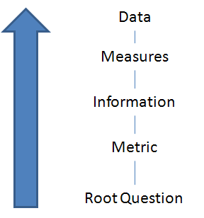
Assumptions
Notes:
Start off with some basic assumptions. That the audience knows the common language of metrics.

Slide 4
Outline
The Answer Key
Product/Service Health
Process Health
Organizational Health
Future Health
The Answer Key
Customers’ view
Business (managers’) view
Organization’s (workers’) view
Leadership’s view
Triangulation
How to Use the Answer Key
References
Notes:
Tell ‘em what I’m going to tell ‘em

Slide 5
Measuring the Present The Answer Key
Notes:
The answer key provides structure to what may seem disparate, unorganized measures

Slide 6
Organizational
Information Needs
Root Need or Root Question

Slide 7
Return vs. Investment
Organizational
Information Needs
METRICS
State of
the Union

Slide 8
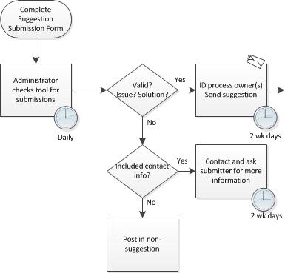
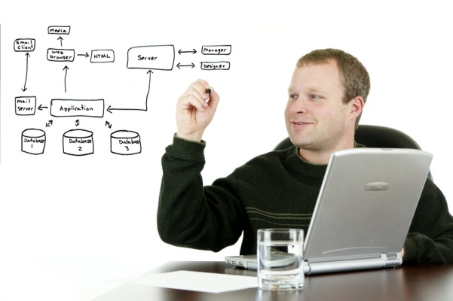
1
Product/Services Health
Effectiveness
Customer View - Return
Return vs. Investment
Organizational
Information Needs
2
Process Health
Efficiency
Business View - Investments
INFORMATION
3
Organizational Health
Workers View
State of
the Union
4
Future Health
Leadership View
Notes:
The four viewpoints dictate different Metrics (data, measures, and information); customer, business, employee, and leadership viewpoints
The measure may seem the same – Speed to resolve but the viewpoint changes our perception. Think Six Sigma and process improvement vs. Customer Satisfaction

Slide 9
1
Product/Services Health
Effectiveness
Customer View - Return
a. Delivery - Products/Services
b. Usage
Return vs. Investment
c. Customer Satisfaction - Surveys
Organizational
Information Needs
2
Process Health
Efficiency
Business View - Investments
MEASURES
3
Organizational Health
Workers View
State of
the Union
4
Future Health
Leadership View

Slide 10
1
Product/Services Health
Effectiveness
Customer View - Return
a. Delivery - Products/Services
b. Usage
Return vs. Investment
c. Customer Satisfaction - Surveys
Organizational
Information Needs
2
a. Cost
Process Health
Efficiency
Business View - Investments
b. Time
c. Resource Allocation
d. Quality – Includes Rework
MEASURES
3
Organizational Health
Workers View
State of
the Union
4
Future Health
Leadership View

Slide 11
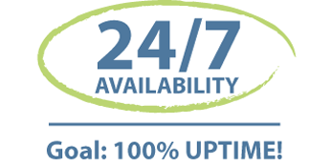
Effectiveness
V.S.
Efficiency
Notes:
A quick comparison
Why effectiveness is a better place to start than Efficiency
How Efficiency can create fear and resistance, which Effectiveness avoids

Slide 12
1
Product/Services Health
Effectiveness
Customer View - Return
a. Delivery - Products/Services
b. Usage
Return vs. Investment
c. Customer Satisfaction - Surveys
Organizational
Information Needs
2
a. Cost
Process Health
Efficiency
Business View - Investments
b. Time
c. Resource Allocation
d. Quality – Includes Rework
MEASURES
3
Organizational Health
Workers View
a. Employee Satisfaction - Surveys
b. Training
State of
the Union
c. Work Environment – Safe/Clean/Space
d. Rewards / Recognition
4
Future Health
Leadership View

Slide 13
1
Product/Services Health
Effectiveness
Customer View - Return
a. Delivery - Products/Services
b. Usage
Return vs. Investment
c. Customer Satisfaction - Surveys
Organizational
Information Needs
2
a. Cost
Process Health
Efficiency
Business View - Investments
b. Time
c. Resource Allocation
d. Quality – Includes Rework
MEASURES
3
Organizational Health
Workers View
a. Employee Satisfaction - Surveys
b. Training
State of
the Union
c. Work Environment – Safe/Clean/Space
d. Rewards / Recognition
4
Future Health
Leadership View
a. Project/Prgm Management – Insight into Projects
b. Strategic Planning and Goal Attainment
c. Priority Setting

Slide 14
1
Product/Services Health
Effectiveness
Customer View - Return
a. Delivery - Products/Services
b. Usage
Return vs. Investment
c. Customer Satisfaction - Surveys
Organizational
Information Needs
2
a. Cost
Process Health
Efficiency
Business View - Investments
b. Time
c. Resource Allocation
d. Quality – Includes Rework
METRICS
INFORMATION
MEASURES
3
Organizational Health
Workers View
a. Employee Satisfaction - Surveys
b. Training
State of
the Union
c. Work Environment – Safe/Clean/Space
d. Rewards / Recognition
4
Future Health
Leadership View
a. Project/Prgm Management – Insight into Projects
b. Strategic Planning and Goal Attainment
c. Priority Setting

Slide 15
What do you Have? (an example)
1
Product/Services Health
Effectiveness
Customer View - Return
Return vs. Investment
c. Customer Satisfaction - Surveys
Organizational
Information Needs
2
Process Health
Efficiency
Business View - Investments
b. Time
METRICS
INFORMATION
MEASURES
3
Organizational Health
Workers View
a. Employee Satisfaction - Surveys
State of
the Union
4
Future Health
Management View
b. Strategic Planning and Goal Attainment
Notes:
What we find many times…You end up with no triangulation, not complete picture.

Slide 16
What do you Have?
1
Product/Services Health
Effectiveness
Customer View - Return
Return vs. Investment
Organizational
Information Needs
2
Process Health
Efficiency
Business View - Investments
METRICS
INFORMATION
MEASURES
3
Organizational Health
Workers View
State of
the Union
4
Future Health
Leadership View
Notes:
What we find many times…You end up with no triangulation, not complete picture.

Slide 17
1
Product/Services Health
Effectiveness
Customer View - Return
a. Delivery - Products/Services
b. Usage
Return vs. Investment
c. Customer Satisfaction - Surveys
Organizational
Information Needs
2
a. Cost
Process Health
Efficiency
Business View - Investments
b. Time
c. Resource Allocation
d. Quality – Includes Rework
METRICS
INFORMATION
MEASURES
3
Organizational Health
Workers View
a. Employee Satisfaction - Surveys
b. Training
State of
the Union
c. Work Environment – Safe/Clean/Space
d. Rewards / Recognition
4
Future Health
Leadership View
a. Project/Prgm Management – Insight into Projects
b. Strategic Planning and Goal Attainment
c. Priority Setting

Slide 18
Use to Build
1
Product/Services Health
Effectiveness
Customer View - Return
Return vs. Investment
Organizational
Information Needs
2
Process Health
Efficiency
Business View - Investments
METRICS
INFORMATION
3
Organizational Health
Workers View
State of
the Union
4
Future Health
Leadership View
Notes:
Pick a Category of Information

Slide 19
Data
Use to Build
Examples
Focus Groups
Surveys – ND Voice
Performance Evaluations feedback
Rewards given by organization
Rewards earned from outside
Recog Program statistics
Training $ spent / employee
% trained / skilled
Continuing Education
Accidents per employee
Computer replacement cycle
Sick Leave / Vacation
Organizational
Information Needs
METRICS
INFORMATION
MEASURES
3
a. Employee Satisfaction - Surveys
Organizational Health
Workers View
a. Employee Satisfaction - Surveys
b. Training
b. Training
c. Work Environment – Safe/Clean/Space
State of
the Union
c. Work Environment – Safe/Clean/Space
d. Rewards / Recognition
d. Rewards / Recognition
Notes:
Notice that for each there are at least three measures (or measurement areas). Triangulation gives us more confidence in the results, the story we’re telling.

Slide 20
1
Product/Services Health
Effectiveness
Customer View - Return
a. Delivery - Products/Services
b. Usage
Return vs. Investment
c. Customer Satisfaction - Surveys
Organizational
Information Needs
2
a. Cost
Process Health
Efficiency
Business View - Investments
b. Time
c. Resource Allocation
d. Quality – Includes Rework
METRICS
INFORMATION
MEASURES
3
Organizational Health
Workers View
a. Employee Satisfaction - Surveys
b. Training
State of
the Union
c. Work Environment – Safe/Clean/Space
d. Rewards / Recognition
4
Future Health
Leadership View
a. Project/Prgm Management – Insight into Projects
b. Strategic Planning and Goal Attainment
c. Priority Setting

Slide 21
Suggested References
Print Matter
Metrics: How to Improve Key Business Results
Transformational Measures
Why Organizations Struggle So Hard to Improve So Little
How to Measure Anything

Slide 22
Suggested References
Online References
LinkedIn.com Groups
IT Metrics – CEITPS
IT Performance Management
Performance Measurement
thepalladiumgroup.com
Search on “Metrics”
Twitter (I tweet daily with a metric quip)
Dilbert Cartoons

Slide 23
Questions

Slide 24
Measuring the Present
The Answer Key
Martin Klubeck (klubeck.1@nd.edu) 574-631-5447
Donald Padgett (dpadgett@nd.edu) 574-631-3556

Slide 25
THANK YOU

