Slide 1
IT Project and
Service Management
Roundtable
Midwest Educause 2012

Slide 2
Participants
Cardinal Stritch University
Marquette University
University of Wisconsin-Milwaukee

Slide 3
Cardinal Stritch University
Approximately 7,000 students
800 faculty and staff
Centralized Office of Information Services staff size of ~50 FTE (including Library and Learning Services)
Project Management Office – 1 Project Office Manager
SharePoint, MS Excel & Word Templates
100% Office of Information Services Project Dedication

Slide 4
Marquette University
Approximately 11,000 students
2,500 faculty and staff
Centralized IT Services staff size of ~80 FTE
6 full time PM’s that report to the PMO
Standardized on Project Server 2010
SharePoint, MS Excel & Word Templates
Approx. 15% IT Projects, 85% Institutional

Slide 5
University of Wisconsin-Milwaukee
Approximately 30,000 students
3,600 faculty and staff
Centralized IT division: University Information Technology Services (UITS) responsible for enterprise services, ~150 FTE + ~200 student employees
  Distributed IT units
Functional Project Management Structure
Project Management Advisory Team
IT Service Management Program Committee

Slide 6
Question 1
What is your project management / service management structure? i.e. do you have dedicated PMs, are they in a PMO, to whom does the PMO report, etc.?

Slide 7
Cardinal Stritch University – Q1
Organizational Realities
2010
  Highly Centralized IT
  No Project Management Experience
  Lack of Standard ITSM Practices
2011/2012
  Highly Centralized IT – Improved Alignment to Administrative and Academic Functions
  Established PMO and Formal Project Management Methodology
  Making Progress in Establishing ITSM Practices

Slide 8
Cardinal Stritch University - Q1
PMO Model
CIO
Director of Enterprise Systems
DBA
Application Developer
Director of Infrastructure
Network Administrator
Executive Leadership
Team/Project Management
Staff
Project Office Manager
Functional Organization Based Project Management (Example)

Slide 9
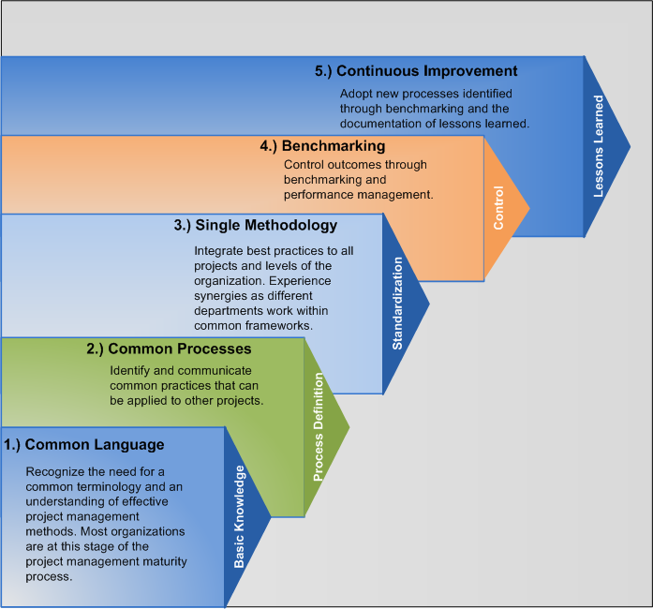
Cardinal Stritch University - Q1
Project Management Maturity Model
Efficiency
Cumulative Gains
Stritch is Currently at the Standardization Level

Slide 10
MARQUETTE UNIVERSITY - Q1
IT Services PMO 6 full time PMs, student PM, BA

Slide 11
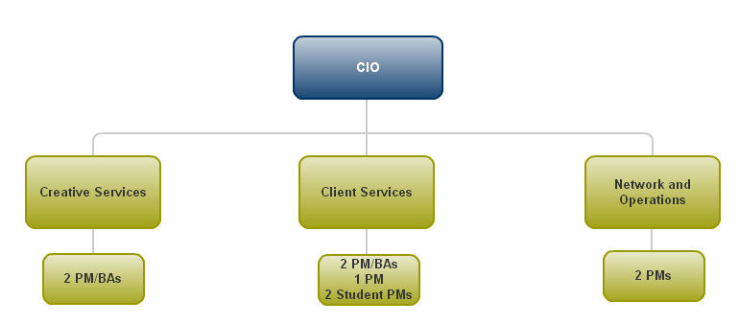
UNIVERSITY OF WISCONSIN-MILWAUKEE - Q1

Slide 12
Question 2
Do you have a methodology for project selection?

Slide 13
Cardinal Stritch University - Q2
To be considered a ‘Project’…
DURATION of 30 days or more
- OR -
DIRECT COST of $5000 or more
- OR -
EXTERNAL vendor INVOLVEMENT
- AND -
Results in a NEW SERVICE or a SIGNIFICANT CHANGE to an existing service

Slide 14
Cardinal Stritch University – q2
Project and Portfolio Management Methodology
Project Initiation/Planning
Development of Project Charter (Scope, Project Plan, WBS, Budget, Resource Requirements)
Vet Project Charter w/ IT and Organizational Leadership
Project Execution
Execute Project Plan and WBS
Report Status Updates to Stakeholder Groups
Project Closeout
Provide Final Project Update to IT Leadership and Stakeholder Groups
Archive Project Documentation
Obtain Internal/External Approval to Proceed
Provide Monthly Updates to IT Leadership (Projects Meeting)
Verify Requirements and Project Milestones/Work Products with Project Stakeholders
Complete Project
Obtain User Acceptance on Project Completion
Complete Post Implementation Evaluation Report (Closeout Report)

Slide 15
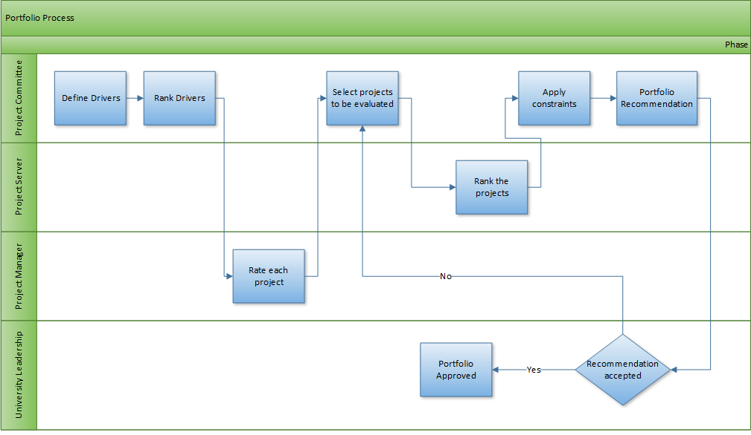
MARQUETTE UNIVERSITY -Q2 Selection Process

Slide 16
MARQUETTE UNIVERSITY - Q2 Workflow Stages

Slide 17
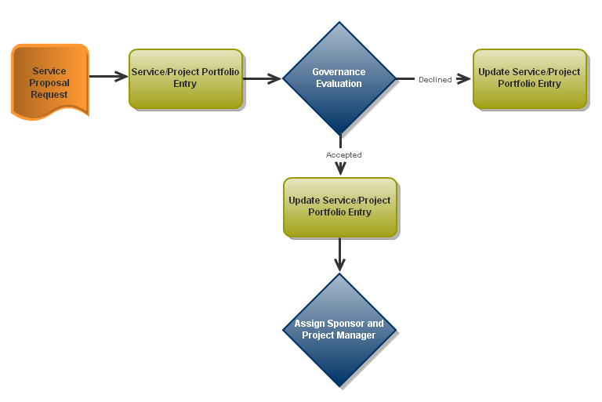
UNIVERSITY OF WISCONSIN-MILWAUKEE – Q2

Slide 18
Question 3
What is your biggest challenge in project management area today?

Slide 19
Cardinal Stritch University - Q3
What is the biggest challenge in the project management area today?
  Culture change and enforcement of PMM across all applicable OIS Projects.
  PMM Maintenance and Automation – PPM System

Slide 20
MARQUETTE UNIVERSITY – Q3
Cultural Change for project selection
Oracle upgrade project
Future Level of Business Performance
How do we accelerate the improvement in performance?
Assimilation/
Continuous Improvement
Current Level of Business Performance
Transition Complete
Uninformed Optimism / Uncertainty
Informed Optimism/
Adoption
Business Performance
Denial
How do we minimize the dip?
Anger
Acceptance
Pessimism
Productivity Dip
Despair / Skepticism
Awareness
Time

Slide 21
UNIVERSITY OF WISCONSIN-MILWAUKEE – Q3
What is your biggest challenge in the project management area today?
Culture
Portfolio management

Slide 22
Question 4
How is project and service management integrated at your institution?

Slide 23
Cardinal Stritch University - Q4
Project Management and Service Management are integrated through the operationalizing of project products/services.
  Moving from project status to production operations.
  Maintenance and support services shift to tier 1 and 2 support staff.
  Production changes are managed using a standard change management procedure.

Slide 24
Marquette University – q4 Perspective of Frameworks and Standards
COSO, ISO 9001,King II, Sarbanes-Oxley, Industry BEE Charter
What
COBIT Domains
What
Plan & Organize
Acquire & Implement
Deliver & Support
Monitor & Evaluate
Bus Alignment
TOGAF
PMBOK
CMMI
Project Methodology
SDLC
ITIL
ISO17799
NIST 800
Balanced Scorecard
Board briefing IT Governance
IASCA Audit Standards
How
COBIT Focus April 2007 Volume 1
Notes:
Approved change requests required to place projects in production
Looking at release management but not yet implemented
This may be clarified by considering some of the major frameworks and standards:
• COSO Internal Control—Integrated Framework—This report from the Committee of Sponsoring Organizations of the Treadway Commission (COSO) consists of four volumes dedicated to improving the quality of financial reporting and ethics through effective internal control (corporate governance).
• ISO 9001—This international quality standard from the International Organization for Standardization is used to increase customer satisfaction and address regulatory requirements (corporate governance).
• IT Infrastructure Library (ITIL)—A collection of best practices in IT service management, it is focused on the service processes of IT and considers the central role of the user.
• ISO 17799, Code of Practice for Information Security Management—This international standard is based on BS 7799-1. It is presented as best practice for implementing
information security management.
• COBIT—This framework and its supporting tools reach beyond information security and
beyond IT service management into general practices for secure, efficient, auditable and effective IT governance. It covers all IT processes, including strategy, finance and human resources.
Based on these descriptions, this slide COBIT into perspective relative to the major
standards and frameworks with regard to corporate and IT governance.
Based on these descriptions, this slide places COBIT and ITIL into perspective relative to the major
standards and frameworks with regard to corporate and IT governance.

Slide 25
University of Wisconsin-Milwaukee – Q4
Service Proposal Request
Project Planning and Execution
Change Management
Transition into Operations
Service Strategy
Project Management
Service Transition

Slide 26
Question 5
Have you faced any resistance when implementing project or service management improvement initiatives and what have you done to address it?

Slide 27
Cardinal Stritch University - Q5
Have you faced any resistance when implementing project or service management improvement initiatives and what have you done to address it?
  Resistance is a natural response to change. Education and holding staff accountable for process adherence is necessary for PM and SM success.

Slide 28
Marquette University – q5
PM
  Grass roots
  Cultural change
  Understanding the value of PM on complex projects
Change Management
  Top down
  Financial audit support

Slide 29
University of wisconsin-Milwaukee – Q5
Resistance to Change Management
Grassroots approach → Change Agents
Road shows / Feedback sessions
Addressed by:
Due to fear that it would create:
Roadblocks
Overhead

Slide 30
Question 6
What communications/marketing tools have you used to disseminate the use of new project and service management processes? Which methods were more successful and which, if any, proved ineffective?

Slide 31
Cardinal Stritch University - Q6
What communications/marketing tools have you used to disseminate the use of new project and service management processes? Which methods were more successful and which, if any, proved ineffective?
  Provide Administrative and Academic staff training on the project initiation and methodology.
  Provide access to the OIS Project Management Reference Guide to all staff.
  Methodology review is a key component to all project kick off meetings.

Slide 32
Marquette University – q6
In-house PM Seminars
PM training
PM incentive for obtaining PMP
Bi-weekly project updates for IT Management

Slide 33
University of wisconsin-milwaukee – q6
Service Management
  Road shows / Feedback sessions
  All-staff Training
  ITSM.uwm.edu
  Email / Newsletter

Slide 34
Question 7
Can you share any attempts to implement project or service management that didn't meet their specified objectives and what were the main lessons learned from these attempts?

Slide 35
Cardinal Stritch University - Q7
Can you share any attempts to implement project or service management that didn't meet their specified objectives and what were the main lessons learned from these attempts?
  Previous attempts to establish Project Management and Service Management standards failed due to various factors.
    Lack of Staff Buy In and Support
    Lack of Formal Project Management Methodology
    Lack of Training
    Lack of Performance Management Tracking and Accountability

Slide 36
Marquette University – q7 Prioritization Criteria
(Drivers)
To help determine which projects provide the greatest value
Force in and force out handled separately
Developing Prioritization Criteria
  University Mission
  University Stature
  Strategic Alignment
  Student Life
  Campus Safety
  Infrastructure
Notes:
The criteria are based on the University’s strategic plan. If the plan changes the criteria will change to mirror the strategic plan. The objective is to define which projects will provide the greatest value to the university without regard to cost. Again this is only a stating point. University leadership may use this list as a factor in making the final decision. We do not expect the tool to make the final decision, but just help make an informed decision.
University Mission:
Pedagogy: Infrastructure that supports quality and desired teaching environment
Student Success: Infrastructure that maintains competitive edge, supports student success, quality and inventory of right size classrooms, and proper technology “quality technology and resources that enhance instructional variety”
University Stature - The project must demonstrate an alignment with university mission or improvement to the university's stature or image.
Strategic Alignment- supports approved initiatives of the University, college and/or departmental programs
Student Life - The project must demonstrate a significant improve in satisfaction or experience of the student body.
Campus Safety - The project must demonstrate a significant improve in quality and effectiveness.
Infrastructure The project must demonstrate significant risk mitigation to the university infrastructure.

Slide 37
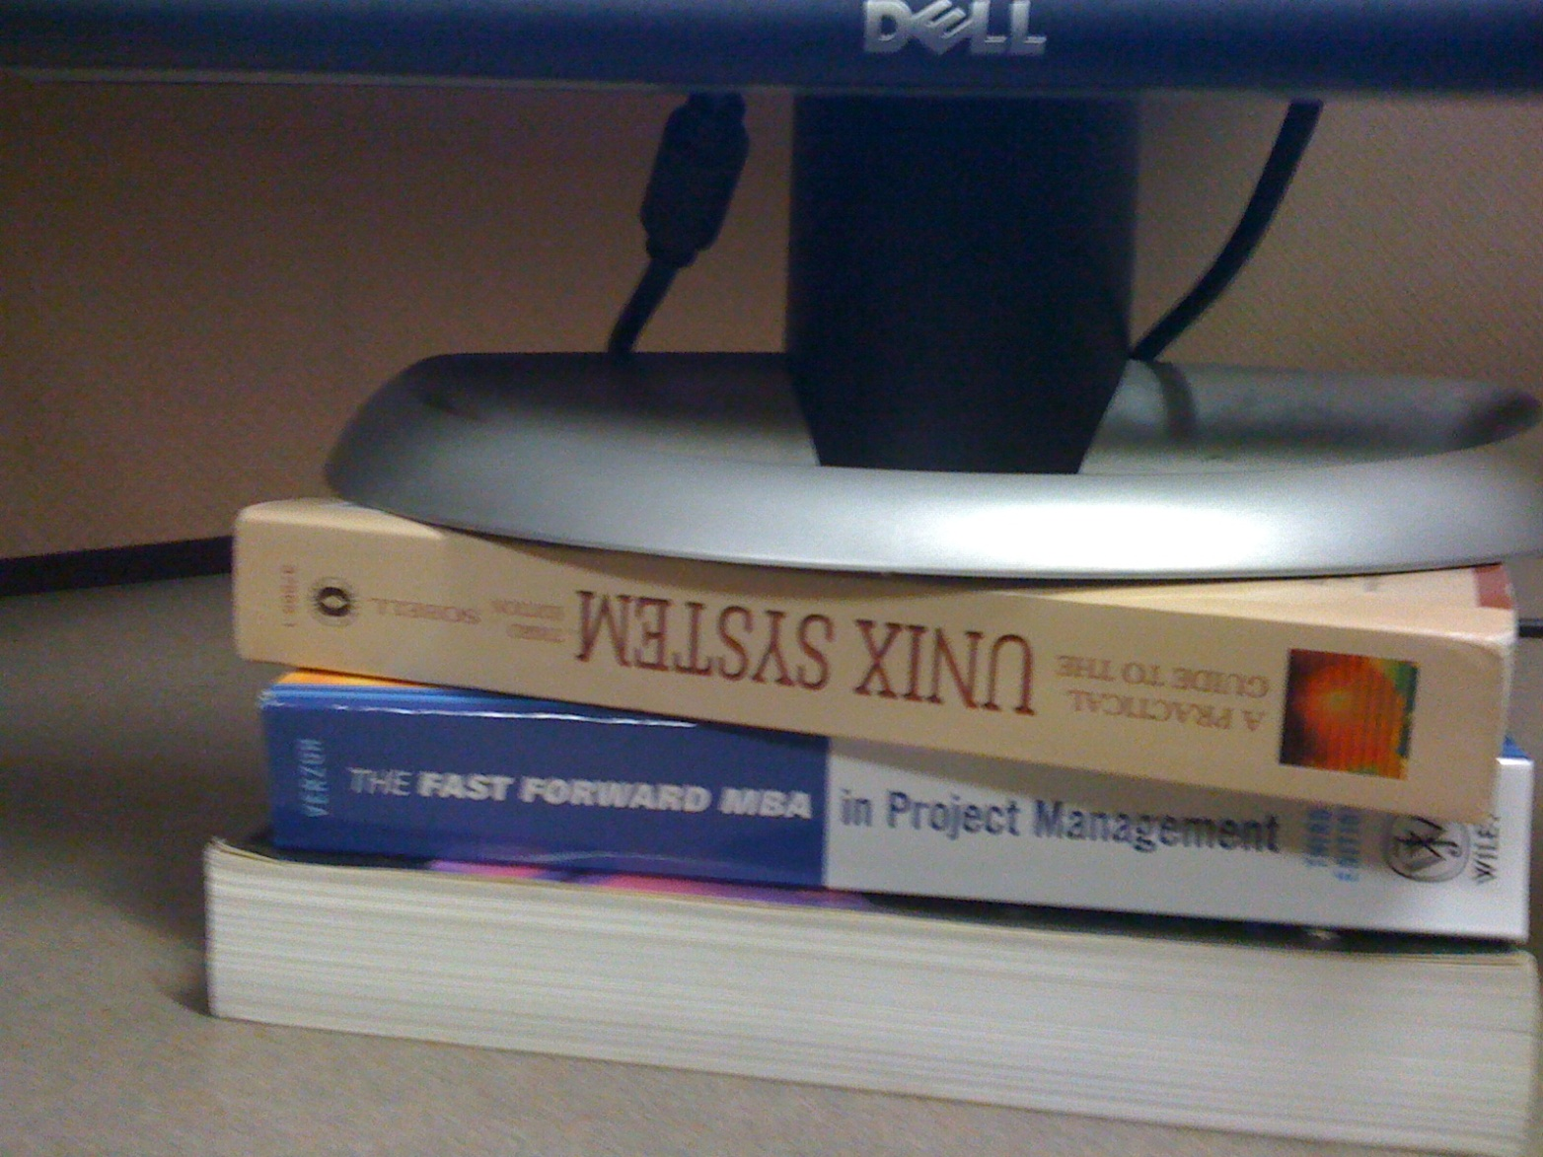
University of Wisconsin-Milwaukee – Q7

Slide 38
THANK YOU!

