Slide 1
Connecting InCommon-Silver and Research at UW-Milwaukee
Tom Barton, Mark Rank and Chris Spadanuda
March 26, 2012

Slide 2
Or…
“Do you want to gamble with future grant money?”
CC-BY-2.0/ Conor Ogle from London, UK

Slide 3
Outline
Research growth at UWM starting in 2006
Meanwhile someone scribbled on a napkin
Things are going to get interesting in 2012
PD-”Lighthouse on Cape Reinga”

Slide 4
Uwm and Research growth

Slide 5
About UW-Milwaukee
By the Numbers
30,000 students representing 50 states, 80 nations
1,600 faculty and instructors
14 schools and colleges
180 degree programs and counting
Research expenditures exceed $60 million annually
More than 150 visiting scholars from 50 countries

Slide 6
“Nerdy Stuff” – how many accounts
UWM Community Size by eduPersonAffiliation
(Reported 3/2012)
eduPerson Affiliation | Count
Affiliate | 122,000
Member | 51,000
Student | 36,500
Employee | 10,400
Faculty | 3,200
Staff | 4,900
CC-BY-SA:User:Martinvl

Slide 7
One UWM research area
UWM has long history in area of health related research…
College of Health Sciences
College of Nursing
Helen Bader School of Social Welfare
UWM is also the new home for the Joseph J. Zilber School of Public Health, Wisconsin’s first accredited school of public health.

Slide 8
UWM Federal Research
Pathways – UWM Research Report 2011

Slide 9
IAM Program and Research
IAM Program is a direct result of UWM’s research growth initiative
Kicked off with the 2009-2011 budget cycle

Slide 10
Pause for some background ON Incommon silver

Slide 11
Who Am I?
UChicago’s central IT
Sr Director for Architecture, Integration, & Security
CISO
External
InCommon Technical Advisory Committee
Internet2 Middleware Initiative/MACE
Grouper Project Manager
EDUCAUSE IAM Steering Group
CIC IdM Task Force
Math professor turned to the dark side

Slide 12
Who Am I?
UChicago’s central IT
Sr Director for Architecture, Integration, & Security
CISO
External
InCommon Technical Advisory Committee
Internet2 Middleware Initiative/MACE
Grouper Project Manager
EDUCAUSE IAM Steering Group
CIC IdM Task Force
Math professor turned to the dark side

Slide 13
Identity & access management
Identity
You
Authentication
Log in
Authorization
What you can do
Access management
Mapping policy & authority to authorization

Slide 14
IAM in Higher Education
Translate those concepts into typical campus environment
Which people?
What systems & business processes?
What policies?
What purposes?
Whose authority?
http://www.internet2.edu/pubs/200703-IS-MW.pdf

Slide 15
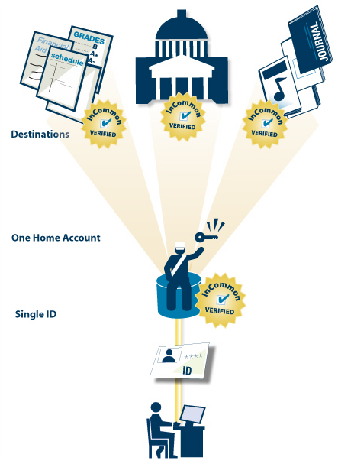
Federated access explained in 60 seconds
If attributes are acceptable to resource policy, access is granted!
Authorization: Privacy-preserving exchange of agreed upon attributes
Federation-based trust exchange to verify partners and locations
1. Authentication: single-sign-on at home institution

Slide 16
InCommon Federation’s Promise
To a user:
I can use the credentials provided to me by my organization to gain access to systems and services from others in the InCommon Federation
To a Service Provider:
I can outsource user account management to Identity Providers (Higher Eds, National Labs) and implement one logon interface that supports many users

Slide 17
level of risk of a Federated Transaction: LOW
Service Provider | Concern
Microsoft Dreamspark | Are you a student?
NIH PubMed | How many different people use us?
EBSCO | Are you covered under your campus license?

Slide 18
level of risk of a Federated Transaction: moderate
Service Provider | Concern
National Student Clearinghouse | FERPA - student transcripts
CILogon | Access to national HPC
NSF & NIH Virtual Organizations | Sensitive data and equipment

Slide 19
level of risk of a Federated Transaction: High
Service Provider | Concern
National Labs - future | Classified programs
Parties need agreed-upon criteria for identity assurance that balance cost, risk, and adoption

Slide 20
InCommon identity Assurance Program: Responding to Assurance needs for the US higher ed sector
Federal Identity, Credential and Access Management (ICAM)
Federal CIO Memo mandates use of FICAM-approved externally-issued credentials
International Grid Trust Federation
.Com’s & .Org’s serving higher ed
Campus assurance needs

Slide 21
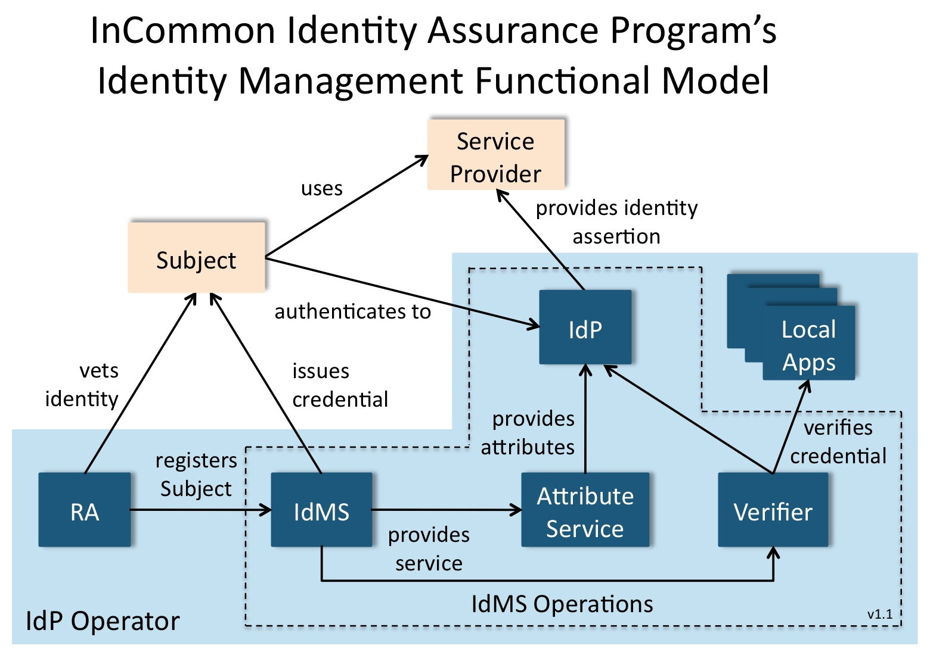

Slide 22
Incommon silver adoption pipeline
CIC Silver Project: 12 CIC schools + Virginia Tech & U Washington
IdM people & Internal Auditors
Really helped InCommon to get it right
U Florida
U Wisconsin - Milwaukee
Many expect to be Silver certified in 2012
Others? You?
Notes:
CIC (Big Ten Schools + University of Chicago) CIOs set a goal in 2009 of all members achieving InCommon Silver in Fall 2011
The CIC Identity Management group started a Silver project to facilitate the members achieving this goal
The Silver project identified some areas for focus – Documentation, Registration Authority processes (the processes involved in validating a person’s identity and issuing their credentials) as well as some authentication technology and process groups such as Active Directory, Multi-Factor and Kerberos authentication.

Slide 23
UWM and credential assurance

Slide 24
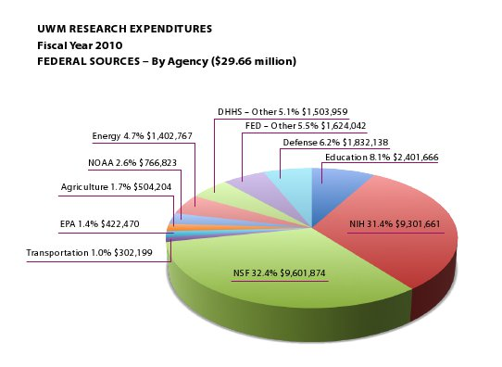
Our business case
UWM wants to grow our research, health being one of the key areas.
NIH is motivated to move to institutional credentials
Notes:
(Mark)

Slide 25
Timeline
2006 – UWM Research Growth Initiative kicked off
2009 – IAM funded to support research
Jan 2010 - IAM Program established
Summer 2011 – Dedicated IAM Group formed
Summer/Fall 2011 –UWM InfoSec Office conducts risk assessment
Notes:
(Mark)

Slide 26
Building capabilities for research
Giving our researchers an edge
External authentication for collaboration and federal mandates
Credential assurance
Notes:
(Chris) We want to give our researchers an edge when utilizing a wide variety of resources including but not limited to the federal resources that have indicated that they will be requiring external credentials and higher levels of assurance for those credentials. So, what do we need to construct in order to make this happen. First, we need to look at our internal credential services. Assure that our accounts are linked to real people, secure the credentials at rest, and secure them during transport between the directories and applications. Sounds easy, right?

Slide 27
2 Years of change
AD Upgrade
OpenLDAP Upgrade
Deploy Shibboleth
Upgrade credential hashing
Deploy eduPerson attributes
Initial AD “Lockdown”
“Current State Survey”
Service Provider Onboarding
Risk Assessments
Process Development
Notes:
(Chris) So far we have completed the following technical tasks. AD Upgrade, Open LDAP Upgrade, Deploy Shibboleth environment, Upgrade credential hashing, Deploy eduPerson attributes and completed an Initial AD “Lockdown”
We have also completed the following non-technical tasks Current State Survey, Service Provider Onboarding procedure, Risk Assessments for AD and LDAP environments, and Formal Operating Process Development

Slide 28
Organizational Alignment
Formalize as a program with dedicated governance structure.
Dedicated team formed with re-assigned staff from 3 different areas and only two new positions.
Funding comes from university research operations thus priority given to support for research efforts.
Notes:
Organizational Alignment

Slide 29
IAM Program Governance
Notes:
(Chris) Explain what teams are responsible for. Who is on them. How they help.

Slide 30
Current IAM Infrastructure
Notes:
(Chris) – It’s complex, lots of moving parts, quite a few technical challenges which we are going to talk about.

Slide 31
Our Goal
Intent to submit application for compliance with InCommon-Silver by the end of 2012
CC-BY-SA:Rick Dikeman
Notes:
(Mark)

Slide 32
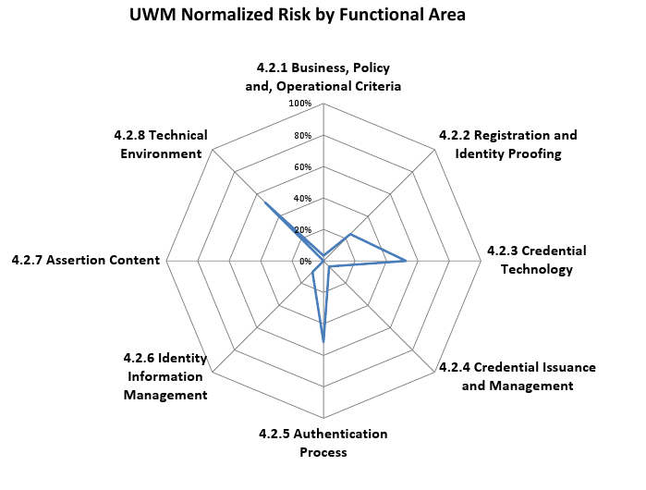
Notes:
(Mark)

Slide 33
Hurdles
Legacy processes and technology
Cultural inertia and resistance to change
Lack of policy or worse the “informal policy”.
CC-BY-20:http://www.flickr.com/people/12495154@N03
Notes:
(Mark)

Slide 34
Technical Complexity – The Biggest Hurdle
UWM Operates two synced credential stores
OpenLDAP
Active Directory
Makes the compliance domain larger
PD-http://en.wikipedia.org/wiki/User:Fubar_Obfusco
Notes:
(Mark)

Slide 35
The known unknowns
Use of credentials by web applications
Everyone has a web server under their desk
Applications authenticating using insecure protocols
NTLMV1
LDAP
PD-http://content.lib.washington.edu/ Order Number WAS0058
Notes:
(Chris) We have over 300 applications in our main ColdFusion environment – And many outside it as well
Need to investigate any app using LDAP or AD – following the path back to the endpoint, ensuring that the entire auth process is secured. This means IPSec, LDAPS, NTLMv2 – no more binds in the clear. Lots of time investigating and identifying the issues. We are pursuing a SIEM / Logging solution to assist. Will take time explain to others and resolve the issues.

Slide 36
Short Term – Address hurdles
Campus partnerships
Focus on small initial InC-Silver population
SIEM Implementation
“Tough Love” for some issues
PD-http://en.wikipedia.org/wiki/Image:Stopwatch2.jpg
Notes:
(Chris) Clock is ticking
We are building partnerships, reaching out to IT staff and key areas on campus –building support.
Some items will require a “tough love” approach and we are going to need to make some hard decisions. Some services will need to be significantly adjusted in order to secure our credentials sufficiently. It’s not that they are insecure, we just need to ensure that they are meeting the compliance standards for InCommon Silver.

Slide 37
Long Term
There are local usage cases for LOA-2 like credential assurance
If multi-factor is not deployed initially, it will eventually
CC-BY-SA-30:http://commons.wikimedia.org/wiki/User:Edubucher
Notes:
(Chris) Yes, two-factor auth is in our future
We are researching pros and cons.
Need something flexible and extensible. Watching what others are doing. InCommon multi-factor group. We like the flexibility of OTP, need to also be able to handle personal certificates.

Slide 38
Lessons learned
Find a campus champion – don’t make it a technical exercise
This is about meeting a compliance standard, not good security
PD:User:Tungsten
Notes:
(Chris) make friends with IT Auditor, your security office others on campus willing to assist in promoting your message.

Slide 39
Lessons learned
ITSM
Go slow to go faster
Hardening standards
Keep things up to date
Staff
Set expectations
Explain compliance vs trust
Chris Spadanuda - 2008
Notes:
(Chris) Just keep talking! To everyone!

Slide 40
Lessons learned
IAM Governance Structure
Aligns business goals and IT processes
Provides guidance for determining deliverables improving quality
Risk, performance and priority management reducing cost and resourcing
Chris Spadanuda - 2008
Notes:
(Chris) Some final important points and considerations when headed down the InCommon Silver road. We know that governance brings value. However, with IAM and InCommon Silver, General purpose governance sometimes is not enough, you should consider special purpose governance dedicated to IAM Services. The issues are complex and most likely interwoven into all facets of campus business process and technical configurations for business and learning systems on your campus.

Slide 41
Questions and Discussion

Slide 42
assurance.incommon.org

Slide 43
IAM.uwm.edu

Slide 44
THANK YOU Tom Barton (tbarton@uchicago.edu) Mark Rank (rankm@uwm.edu) Chris Spadanuda (cspada@uwm.edu)

