Slide 1
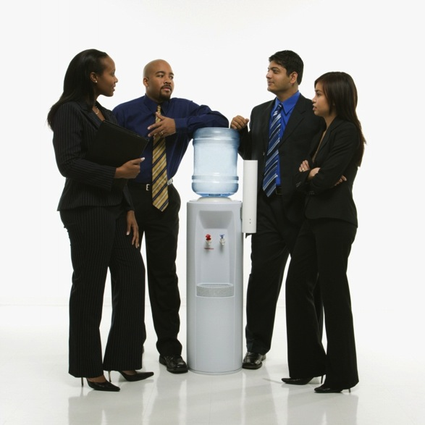
Building the IT Water Cooler
Bob Flynn, Todd Herring & Michele Kelmer, IT Community Partnerships at Indiana University
Midwest Educause 2013

Slide 2
Laying the Groundwork
Profile of Indiana University
Eight campuses (two core, six regional)
Fall 2012 enrollment: 110,393 students,
19,706 faculty, staff and administrators http://www.iu.edu/~uirr/reports/standard/factbook/
Central vs. Distributed IT at IU
University Information Technology Services (UITS)
Total “IT Shops”
Edge, Leverage, Trust
IT Strategic Plans
Architecture for the 21st Century (1998)
Empowering People (2008)
Notes:
Speaker: Todd
Describe “UITS” in distributed vs. Central IT section
Mention IT Managers Council
EP 29 is on a future slide

Slide 3
What’s the problem?
Silos
Lack of communication
Lost opportunities for collaboration
Notes:
Presenter: Bob
Animation:
Silos
Better case: First Arrow
More likely: Circle graphic
Text: Lack of Communication
Text: Lost opportunities

Slide 4
Quick Poll: Is your institution more like the arrow, or the circle?
The arrow: text code 182957
The circle: text code 182958
To 37607
Or online, submit code to http://PollEv.com
Notes:
Presenter: Todd

Slide 5
Small Group Activity
In groups of three, please discuss
Profile of your institution
Size of your institution
Distributed IT vs. Central IT – what’s the balance?
Where do you fit in?
If silos exist, what’s the cost at your institution?
Notes:
Michele:
Activity Setup:
Groups of three (not people from your institution)
Profile of Institution
Balance of Central vs. Distributed IT
Which area do you fit in?
Size of institution
Existence of silos, what’s the cost?
Text/Web poll: get link from Todd
Bob: report back while Michele types responses in Word

Slide 6
Report Back: Cost of Silos
Notes:
Bob to lead discussion, Michele to type in Word

Slide 7
Leads to
Duplication of effort
Waste of resources
Examples:
Digital signage
Event management
Notes:
Presenter: Bob

Slide 8
Empowering People: Action Item 29
Community Engagement UITS should expand its formal and informal engagements with the IU community to ensure continuous, timely dialogue, and flow of information to effectively adapt IT services to user needs.
Notes:
Presenter: Bob

Slide 9
What is the IT Water Cooler?
A gathering place
An information exchange
A place for discovery
Building relationships
Connect. Discover. Inspire.
Notes:
Presenter: Bob

Slide 10
How do we build the IT Water Cooler?
Meetings with IT Professionals
Listen
What are their current projects?
What are their needs?
Inform
Existing projects or services
Collaborative opportunities
Represent interests of IT Professionals to central IT
Project teams
In meetings
Notes:
Presenter: Todd
One-to-one conversations
This is what creates the environment/communication channels that occur a water cooler
Trust & relationship building
Making connections
“shrinks the size of the university”
Relationship maintenance with introduction of new policies

Slide 11
How do we build the IT Water Cooler?
Promotion of IT services (campaigns)
Outreach & Engagement
Staff
Faculty
Student outreach
Notes:
Presenter: Michele
Source of duplication is lack of awareness
So we work to get the word out…
Mailing lists
Events
Arranging meetings between IT Pros and IT Service owners
Workshops, TechTalks, Infoshares
Tabling events
User/Constituent Groups
Etc.
Focus: IT Pro staff and the community (one-to-many communications)
Mention: how we are engaging other groups (non-IT staff, faculty, students) to use the technology services IU offers

Slide 12
How do we build the IT Water Cooler?
Internal at UITS
Feedback to central IT
Interviews of IT Service Owners
New Desktop Paradigm
Infrastructure
Web & Digital Media
Notes:
Presenter: Michele
Tie to Water cooler theme – facilitating the flow of information
Info gathered from IT Pros → Service Owners
Talking points and innovations from service owners → IT Pros

Slide 13
Goal: 1IUIT
Less us vs. them
More collaborative
Better use of resources
Increased awareness of IT services
Notes:
Presenter: Bob
Increased understanding of the motivations for institutional IT change

Slide 14
Building the water cooler at your institution…
What opportunities exist at your institution for broader collaboration in IT?
What obstacles need to be overcome?

Slide 15
Questions?

Slide 16
IT Community Partnerships
Bob Flynn, reflynn@iu.edu
Todd Herring, therring@iu.edu
Michele Kelmer, mkelmer@iu.edu

