Slide 1
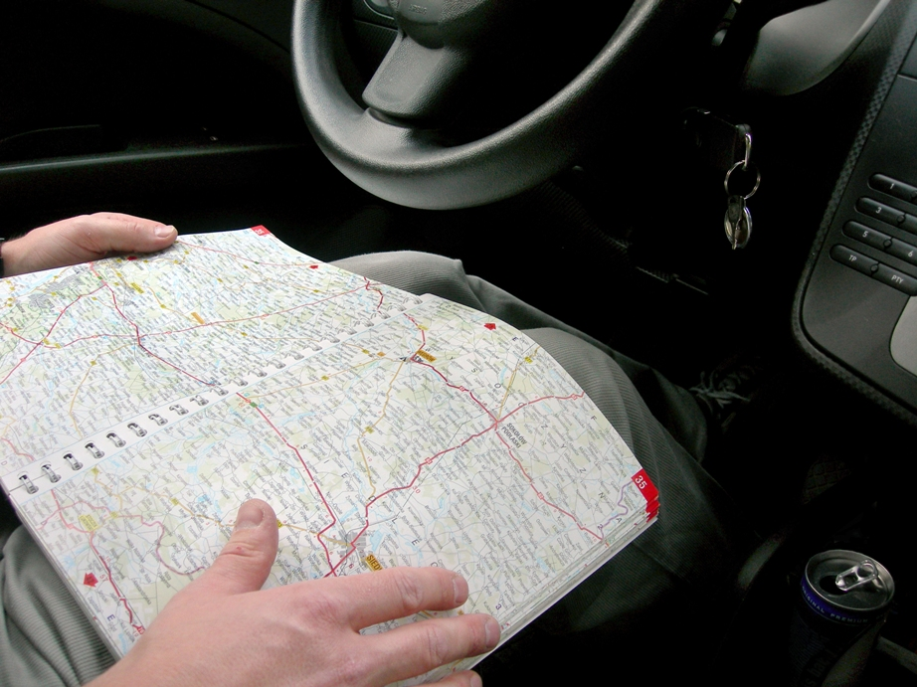
Where do we go from here?
Using Collaboration Carefully to Navigate Growth
Cornelia Bailey, University of Chicago (@cornelia_bailey)

Slide 2
In a nutshell…
IT Services senior leadership wants to be involved in the most creative parts of our campus. To find out what that’s like, we ran small creative experiments with various partners.

Slide 3
BACKGROUND 3 EXPERIMENTS WHAT HAPPENED NEXT

Slide 4
BACKGROUND
The Experience Economy
Pine and Gilmore

Slide 8
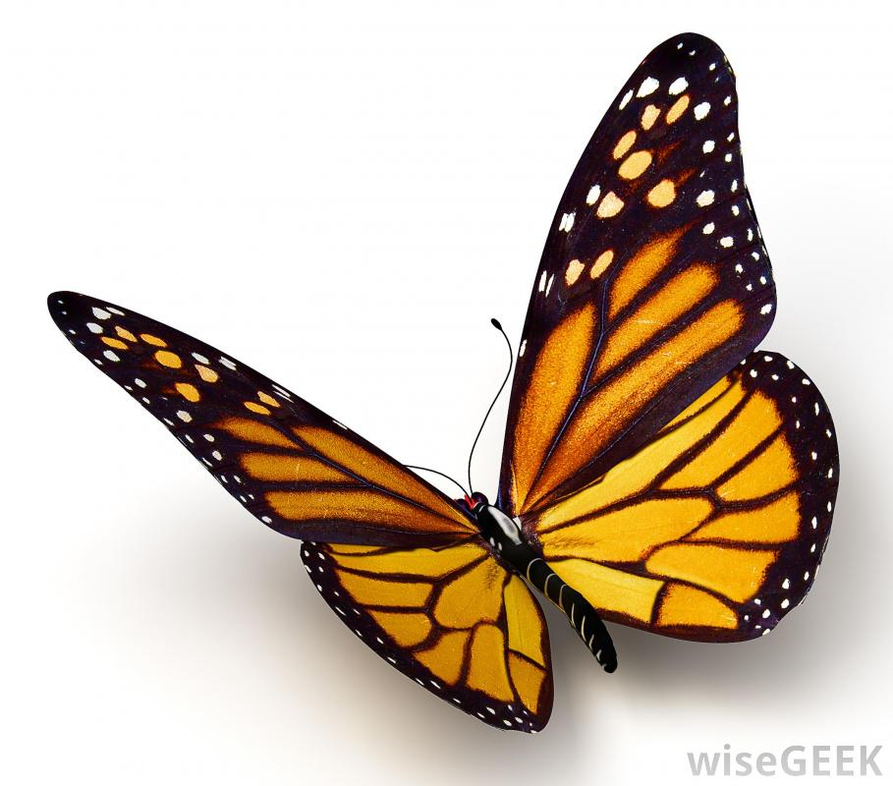

Slide 9
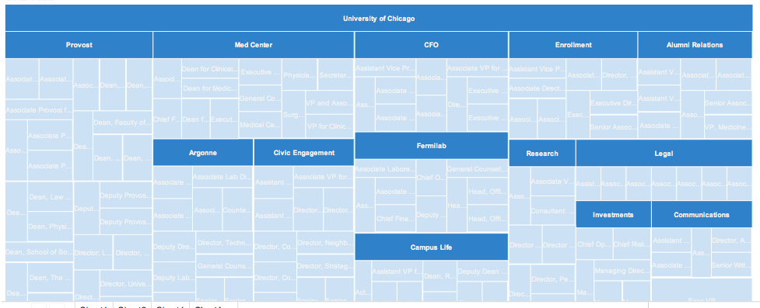

Slide 11
Time and money are at a premium.
What are the smallest yet significant experiments we can execute with our partners?

Slide 12
3 EXPERIMENTS
Smart Museum
Logan Center for the Arts
Mobile App Challenge

Slide 13
SMART MUSEUM
Go Figure and Feast Exhibits

Slide 19
How do we make these works vivid for the viewer?
We're shooting videos for each artist. How can we make those available?

Slide 22
Not too much effort
50 hours total
Loan of 7 iPads

Slide 27
Even less effort
25 hours from IT Services
25 hours from Smart Museum intern
Loan of 7 iPads

Slide 33
LOGAN CENTER FOR THE ARTS
Would you like to have an artistic experience?

Slide 41
Can we extend the art object and not give the visitor all the answers?

Slide 46
More effort, combined
50 hours from IT Services
100 hours Sandbox Studios
Loan of 1 iPad

Slide 48
MOBILE APP CHALLENGE

Slide 52
More effort for a broader reach
120 hours from IT Services
$1500 in prizes

Slide 54
WHAT HAPPENED NEXT?
Smart Museum
Logan Center
Mobile App Challenge

Slide 55
Smart Museum
Initial efforts: 75 hrs and 7 iPads on loan
Director referred ITS to the Oriental Institute. ITS written into a multi-year grant to refit the OI museum space with interactive screens.
Smart is financing the creation of a cross campus multi-discipline artifact catalog with ITS help.

Slide 56
Logan Center for the Arts
Initial efforts: 50 hours and equipment loan
Strengthened position for subsequent Logan work.
QandAalator will be repurposed as part of the Neighborhood Schools Program out of Civic Engagement.

Slide 57
Mobile App Challenge
Initial efforts: 120 hours and $1500 in prizes.

Slide 58
appchallenge.uchicago.edu
$10,000 prize.
Ideas submitted in the first phase, semifinalists prototype ideas in second phase, finalists receive programming talent. Discovered a great deal of ideas from Medical Center.
Tested the plumbing for a campus-wide IT incubator.

Slide 59
Incubation

Slide 60
CONCLUSION
3 experiments demonstrated that ITS can generate and sustain creative efforts at the university.

Slide 63
Thank you!
cornelia@uchicago.edu
@cornelia_bailey

