Slide 1
Supporting Online Faculty
Sharon Gray, Augustana College, SD
EDUCAUSE Chicago 2013

Slide 2
Presentation Abstract
Robust faculty and student support is crucial to the success of an online program. Faculty need coaching in effective online course design and delivery. They must be provided just-in-time, often one-on-one support. At Augustana College, faculty are given the opportunity to be "students" in an online course while developing their own online courses. Peer feedback and interaction with experienced online faculty foster shared insights and experience. Participants will leave with a model for immersive online faculty development.

Slide 3
“Immersive Faculty Development”
Notes:
At Augustana College, we’ve developed a Faculty Development Workshop for Online Teaching and Learning that is, itself, online, providing participants with the experience of being a student in an online “course”.
The goal is to support faculty in developing their own course using commonly accepted “Best Practices. Taking an online “course” as a student helps future online faculty appreciate the unique challenges faced by online learners and hopefully encourages them in their efforts to create their own accessible and effective courses.

Slide 4
Background
Tremendous growth since 2006
~8 new faculty/year
Moodle LMS
Notes:
We started offering online summer courses in 2006. The program has seen tremendous growth, going from 9 courses in 2006 to 44 in 2012.
We started with WebCT, but have migrated to Moodle as our Learning Management System.
We have roughly 8 new faculty per year.

Slide 5
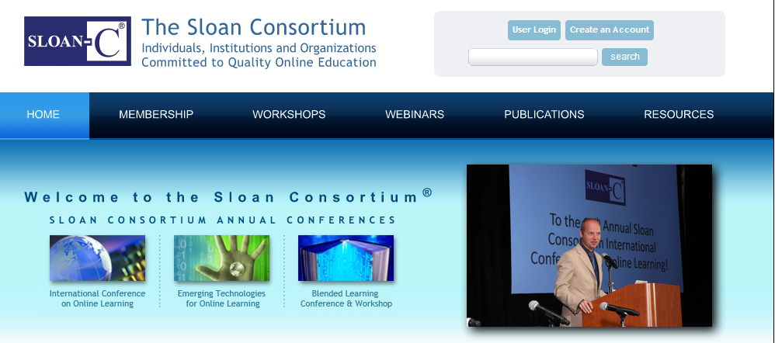
Considered Sloan Consortium and QM
good, but expensive
Decided to do it ourselves
could customize to our needs
“free”
Notes:
I “taste-tested” a number of faculty development opportunities for online faculty. (In the process, I received my Sloan Certification.) They were useful (especially Sloan), but expensive.
We decided to create our own. Doing so allows us to customize the training to our specific needs and provide our own information (syllabus wording, peer-shared resources, etc.)
Also, it was “free”. But, I want to point out that “free” is not necessarily without cost. In order to provide this myself, I must carve out the time to provide the training, meaning I must necessarily shift time from other duties. Given my role, that is reasonable. But, you’d want to take into consideration the time it will take for whomever is facilitating to administer the training.

Slide 6


“Faculty Workshop for Online Teaching and Learning” goals…
Experience BEING an online “student”
Design course ⇨ “Best Practices”
Determine learning objectives
Align course activities to meet objectives
Create means for meaningful communication
Create authentic assessments directly aligned with course objectives
Use Moodle activities
Notes:
We wanted to provide new online faculty with an opportunity to
Design their own online course based upon commonly accepted best practices for online instruction
Determine their course learning objectives and outcomes and align course activities to meet those objectives and result in those outcomes
Create means to foster meaningful communication among students and between instructor and students
Create authentic assessments directly aligned with their course learning objectives and desired outcomes.
Gain experience and familiarity with the various Moodle activities (discussion forums, quizzes, wikis)
And, very importantly, we wanted them to experience an online course (the workshop itself) from the perspective OF an online student. We have found that goes far in helping faculty appreciate the unique needs of online learners.

Slide 7
Timeline
1 week with bookend weekends
Clearly specified deadlines
Fri | Sat | Sun | Mon | Tue | Wed | Thu | Fri | Sat | Sun
Notes:
We offer it during Spring Break and again in May.
It runs for a week, including the weekend before and after.
Deadlines are clearly spelled out in order to keep everyone on task so our discussions, review and feedback are productive. (It also demonstrates to the faculty how challenging it is for their students to keep up with an online course when they have other life duties vying for their time!)

Slide 8
Structure
Main workshop course
TOPIC 1: Determine learning objectives
TOPIC 2: Become familiar with “Best Practices”
TOPIC 3: Develop syllabus
TOPIC 4: Create means to foster communication
TOPIC 5: Create authentic assessments
TOPIC 6: Develop own online course
Individual student course shells
Notes:
The main workshop course includes 6 topics:
TOPIC 1: Determine learning objectives
TOPIC 2: Become familiar with “Best Practices”
TOPIC 3: Develop syllabus
TOPIC 4: Create means to foster communication
TOPIC 5: Create authentic assessments
TOPIC 6: Develop own online course
I also create empty course shells for all of the participants. Each student is the instructor for their own course, while their fellow workshop participants are “students” in their course. That way the participants can see and comment upon each others’ courses.

Slide 9
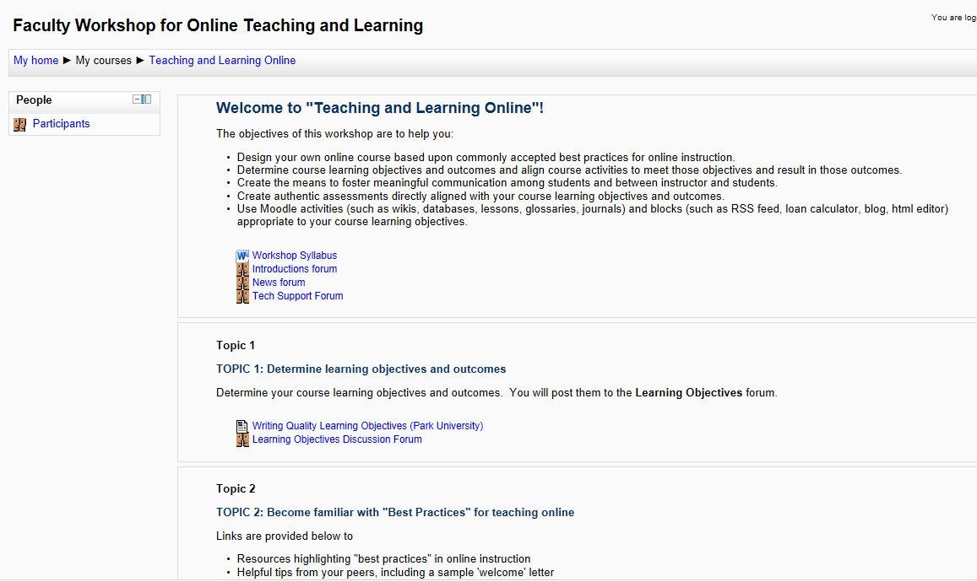
Let’s take a look…

Slide 10
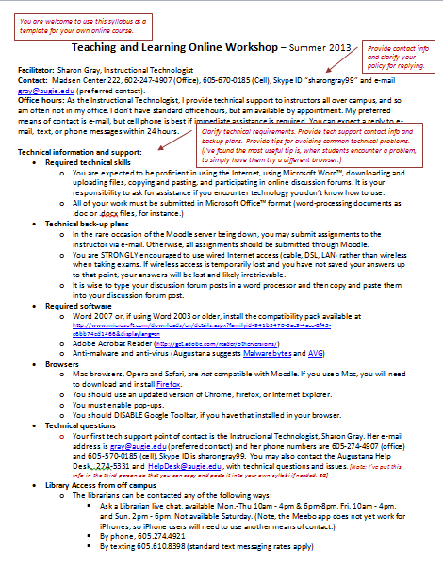
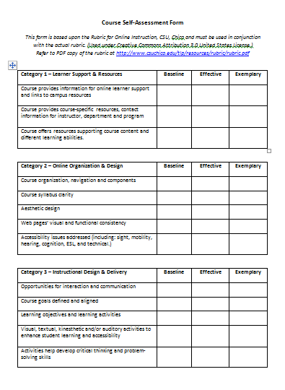
Here are links to the syllabus and course self-assessment form
Notes:
The syllabus is designed so faculty may take from it whatever they’d like.
At the end of the workshop, each participant assesses their own course using the ROI (Rubric for Online Instruction) from California State University Chico (used with creative commons license permission).

Slide 11
Recommended resources…
Excellent!
Rubric for Online Instruction (ROI), California State University Chico http://www.csuchico.edu/roi/
Writing Quality Learning Objectives, Park University http://www.park.edu/cetl/quicktips/writinglearningobj.html
Creating a Syllabus Tutorial, SFSU http://oct.sfsu.edu/design/syllabus/index.html
6 Keys to Engaging Students Online http://campustechnology.com/articles/2012/05/31/6-keys-to-engaging-students-online.aspx?=CTIN
Copyright, Fair User, and Education, Columbia University Copyright Advisory Office http://copyright.columbia.edu/copyright/
NEA Guide to Teaching Online Courses http://www.nea.org/assets/docs/onlineteachguide.pdf
Effective Online Assessment: Scalable Success Strategies http://teach.ucf.edu/files/2010/12/Authentic-Assessment-Online.pdf
Assessing Online Learning: Strategies, Challenges and Opportunities http://www.facultyfocus.com/wp-content/uploads/images/AssessingOnlineLearning-OC.pdf
Notes:
Here are some resources I’ve found to be very useful.
We also have a section for peer-shared resources which includes things like “welcome letters” and discussion forum rubrics that fellow faculty have developed and found to be useful.

Slide 12
The content in this presentation carries the Creative Commons Attribution-NonCommercial-ShareAlike license, which grants usage to the general public with the stipulated criteria. (User must attribute source, be non-commercial, and agree to share the derivative work under the same conditions.)

