Slide 1
Richard Chamberlain
Executive Director, University Technology
Western Illinois University
Christopher Dobson
Curriculum Content Graphic Illustrator
Harper College
Giovanni Duarte
eLearning Accessibility Team Lead
DeVry University
Kevin Price
Assistive Technology Specialist
University of Illinois at Chicago
Matthew Ramir (Student)
Digital Access Assistant
University of Illinois at Chicago
Jon Gunderson (Moderator)
Coordinator of IT Accessibility
University of Illinois at Urbana-Champaign

Slide 2
Western Illinois University (WIU) Captioning Videos
Richard Chamberlain
Executive Director, University Technology
Western Illinois University

Slide 3
What we did at WIU
Solicited volunteers
Trained volunteers
Developed an online request form
Centrally managed the requests
Increased the availability of captioned videos

Slide 4
Crowd-Sourced Video Captioning for the Web
Volunteers, on and off campus
Free, web-based software
Intuitive captioning system
Works with a variety of media formats

Slide 5
Amara (www.amara.org)
A project of the Participatory Culture Foundation

Slide 6
Harper College: Universal Design In Education
Christopher Dobson
Curriculum Content Graphic Illustrator
Harper College

Slide 7
Harper College: Successful Implementations
Universal Design for Education (UDE) Initiative
Faculty Fellowships in which faculty learn, implement and present to share experience with peers
Supported by partnership between Access and Disability Services & the Center for Innovative Instruction
Software that Supports Accessibility
LecShare Pro
SoftChalk
Legacy Courses
Antiquated telecourses are currently being redesigned with accessible instructional materials (AIM)

Slide 8
LecShare Pro Authoring Tool
Principle I. Provide Multiple Means of Representation
Accessible HTML format, with audio, captions, and notes, mobile friendly
Structure and Table of Contents from HTML headings
Exports to multiple media formats for user choice or learning style
Principle II. Provide Multiple Means of Action and Expression
May be used for digital storytelling, e-portfolios, presentations may be customized by CSS and changed according to user preferences
Navigation or physical interaction may be customized by end user
Principle III. Provide Multiple Means of Engagement
Optimize individual choice and autonomy by providing options for file format, information delivery or graphic, print, or text only layout etc.

Slide 9
SoftChalk Authoring Tool
Principle I. Provide Multiple Means of Representation
Customization of the display of information, alternatives for auditory and visual information and media, long descriptions for activities and interactions
Accessible HTML, table of contents and structure from HTML headings
Mobile pages and accessibility are created while authoring
Guide information processing through the use of visual cues and feedback
Principle II. Provide Multiple Means of Action and Expression
Several options for providing multiple attempts for activities and feedback that integrates with Learning Management Systems (Blackboard, Desire2Learn, etc.)
Add prompts and visual cues for cognitive and executive functioning
Principle III. Provide Multiple Means of Engagement
Learning can be personalized and contextualized to learners’ lives
Feedback can be added while authoring interactions to provide immediate, substantial and timely feedback rather than comparative or competitive

Slide 10
DeVry Inclusive Design
Giovanni Duarte
eLearning Accessibility Team Lead
DeVry University
E-mail: gduarte@devry.edu

Slide 11
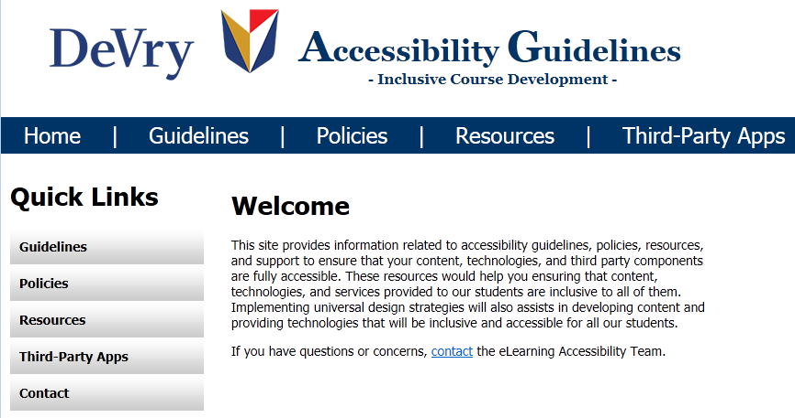
Designing Inclusivity: Success factors
Be ahead of the curve: Work closely with ADA officers to identify student needs and provide support before the student experiences difficulties
Develop gatekeepers: Ensure Instructional Designers and Course Developers become accessibility “gatekeepers” for web accessible content development
Make it easy: Develop accessible templates and tools for creating web accessible content
Support the front line: Provide processes and tools for fast and effective support

Slide 12
Achieve. Grow. Build.
Implementing IT Accessibility at DeVry Online Services

Slide 15
Building accessibility in from the START
Build the right team – Coders with deep understanding of accessibility tools
Build with the right principles - Universal Design: Access and options for all (multiple delivery channels for student selectivity)
Build with the right tools – CSS, HTML5, JavaScript. MathML

Slide 16
UIC Strategic Planning
Kevin Price
Assistive Technology Specialist
University of Illinois at Chicago

Slide 17
IT Leadership support of Digital at UIC
Michael Hites, Executive CIO
University of Illinois Central Administration
“No Reason to Prioritize Accessibility because it should just automatically be a part of the process”
Cynthia Herrera Lindstrom -Chief Information Officer (CIO) for UIC and Executive Director of the Academic Computing and Communications Center (ACCC) support of Digital Accessibility
University of Washington’s DO-IT Video: IT Accessibility: What Campus Leaders Have to Say
http://www.washington.edu/doit/Video/index.php?vid=55

Slide 18
Integrated Disability Accessibility
Bi-weekly Digital Accessibility Committee Meetings
Representation from Departments Across Campus
Brown Bag Web Technology Trainings
Caffeine Break Meetings
Digital Accessibility Planning alongside IT Strategic Planning

Slide 19
Integrating Digital Accessibility
Support from Instructional Technology Lab (trainings/faculty support)
Upgrade to Accessible Versions (Blackboard)
Email Support from Digital Accessibility Committee Members
Member of the UIC Information Technology Governing Council (ITGC) – Infrastructure and Security Subcommittee
Digital Accessibility Expo and Digital Accessibility Lecture Series Financial Support
Digital Accessibility Website with procedures/tips/tools
Purchasing Accessibility Language in Contracts

Slide 20
Student Perspective
Matthew Ramir (Student)
Digital Access Assistant
University of Illinois at Chicago

Slide 21
Questions and comments?

Slide 22
Continue the Accessibility Dialog …
IT accessibility lunch round table
(following this session)
IT Accessibility Constituent Group Poster (after lunch)

