Slide 1
Achieve. Grow. Build.
Implementing IT Accessibility at DeVry Online Services

Slide 2
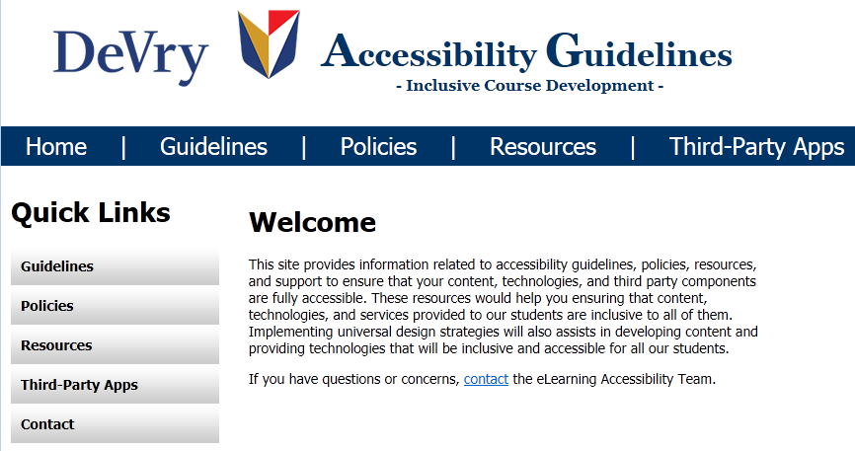
Designing inclusivity in – Success factors
Be ahead of the curve: Work closely with ADA officers to identify student needs and provide support before the student experiences difficulties
Develop gatekeepers: Ensure Instructional Designers and Course Developers become accessibility “gatekeepers” for web accessible content development
Make it easy: Develop accessible templates and tools for creating web accessible content
Support the front line: Provide processes and tools for fast and effective support

Slide 3
Printing options
Headings and automation
Lightboxes and keyboard access
Embedding HTML descriptions
MathML Implementation

Slide 4
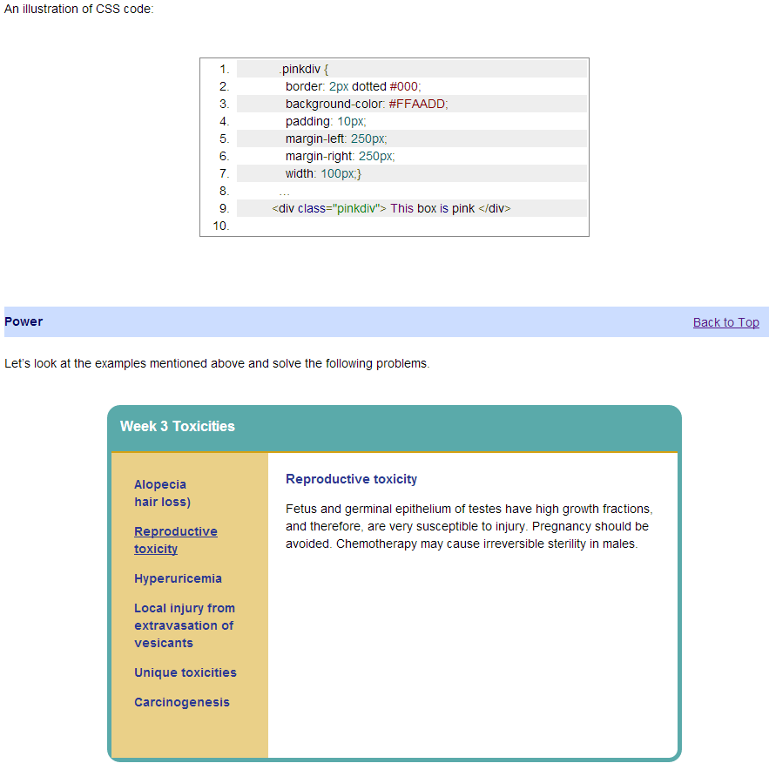
JavaScript and CSS to automate styling
HTML based interactives

Slide 5
Building accessibility in from the START
Build the right team – Coders with deep understanding of accessibility tools
Build with the right principles - Universal Design: Access and options for all (multiple delivery channels for student selectivity)
Build with the right tools – CSS, HTML5, JavaScript. MathML

Slide 6
Giovanni Duarte Senior Instructional Technologist / eLearning Accessibility Team Lead DeVry Online Services gduarte@devry.edugduarte@devry.edu

