Slide 1
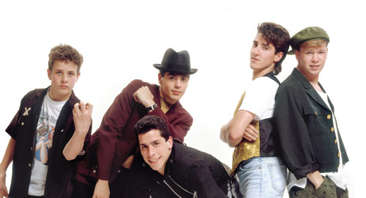
Standing out in the Crowd
Getting Your Message Heard by the New Kids on the Block
Notes:
----- Meeting Notes (3/19/13 09:44) -----
NKOTB - late 1980s

Slide 2
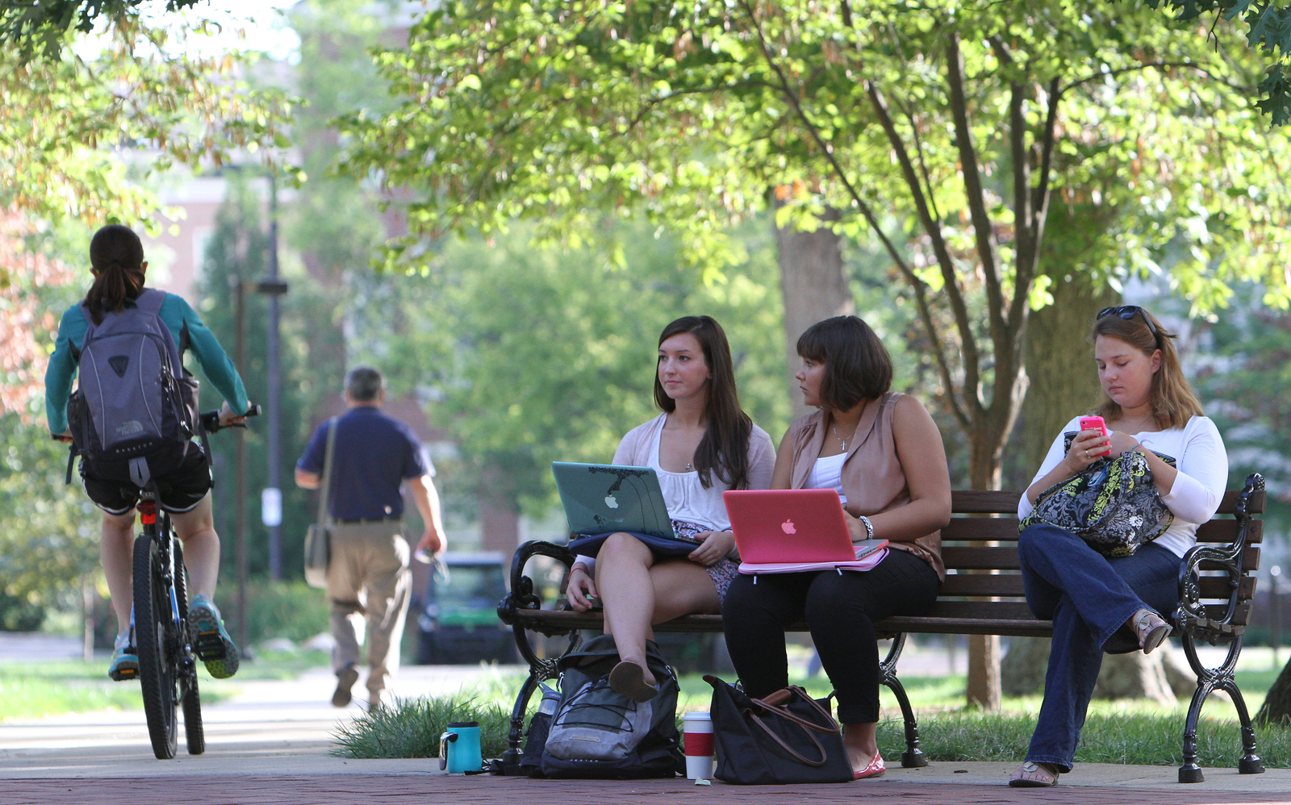

Setting the stage
  Located in Oxford, Ohio
  16,000 undergraduate students
  2500 graduate students
  Primarily residential
  202-year tradition of excellence
Notes:
So – let me take a minute to tell you a little about myself and what qualifies me to speak on this topic. If you would have told me 10 or 15 years ago that I would be working in information technology – I would have been highly skeptical. To bare a deep dark secret – the only “D” I have ever gotten was in a computer programming course as an undergraduate. I could not get those punch cards to run and I think I was lucky to have escaped with the grade I got.
While my career has taken me through a pretty wild course, from radio and newspaper to social service to arts management and now in higher education IT, at the core of my experiences is communication. Whether it’s been writing grants, fund raising, event promotion or individual counseling, communication – sharing information and listening – has been key to success in every setting.
I am lucky to be part of an extraordinary institution - Miami University – located in Ohio, not in Florida. We have a beautiful campus, dedicated and engaged faculty, competitive, bright students and outstanding leadership. Currently we are also facing decreasing state support, escalating health care costs, an aging physical infrastructure and a limited ability to raise tuition – all converging to form a budget picture that we can call “challenging”
So enough about me – let’s learn something about you . How many of you have a position that officially includes communication as one of your primary responsibilities? As a part of your regular responsibilities? As an occasional part of your job? How many of you are just curious? Other???

Slide 3
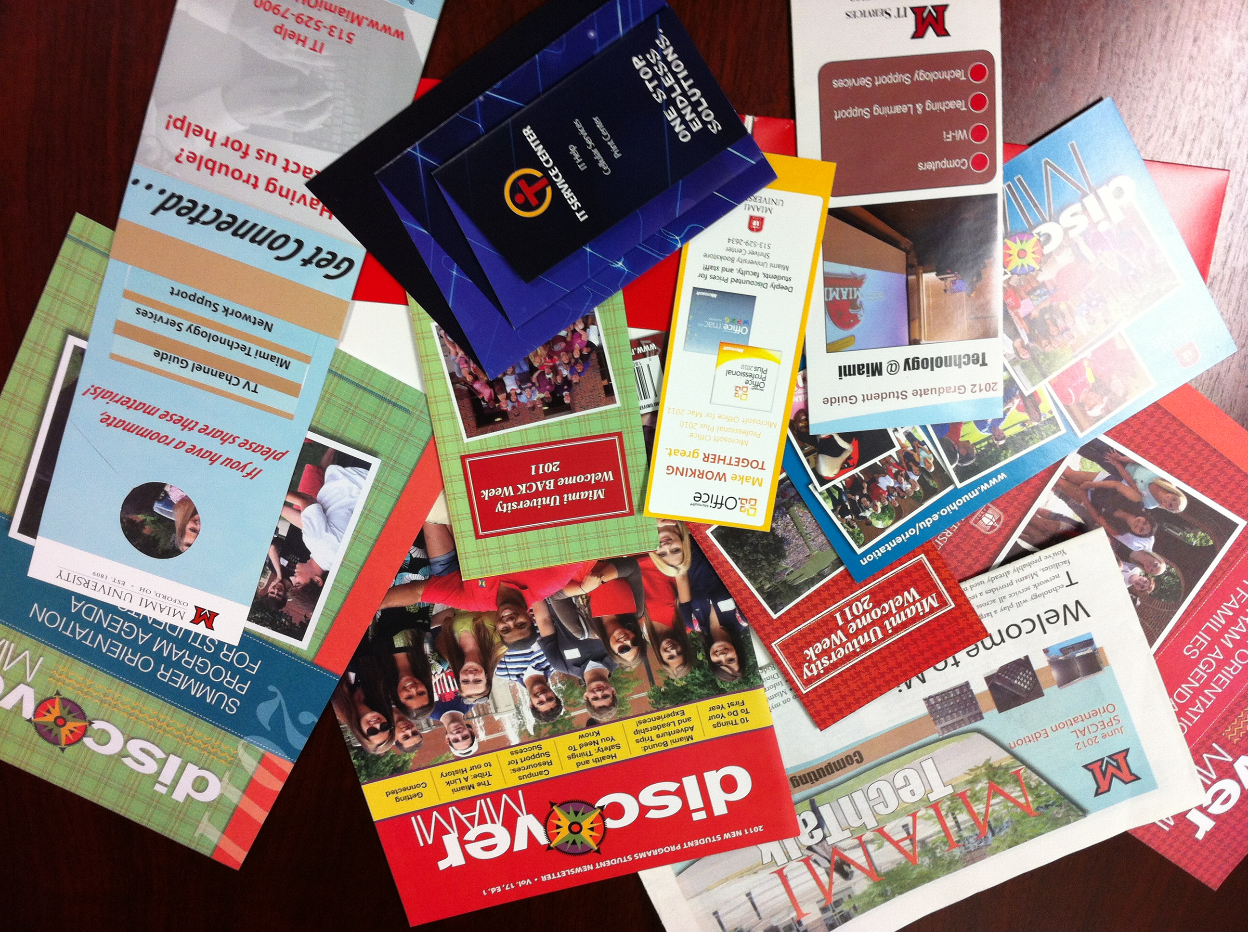
The challenge
Notes:
Well –even if communication is just a part of your job, you (hopefully) know that one of the basic rules for good communication is “know your audience”. On Miami’s main campus we primarily serve a traditional college-age student – mostly recruited directly out of high school. So – when we are talking about how to communicate with our incoming class, that homogeneity makes our job somewhat easier, because our primary audience is a 17 – 18 year old and our secondary audience is the parents of those 17 – 18 year olds.
Define the challenge
Communicating to 17/18 year olds
Cutting through the information overload
Info at the right time

Slide 4



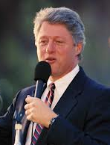

Miami Class of 2017:
Born in 1995
Notes:
Using the Beloit Mindset List as a reality check to keep us dinosaurs aware of what it’s like to be 18 today.
From last year’s Mindset -
Kurt Cobain, Jacqueline Kennedy Onassis, Richard Nixon and John Wayne Gacy have always been dead.
They watch television everywhere but on a television.
Bill Clinton is a senior statesman of whose presidency they have little knowledge.
They have never seen an airplane “ticket.”
Women have always piloted war planes and space shuttles.
And – from a quick search of Google images for 1995 – this year’s incoming class
Joe Montana has always been retired
Fraiser has always been on the air
Prince Harry was always the rowdy royal
And
Bill Gates has always been a high profile public figure

Slide 5
Miami Class of 2017
Expectations?
  Digital natives??
  Laptops/tablets/smartphones/???
Reactions?
  Communication style – short, attention grabbing
  Communications vehicles – what do they see??

Slide 6
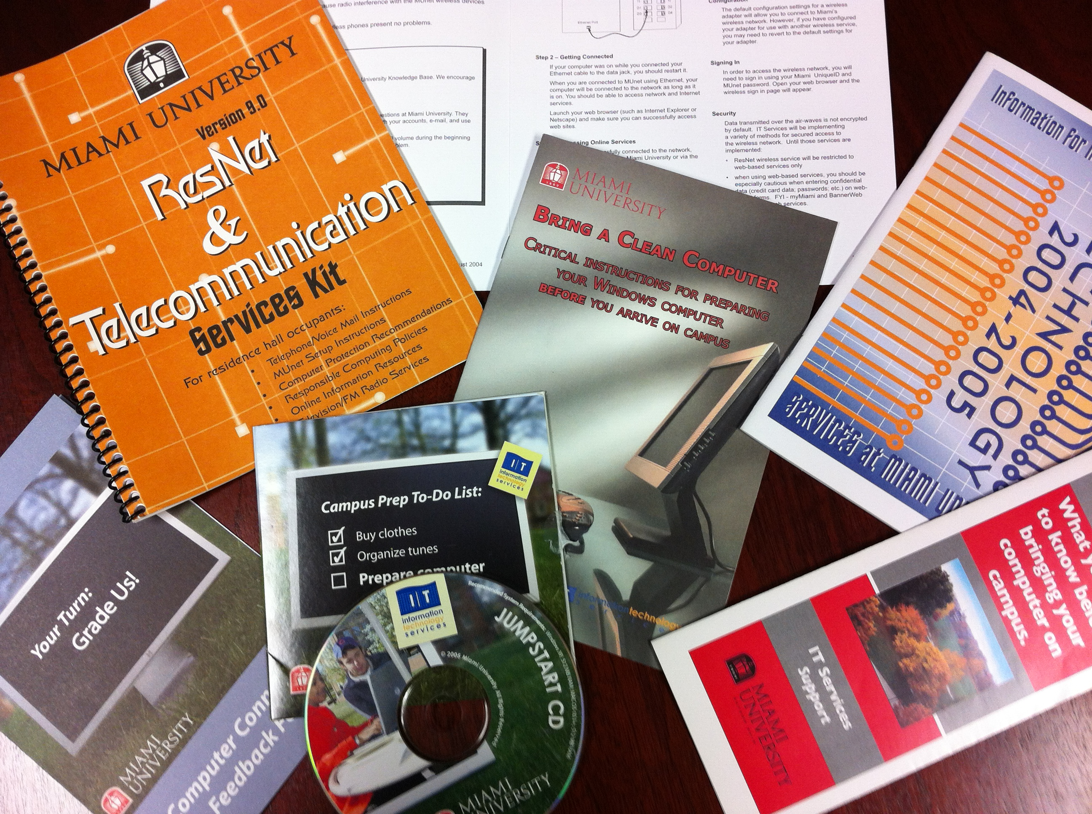
History of MUnet
Notes:
In Miami’s early years
Print materials designed to provide comprehensive information - Quickly out of date, expensive, little visual coherence
CD - Fall 2005 – fun, but expensive to produce. Ignored by students

Slide 7
Approach
Team
  Get the right persons on the bus
Schedule
  Know the when, where, and how of your admission and acceptance process
Tools
  Match the delivery and the message to the audience

Slide 8
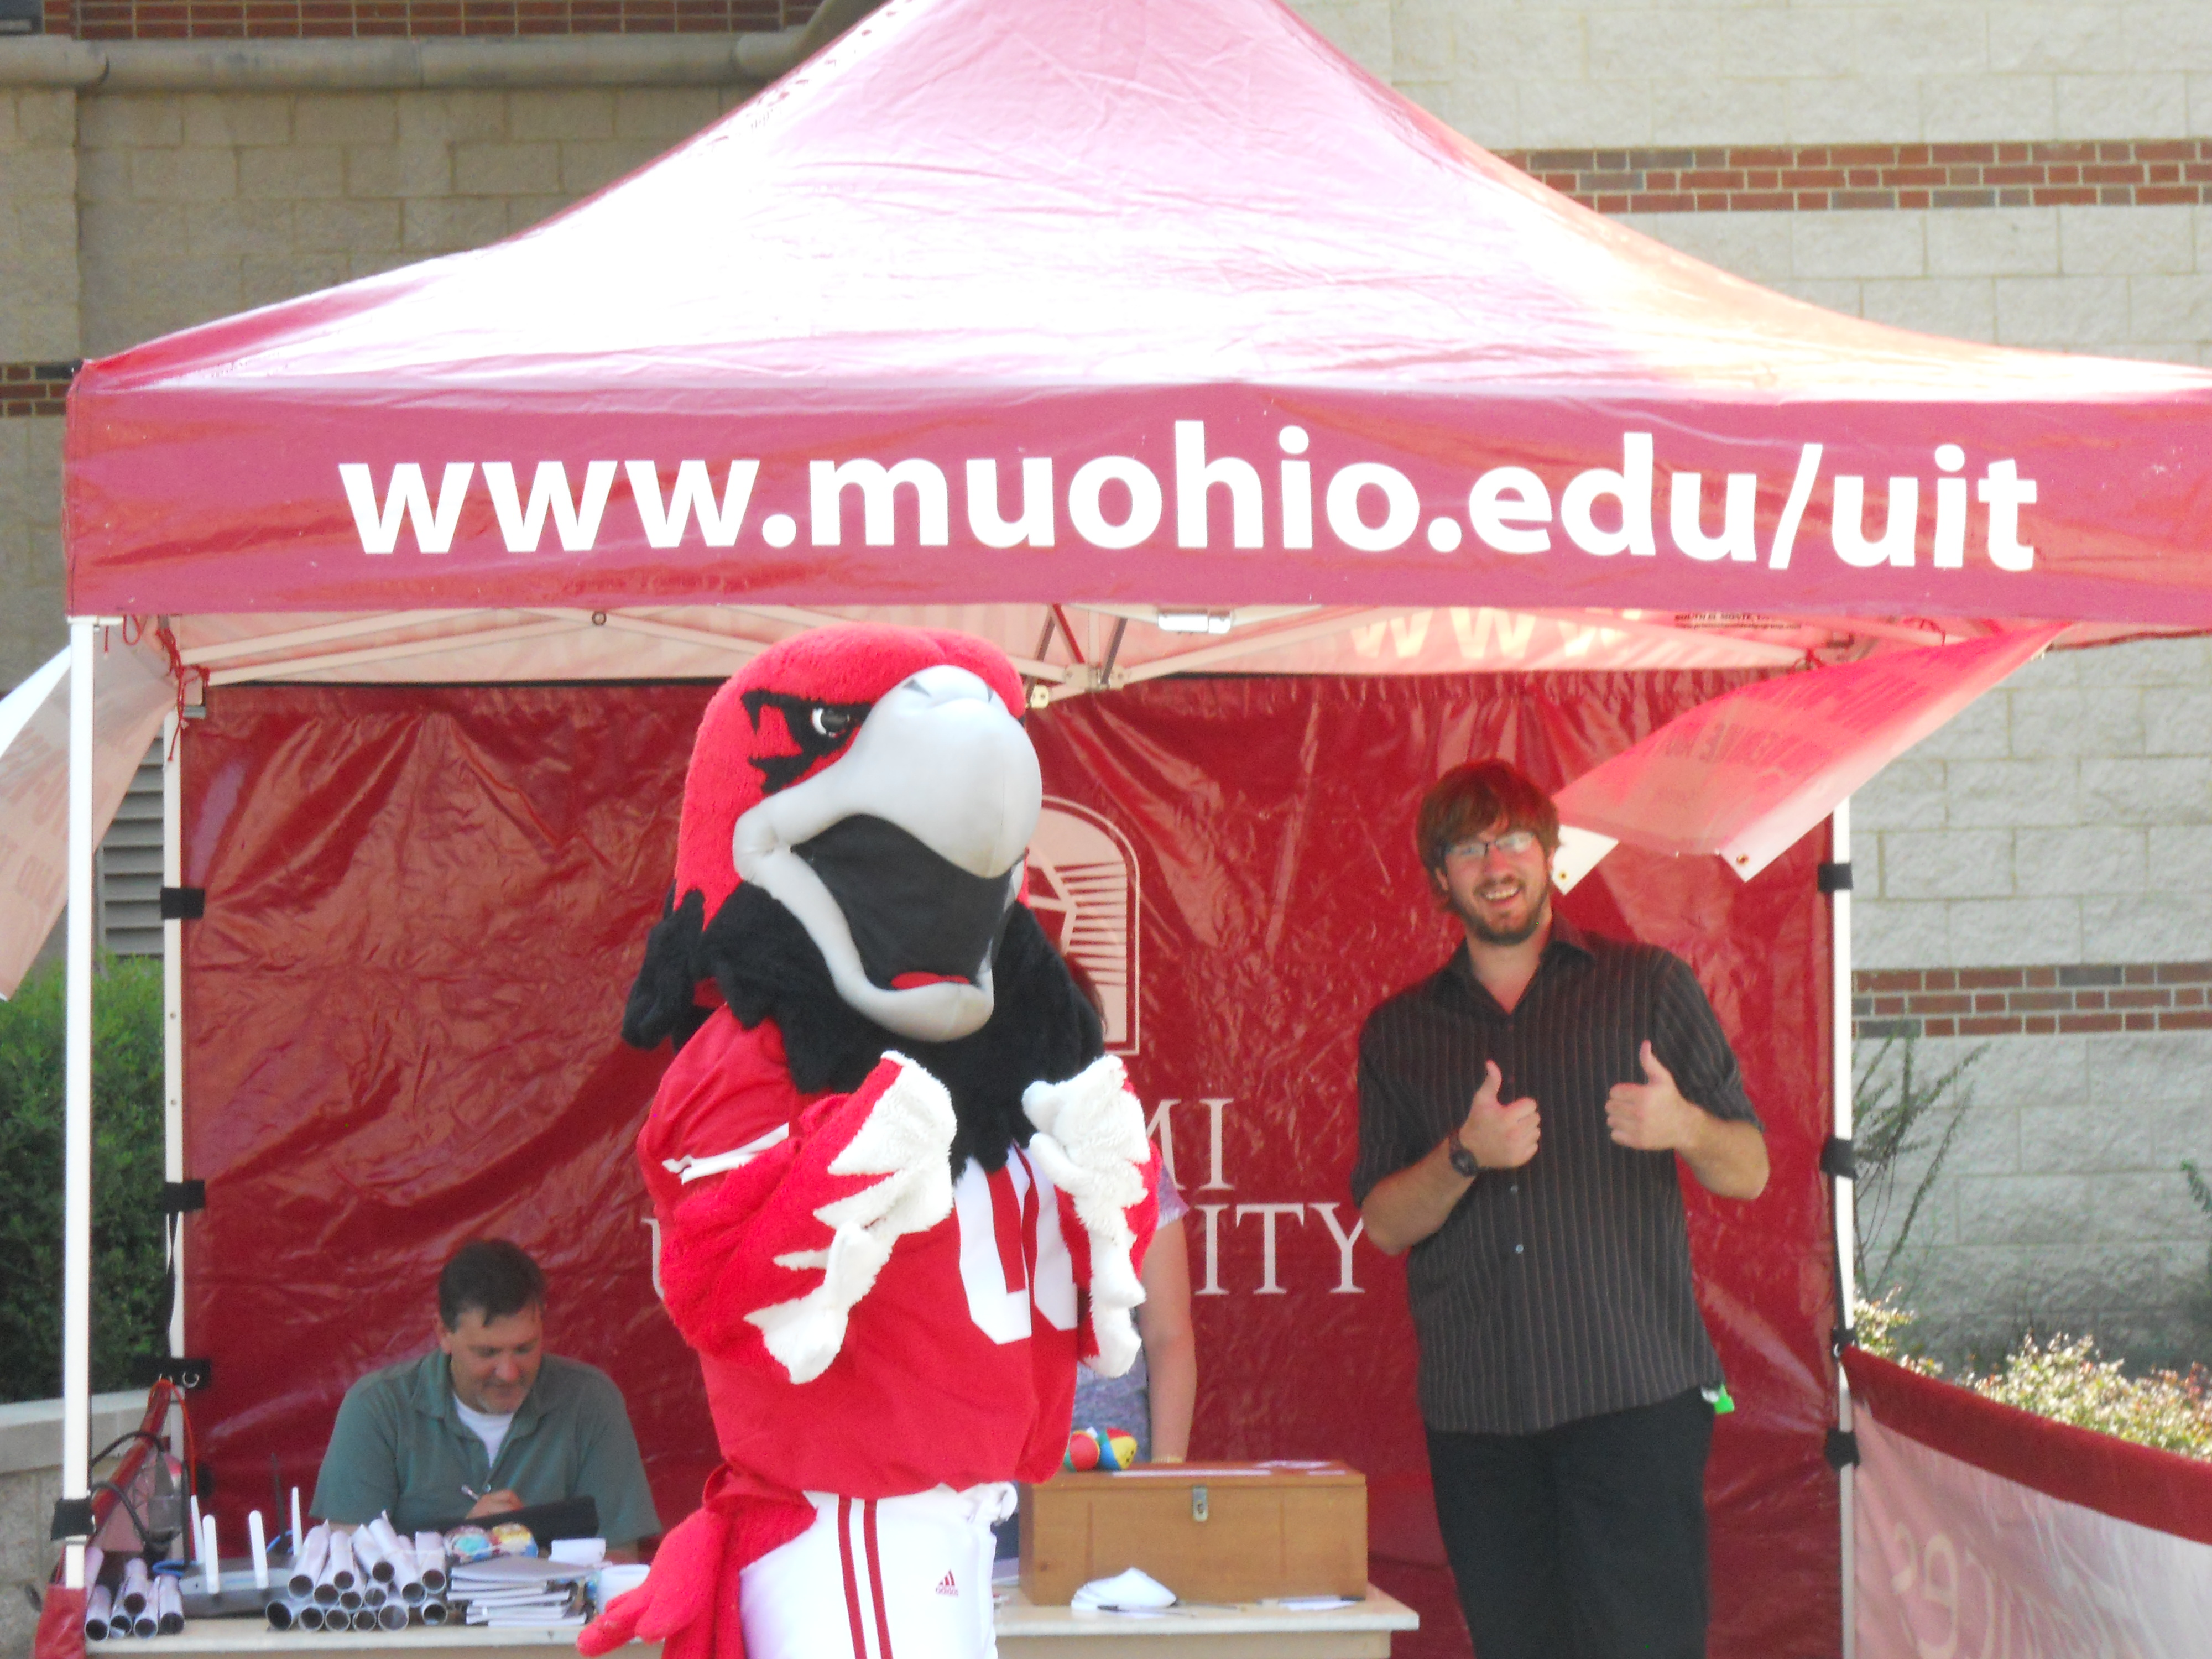
Who’s on the bus?
Who is included
Why
When
Notes:
Who is included?
Primary players – IT Support Desk and IT Communications
Resources: Admissions, Office of First Year Programs, MU Bookstore, Portal Team, Networking, Office of International Studies, Graduate School
Vendor partners – Apple, Dell
Why –
Know the role each team member will play, clearly define for them
When –
Especially important for the resources – bring them in only as you need them. Don’t chew up your colleagues time in meetings they don’t need to attend.

Slide 9

Schedule
Opportunities to make contact:
  Acceptance
  Confirmation
  Orientation
  First Year Move In Day
  Other??

Slide 10
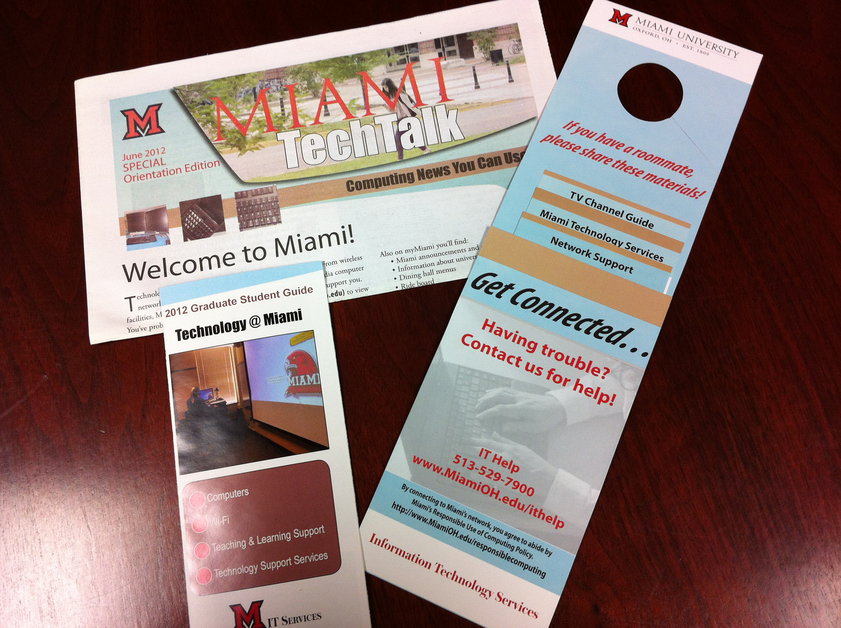
Tools
Print materials
Notes:
While no longer our only communication method – we still rely on print materials. The difference is they are designed to provide only the most basic information and drive the reader to a person or a web site to get more details.

Slide 11
Tools
myMiami portal

Slide 12
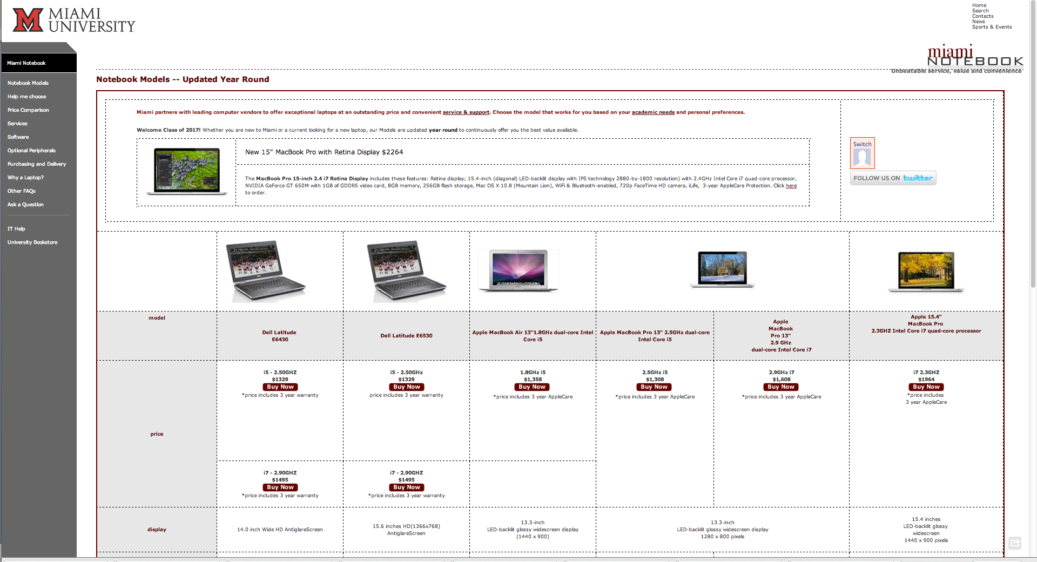
Tools
Email
Snail mail
Point of sale:
  Miami Notebook
Face to face
Notes:
Email – Office of FY programs e newsletter
Snail mail – each confirmed student gets a letter from the VP for IT about the Miami Notebook program
Point of Sale – information at the MU Bookstore, Miami Notebook web site
Face to face -

Slide 13
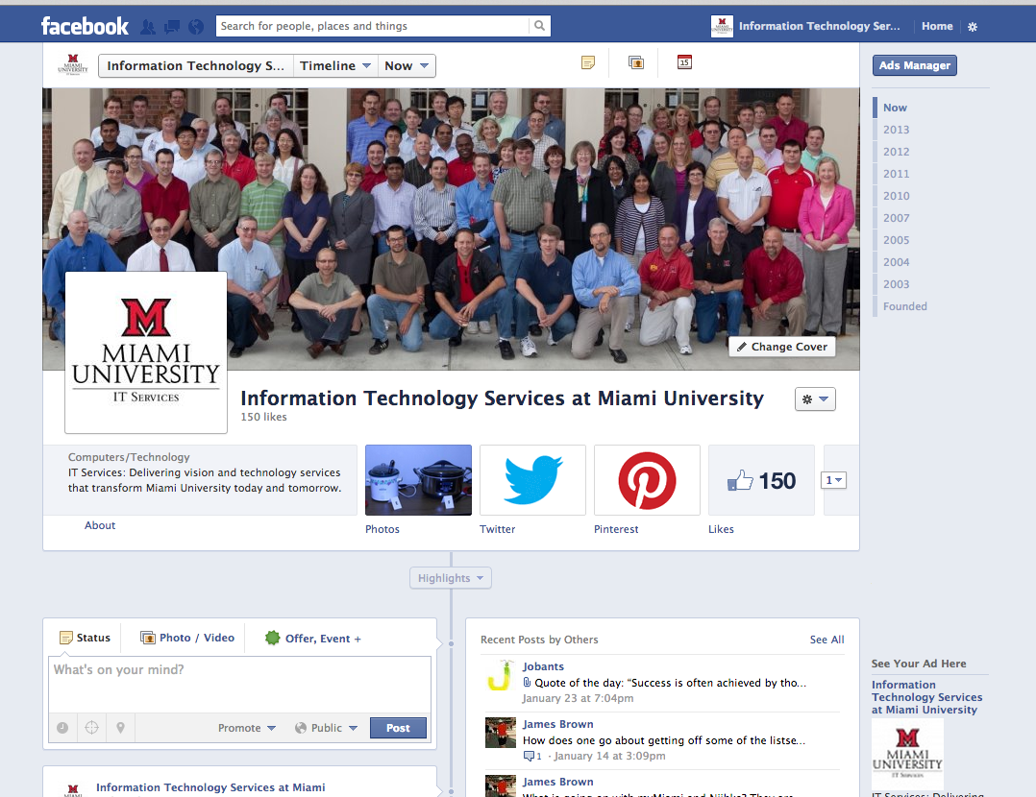
Tools
Social media
  Facebook
  Twitter

Slide 14
March
Convene team
Students notified of acceptance March 15
myMiami portal content for accepted and confirmed students
Miami Notebook: web site, postcard, brochure prep
Messages: Wireless availability, Miami Notebook

Slide 15
April
Prepare content for Office of FY Programs’ materials
Update New2MU content in knowledge base
Participate in Admissions’ postcard campaign
Messages: Support Admissions’ Yield Efforts

Slide 16
May
Students confirm by May 1
Final prep of materials for Orientation
Snail mail letter re: Miami Notebook
Messages: Miami Notebook, services

Slide 17
June
Tech Talk
Informal Lunch with Parents
Orientation Formal Presentation
Orientation Resource Fair
Messages: Support, Miami Notebook, services
Notes:
Orientation in June provides a great opportunity for us to put our arsenal of tools to work. Our major print piece, Tech Talk, goes into the folders provided to each parent and student. This newsprint tabloid covers basic information about all of IT’s major services with lots of links
During the day and a half parents and students spend on campus, service providers – like IT Services – are invited to join parents during their lunch break during the first day. While this does not reach a broad number of parents, it means we are beginning to make our presence known.
In the morning of day 2 students go to register for classes and parents attend the orientation resource fair. When the students are finished registering, they meet up with their parents at the resource fair. Alongside the Miami University Bookstore, our partners in the Miami Notebook Program, we have significant one-on-one time with both parents and students. We answer questions, give advice and point them to the Tech Talk publication and the Support Desk contact information. At a minimum, they get a smile from a member of the IT staff at the end of a very information-packed experience!
During the resource fair a variety of small information sessions are scheduled – and IT offers a brief power point and another opportunity for parents and students to get questions answered. And believe me the questions never cease to amaze me.

Slide 18
July
Office of FY Programs Email/Online Newsletter
Prepare for Move In
Track sales of Miami Notebooks
Prep for International Student Orientation
Messages: Be ready to come to campus!
Notes:
July is the lull before the storm. Anyone who things summer on a university campus is slow and lazy time has not worked in IT!

Slide 19
August
Hang Tag
Wireless Tent
Welcome Week
Social Media
International student and Transfer/New students Orientation
Messages: Connecting to network, tv guide, support
Notes:
Beginning in early August we welcome the new international students – Miami’s Chinese student population has exploded over the past few years and we offer a special orientation for those students, filled with everything from how to set up a bank account to getting a cell phone. Every year the demands of this group shift dramatically – meaning close coordination with our colleagues in International Education is important so we can provide the information that this year’s class needs.
Finally it’s Move In Day – and just before the stream of cars and vans pull into town, IT students and staff go into the first year residence halls and place a hang tag on every doorknob. (Show hang tag) This is a perfect example of “just in time” communication, focused on how to connect to the network, how to hook up your tv, Xbox, Play Station etc and how to get any questions answered.
Like many schools we constantly fight the battle of keeping up with the bandwidth demand of our Netflix watching, online gaming, Facebook surfing students. Faced with users clamoring for more and to knit together some of our own silos – we brought the Support Desk and Network Services groups together to staff the MU Wireless Tent – set up in high traffic locations from move in through the first week of classes. Students – and anyone else – can stop by and ask questions about any IT service.

Slide 20
September
Wireless Tent
Social Media
Survey
Messages: Support, support, support

Slide 21
Survey Results: Post Move-in Day
How helpful did you find the following: | Very helpful | Somewhat helpful | Not at all helpful | Did not use
Network Support | 115 (19.32%) | 100 (16.81%) | 20 (3.36%) | 363 (61.01%)
Handheld/Smartphone information | 63 (10.59%) | 47 (7.90%) | 21 (3.53%) | 450 (75.63%)
Other Network Devices information | 69 (11.60%) | 55 (9.24%) | 13 (2.18%) | 449 (75.46%)
Support Services Guide | 107 (17.98%) | 128 (21.51%) | 5 (0.84%) | 344 (57.82%)
Miami Technology Services | 130 (21.85%) | 134 (22.52%) | 10 (1.68%) | 315 (52.94%)
TV Channel Guide | 274 (46.05%) | 96 (16.10%) | 10 (1.61%) | 212 (35.59%)
General service information on back of hang-tag | 149 (25.04%) | 143 (24.03%) | 8 (1.34%) | 286 (48.07%)
Did you receive the hang-tag and cards?
Yes 81% No 19%

Slide 22
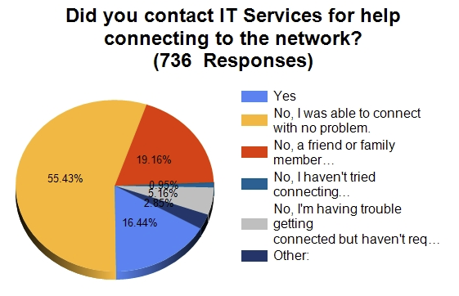
Survey Results: Part 2

Slide 23
Other sources of intel
Support Desk tickets
Resources
Student Technology Advisory Committee
Office of Residence Life
Other??

Slide 24
Lessons Learned
Understand your audience
Begin planning early
Support efforts of the Admissions office
Aim for “just in time” messages
Look for opportunities to make contact

Slide 25
Questions??

