Slide 1
Moving to Exchange?
Avoid some of the pain in the calendaring migration
NERCOMP 2009
© 2009 Sumatra Development LLC
This work is the intellectual property of the author. Permission is granted for this material to be shared for non-commercial, educational purposes, provided that this copyright statement appears on the reproduced materials and notice is given that the copying is by permission of the author. To disseminate otherwise or to republish requires written permission from the author.

Slide 2
Agenda
Business Objectives
Timetables
Calendar migration solutions
Hurdles
Testing and Training

Slide 3
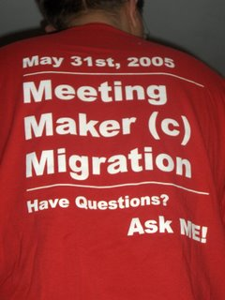
Migration is a lot like a plane flight:
The tough parts are take-off and landing
Very little can go wrong while running an insertion. The trick is to have everything (especially user list maps) set up correctly at the beginning and fully tested - long before you go live.

Slide 4
Business Objectives
Reduce overall costs
  Licensing two systems can have $$ impact
Better workflow for users
  One app for everything
Simplify Support
  Consolidate infrastructure
  Leverage Microsoft collaboration platform
Notes:
Vince talks
Russ says many of Sumatra’s customers want cost and workflow

Slide 5
Business Objectives (cont’)
Minimize impact on the organization
  Minimize time users spend re-keying data esp. President, Provost, Legal, and Deans
    Highest-possible conversion accuracy
    Re-create resource bookings (avoid conference room “land grab”)
  Smallest-possible outage window
  App MUST be compatible with portable devices (MS ActiveSync--iPhone, Windows Mobile OS, Palm and Blackberry)

Slide 6
Timetables Decisions
Plan the overall project (now that you are going forward with Exchange)—
  Decide when you want to go live
  Mailbox/account creation
  Calendar importing
  Testing components
  How long do you keep your old system alive in case things go pear-shaped (DR)?

Slide 7

Why you can’t “Drag and Drop”

Slide 8
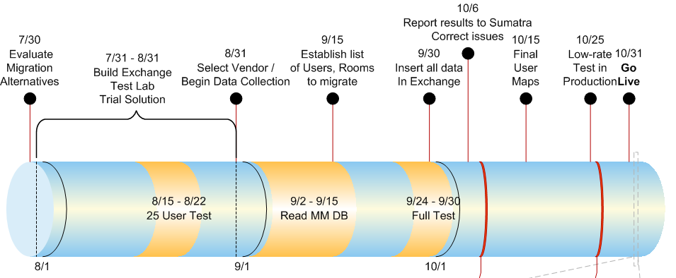
Timeline: it takes longer than you think!

Slide 9
What were our choices?
Choice | Pros | Cons
Cold Turkey | No Cost! | Huge impact on users No resource bookings
Synch calendars w/ handhelds | Low cost | Takes a long time Lose live aspects & recurrence of meetings No resource bookings
Do it ourselves | Low direct cost | Limited programming resources & R&D time
CalMover; Intellisynch | Experienced moving email | Can’t read MM database accurately; Charged every time they read the MM database
Sumatra | Experienced moving calendars | Cost

Slide 10
Initial Project Hurdles
Politics
  Senior business person must own the project
  Set expectations early (both for management and for the users)
Technology
  Build a test lab that emulates production
  Have a Microsoft TAM “on call” just in case
  MACs do not play well w/ Exchange
Data
  Lots to do: get help managing “the data”

Slide 11
Your Data: Your Responsibility
Assign data management responsibilities EARLY-ON!
Data | Group Responsible
Mapping between Exchange accounts & MM Accounts | AD Team
Calendar data (Does the Exchange calendar look like the MM Calendar?) | Desktop Support
Business and Technical Processes (Provisioning new accounts; configuring resources; handheld device servers) | IT Messaging & Collaboration Team
MM databases | MM Admins

Slide 12
We picked Sumatra’s solution…
Sumatra came as a recommendation from another school who had done what we were about to do.
We tested it in our lab with our data. It worked as we had hoped.
The price was GREAT!!!! This can be a relative issue and is not promised to be a universal truth.

Slide 13
How does the Sumatra solution work?
Insertion into Exchange is complex BUT Sumatra’s code:
  Automates the process
  Leverages Exchange messaging capabilities
Client
Exports
Calendar
Data
Sumatra
Converts
Data into
Access DB
Client
Views
Exchange
Calendars
Client
Maps MM
IDs To
Exchange
Client
Inserts
Data into
Exchange

Slide 14

Go-live: a well-rehearsed event

Slide 15
Calendar conversion is easy
(And Murphy is an optimist)
Things will go wrong
Start early
Test frequently
Leave enough time to find and fix problems
Everything should be “done” two weeks prior to your cut-over date

Slide 16
Key business decisions made during the process
How much historical data do we need?
Who owns and manages resources?
How do we deal with group calendars?
Do we shutoff access to Exchange?
  What is the outage window?
  What about SMTP mail flow?

Slide 17
Keep your users from whining
  Outlook & MM use models are different
Start training early
  Use the MM database to figure out who your ‘big’ calendar users are
Start training early
  Make sure the key users’ Admins are familiar with scheduling via Outlook
Start training early
  Bring users into the test lab & let them see their calendars in Outlook

Slide 18
What we liked about Sumatra
“Try it before you buy it”
  Migration is tricky stuff.
  Test it - before signing a contract!
  Testing proved Sumatra’s solution worked
Vendor support is critical!
  Sumatra worked with us –
    When things broke, there were no excuses, just results
  Exchange is complicated. Sumatra customized its process to ensure it worked in our environment!

Slide 19
Best practices / Looking back…..
Start EARLY
Test – things break
Don’t be afraid to ask questions
Engage your organization in the transition
Look at the calendar data
Train your users

Slide 20
Final thoughts
I am not paid by nor am I an agent Sumatra. I would like to say something they did not do right to give this presentation some credibility beyond being a marketing tool. But I can not. The experience Wesleyan as (me personally) had with Russ and Sumatra was nothing but stellar. They truly were a partner in getting Wesleyan on to Exchange.

Slide 21
Contact Us:
Vince Spiars
    Wesleyan University
    vspiars@wesleyan.edu
    860-685-3072
Russ Iuliano
    Sumatra Development
    riuliano@sumatra.com
    781-235-4465

