Slide 1
Compliance: Easy as PIE
William O. Anderson, CIO
Mary Jane Russell, Director of Finance
Copyright Saint Michael’s College 2011. This work is the intellectual property of the authors. Permission is granted for this material to be shared for non-commercial, educational purposes, provided that this copyright statement appears on the reproduced materials and notice is given that the copying is by permission of the author. To disseminate otherwise or to republish requires written permission from the authors.

Slide 2
Agenda
Institutional context
Project approach
Compliance architecture
PIEmatrix
Crowd sourcing and other next steps

Slide 3
Saint Michael’s College
Mission: It is the mission of Saint Michael’s College to contribute through higher education to the enhancement of the human person and to the advancement of human culture in the light of the Catholic faith.
Burlington, Vermont
21st Catholic with Phi Beta Kappa chapter
Top 50% National Liberal Arts US News
100% Residential with 2000 Undergraduate FTEs

Slide 4
Culture of Continuous Improvement
NEASC
2010 Accreditation
Cross-functional reporting, analysis & communication
Financial Planning
Assessment
Quality
Institutional Effectiveness
Strategic Planning
Leadership development
Data integrity

Slide 5
Common Compliance Challenges
Lack of awareness
Lack of expertise
Frequently changing regulations
Lack of time
Lack of staffing
Unclear responsibilities
Compliance is Important …
but not usually Urgent

Slide 6
Who’s on the Team?
Compliance
Finance
Human Resources
Financial Aid
Registrar
IT
Institutional Research

Slide 7
Who’s on the Team?
Compliance
Finance
Human Resources
Financial Aid
Registrar
IT
Institutional Research
HEOA Title IV
FERPA
PCI/DSS→
PA-DSS
HIPPA
HEOA
GLBA, etc

Slide 8
IDEO Design Process
Inspiration
Ideation
Implementation

Slide 9
Objectives
Inventory regulations applicable to Higher Ed
Develop necessary policies & procedures
Assign responsibilities & raise awareness
Training
Incident Response Plans
Reporting
System to capture and document compliance

Slide 10
First Thoughts

Slide 11
Scope Explosion: the need for a more comprehensive approach

Slide 12
Compliance Architecture
Generic steps needed to address any regulatory requirement
Uncovers opportunities for sharing data, discovery, reporting functions across requirements.
Customizable from regulation to regulation
Customizable from department to department to department

Slide 13
SMC Architecture
Projects: each regulation is a separate project
Process steps:
Assessment
Plans and Policies
Implementation
Incident Response
Reporting
Phases:
Initial baseline
Ongoing monitoring

Slide 14
SMC Architecture Example: HEOA
Assessment:
Regulation impacts academic affairs, campus store, IT p2p, financial aid calculator
Plans and Policies:
New policy on timing of book selection and publication
Admission and Financial aid plan their choice of FA calculator vendor
Implementation:
VPAA announce policy on books, IT announces resources for free file sharing
Incident Response may not be applicable
Reporting:
Internal reporting will be required

Slide 15
Technical Environment
www.piematrix.com
www.piematrix.com

Slide 16
Notes:
Slices = project phases or stages (similar to PMI content)
Layers are standard content for a process … a collection of best practices, etc.
A collection of related layers is grouped into a process template by a PIEmatrix administrator
USERS then use the project management functions of PIEmatrix to receive assignments, document progress, post project documents and web links, etc.
Project Managers & Executives can use dashboard features to monitor the status of all projects across the business unit (IT, Finance, etc)

Slide 17
PIEmatrix
Demonstration

Slide 18
Scope Explosion: the need for a more comprehensive approach

Slide 19
Executive Dashboard
Notes:
A quick view of the top level dashboard to help us see how we organized the columns in our earlier spreadsheets into cake “layers” in this dashboard, thus the collection of all projects in one place, with consistent slices for each project – assessment, plans/policies, implementation, incident response, and reporting as the constants for each.
Drill in, focus on GLBA

Slide 20
Notes:
This list of projects essentially = the columns on our prototype compliance grid

Slide 21
Notes:
Clicking on a project calls up a summary “info” box, as well as icons for various commands: project status, tags (“SMC compliance”), set up details.
We can also export a project to MS Project (why would we want to?), or archive completed projects from this menu

Slide 22
Notes:
A layer again is a series of constant steps, that apply across related projects. It’s sometimes easier to envision this in outline view. Here the “slices” of the pie have a PIE symbol, then the process boxes and related sub steps are indented under each.
This gives a birds eye view of the entire process and again, each layer’s steps may be similar, related, or totally different. For SMC, the Fyxx layers are similar but worded to focus more on “annual update & monitoring” vs. our initial design of the comprehensive plan for compliance overall.

Slide 23
Notes:
Drilling in or “launching” a project, we see that our environment includes several layers.
A layer is standard content for a process – a collection of steps that may differ slightly or may be totally different, but fit within the overall structure of the SLICES defined in the pie
SMC compliance architecture is the baseline stage we’re in now – gathering info about all these regs, documenting and in some cases writing necessary policies, and deciding “who’s going to do what?” Getting organized and creating a master plan.
Then, routine “business as usual” monitoring during future fiscal years, beginning with FY11, is tracking in a layer for each fiscal year. Where you see FY2011 in the slides, our production environment now labels this as a more generic “annual monitoring” label. This annual layer will focus on updating our knowledge of the regulations and checking for any regulatory updates, as well as response to any incidents should one occur during a fiscal year, and annual reporting/ monitoring efforts. (Ie, heavier emphasis on the last two slices in the “year” layers and “update” theme in the assessment/ plans & policies/ implementation phases)
Here, for Gramm Leach, we see that the only “task” in the assessment phase under regulatory review was to post the link to the GLB legislation since this was something that came out 7 years ago ….

Slide 24
Notes:
But in the FY11 (now called “Annual Update”) layer, our tasks are to research the current regulations to see if there have been any updates, and if so, to post links to the new information to PIEmatrix

Slide 25
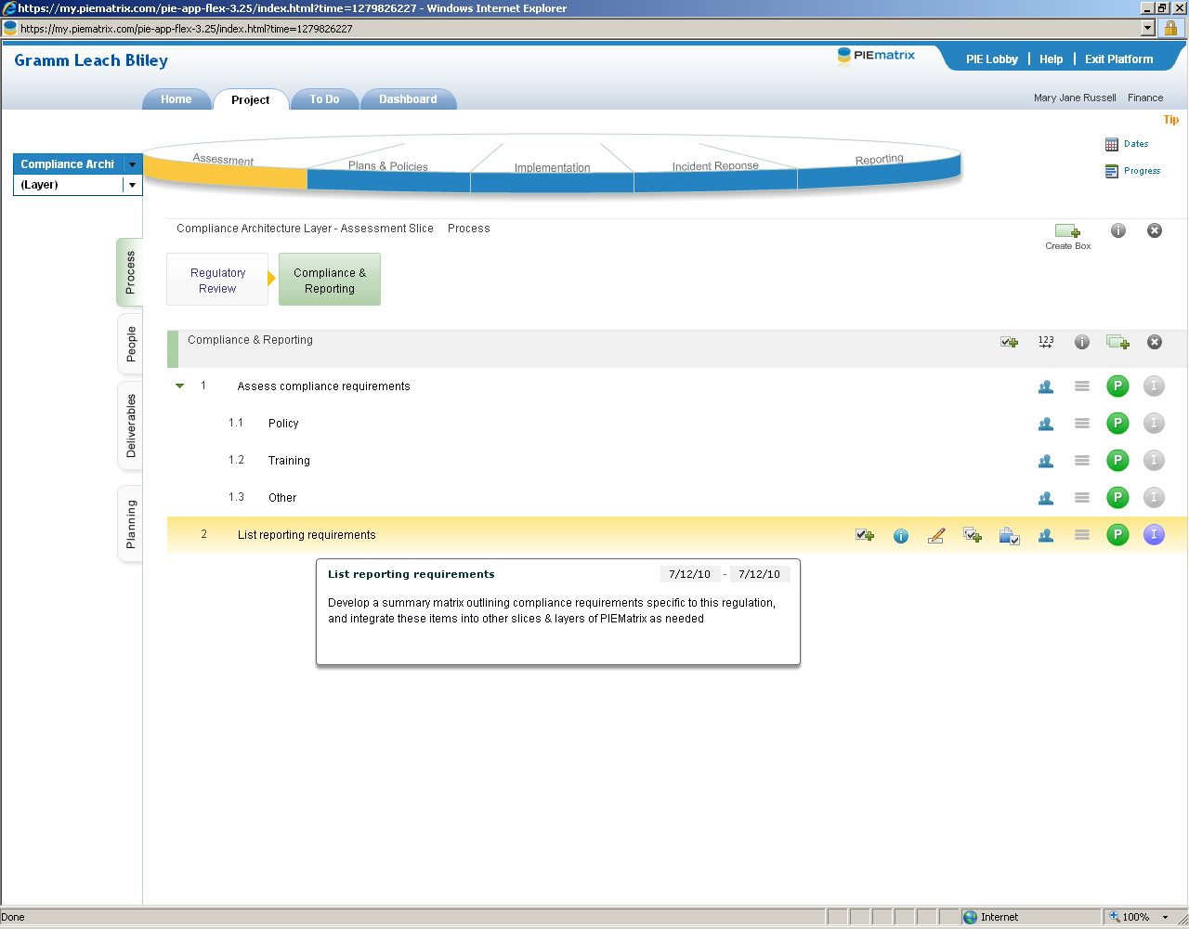

Slide 26
Example: Checklist of Requirements
Notes:
Specific example of documented compliance requirements based on review of GLBA in particular – building a master database of requirements across regulations to aid in policy and procedure coordination across all compliance initiatives

Slide 27
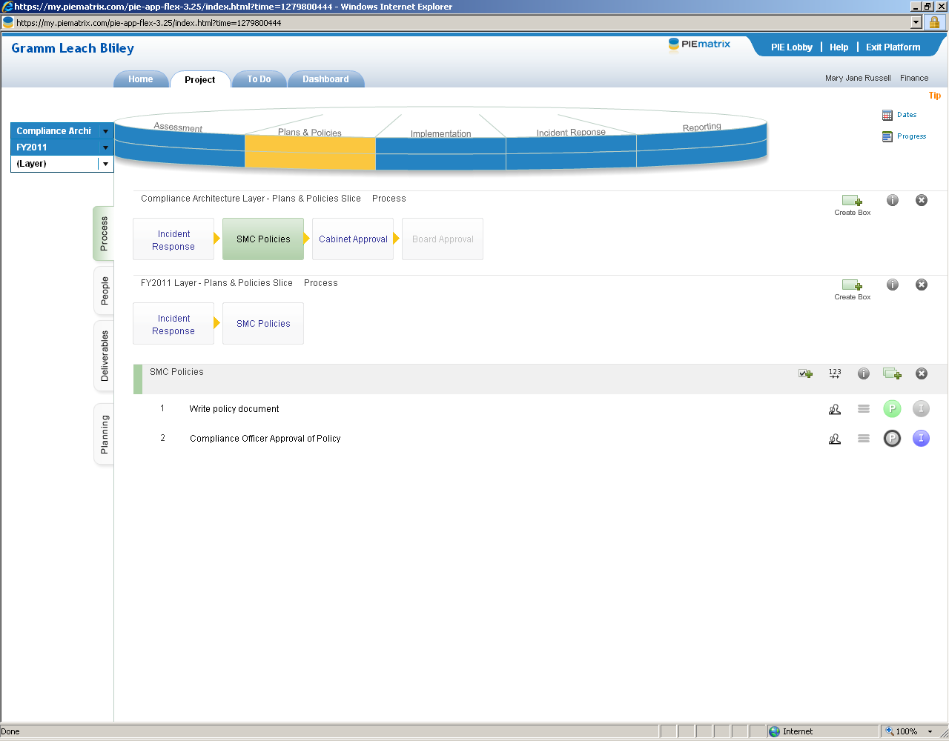
Notes:
Here’s an example of where our layers differ a bit more as an illustration.
In the early design of our GLB compliance, we developed a policy which had to be approved by both the Cabinet and the Board. In our design project during FY2010, we decided to re-configure that policy into something more holistic and decided we should sent that policy to the cabinet for approval, but that it would not require board approval (that box greyed out)

Slide 28
Notes:
Then in FY11, we’ll do the same “review and update policy document” and have our Compliance Officer approve any revisions, but have moved the Cabinet and Board approval to be sub-steps in the Policies tab, assuming that only rarely would updates be significant enough that they would require approvals beyond the compliance officer.
Here we also see the embedded notes feature (pop up windows) where we can further explain what a step means. We also see icons to create substeps, edit documents & files associated with a substep, and assign specific people to tasks. We also mark % completion and any integration with other tasks here (ie, if this step can’t begin until some earlier step has been completed).

Slide 29
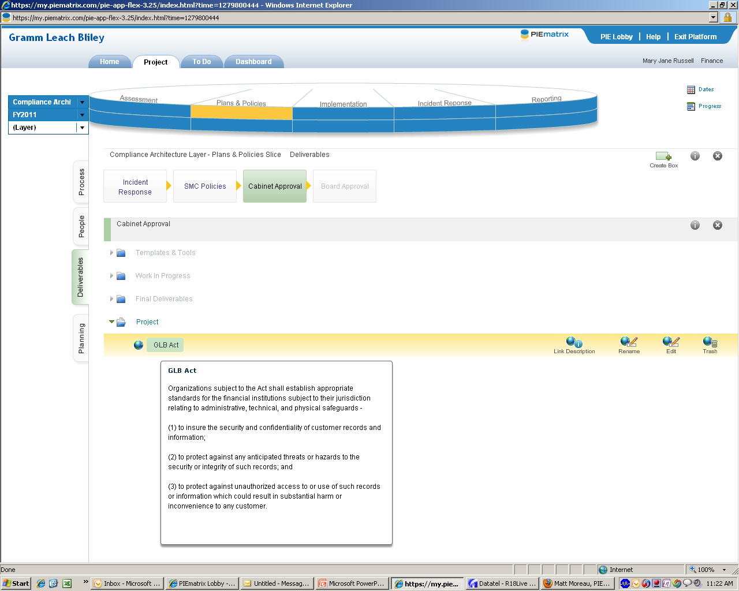
Links to Reference Material
Notes:
The Deliverables tab is a repository for project-related, as well as task-related, resources. Here we see a hyperlink to the GLB regulations and we’ve input a short summary of the Act into the “info” tab- Cliff Notes to summarize the nature of the Act

Slide 30
Repository for Project Documents
Notes:
Also a place to store project or task documents as they work through stages “WIP” to completion.

Slide 31
Example: Plans & Policies

Slide 33
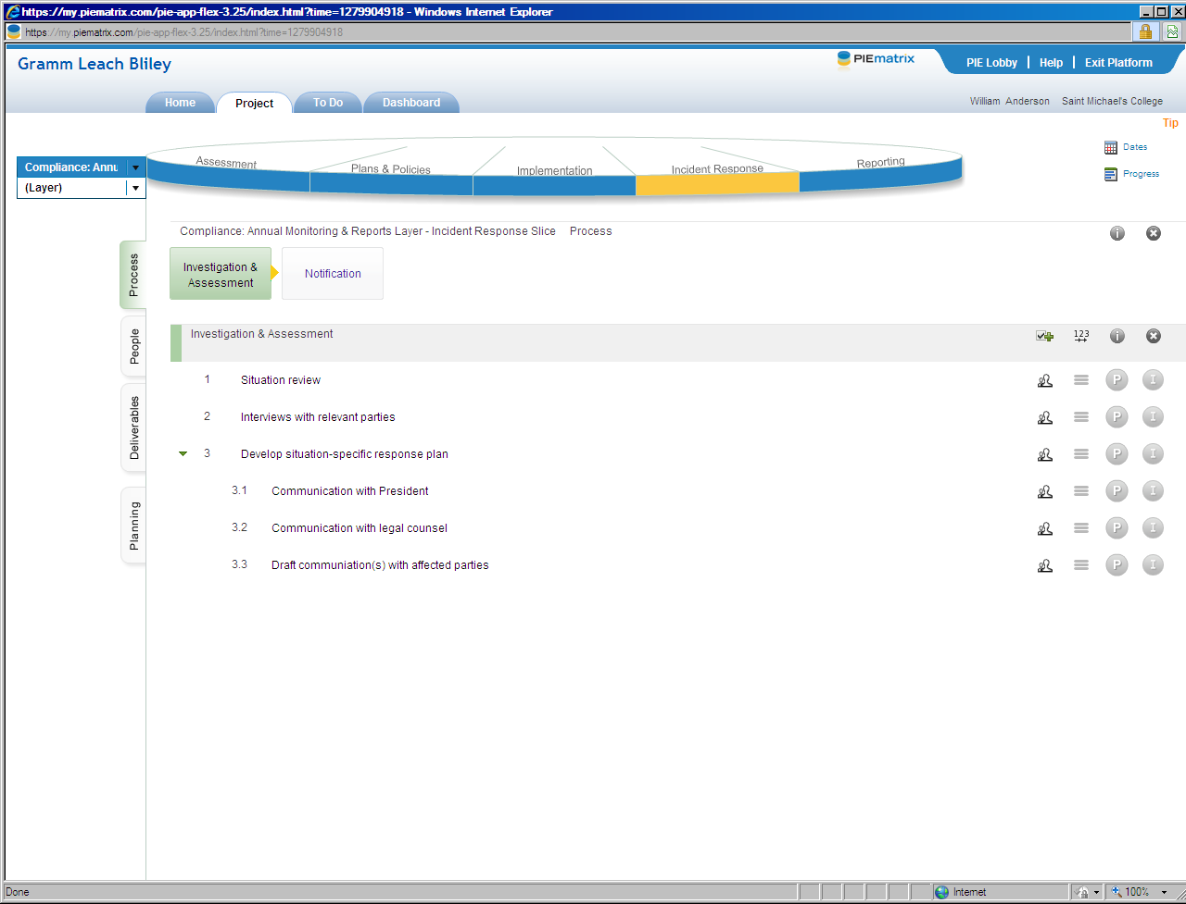

Slide 35
Project Management

Slide 36
Role & Task Assignments

Slide 37
Notes:
People can be globally defined on the project set up tab we’ll see in a minute, or we can also assign specific tasks to others. Here Billie and Shirley are the project managers, but I was assigned the task of gathering WWW links to this regulation during the Compliance Architecture stage

Slide 38
User Task Lists

Slide 39
Project Administration
Notes:
In addition to assigning macro roles such as Project Mgr & Administrator, we can assign a project to a business unit (SMC has finance and IT), define the project size and whether changes to the project will ripple through related projects in the same environment. We’ve also tagged this project past part of the SMC compliance matrix (now finance is only using PIEmatrix for compliance, but we’re in the process of adding financial management (budget, year end close, etc) so this would help us filter to find related items).
This is the view once a project has been set up, but user-friendly wizard walks us through each of these steps upon initial project set up – with an escape route so you can cut to the chase and just create the project, then fill in the other details later.

Slide 40
Status Reporting

Slide 41
Executive Dashboard
Notes:
Next Bill will wrap up with information about costs, the bigger picture, and next steps.

Slide 42
Crowd sourcing
Share the work
Develop best practices
Establish a standard of care

Slide 43
Costs
Time and effort
Opportunity costs – other competing projects
PIEmatrix software-as-a-service
License fees

Slide 44
Status
Completing “Compliance Architecture” layer now
Beginning 2011 annual monitoring
Working with PIEmatrix to address technical issues as they arise
Quick, personal response from tech support
Other uses for PIEmatrix
IT projects
Financial Management

Slide 45
PIEMatrix Community Templates
Notes:
PIEmatrix has a “creative commons” where other users from other organizations can post content – templates that others may wish to use as is, or modify for customized needs at their own organization.

Slide 46
Conversation
Your input is important to us!
Questions?
Comments?
Volunteers?

Slide 47
Contact Information
Bill Anderson
CIO
wanderson@smcvt.edu
802-654-2252
MJ Russell
Director of Finance
mrussell@smcvt.edu
802-654-2494

