Slide 1
Moving to Moodle
Joshua Fiske
Manager of User Services

Slide 2
About Clarkson University
New York State’s highest ranked small research institution
3,500 students, primarily undergraduate
Well-known for Engineering and Business programs
Focused on collaborative, on-campus learning

Slide 3
Background for Clarkson
Blackboard Environment — Fall 2009
Running version Blackboard Academic Suite 8.0 (Enterprise License)
Paying approximately $45,000 / year in licensing
5-year contract soon-to-expire
Running on 4-year old hardware

Slide 4
Background for Clarkson
Options
Buy new hardware and upgrade to version 9
Virtualize and upgrade to version 9
Virtualize and move to another LMS platform

Slide 5
A Little on IT Governance
IT Advisory Committees
We have lots of “TAC”s
Academic
Administrative
Student
Involved each of them in the conversation about Blackboard’s future on-campus

Slide 6
Decision Time — Fall 2009
Continue conducting all classes in Blackboard v8
Investigate alternative LMS options
Moodle
Sakai
Etc.
Stand-up a pilot environment, invite adventurous faculty to “play around”

Slide 7
Pilot Time — Spring 2010
A diverse group of faculty participated in a limited pilot
19 courses
14 faculty
552 enrolled students
Participants were surveyed mid-semester

Slide 8
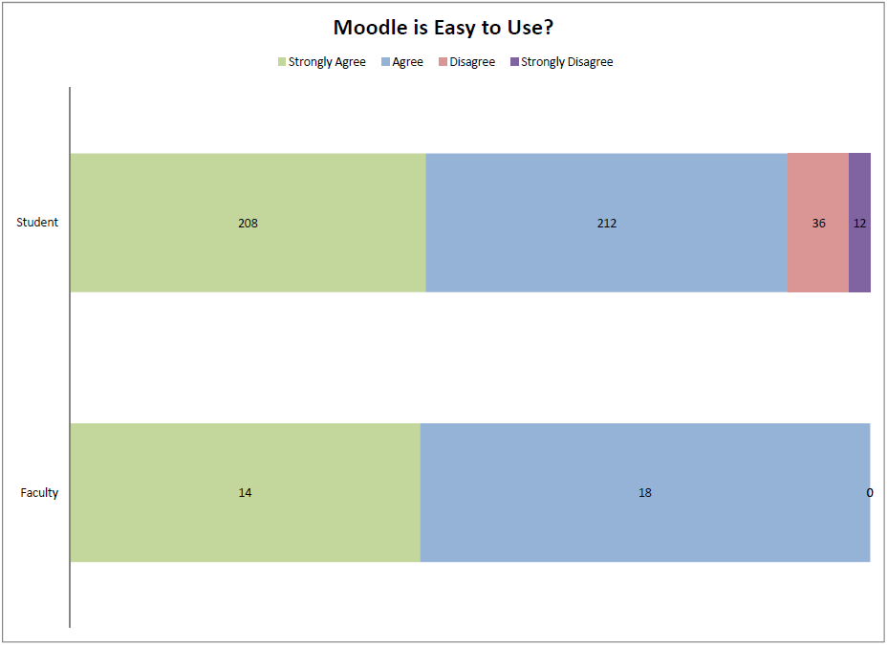

Slide 9
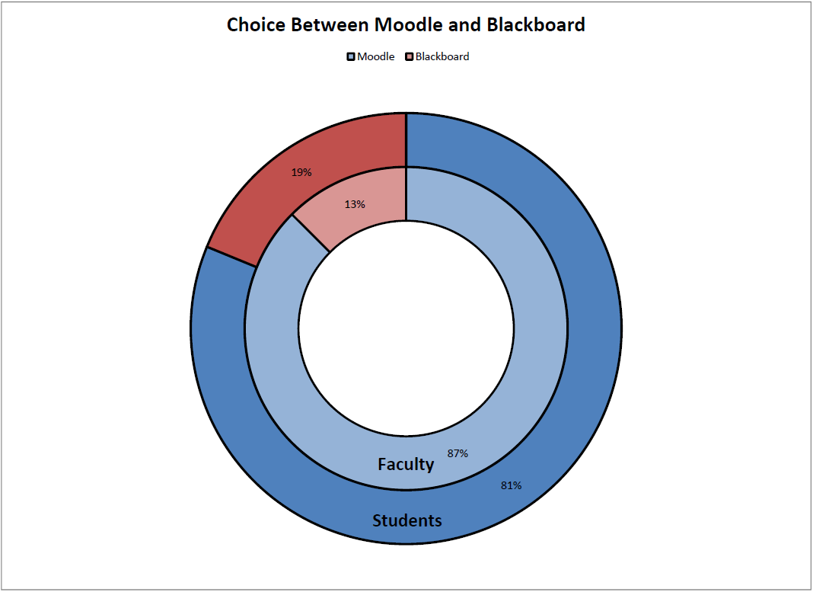

Slide 10
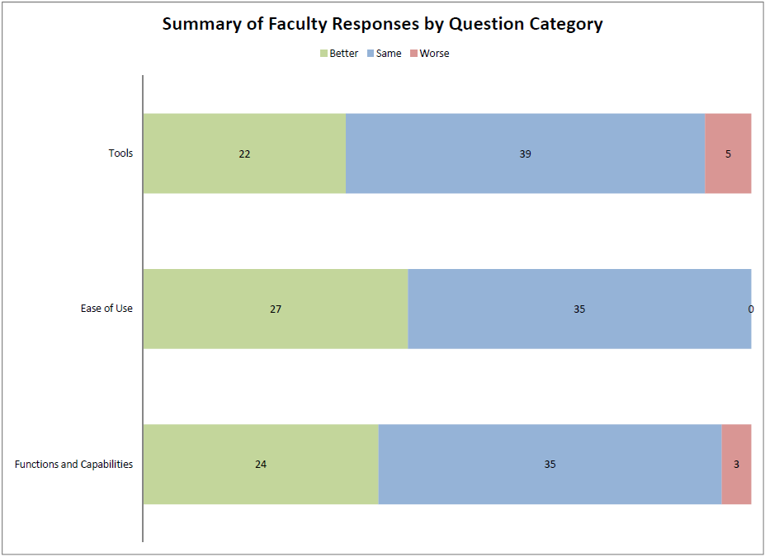

Slide 11
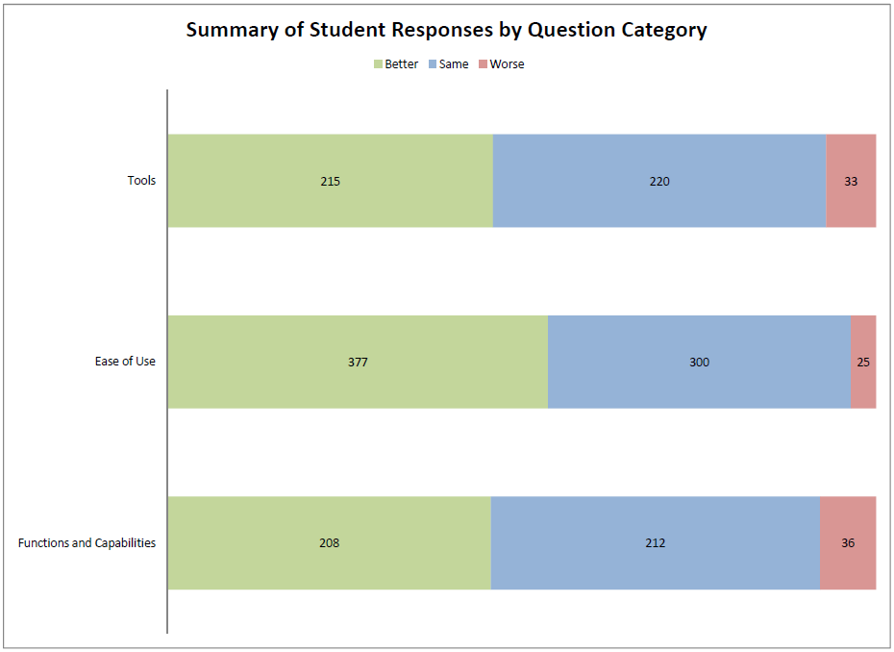

Slide 12
Roadmap — Summer 2010
Recommendation to the Provost that the contract with Blackboard not be renewed
Transitioned pilot environment to production
Created training materials and hosted faculty training sessions

Slide 13
Roadmap — Summer 2010
Exported all Blackboard courses; provided migration documentation to HelpDesk

Slide 14
Go Time! — Fall 2010
Created course shells for all courses
Enrolled all students and faculty based on SIS enrollment data
Lots of instructor hand-holding…

Slide 15
System Architecture
mySQL
Apache

Slide 16
Internal Cloud
Compute Resources
VMWare ESXi 4
5 Dell M610 with 12x3.3GHz & 48GB RAM
2 Dell M610 with 12x3.3GHz & 196GB RAM
2 M1000e blade chassis
mySQL
Apache

Slide 17
Internal Cloud
Compute Resources
VMWare ESXi 4
5 Dell M610 with 12x3.3GHz & 48GB RAM
2 Dell M610 with 12x3.3GHz & 196GB RAM
2 M1000e blade chassis
mySQL
Apache

Slide 18
Internal Cloud
Storage Resources (28TB)
1GB ethernet, iSCSI connected
4 Dell MD3000i
2 Dell MD1000
1 Equallogic PS6000XVS
mySQL
Apache

Slide 19
Database (MySQL)
MySQL Server Configuration
2 vCPU
3GB RAM
Total Database Size 1.8GB
mySQL
Apache

Slide 20
Web Server (Apache)
Apache Server Configuration
4 vCPU
3GB RAM
Total User Data Size 53GB
mySQL
Apache

Slide 21
Lessons Learned
Courses will not import from Blackboard as smoothly as you hope
Support costs have not increased!
Involving faculty in the decision makes a move much more palatable
Present company excluded, faculty are lazy!

Slide 22
Summary of Benefits
Saves ~$45,000 annually
No increase in support calls
Virtual environment
No additional capital costs
Improved DR posture

Slide 23
Questions at the end, thanks.

Slide 24
Migrating to Moodle
Candy Center, Dean
Hemant Chikarmane, Professor
Cape Cod Community College

Slide 25
About Cape Cod Community College
One of 15 Community Colleges in Massachusetts
Commuter school, serves S.E. Massachusetts, including Martha’s Vineyard and Nantucket
A.S., A.A. degrees, certificate and 2+2 programs
Feeder to 4-year schools and universities – credits transferred seamlessly
~5,000 FT/PT students, ~ 70 FT, 260 PT faculty
Major programs in health sciences, environ. tech
State school, miracles expected on a limited budget!

Slide 26
A change was being forced …
As of Fall 2009, no enhancements for BB 7.3
No BB 7.3 support after 2011
Clients using BB 7.x and 8.x urged to move to BB 9
BB 9 includes license fee increase, with annual fee increases of 17-23%
Enterprise version additional cost
Customized features ~$20k per feature
BB acquired its major competitors WebCT/Angel
BB 7.x upgrade to BB 9 has learning curve

Slide 27
Time to Redefine Distance Learning
Informal brainstorming session, October 2008
If change is coming, why not move from BB …
Ask for faculty input on what they want in the LMS
Provide professional development opportunities – workshops, online tutorials
Faculty mentors to provide support to FT faculty and adjuncts
HC to run a pilot course on Moodle starting Spring 2009, locally hosted, to test capabilities

Slide 28
LMS Survey, March 2009
What features would you like in an LMS to improve pedagogy and instructional goals?
10 survey responses!
Passionate college-wide discussion via email
Stable LMS environment
All current (BlackBoard) tools, plus more
Audio / video capability to support online, hybrid, and face-to-face classes
NO CHANGE!

Slide 29
What were others doing …
N Carolina Community Colleges, Assessment Report
Surveys show that BB and Moodle are not that different
Real difference is student perception of teacher’s comfort level with Moodle
Functional comparison: Moodle has higher perceived functionality than any BB version
Case studies of 4 exclusive Moodle institutions: Challenging transition, but Moodle was preferred choice

Slide 30
What were others doing …
Pitt Community College
Overall feedback – loved Moodle once started using
Moodle is a mindshift – some faculty adapt better than others
Conversion process difficult, but once completed, most faculty and students satisfied
Works best for faculty using discussions, chats, group work

Slide 31
What were others doing …
University of North Carolina
LMS Evaluation Committee, 2009
Evidence strongly favors transition to Moodle on pedagogical and financial grounds
Moodle provides better or comparable functionality with increased control and (in long run) lower cost

Slide 32
Student survey, Moodle pilot course …
BIO201: summer 2009, fall 2009
Server on campus
Questions posed to the class:
Do you like using Moodle to access course content?
If you have used BB in other courses, how does Moodle compare with respect to usability, speed?

Slide 33
What the students said …
Students on Q1 about liking Moodle | Like very much | 43 | Also said on Q2 about Moodle vs BB | Better | 30
 |  |  |  | About the same | 9
 |  |  |  | Worse | 0
 |  |  |  | Never used BB | 4
 | Like it | 22 |  | Better | 6
 |  |  |  | About the same | 15
 |  |  |  | Worse | 0
 |  |  |  | Never used BB | 1
 |  |  |  | No response | 0
 | So-so | 1 |  | About the same | 1

Slide 34
Options with limited financial resources…
Option 1
Upgrade to BB 9, with increased cost ~$36K - $52K
Continued increased annual projected expenditure
Significant change in look and feel in new version
No additional resources for faculty support

Slide 35
Options, cont …
Option 2
Use federal stimulus funds to purchase Moodle server, conversion resources and modules
OR host externally
Consultant to convert existing BB courses to Moodle (~ $200 - $500 per course)
After transition, savings used for faculty/staff support and professional development

Slide 36
Implemented plan and timeline
Pilot Moodle server on campus: BIO201 Summer & Fall 2009, other volunteer faculty Spring 2010
LMS faculty / staff survey Spring 2010: 100 respondents
80 faculty requested Moodle professional development opportunities – workshops, etc.
35 faculty requested assistance with course conversion for:
67 courses
37 of which are online or hybrid

Slide 37
Implemented plan and timeline ….
Course conversion set:
Summer 2010 for Fall 2010 courses
Fall 2010 for Spring 2011 courses
Implementation of Moodle on hosted service (Remote Learner) in Summer 2010, with Fall rollout
Transparency: Progress status shared regularly with college community

Slide 38
Course conversion management
Set timeline, action matrix
Review of course space
Develop course specific action plan – based on teaching style of the faculty member, and discipline
Conversion of course content, audio/video content
Faculty review of course space, additional revisions/edits
Average conversion time = 6 hours per course
Range = 4 – 13 hours
Total conversion hours = 350

Slide 39
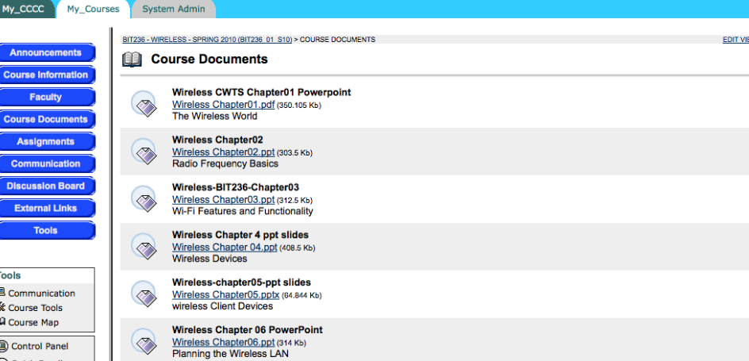
Sample BB 7.x course organization

Slide 40
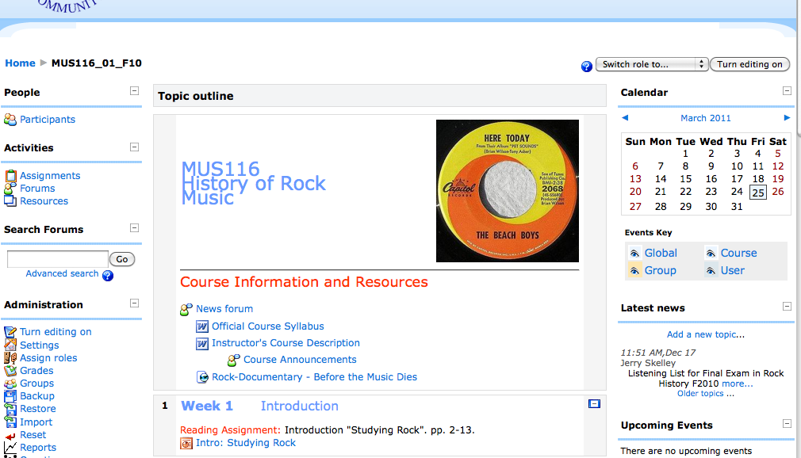
Sample course conversion

Slide 41
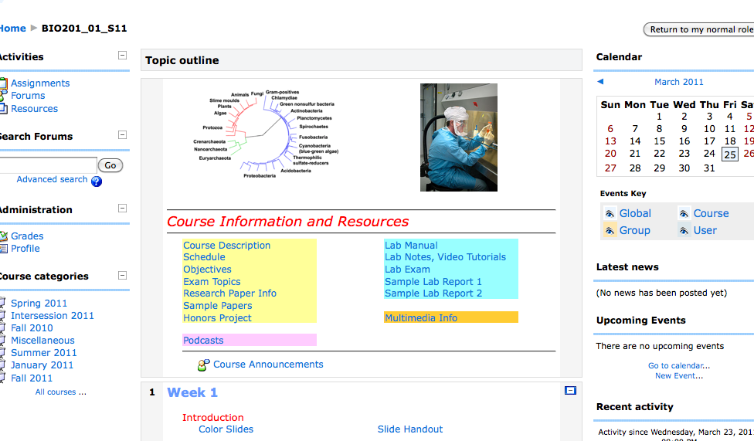
Sample course conversion

Slide 42
Sample course conversion

Slide 43
Migration ROI
 | Pre-transition year | Transition Year |  | Post transition year
 | BB | Moodle | BB | Moodle
Migration year | 2009-2010 | 2010-2011 |  | 2011-2012
License fee | 23,000 | 0 | 17,700 | 0
Vendor hosting | 0 | 10,000 | 0 | 10,000
Training | 00 | 4,047 | 0 | 5,000
Course conversion | 0 | 18,025 | 0 | 0
Clerical support |  | 6,840 |  | 0
Sub-total | 23,000 | 38,912 | 17,700 | 15,000
LMS cost | 23,000 |  | 56,612 | 15,000
BB license costs and additional servers are $54K. Annual license ~$44K for 2,700 FTE

Slide 44
Migration costs summary
External hosting: Remote Learner, guaranteed uptime
Training: Ongoing professional development
Course conversion:
One time expense
Vendor was to provide Spring 2011 conversions at no cost with an automated tool – vendor was not ready for BB 7.x
Spring course migration done in house

Slide 45
Migration team
Candy Center, Dean: Project Manager
Hemant Chikarmane, Professor: Lead, course migrations
Adam Farrell, Media Prod Mgr: A/V conversions
Cathy Fraser, Admin Asst: Help desk support
Dan Gallagher, CIO: Liaison with IT
Bill Berry, Hemant Chikarmane, Joy Haagsma:
Online faculty mentors - Workshops, online help (passwords, etc), one-on-one mentoring

Slide 46
Summary of lessons learned – both approaches
A pure IT- or administration- driven approach won’t work
Make decisions based on faculty and student survey of needs, likes, and dislikes
Involve faculty at all steps of decision making
You cannot make everyone happy - a certain faculty will want everything done for them
You cannot make everyone happy - a certain faculty will complain no matter what
Conversion takes time !

Slide 47
Questions?

