Slide 1
March 29, 2011
Elizabeth Ciabocchi, Valeda Dent, Patrick Kennelly,
Nancy Marksbury, Devabrata Mondal

Slide 2
A Mobile Technology Initiative at LIU
Creating a Multi-Campus iPad Learning Community
Student Life
Communication & Collaboration
Teaching & Learning
Web Access, E-books & Apps
Cloud-based Resources
Transforming learning environments
Institutional Profile
Marketing & Recruitment

Slide 3
Who wants an iPad?
Eligibility criteria
Academic
Freshmen, new transfers
Later, half-priced iPads for continuing students
Financial
Cleared bill, after the add/drop period
Health
Up-to-date immunizations
Admissions
Reporting and credentials

Slide 4
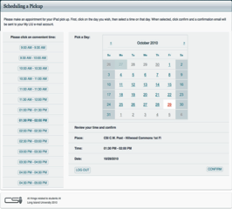
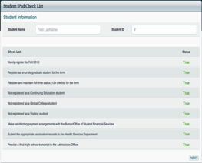
Student Appointments
[Text]
e-signature

Slide 5
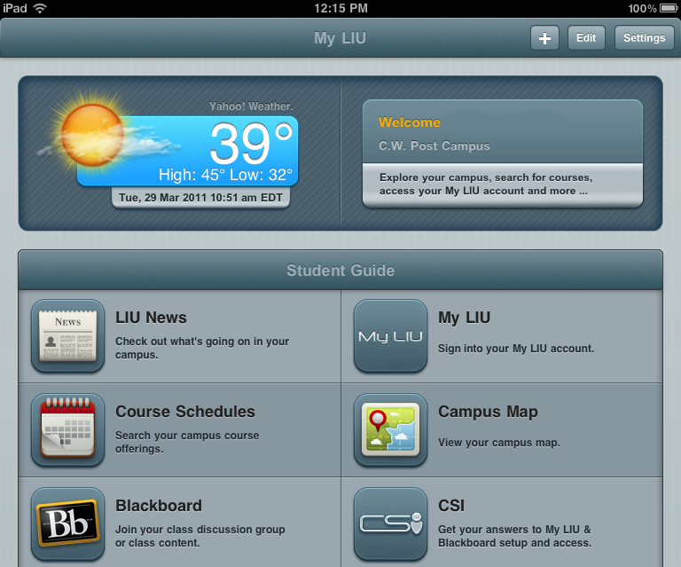
The MyLIU App
Notes:
IT created an in-house, custom-made software application that automatically extracts the serial number, MAC address, and create a My LIU email profile. At the appointment, students were also provided with an information card that listed resources on the CSI website.

Slide 6
The MyLIU Configuration
Blackboard Mobile Learn
Support (csi.liu.edu)

Slide 7
Faculty Adoption of iPads
Creating a Multi-Campus iPad Learning Community
Distribution of Devices
AY 2010-2011
Faculty computer replacement program & option for new faculty (Fall)
RFPs from Office of Academic Affairs (Fall/Spring)
Analysis of Faculty Proposals & Distribution (Fall/Spring)
Fall 180 | Spring 150

Slide 8
Examples of Faculty Proposals
Creating a Multi-Campus iPad Learning Community
English - Faculty Seminar on Reading & Writing Program; productivity apps - note-taking, annotation, highlighting, & flash cards; online dictionary/thesaurus; e-portfolios
Mathematics– Graphing calculator for 2D, 3D images to engage students in learning challenging mathematical concepts
Earth & Environmental Science– Blackboard mobile, NY Times and Google Earth apps for geography instruction
Respiratory Care– Use of video to troubleshoot equipment problems,.e.g., ventilators, resuscitator bags, endotracheal tubes, nebulizers, other oxygen equipment
Sociology – Web access to engage students in active learning; redirect lectures in response to content and student inquiry; establish group learning & enhance community; new pedagogical strategy
Psychology - Psychological testing, assessment and research via multiple surveys & questionnaires, e.g., Survey Monkey, Student Voice, for mobility in data collection
Biology – Use of digital media (time lapse movies, slide presentations, PDFs) in Blackboard that support the lecture portions of the course
Studio Art - artists’ websites for critiques and project ideas; ArtStor digital images for project ideas, discussions of art history; create videos or link to sites that run techniques used in the studio

Slide 9
Faculty Responses: The “Pros”
Creating a Multi-Campus iPad Learning Community
“Great battery life & portability!”
“Useful apps for (fill in the blank)!”
“Helpful with group work & student collaboration”
“Beautiful graphics and media!”
“I like the Blackboard app!”
“Wow, it’s just so cool!”
“Fast and easy web access!”

Slide 10
Faculty Responses: The “Cons”
Creating a Multi-Campus iPad Learning Community
“I’m concerned about students using the device to cheat!”
“There aren’t enough e-books available yet!”
“Some of my students have the device, but I/they don’t!”
“I like the device, but it doesn’t do (fill in the blank) very well!”
“This device is too distracting in class!”
“I have trouble projecting from it!”
“It’s hard to type on this keyboard!”

Slide 11
iPad User Group
Creating a Multi-Campus iPad Learning Community
Faculty, staff, students
Faculty support - ongoing
Workshops through FMRC|FTRC
Apple-sponsored workshop
F2F group meetings re: teaching & learning
Sharing apps and academic projects
Networking with peers, IT and campus/CSI’s
Campus listservs
Faculty & student iPad showcases, Summer Teaching with Technology Institute

Slide 12
User Experience Design, the iPad, and the Library
Users
Content
Context
Tools

Slide 13
UNDERSTANDING UX Design
Useful
Usable
Desirable
Valuable
Findable
Accessible
Credible
Morville’s UX Honeycomb
http://semanticstudios.com/publications/semantics/000029.php

Slide 14
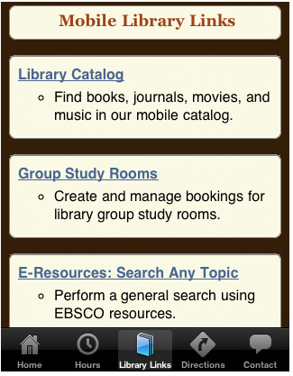
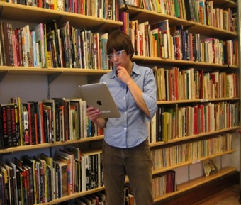
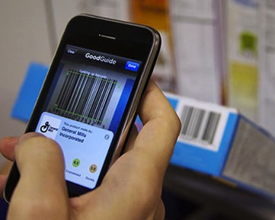
SIMPLIFYING the Routine
Search the catalog using catalog app
Locate the resource using place-aware app
Self check-out using barcode technology/ILS

Slide 15
TRANSFORMING Information Literacy
Digital learning objects
Assessment
eBooks & learning resources
Information Competencies

Slide 16
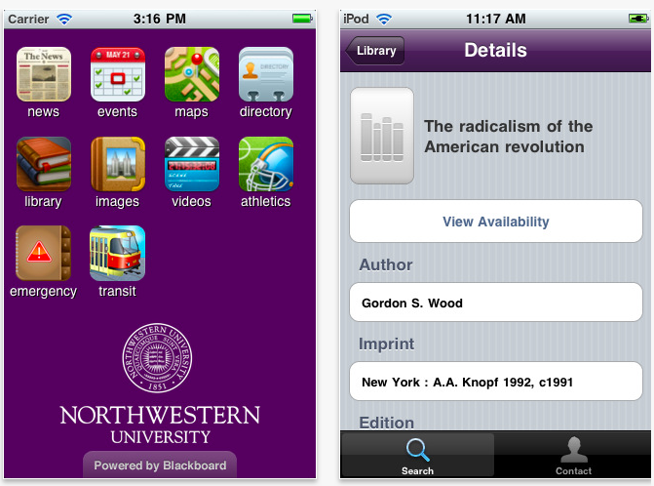

Slide 17
Class Project - Campus Wi-Fi Map
The class
GIS Applications
Earth Science 502 / 018
Five graduate and five undergraduate students
Web-enhanced learning environment
The campus
8,000 students
307 acres
50 buildings
204 Wi-Fi antennas

Slide 18
Class Project - Campus Wi-Fi Map
The objective
Create a map showing the availability and strength of Wi-Fi signal across campus
Project phases
Locate Wi-Fi antennas
Pilot project
Sampling strategy
Wi-Fi availability and strength
Recommendations

Slide 19
Class Project - Campus Wi-Fi Map
Web-enhanced learning environment tools
Discussion forums
Wikis
Google Docs spreadsheet
GIS Server
Google Earth
Group file repository
Picasa

Slide 20
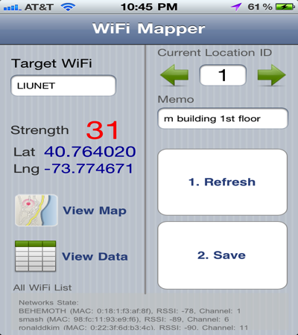
Class Project - Campus Wi-Fi Map
Locate Wi-Fi antennas Pilot project Sampling strategy Wi-Fi strength Recommendations
Locate Wi-Fi antennas Pilot project Sampling strategy Wi-Fi strength Recommendations

Slide 21
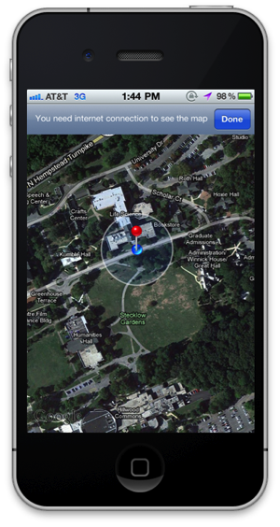
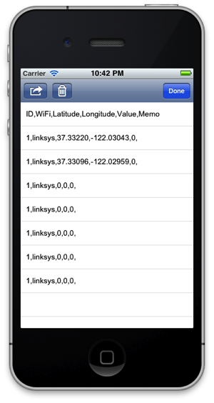
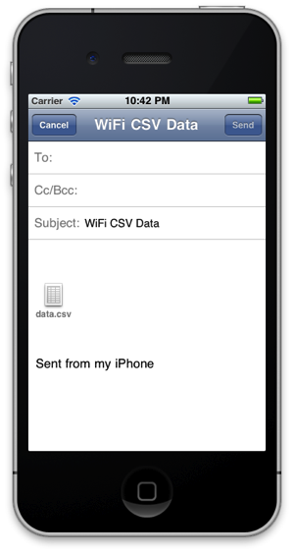
Class Project - Campus Wi-Fi Map
Home Screen
Map
Data
Email
Locate Wi-Fi antennas Pilot project Sampling strategy Wi-Fi strength Recommendations

Slide 22
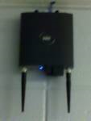
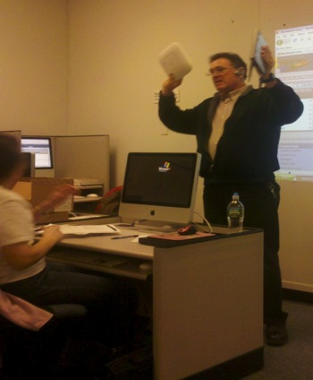
Class Project - Campus Wi-Fi Map
Locate Wi-Fi antennas Pilot project Sampling strategy Wi-Fi strength Recommendations

Slide 23
Class Project - Campus Wi-Fi Map
Locate Wi-Fi antennas Pilot project Sampling strategy Wi-Fi strength Recommendations

Slide 24
Class Project - Campus Wi-Fi Map
Locate Wi-Fi antennas Pilot project Sampling strategy Wi-Fi strength Recommendations

Slide 25
Class Project - Campus Wi-Fi Map
Locate Wi-Fi antennas Pilot project Sampling strategy Wi-Fi strength Recommendations

Slide 26
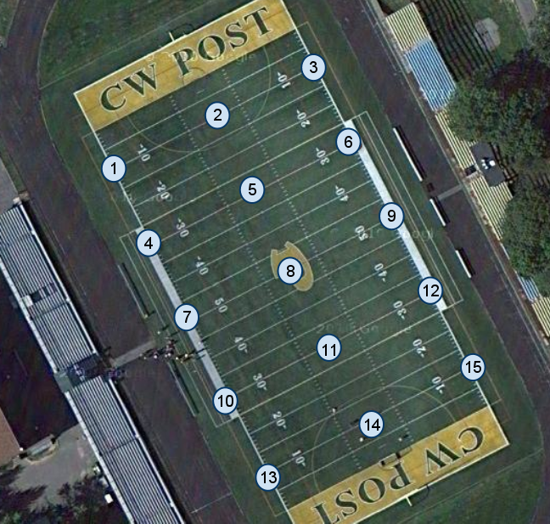
Class Project - Campus Wi-Fi Map
Locate Wi-Fi antennas Pilot project Sampling strategy Wi-Fi strength Recommendations

Slide 27
Class Project - Campus Wi-Fi Map
Locate Wi-Fi antennas Pilot project Sampling strategy Wi-Fi strength Recommendations

Slide 28
Class Project - Campus Wi-Fi Map
Locate Wi-Fi antennas Pilot project Sampling strategy Wi-Fi strength Recommendations

Slide 29
Class Project - Campus Wi-Fi Map
List of stakeholders
Provost
Student body representative
Chief Information Officer
Director of Information Technology, C.W. Post
Associate Vice President, Academic Affairs
Network Associate
Locate Wi-Fi antennas Pilot project Sampling strategy Wi-Fi strength Recommendations

Slide 30
Moving Forward
Blackboard Mobile Central - 2011/12 (ongoing distribution to students and faculty)
Presentifire
Lecture Capture | e-Portfolio | Online Tutoring | Web Conferencing
iPad Showcase at TTI2011 (students and faculty to present)
Naturally-occurring, grass roots collaborations
Research and assessment

Slide 31
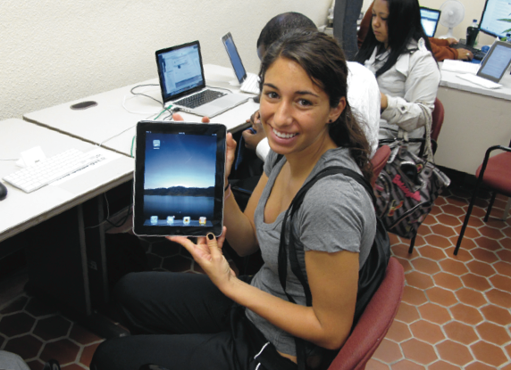
Questions?

Slide 32
Contact us:
[Firstname.Lastname]@LIU.edu
Liz Ciabocchi
Valeda Dent
Patrick Kennelly
Nancy Marksbury
Devabrata Mondal

