Slide 1
HIPAA Demystified: A Simple Approach to Building a HIPAA Compliance Program
Patty Patria, Chief Information Security Administrator
Bentley University

Slide 2

What is HIPAA & why should I care?
HIPAA, aka the Health Insurance Portability and Accountability Act, was first enacted in 2003. It was followed by Security and Privacy Rules in 2004.
The HITECH Act, enacted in 2009, requires any entity that handles protected health information (PHI) to report breaches, whether in paper or electronic form. For colleges and universities with employee health plans or student health centers, this means complying with various aspects of the HIPAA privacy, security, and HITECH rules.
It is very important to make a good faith effort to protect PHI. Civil penalties can be up to $100 for each offense (with a cap of $25,000 per year for multiple offenses), and criminal penalties can be up to $250,000 and/or 10 years in prison for deliberate, wrongful misuse of personal health information.

Slide 3
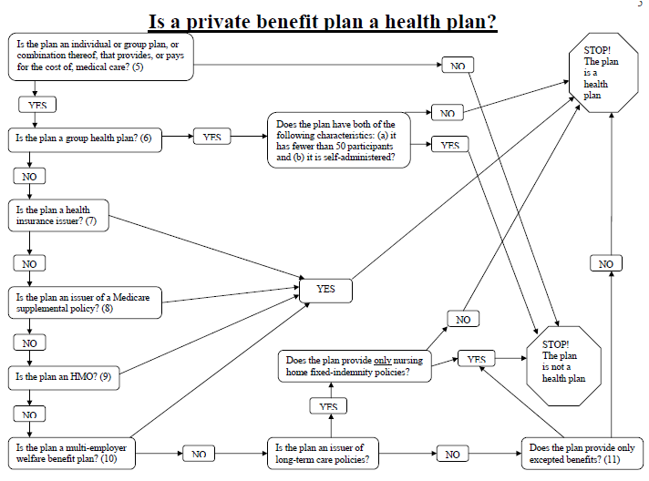
What does that mean for me?
If you have a:
  Employee Sponsored Health plan and more than 50 employees; or
  Section 125 Plan and more than 50 employees (even if fulfilled through a vendor)
  HIPAA applies to you!
Source: https://www.cms.gov/HIPAAGenInfo/Downloads/CoveredEntitycharts.pdf

Slide 4



How did HITECH change the game?
As part of the American Recovery and Reinvestment Act of 2009, legislation called the Health Information Technology for Economic and Clinical Health Care Act (HITECH Act) was also passed.
You are now required to report a breach of PHI if it occurs.
There are additional privacy and security requirements.
Business Associates (anyone external vendors that handle PHI) are also bound by the HIPAA Security and Privacy rules.
For medical institutions, it establishes a timeframe for the use of electronic health records by 2014.

Slide 5


What is a breach? What is unsecured PHI?
“Breach” means unauthorized access, acquisition, use or disclosure of protected health information which compromises the security or privacy of that information.
  If an employee opens mail with PHI, but that employee is not on the designate access list for PHI, is this a breach?
  If a laptop with PHI is lost, but not encrypted, is that a breach? Is it a breach if the laptop is encrypted?
“Unsecured PHI” means PHI that is not secured through use of a technology or methodology identified by the U.S. Department of Health and Human Services (HHS) as rending the informant unusable, unreadable, or indecipherable to unauthorized persons.
  Encryption of data at rest and in transit.
  Scrubbing that uses DOD standards for electronic data when reused, sold or destroyed.
Source: http://www.hhs.gov/ocr/privacy/hipaa/administrative/breachnotificationrule/index.html

Slide 6
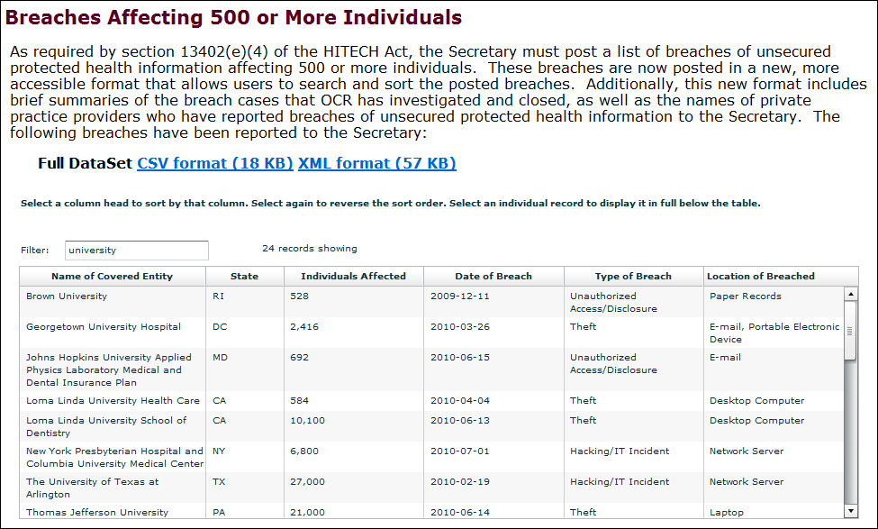
What are the breach notification requirements?
Notification is required to the affected individuals, the government and in some cases, the media in the event of a breach of “Unsecured Protected Health Information.”
Breach requirements are applicable to both “covered entities” and their “business associates.”
If your BA has a breach, you need to report it.
  Breach notification is required within 60 days of finding that a breach occurred.
Source: http://www.hhs.gov/ocr/privacy/hipaa/administrative/breachnotificationrule/breachtool.html

Slide 7
No breach notification is required when:
  The recipient of the information would not reasonably been able to retain the information.
  The breach involved the unintentional acquisition, access or use of information by employees or person’s acting under the authority of a covered entity or business associate.
  Certain inadvertent disclosures among persons similarly authorized to access PHI at a business associate or covered entity.

Slide 8
What happens if my BA has a breach:
Business Associates must notify their covered entity in the event of a breach.
The timing is still only 60 days to report the breach, so make sure you BA notifies you in a timely manner.
Work with your BA to assess what happened, how it happened, who is affected and how to correct it for the future.
You must send the letter to affected parties.
You will be listed on the HHS site if more than 500 individuals (not the BA).

Slide 9

What happens if I don’t comply?
There are stiff penalties for non-compliance, ranging from fines of $100 to $50,000 per violation, capped at $25,000 to $1.5 million per violation of the same standard.
Criminal penalties of 1 to 10 years in jail for gross negligence.
HITECH created new avenues for enforcement, allowing state attorney generals to enforce HIPAA regulations.
CT attorney general brought a suit against Health Net for a breach of data on 1.5 million customers and won the suit.
VT Attorney announced he also settled a lawsuit against Health Net for $55,000.

Slide 10
So, what is PHI?
Names;
All geographic subdivisions smaller than a State, including street address, city, county, precinct, zip code
All elements of dates (except year) for dates directly related to an individual, including birth date, admission date, discharge date, date of death; Telephone numbers;
Fax numbers;
Electronic mail addresses;
Social security numbers;
Medical record numbers;
Health plan beneficiary numbers;
Account numbers;
Certificate/license numbers;
Vehicle identifiers and serial numbers, including license plate numbers;
Device identifiers and serial numbers;
Web Universal Resource Locators (URLs);
Internet Protocol (IP) address numbers;
Biometric identifiers, including finger and voice prints;
Full face photographic images and any comparable images; and
Any other unique identifying number, characteristic, or code, except as permitted by paragraph (c) of this section; and
Source: http://www.hipaa.com/2009/09/hipaa-protected-health-information-what-does-phi-include/

Slide 11
What is a covered transaction?
45 C.F.R.162.1101: Health care claims or equivalent encounter information transaction is either of the following:
  (a) A request to obtain payment, and necessary accompanying information, from a health care provider to a health plan, for health care.
  (b) If there is no direct claim, because the reimbursement contract is based on a mechanism other than charges or reimbursement rates for specific services, the transaction is the transmission of encounter information for the purpose of reporting health care.
45 C.F.R.162.1201: The eligibility for a health plan transaction is the transmission of either of the following:
  (a) An inquiry from a health care provider to a health plan or from one health plan to another health plan, to obtain any of the following information about a benefit plan for an enrollee:
  (1) Eligibility to receive health care under the health plan.
  (2) Coverage of health care under the health plan.
  (3) Benefits associated with the benefit plan. (b) A response from a health plan to a health care provider's (or another health plan's) inquiry described in paragraph (a) of this section.
45 C.F.R.162.1301: The referral certification and authorization transaction is any of the following transmissions:
  (a) A request for the review of health care to obtain an authorization for the health care.
  (b) A request to obtain authorization for referring an individual to another health care provider.
  (c) A response to a request described in paragraph (a) or paragraph (b) of this section.
  45 C.F.R.162.1401: A health care claim status transaction is the transmission of either of the following:
  (a) An inquiry to determine the status of a health care claim.
  (b) A response about the status of a health care claim.
  45 C.F.R.162.1501: The enrollment and disenrollment in a health plan transaction is the transmission of subscriber enrollment information to a health plan to establish or terminate insurance coverage.
45 C.F.R.162.1401: A health care claim status transaction is the transmission of either of the following:
  (a) An inquiry to determine the status of a health care claim.
  (b) A response about the status of a health care claim.
45 C.F.R.162.1501: The enrollment and disenrollment in a health plan transaction is the transmission of subscriber enrollment information to a health plan to establish or terminate insurance coverage.
Source: https://www.cms.gov/HIPAAGenInfo/Downloads/CoveredEntitycharts.pdf

Slide 12
What is a covered transaction?
45 C.F.R.162.1601: The health care payment and remittance advice transaction is the transmission of either of the following for health care:
  (a) The transmission of any of the following from a health plan to a health care provider's financial institution:
  (1) Payment.
  (2) Information about the transfer of funds.
  (3) Payment processing information.
  (b) The transmission of either of the following from a health plan to a health care provider:
  (1) Explanation of benefits.
  (2) Remittance advice.
45 C.F.R.162.1701: The health plan premium payment transaction is the transmission of any of the following from the entity that is arranging for the provision of health care or is providing health care coverage payments for an individual to a health plan:
  (a) Payment.
  (b) Information about the transfer of funds.
  (c) Detailed remittance information about individuals for whom premiums are being paid.
  (d) Payment processing information to transmit health care premium payments including any of the following:
  (1) Payroll deductions.
  (2) Other group premium payments.
  (3) Associated group premium payment information.
45 C.F.R.162.1801: The coordination of benefits transaction is the transmission from any entity to a health plan for the purpose of determining the relative payment responsibilities of the health plan, of either of the following for health care:
  (a) Claims.
  (b) Payment information.
Source: https://www.cms.gov/HIPAAGenInfo/Downloads/CoveredEntitycharts.pdf

Slide 13
Where do I start?
Find out what PHI you process, where it comes from, where it goes and how you store it. Start with HR and your health center/medical facilities.
Build a flow to help others understand where that information resides and have internal or external counsel confirm if your assumptions are correct.
Review Process
Engage Experts
Document Flows

Slide 14
Ask the following questions:
What information do we exchange with our health and dental plans in paper form? Where do we store this information? Is it separate from other employee information?
What information do we exchange with our health and dental plans in electronic form? Where do we store this information?
Who are our Business Associates? Do we have BA agreements on file for each one?
What information do we exchange with our BA’s in paper form? Where do we store this information?
What information do we exchange with our BA’s in electronic form? Where do we store this information?
Do we disclose PHI about individuals? If so, how is it used (other than criminal activity or legal obligation)? Who tracks disclosures and how?
Do we disclose PHI in situations that might require authorization? If so, do we:
  Do we track disclosures of ePHI now (defined as disclosures to third parties for treatment, payment and healthcare operations)? Or do we not disclose information on any of these items? Disclosure could be for law enforcement, judicial, coroner, etc.
  Do we require employees to sign an authorization form to disclose PHI? If so, were do we keep these and then what types of information do we disclose? Do we have a special authorization form for this purpose?
Who has access to the PHI we store in paper form?
Who has access to the PHI we store in electronic form?
Do we share PHI or EPHI with staff outside of HR?
Do we have HIPAA training in place? Who is required to take it?
Do we have Information Security training in place? Who is required to take it?

Slide 15
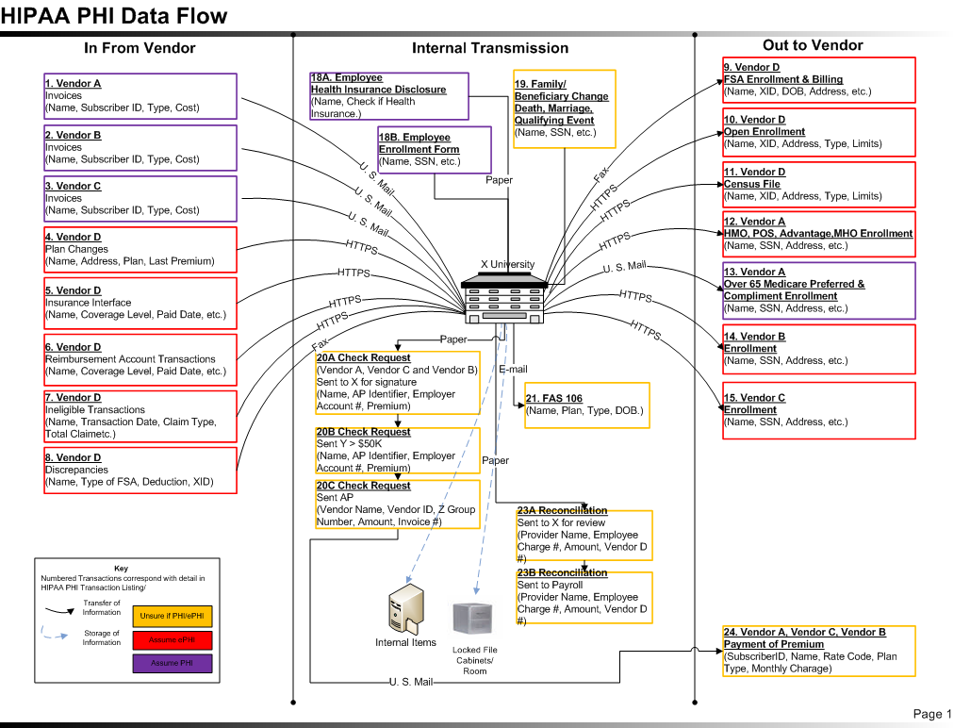
Build a Data Flow

Slide 16
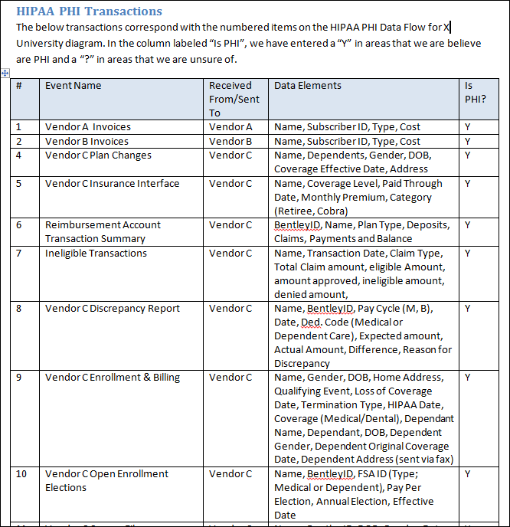
Assessment Results
Create a matrix that corresponds to your diagram. List all data elements collected to see if you can determine if the information is PHI.
Use this this grid and the diagram to review with internal stakeholders and appropriate HIPAA experts.

Slide 17
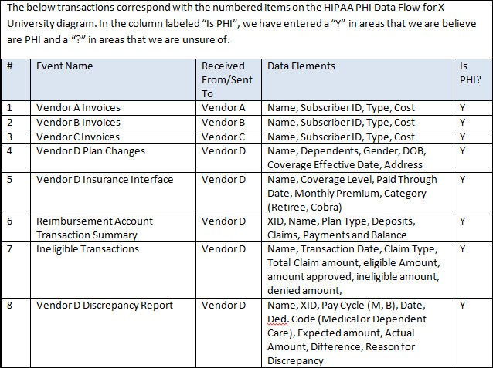
Assessment Results
Create a matrix that corresponds to your diagram. List all data elements collected to see if you can determine if the information is PHI.
Use this this grid and the diagram to review with internal stakeholders and appropriate HIPAA experts.

Slide 18
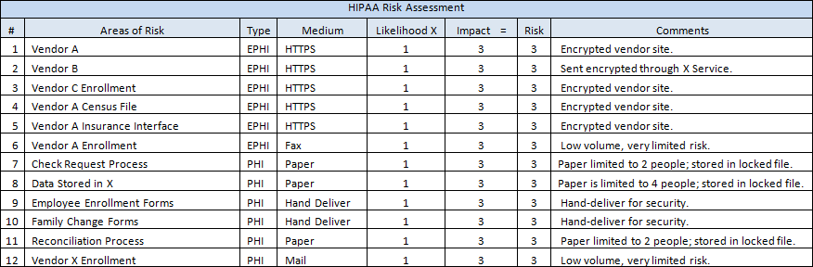
Sample Risk Assessment
Use the items Identified in the Assessment to create a risk matrix
Assign a Likelihood and Impact
Add comments on how to address the risk

Slide 19
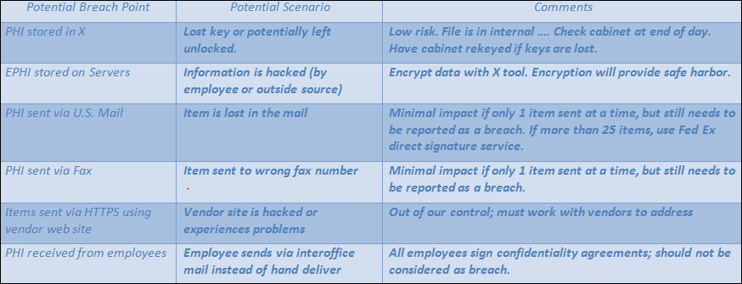
Sample Breach Point Analysis
Use the items from the risk assessment to determine where a breach could occur
Discuss potential breach scenarios and ways to mitigate breach
Understand that it is not possible to mitigate all breaches (i.e. paper lost in the mail).

Slide 20
Additional Items for Consideration:
Leverage the Risk Assessment tools on the EDUCAUSE site prepared by UW-Madison to help you get started. This includes:
  Finding potential risks and vulnerability of electronic PHI
  Implementing security measures to reduce the risk of PHI
Review with General Counsel or an outside broker or outside counsel with HIPAA experience.
HIPAA regulations are very complex; someone other than you should review and ensure information is accurate.
Review National Institute of Standards and Technology (NSIT) “An Introductory Resource Guide for Implementing the Health Insurance Portability and Accountability Act (HIPAA) Security Rule” document for additional details.

Slide 21
After you find your PHI, create policies & procedures:
For the Privacy Rule, update your HIPAA Privacy Policy and post it to the web. Notification is required to appropriate parties every 2 years. Assign a security official who is responsible for development of policies and procedures.
For the Security Rule,
  Update or create HIPAA Procedure documents for anyone handling PHI.
  Ensure that all employees that handle PHI participate in HIPAA training on a yearly basis.
  Create or update your breach response plan.
  Update your Business Associate Agreements if necessary. Ensure that if the BA experiences a breach, that the BA pays the cost of the breach.

Slide 22
The Security Rule: Required vs. Addressable
A “required” implementation specification is similar to a standard. A covered entity (you) must comply with it.
For “addressable” items, you must perform an assessment to determine if it is a reasonable and appropriate safeguard.
For addressable items, you must document the assessments and all decisions.
All EPHI created, received, maintained or transmitted by a covered entity is subject to the Security Rule.
Source: http://csrc.nist.gov/publications/nistpubs/800-66-Rev1/SP-800-66-Revision1.pdf

Slide 23
Procedures: Address the Administrative for ePHI:
Risk Analysis
Risk Management
  PHI in paper form must be stored in a separate, locked area. The information can not be intermingled with employee files.
Sanction Policy
Information System Activity Review
Assign Security Responsibility
Address Workforce Security (Authorization, Access, Clearance & Termination)
Access Authorization, Establishment & Modification
Security Awareness Training
Security Incident Procedures
Contingency Planning

Slide 24
Procedures: Address the Physical for (ePHI):
Workstation Use and Security
Device and Media Controls Disposal and Reuse
  When destroying PHI (paper, film or other hard copy media), use a cross-cut shredder or shredding service that renders the information unreadable.
Data backup and storage

Slide 25
Procedures: Address the Technical for ePHI:
Unique User Identification
Emergency Access Procedures
Automatic Logoff
  Encryption and Decryption
    For encryption of data at rest, review NIST Special Publication 800-111.
    For encryption of data in transit, review Federal Information Processing Standards (FIPS) 140-2
    When scrubbing electronic media for reuse or sale, ensure it is cleared, purged or destroyed consistent with NIST Special Publication 800-88, guidelines for Media Sanitation.
  Audit Controls & Integrity
  Person or Entity Authentication

Slide 26
Sample Procedure Document
Break out the Administrative, Technical and Physical categories
Note if the item is required or addressable
Put in the reference that the item pertains to

Slide 27
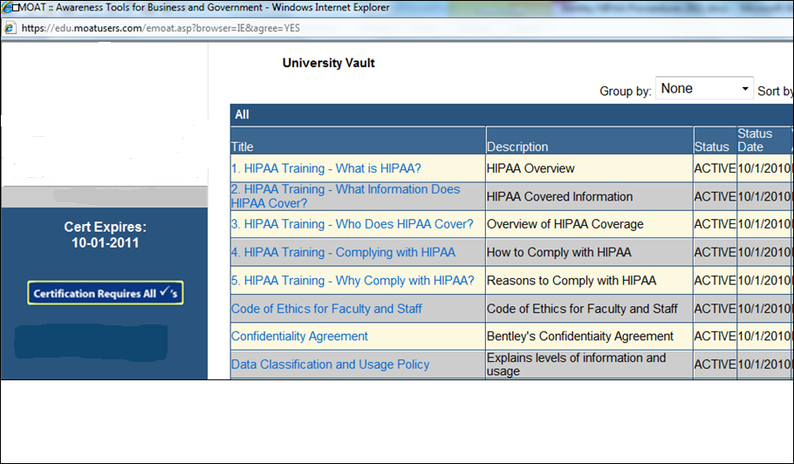
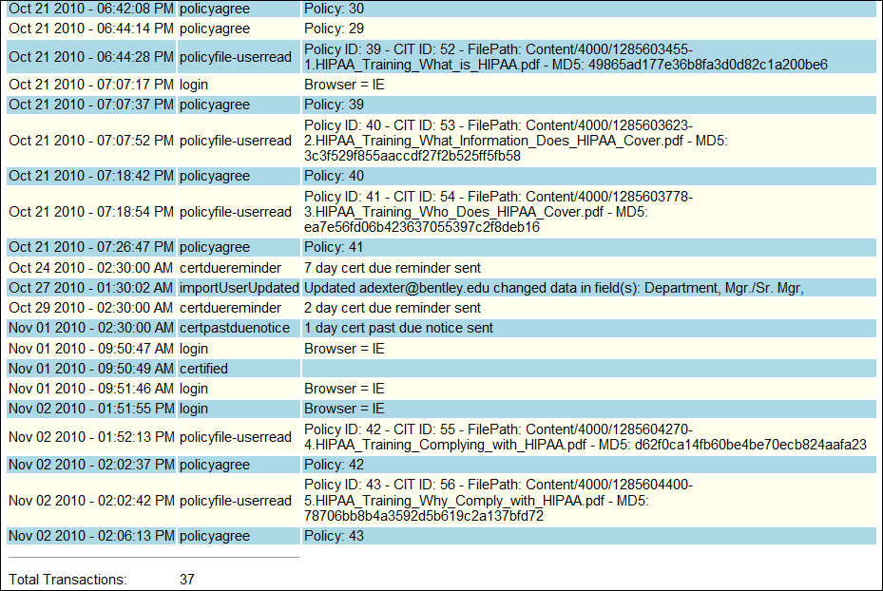
Training

Slide 28
Breach/Incident Response Plan
Excellent source for an Incident Response Plan is NIST Guide NIST SP 800-61. It can be found at: http://csrc.nist.gov/publications/nistpubs/800-61-rev1/SP800-61rev1.pdf
Make sure your existing response plan includes updates for HIPAA provisions. These include:

Slide 29
Breach Investigation
Breach Investigation: The organization shall name an individual to act as the investigator of the breach (e.g., privacy officer, security officer, risk manager, etc.). The investigator shall be responsible for the management of the breach investigation, completion of a risk assessment, and coordinating with others in the organization as appropriate. The investigator shall be the key facilitator for all breach notification processes to the appropriate entities (e.g., HHS, media, law enforcement officials, etc.).

Slide 30
Risk Assessment
To determine if an impermissible use or disclosure of PHI constitutes a breach, the organization will need to perform a risk assessment to determine if there is significant risk of harm to the individual. The risk assessment shall be fact specific and shall address:
  Consideration of who impermissibly used or to whom the information was impermissibly disclosed.
  The type and amount of PHI involved.
  The potential for significant risk of financial, reputational, or other harm.

Slide 31
If you have a breach:
Provide notice to the affected individual and the HHS if more than 500 affected individuals.
For notice to the HHS, it can be immediate, or at the end of the calendar year if less than 500 affected individuals.
Notice should contain:
  A brief description of what happened, including dates.
  A description of the types of unsecured PHI involved.
  Steps the individual should take to protect against potential harm.
  A brief description of the steps that you or your BA took to investigate the incident and mitigate harm and protect from future breaches.
  Contact Information.
***Federal breach laws supersede contrary state breach laws, but you must ensure that you are simultaneously complying with state notification requirements.***

Slide 32
Notice to Individuals
Generally, written notice should be made via first class mail.
  If there is insufficient contact information for 10 or fewer individuals, substitute notice via e-mail or telephone is allowed.
  If there is insufficient contact information for 10 or more individuals, substitute notice via a conspicuous posting on your web site, major print or major broadcast notice is allowed.
For breaches involving more than 500 individuals, notice to the HHS must be made at the same time. If less than 500 individuals, notice to the HHS can be provided at the end of the year.
Sample breach notification letter at http://www.ahcancal.org/facility_operations/hipaa/Documents/Sample%20Notification%20Letter%20for%20Affected%20Party.pdf.

Slide 33
Questions?
Contact Patty Patria at ppatria@bentley.edu
for more details.

