Slide 1
Electronic Transcripts: The Future is Now
Mar 13th, 2012
11:30 AM - 12:20 PM
Room 554
Matthew Burfeind
Senior Business Analyst
Massachusetts Institute of Technology
burfeind@mit.edu
1
Notes:
Welcome and Introduction

Slide 2
Why Are We Here?
What are electronic transcripts, and why should I care?
How did MIT implement electronic transcripts?
How can I implement electronic transcripts?
Notes:
I hope you’ll leave today’s session with answers to the following questions…
What are electronic transcripts, and why should I care?
What decisions did MIT make in implementing electronic transcripts?
What factored into MIT’s decisions?
What can I learn from that?

Slide 3
What are Electronic Transcripts?
Transcripts, but electronic!
Two paths
Incoming
Outgoing
Two formats
Data
Document
We’re focusing on #2
Notes:
Two Paths in Higher Education
Incoming = Secondary to Postsecondary
Large number of organizations/consortia to manage transfer of electronic transcripts, often managed at the state level
Outgoing = Postsecondary to Employers or Postsecondary to other Postsecondary
This is where we needed to meet a demand
Formats
Data = transcript data sent in electronic format
SPEEDE (Standardization of Postsecondary Education Electronic Data Exchange)
Task force of AACRAO (American Association of Collegiate Registrars and Admissions Officers)
EDI/EDX – Electronic Date Interchange/Exchange
PESC (Postsecondary Electronic Standards Council)
XML
Documents = transcript document reproduced in electronic format
Often an exact reproduction of print version
But sometimes format is modified
We’re focused on outgoing documents, but left options open for XML delivery in the future

Slide 4
Why Now?
MIT not always an early adopter, despite reputation
Look for:
Proven technologies
Critical mass
Protection against misuse of student records
Gain efficiencies
Improve customer service
Notes:
Why did MIT implement them now?
MIT is not always on cutting edge with administrative and student systems
Have needed critical mass of schools and employers demanding electronic transcripts, or even accepting them.
At MIT, we’ve found that critical mass has been reached, based on demands from students
Increasing reports of students scanning unofficial transcripts or grade reports
At best, inappropriate
At worst, fraud
To gain efficiencies
Labor
Supplies
Not to cut personnel, but to provide better service

Slide 5
MIT Before Electronic Transcripts
Processed ~22,000 official transcripts annually
Paper process
Mail, email, in-person
Separate payment processing
Up to three business days to process
Mixture of on-demand (from SIS) and microfilm
Two offices (Registrar and Student Services Center)
Unofficial transcripts for current students, in-person only
Notes:
Around 22,000 official transcripts processed annually
Paper-based process
PDF could be printed, mailed, emailed, delivered in-person
Or bypassed and request made via email
Separate payment processing system for credit cards, required submission of receipt
Or check, money order, charged to student account
70-80% of current students charge to account, and current students are half of all transcript requests
Up to three business days to process, prior to mailing, although usually faster than that.
Mixture of on-demand (generated from SIS) and microfilm
Two offices providing transcripts
Registrar’s Office serving alumni
Student Services Center (part of SFS)
Unofficial transcripts for current students, in person only

Slide 6
MIT After Electronic Transcripts
Between 10/13/11 and 3/12/12
~9800 transcripts requested
35% electronic, 65% paper
All transcript orders managed online
Most eTranscripts processed and delivered in minutes
Certain categories up to one business day
Most paper transcripts processed in 1-2 business days
Manual intervention is limited
Notes:
Between 10/13/11 and 3/12/12
~9800 official transcripts requested
35% electronic, 65% paper
All official transcript orders managed online
Anyone who can do self-service is asked to do so
Even walk-ups are entered into system
Speed to delivery
Stated time to delivery for most eTranscripts is 30 minutes
Delivered means available to be downloaded
Certain categories up to one business day
Most paper transcripts processed in 1-2 business days
Manual intervention is limited
If no holds, most orders go straight to printer or out for electronic delivery

Slide 7
What Did We Do?
Original Project:
Transcript Imaging
Web-based ordering system
Repository/Archiving SIS transcripts (not done)
Later additions:
Electronic delivery (vendor solution)
Custom application/System integration
Notes:
Original project had three components, beginning in early 2008:
Transcript Imaging – convert legacy transcripts from microfilm to PDF.
Microfilm was cumbersome and hard to support
Web-based ordering system, allow students and former students to place and track requests online
Many have this ability through their SIS, but MIT did not
Building data repository and archiving transcripts from SIS on PDF
Ended up not needing this
Later addition:
Secure electronic delivery of PDFs
Vendor solution, why reinvent the wheel
System integration
Custom application to tie vendor’s system to ours
Replace legacy transcript components of SIS

Slide 8
What Was Our Process?
Analysis
Imaging Analysis
Functional Requirements
Vendor Evaluation
Recommendation
Functional and Technical Specifications
Implementation
Vendor solution and custom development
QA Testing
Notes:
Imaging analysis and implementation were separate and earlier
Analysis
Functional requirements
Vendor analysis
Recommendation to project sponsors (Registrar and IS&T)
Signed contract with vendor
Specifications
User scenarios
Functional specifications
Authentication
System Processing
Special cases
Pre-1994 Transcripts
CME (Cambridge/MIT Exchange) Processing
Grade and Degree Holds
Implementation
Vendor solution
Custom development
Integration
Quality Assurance/Testing

Slide 9
Transcript Imaging
Analysis done in Spring 2009
Outsourced implementation in Spring 2010
Scope
1950-1994
156 reels of microfilm
113,000 transcripts
Resolution
First implemented as standalone system
Later integrated with new application
Notes:
The imaging project was conceived before the electronic transcript project.
Intended to improve process and remove risk from outdated equipment
Analysis done in Spring 2009
In combination with analysis for admissions
Registrar needed one-time scanning of legacy documents, not ongoing work
Actual imaging completed in Spring 2010
Outsourced completely
Microfilm mailed to vendor, who returned data on a hard drive
PDFs, with student name and year
Simple file structure
Scope
~113,000 transcripts
1950-1994 (pre-SIS)
156 reels of microfilm
Resolution
First implemented as a secure, isolated system
Direct connection to printer, not on network
Later moved onto file server and integrated with new application (ETP)

Slide 10
Imaging - Issues and Challenges
Format changes
Grading keys
Magnification ratio
Organization
Superseded documents
Post-implementation cleanup
Notes:
Format changes
Grading keys
Pre-1960 included on reel
Magnification ratio
12-to-1, 17-to-1 or 20-to-1
Organization
Some rolls in reverse order
Superseded documents
Some documents with hole punched, not to be scanned
Registrar had to find updated paper document and send separately to be scanned
Post-implementation cleanup
Typos
Matching to SIS
Comments/markings on image files
Registrar staff spent much time on this

Slide 11
What Were Our Project Goals?
Ordering and tracking for all official transcripts
Payment processing
Replacement of legacy transcript components in SIS
Automation for all users, if possible
Electronic delivery for all transcripts, if possible
Best experience for all users
Notes:
Web-based ordering and tracking for all official transcripts
But not delivery of print transcripts
Payment processing
Credit cards
In-person payments
Charge to student accounts (70-80% of current students use this)
Replacement of legacy transcript components
Old Banner system, Oracle Forms
Meant bringing unofficial transcripts in scope
Automation for both current and former students
Electronic delivery as an option for all transcripts, if possible
Current transcripts from SIS
Pre-1994 transcripts from image archive
Best experience for all users

Slide 12
How Did We Evaluate Vendors?
Five vendors
Criteria
Security
Flexibility/Customization
Peer recommendations
Cost
Recommendation
Avow Systems
Notes:
Five vendors
Avow
Docufide
National Student Clearinghouse
National Transcript Center
SCRIP-SAFE
Significant differences in vendors, pros and cons for each
Docufide was already being used by our Admissions office to receive transcripts
We use other NSC services
Briefly considered homegrown solution, but why reinvent the wheel?
Security
Document security
Document delivery method
How long vendor keeps documents and data
Flexibility and customization
Look and feel/branding, for pages and emails
SSN and other PII
Integration/automation
Peer recommendations
Cost
Transaction and/or document fees
Installation and/or maintenance fees
To MIT and/or students
Structured Process
No RFP
But ranked vendors against requirements
Final Recommendation
Ultimately chose Avow, best met needs of MIT

Slide 13
What Did We Get From the Vendor?
Document Ordering
PDF Generation
Document Certification
Document Rights Management
Document Delivery
Notes:
Document Ordering
PDF Generation
We could send data or document and have them produce a PDF for us
We chose to do this ourselves
Produce complete document, with cover letter and legend, and transmit to Avow
Document Certification
Document Rights Management
Document Delivery

Slide 14
Document Ordering
Hosted
Payment processing
Order tracking and history
Orders and documents
All transcript requests go through system
Analytics
Notes:
Hosted
Payment processing
Credit card and charge to student account
We can also note or waive payment for a walk-up order
Order tracking and history
Requestor can track status changes in the order
Or at individual document level
All transcript requests go through system
Provides basic analytics
Electronic vs Paper
Top destinations
Orders by time period (day, months, etc)

Slide 15
Document Security
Certification
Provides digital signature to document
Certifies that document is from MIT and is unchanged
Rights Management
Allows us to set rules for document usage
Adobe LiveCycle
Vendor relationships with Adobe and GeoTrust
Notes:
Certification
Provides digital signature to document
Certifies that document is from MIT
Certifies that document is unchanged
Blue ribbon displays on document
Rights Management
Allows us to set rules for document usage
Number of times it can be opened
Period of time it can be opened
Documents can be revoked
Have to balance convenience with security
Uses the Adobe LiveCycle product line
Vendor relationships were strong with both Adobe and GeoTrust

Slide 16
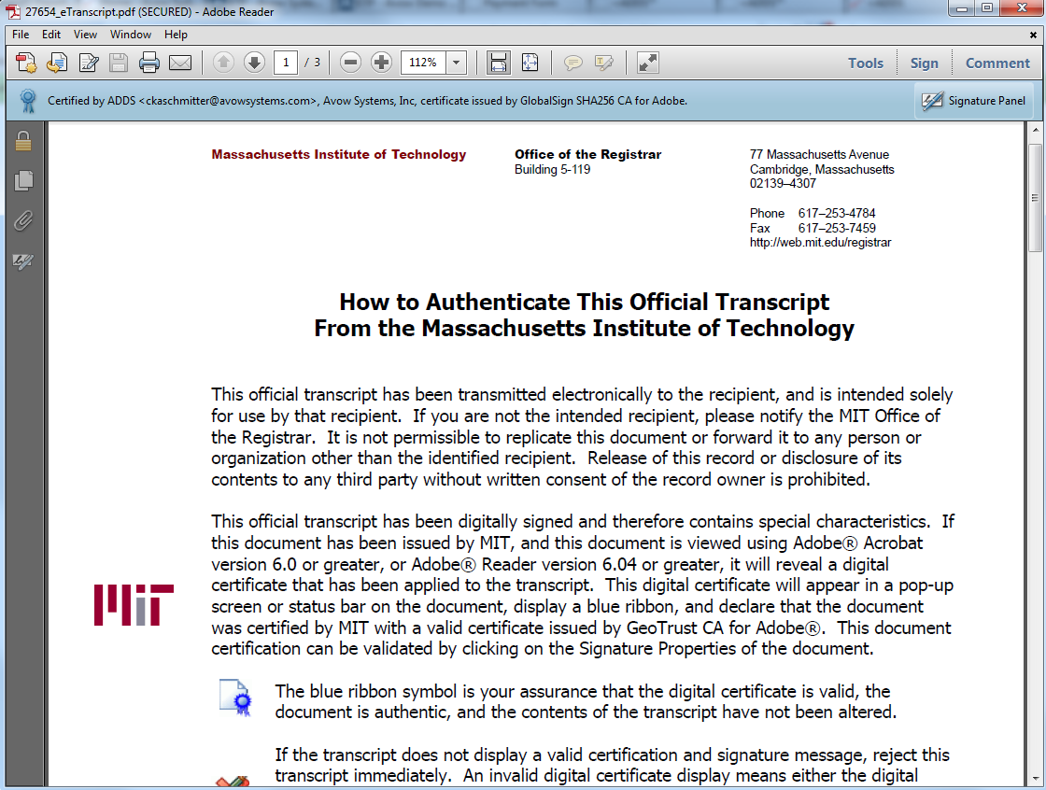
Certified Document

Slide 17
Document Delivery
Two emails sent to recipient
Notification and link to request passcode
Passcode provides link to download document
Document download expires in 30 days
Can be reset at any time by MIT
Notes:
Documents stored on Avow servers, never emailed
Vendor handles notifications on MIT’s behalf
Two emails sent to recipient
Notification and link to request passcode
Passcode provides link to download document
Document download expires in 30 days
Can be reset at any time by MIT

Slide 18
Implementation Options
Out of the box
Users place requests
Requests reviewed and processed
Uploaded and/or updated in vendor console
Next level
Authentication
Goals
Full automation wherever possible
Change user experience once
Notes:
Out of the box solution
We direct users to the vendor’s site
Users create accounts
Submit transcript request, FERPA consent, and payment
We review requests in vendor console
Print and mail transcripts
Upload electronic transcripts
Update requests in console
Student tracks requests and/or document
Solution could have been available in weeks
Next level of service
Authenticate students through our portal
Pre-populate some information
No need for FERPA consent with each request (consent implied)
Final level of service
Fully automate process wherever possible
Authenticate for all user classes (students and alumni)
Change user experience once, i.e. don’t introduce a service then change it later

Slide 19
Vendor Setup
Basic setup
Look and feel
Language
Self-registration settings
Customizations
Authentication
Charge to Student Account
Current vs former students
Notes:
Basic setup on vendor’s site
Look and feel
Logo, branding
Language
Pages, transcript descriptions, emails
Self-registration settings
Required fields
Customizations
Authentication
Charge to Student Account
Current vs former students (for our separate fulfillment sites)

Slide 20
Authentication
SSO access for current students
Certificate or username/password
Username/password for Alumni
Self-registration
Additional checks for authenticated users
Charge to student account
Disciplinary hold
Authentication only valid if we can send an MIT ID
Notes:
Three entry points
SSO access for current students
Username/password for Alumni
Check against Infinite Connection
Self-registration
Additional checks
Charge to student account
Disciplinary hold
Authentication only valid if we can send an MIT ID
Not an issue for current students
Maybe an issue for former students

Slide 21
System Processing
Use web services to receive/send requests
Authentication of self-registrations
Process for holds, payment, etc.
If electronic, generate transcript and send
Automatic printing to correct location
Notes:
System Processing/Automation
Bulk of our development effort
Use web services to receive/send requests
Initial authentication
Receiving orders
Sending documents and/or updates
Authentication of self-registrations
If student enters birthdate and MIT ID, we try to match it
If matched, user becomes authenticated and can be automated
Process for holds, payment, etc.
Disciplinary holds, if not caught in initial authentication
Grade holds
Degree holds
If electronic, generate transcript and send
Automatic printing to correct location
Based on current student status, document prints at Registrar or SSC

Slide 22
Manual Processing
Data lookup and/or correction
Pre-1994 transcripts
CME transcripts
Packaging/Mailing
updating request in console
Notes:
Data lookup and/or correction
Self-registrations
ID issues
Pre-1994 transcripts
Locate in image archive
Associate document with request
Once associated, future requests will be automated
CME transcript retrieval
If electronic, upload supplemental document to order
If print, produce document and package it with official transcript
Packaging and mailing
Updating in console to indicate completion

Slide 23
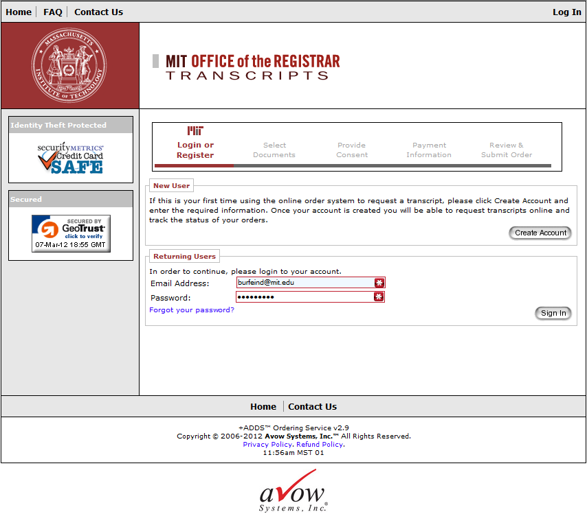
Avow Login

Slide 24
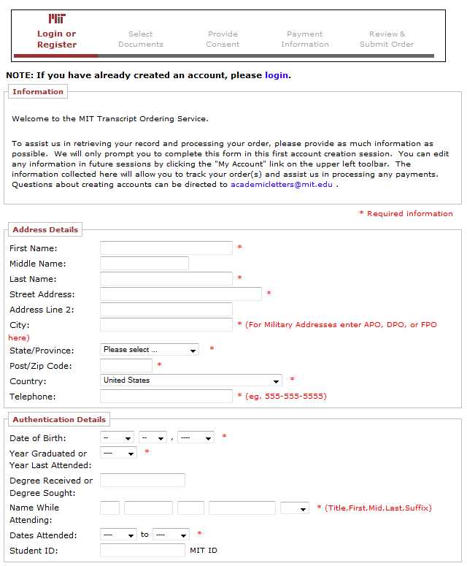
Avow Account Creation

Slide 25
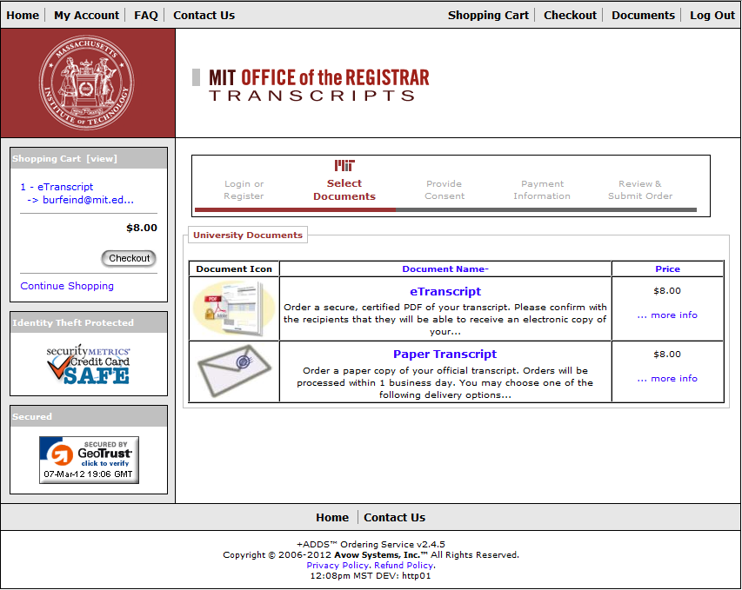
Select Document

Slide 26
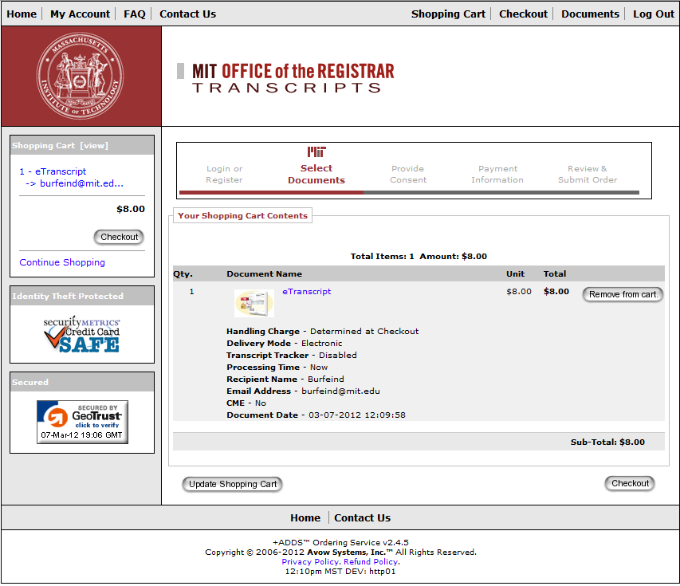
Shopping Cart

Slide 27
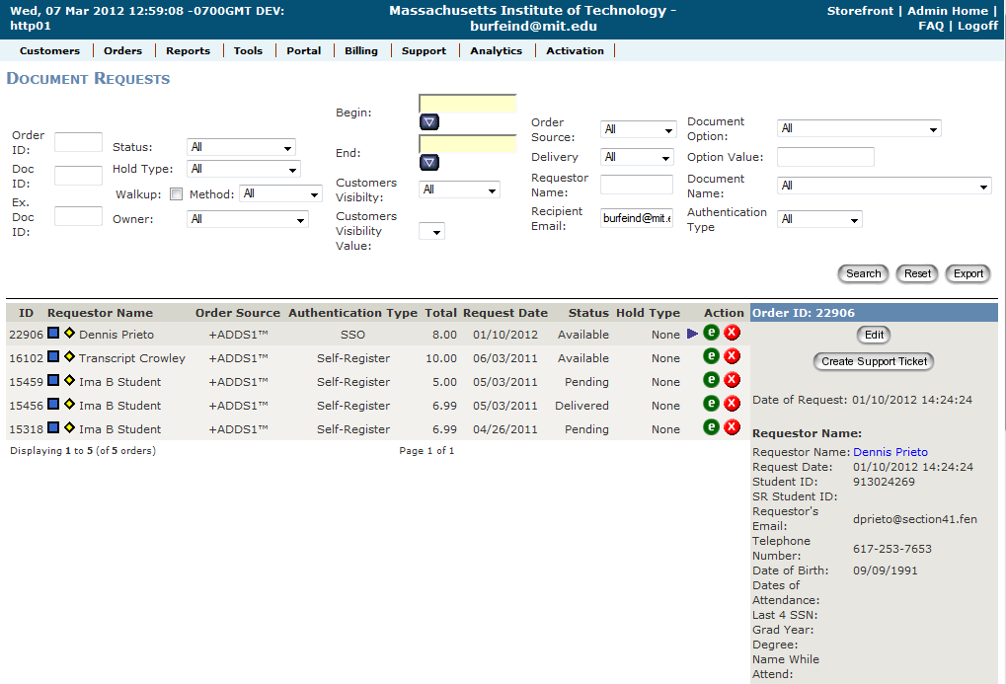
Avow Console

Slide 28
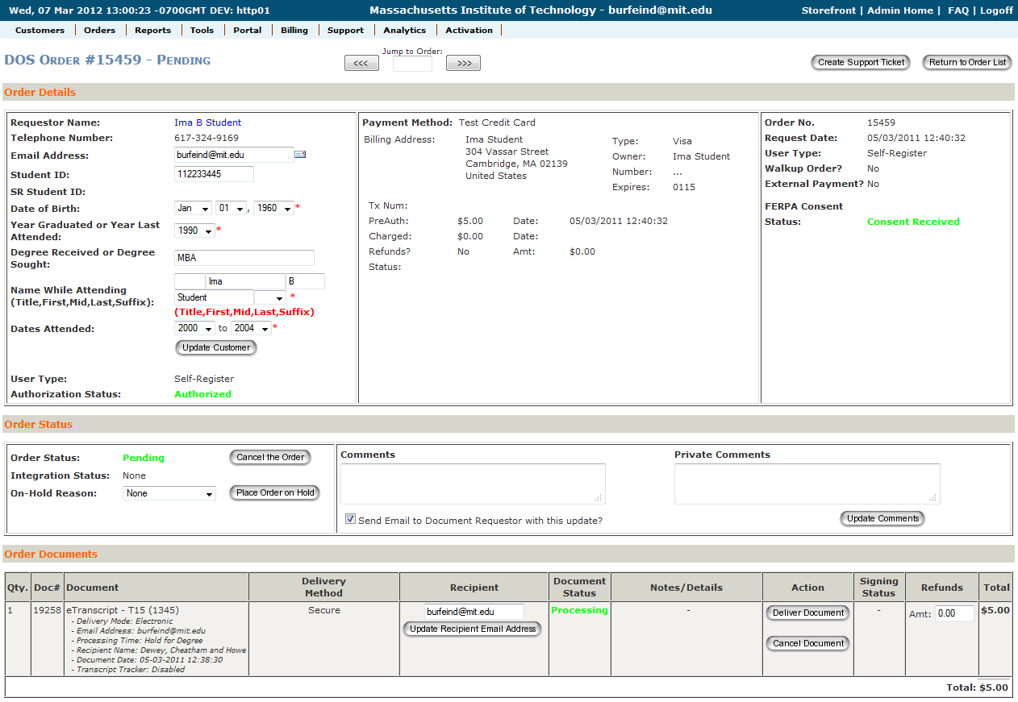
Avow Order Details

Slide 29
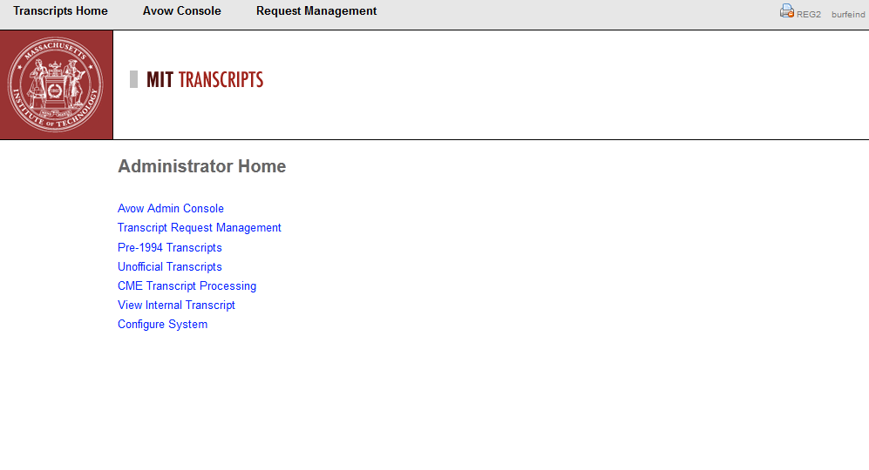
ETP Home

Slide 30
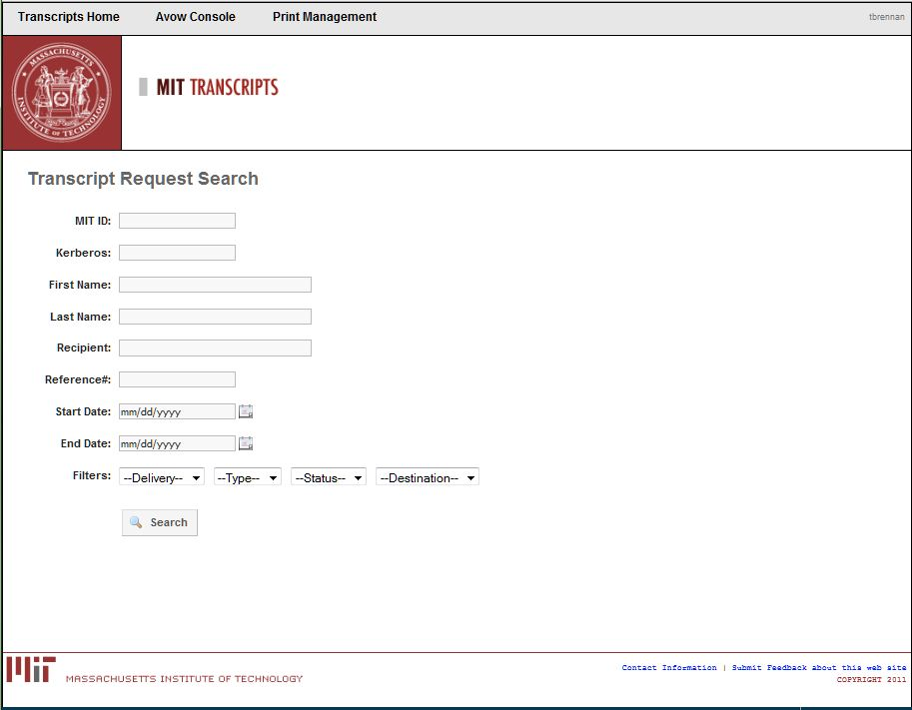
ETP Transcript Request Search

Slide 31
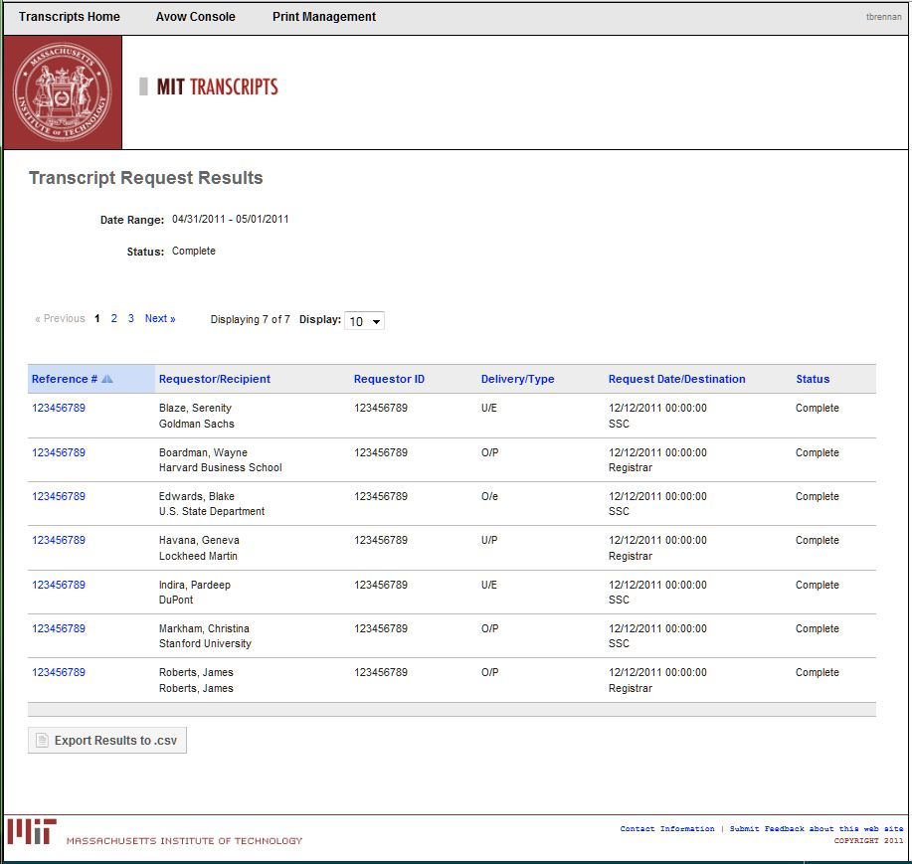
ETP Search Results

Slide 32
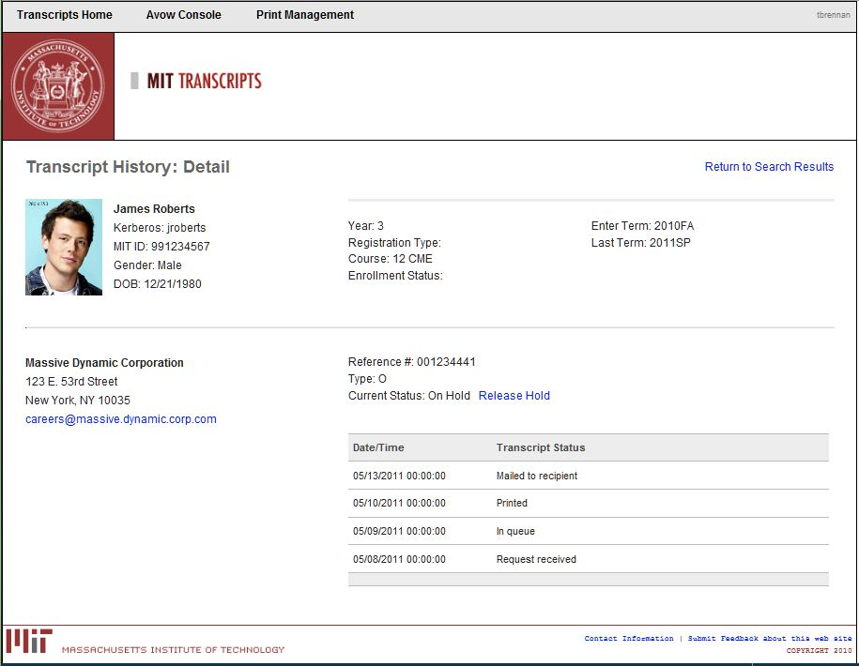
ETP Request Details

Slide 33
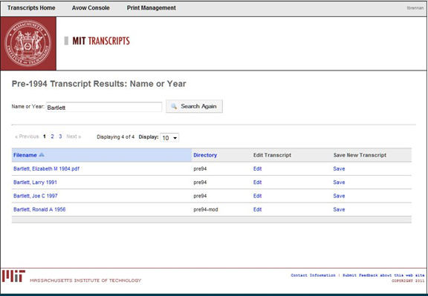
Pre-1994 Transcript Search
Notes:
Pre-1994 transcripts are held in process
Can be found through the main transcript search or through this interface
Interface can also be used to manage image archive

Slide 34
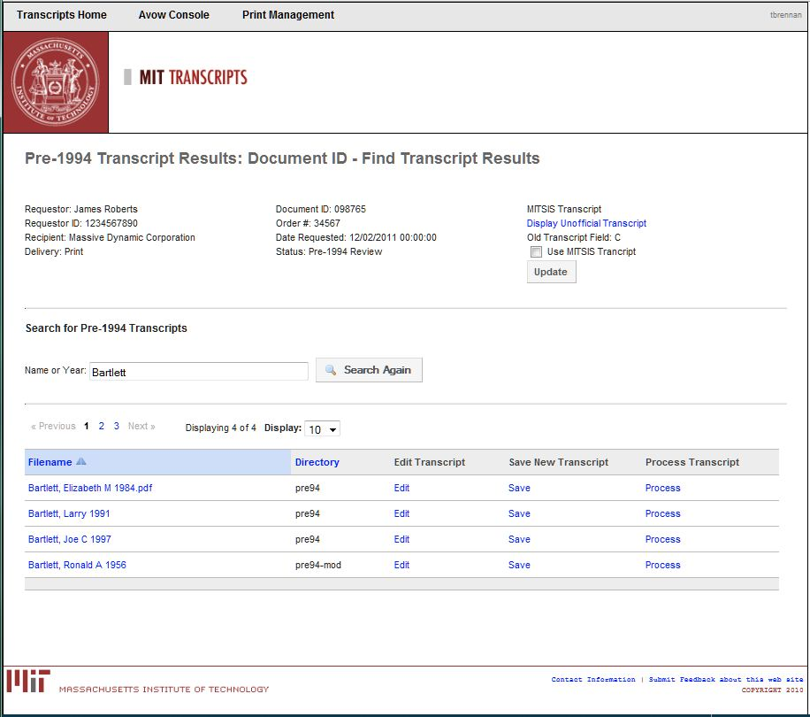
Pre-1994 Transcript Details

Slide 35
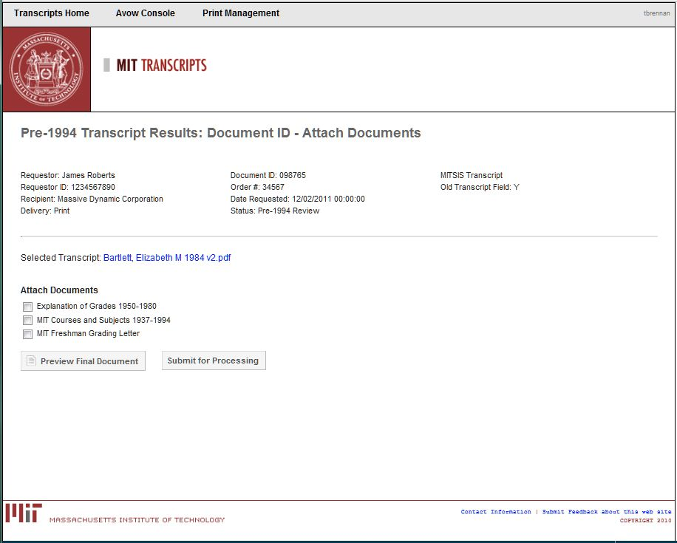
Pre-1994 Transcripts Process

Slide 36
Lessons Learned
Collaboration
Registrar and IS&T
Communication
Have answers ready
Customer Service
All about meeting customer demand
Services can be implemented fairly easily
Notes:
Collaboration between IS&T and Registrar was key
Registrar was decision maker, but IS&T had strong input
Communication
Didn’t do mass marketing of effort
But important to be prepared
Customer Service
Project is all about meeting customer demand
Much of our work was done to speed process and improve workflow
Don’t have to implement all the bells and whistles
Service can be implemented fairly easily with good benefit to users

Slide 37
Resources
PESC Transcript Standards
http://www.pesc.org/interior.php?page_id=183
SPEEDE
http://www.aacrao.org/About-AACRAO/committees/speede.aspx
Educause
http://www.educause.edu/
MIT
http://web.mit.edu/registrar/records/transcripts/official.html

Slide 38
Vendors
Avow
http://www.avowsystems.com/
Docufide (now part of Parchment platform)
http://www.docufide.com/
National Student Clearinghouse
http://www.studentclearinghouse.org/colleges/exchange/default.htm
Pearson's National Transcript Center( NTC)
http://pearsondatasolutions.com/transcripts/general-info
SCRIP-SAFE
http://www.scrip-safe.com/

Slide 39
Questions?

