Slide 1

IT Resource Allocation – Before & After implementing a PPM system
Deb Timmons
Jackie Snow
Paul DeMello
March 2012
NERCOMP 2012

Slide 2
Presentation Outline
  Copyright Deb Timmons, 2012. This work is the intellectual property of the author. Permission is granted for this material to be shared for non-commercial, educational purposes, provided that this copyright statement appears on the reproduced materials and notice is given that the copying is by permission of the author. To disseminate otherwise or to republish requires written permission from the author

Slide 3

Presentation Outline
Background/opportunity
Session objectives
Definition of key terms
The UNH evolution – 4 phases
Summary/recommendations
    Challenges
    Successes
    Lessons learned
Q & A

Slide 4

Background/opportunity
The UNH IT department has faced challenges in servicing a wide range of project requests while balancing operational demands. Faced with regulatory changes, state funding cuts, new system implementations, unfunded mandates, rapidly evolving technologies, and ever-changing business needs, UNH IT needed to demonstrate alignment of IT resources with strategic institutional objectives. As one key strategy to address that charge, UNH implemented a methodology to understand and quantify current operational demands on and predict future availability of its IT workforce.

Slide 5


Definition of key terms
Resource allocation
  The process of dividing up and distributing available, limited resources to competing, alternative uses that satisfy unlimited wants and needs.
  [source: econguru.com]
PPM system (Project & Portfolio Management system)
  A methodology which automates and centralizes the collection of data about demand, costs, schedules and resources for investment prioritization, as well as the execution of the programs and projects delivering new technologies and other IT assets to the business.
  [source: Gartner]

Slide 6
Session objective
Understand…
the benefits of building a culture of IT time accountability and a predictive resource allocation methodology
  the basic steps
  potential pitfalls
  and the must-do’s
  in building that culture and methodology
how a Project & Portfolio (PPM) management system can help

Slide 7
Why does it matter?
Increasing pressure to demonstrate IT’s value to the institution
  Demonstrate to campus leadership that our resources are focused on those projects and initiatives that are most critical to institutional strategic goals (data backed!)
Staff salaries constitute around 50% of the IT budget
Desire to identify competing priority situations before they become painful
  Objectively identify options to address competing priority situations
Notes:
Bring in the Audience
Why are they pursuing a PM Culture?
What kind of challenges are they facing?
What is motivating the need?

Slide 8
Why does it matter?
Solid Resource management is required in order to mature toward systematic prioritization
  Understand effort required to run IT’s support, operation and maintenance activities (data backed!)
  Understand IT capacity available to support future business initiatives (data backed!)
Notes:
Bring in the Audience
Why are they pursuing a PM Culture?
What kind of challenges are they facing?
What is motivating the need?

Slide 9
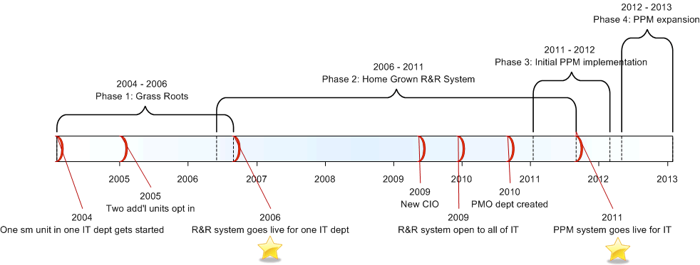
The UNH evolution – 4 phases

Slide 10
The UNH evolution – background
UNH IT organization
Associate Vice President
Chief Information Officer
Sr. Admin Asst.
Information Technology
Security
Academic Technology
Finance & Planning
Enterprise Computing
Client Services
Strategic Technology
Academic Computing
Business Service Center
System Administration
Database Administration
Data Center
IT Communications and
Training
Web Solutions
Computer Store
UNH Enterprise
Applications
IT Service Desk
Cyberinfrastructure
Instructional Dev Center
Documentation & Training
Media & Collaboration
USNH Enterprise
Applications
IT Accounts & Remedy
Administration
Portal Admin & Dev
Management Reporting
Program Office
Process Redesign
Computer Repair Services
Desktop Support &
Service Level Agreements
IT Support Center
Audio Visual Services
Telecommunication
Operations
Enterprise Collaboration
& Messaging
Network Engineering

Slide 11
The UNH evolution – Phase 1
Grass Roots
2004: one small IT unit began recording time spent in an existing status report template
Template already included major categories of work, completion and schedule status
Administrative assistant compiled summaries
Motivations
    Not able to identify why staff had to postpone project work
    Not able to determine total effort of a specific project
    No solid history on which to base new work estimates
    No baseline effort data for routine work

Slide 12

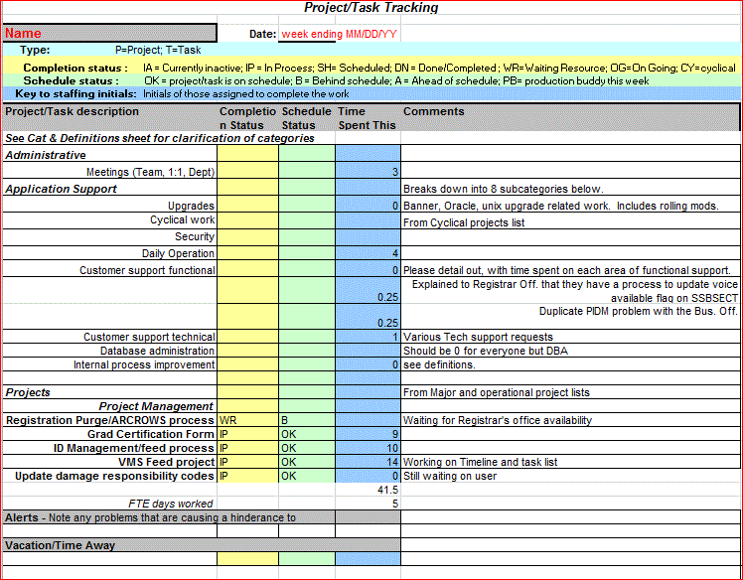
The UNH evolution – Phase 1
2004-2006 Time Tracking

Slide 13

The UNH evolution – Phase 1
Grass Roots
2005: benefits seen from time tracking
  previously unanswerable questions could now be answered
  baseline effort data for routine work established
  Staff see benefits (big win)!
Two additional IT units within the same department opt-in
  Culture of time accountability nearly department-wide
Forward looking resource allocation spreadsheets (quarterly) created

Slide 14
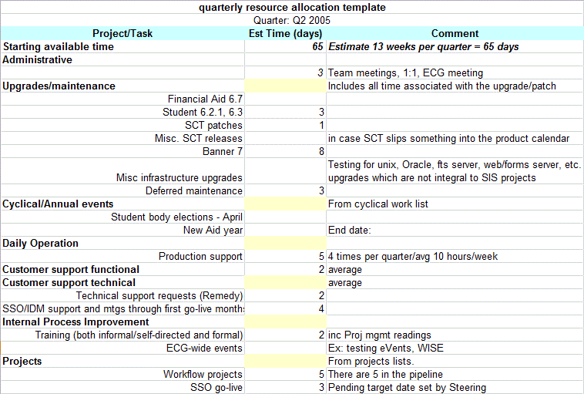
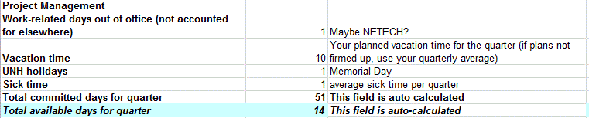
The UNH evolution – Phase 1
Grass Roots

Slide 15
The UNH evolution – Phase 1
Grass Roots
Despite benefits realized, tool limitations lingered
Limited, manual reporting – labor intensive, error prone!
Lack of data dimensionality
Volume of files in various locations – hard to manage and risk of data loss
Tweaks to the templates were difficult to provision

Slide 16
The UNH evolution – Phase 2
Home-grown request/resource system
2006: implemented a request and resource tracking system, called R&R.
Home-grown, developed in Oracle Application Express:
    Request tracking and reporting of requested, in process, completed and cancelled projects.
    Resource hours; Actual vs Plan.
    Track employee hours per project and type of work within project/effort.
    Provide the ability to query and produce standard reports.

Slide 17
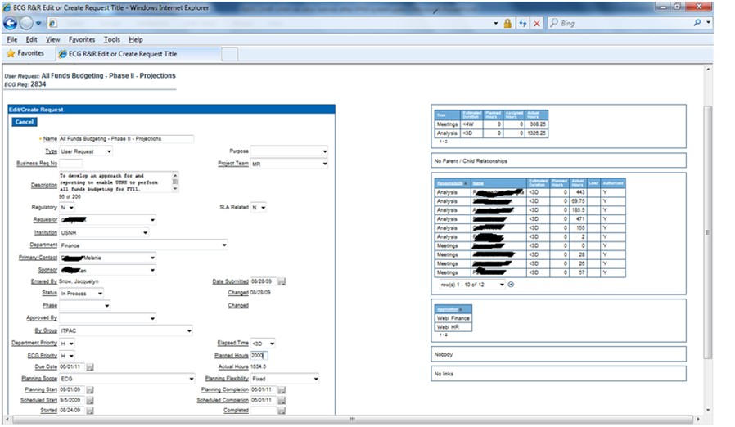
The UNH evolution – Phase 2
Home-grown request/resource system

Slide 18
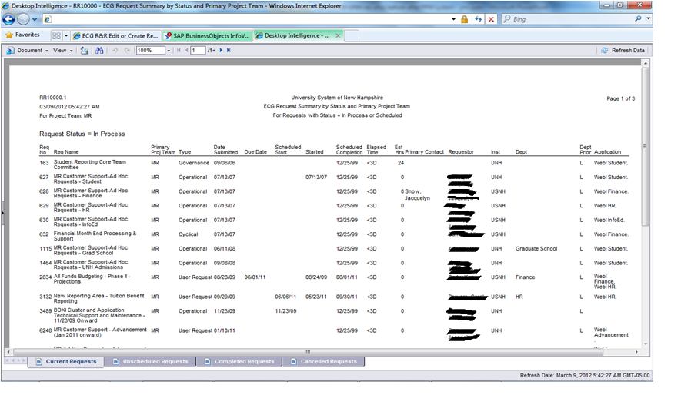
The UNH evolution – Phase 2
Home-grown request/resource system

Slide 19
The UNH evolution – Phase 2
Home-grown request/resource system
R&R was a great success:
  Fostered a culture of time tracking
    Understanding where our time was being spent and for whom!
  Transparency, and Value!
    What have you done for me lately?
    Where are we focusing our efforts?
  Identify resource constraints due to overlapping projects.
  Ability to easily report and analyze data and trends

Slide 20
The UNH evolution – Phase 2
Home-grown request/resource system
The R&R system did have limitations and was not meeting all of our resource planning needs:
  It did not provide the ability to allocate effort by time period. Only total estimates for projects or phase of work could be tracked.
  Manual spreadsheets were being used to determine a team’s resource allocation and their commitment/availability for a given time period.
  No integration between hours estimated in R&R system and staffing/ hours identified on actual project plan for project/effort

Slide 21
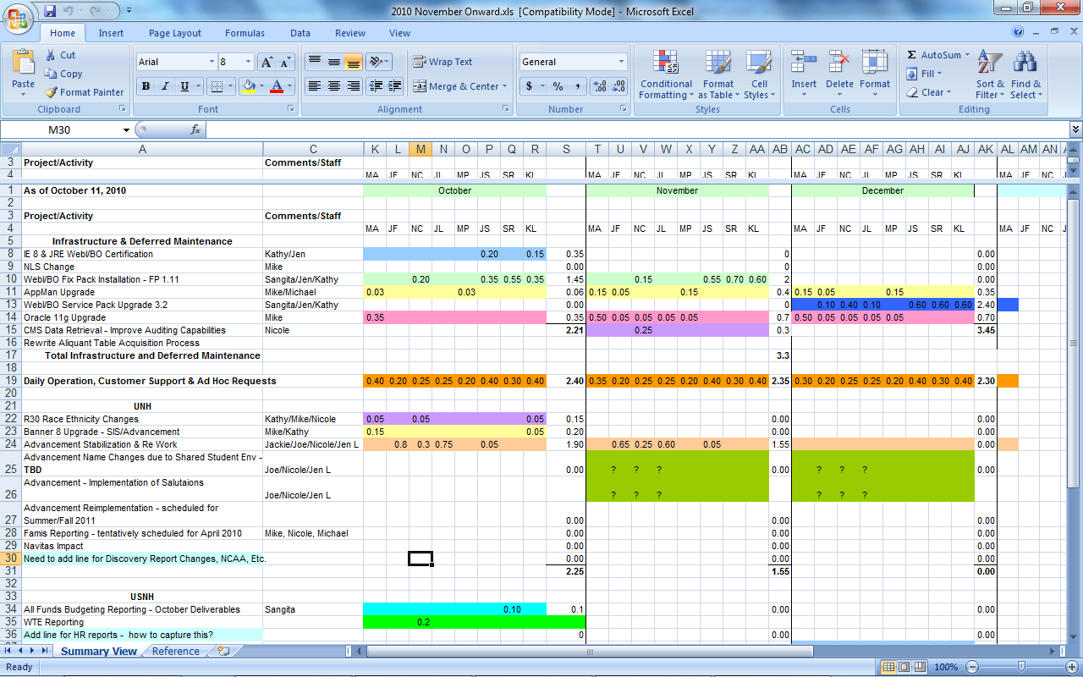
The UNH evolution – Phase 2
Home-grown request/resource system

Slide 22
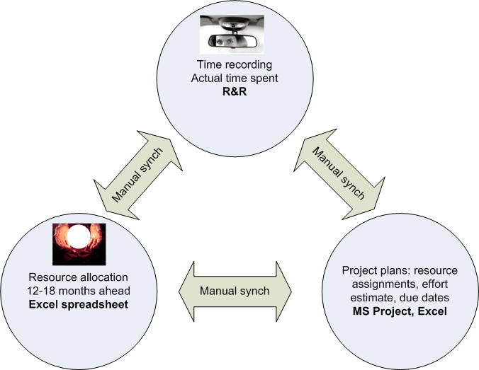
The UNH evolution – Phase 2
Outcome

Slide 23
The UNH evolution – Phase 3
Who needs a PPM tool anyway!!!
We Did!
  Our processes and tools were not unified
  No seamless way to address our Portfolio and Project Mgt. needs!
Internal Tool Assessment Conducted 9/7/09
  56% of the Survey population were using Excel or MS Project for Project Management
    29.5% using MS Project vs. 70.5% use Excel
  Leveraged R&R (Home Grown Tool) to collect portfolio metrics
    Assessed PM maturity and needs
  11/5/09 granted permission to evaluate third party tools

Slide 24










Some of the tools investigated

Slide 25
The UNH evolution – Phase 3
PPM System initial implementation
We Chose
Rollout of TeamDynamix to IT only!
Large Cultural shift; Project & Portfolio Management
  Our Goal:
    To ensure that we are properly leveraging IT resources and bringing them to bear on those projects that return the maximum value for our business clients and to UNH.

Slide 26

The UNH evolution – Phase 3
Goals
One source of truth for:
  Project Inventory
    What is currently on our plate?
  Request Tracking
    Who is asking us for what, and when do they want it?
  Capacity planning
    Do we have the time and resources to deliver what is being asked of us?
  Time Accounting
    Where and on what are we spending our time?
  Project Management

Slide 27
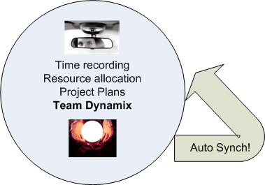
The UNH evolution – Phase 3
Outcome

Slide 28

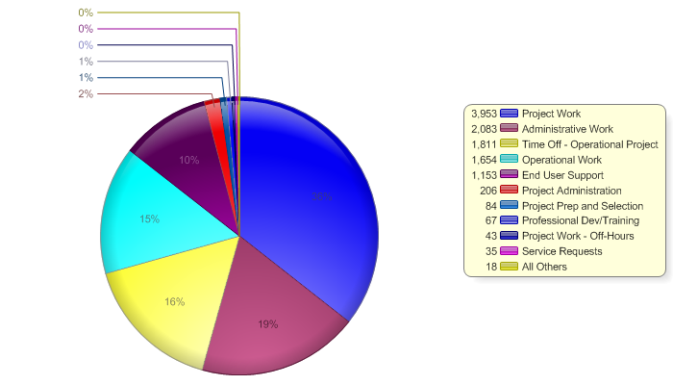
The UNH evolution – Phase 3
Outcome

Slide 29
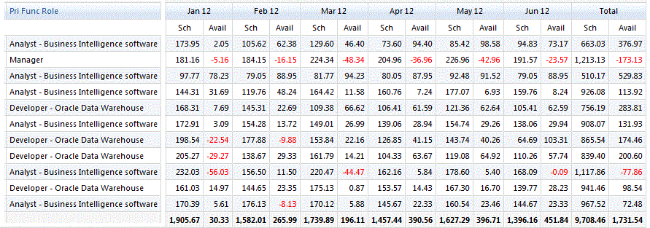
The UNH evolution – Phase 3
Outcome

Slide 30
The UNH evolution – Phase 3
Capacity
IT Capacity Loading & Prioritization Scheme
  G&A General Administrative “Can’t Touch that” Estimate 15–20 % total FTE
    Vacation, Sick, Non Project Related Meetings, Email, Department / Personnel Management, Personal Development etc…
  Applications Portfolio Estimate 65-70 % total FTE
    Lights On / Daily operations, SLAs = estimate > %65 of total available FTE
    Regulatory Projects
    Maintenance Projects (Upgrades)
  Project Portfolio Estimate 10-20 % Potential Capacity
    Strategic; Cabinet approved
    Governing Bodies
    UNH Priority Projects
Best Practice Leverage Operational Projects to track 1 & 2

Slide 31
The UNH evolution – Phase 3
Cultural Gaps and Hurdles
Where We Were
Time Accountability
    Not an accepted practice
    “Big Brother” Syndrome
    I’m already too busy
Capacity Planning
    Excel spread sheets
    Distribution of work largely unknown
Resource Allocation
    Not strategically aligned
    Only one organization forecasting 12-18 months out
Where We Went
Time Accountability
    All of IT reporting 100% time
    Capturing in TeamDynamix
Capacity Planning
    TeamDynamix
    G&A, Operational, and Project
Resource Allocation
    Not strategically aligned
    Only one organization forecasting 12-18 months out

Slide 32


The UNH evolution – Phase 4
This is a Journey!!!
Keep true to your Vision and Goals
In the spirit of Continuous Improvement we are never done!
  We will Mature and Evolve

Slide 33
The UNH evolution – Phase 4
PPM Maturity Model
[Project Institute of Finland]
5. Pre and Post project evaluation of business value, continuous evolution of PM Culture
Increased Efficiency
Maximize IT Value
4. Systematic project prioritization
3. Resource management across all projects and all other work
2. Awareness of the status and balance of projects
TeamDynamix
Initial
Roll Out*
1. Awareness of
current projects

Slide 34
The UNH evolution – Phase 4
Process Maturity & Expansion
Process Maturity
  Strategic Alignment
    Score Carding
    Intake Process
    Governance
    CPI (Continuous Process Improvement)
Expanding beyond IT
  Targeting Distributed IT Departments
    Internal Intake and Workflow
  Client access for Project Participation
  Enterprise Solutions
Focus IT resources on those projects that return maximum value for our business clients and to UNH.

Slide 35

Summary/Recommendations
Pitfalls to avoid; don’t…
Underestimate the significant culture shift
Use time tracking data punitively!
Rush the job. Accurate time tracking and estimating future work comes with time and experience
Overemphasize the tool; maturity can’t be bought or copied
Attempt to boil the ocean

Slide 36
Summary/Recommendations
Must do’s
Communicate and sell the value (regularly)
Transparency is a beautiful thing! Embrace it!
Clearly define key terms; use them consistently
Take advantage of supporters across all organizational levels
This is an evolutionary process
  You don’t need a fancy tool to get started
  Small steps add big value
Use collected data in a meaningful, timely way
Lead by example! Ex: managers start time tracking first
What have you done for me lately? Use your data to demonstrate the answer

Slide 37
Thank You!
Questions?
Please remember to fill out the session evaluation by going to the appropriate listing in the conference program on the EDUCAUSE website.
Deb Timmons
Deb.timmons@unh.edu
Jackie Snow
Jackie.snow@unh.edu
Paul DeMello
paul.demello@unh.edu

