Slide 1
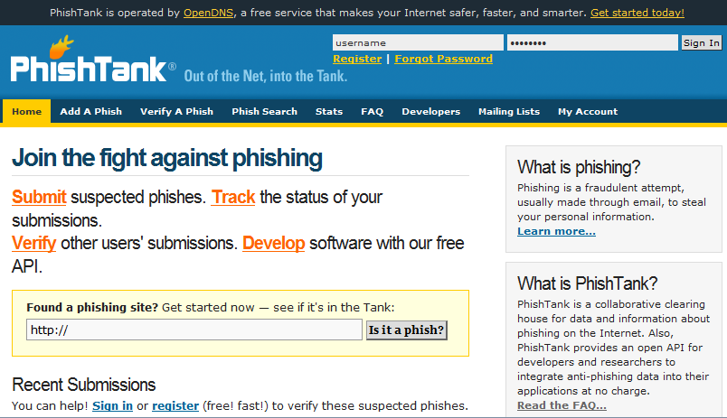
Phishing, Spear Phishing, and what to do about it.
Mark Berman | Angelo Santabarbara March 13, 2013
Abstract
There has been a dramatic increase in phishing and other hacker attacks this year. Many in our communities have fallen prey to identity theft attacks, have had their e-mail accounts compromised, or have been tricked into downloading malware onto their machines, which has spurred a great deal of discussion among security professionals trying to figure out how to handle the problem. Siena College has taken a multipronged strategy, educational as well as technical. This session will present Siena's approach, detail how successful we have been, and survey approaches used by other institutions.
What Are We
DOING
About it?
Technical Solutions, Timely Notifications,
& Awareness Training
Traditional Phishing Response/Prevention
Not proactive
Collected phishing samples, analyzed, blocked at firewall by blocking domain/site (such as Google form)
Monitored e-mail queues for suspicious activities to identify compromised accounts to disable
Notify user and informally educate user on prevention
RESULT: Number of compromised accounts continued to grow and hit an all time high in September 2012. Sophisticated spear phishing attacks were harder for users to identify as malicious content and increasing in number.
Evolving Phishing Response/Prevention
Main Objectives
Formal notifications and preliminary education
Proactive technical prevention
Participation in phishing identification systems to bring known phishing attacks to light in the security community
Education during detected/intercepted activity
Formal education requirement for re-enabling compromised accounts
Proactive Technical Prevention
Update DNS forwarders on Active Directory DNS servers to OpenDNS
Blocks known phishing hosts, botnets, and typosquatters at no cost based on constantly updated security community definitions as well as community driven PhishTank service.
Faster DNS response than most ISP DNS servers
Customizable intercept pages
Reporting on DNS requests, phishing requests, and botnet requests
OpenDNS is the largest and most reliable recursive DNS service available providing a better Internet experience to more than 50 million Internet users around the world.
Utilize new methodologies to eradicate malware, botnets and phishing through DNS, and use the system to intelligently route our users around it.
OpenDNS uses PhishTank to identify phishing sites.
Participation in Phishing Identification
Process in place for help desk and system admins to report phishing/spear phishing attacks to PhishTank and Google’s Report Phishing
PhishTank is community driven and used by many of the biggest security providers as well as OpenDNS
Having multiple reports and verification of phishing sites aids in getting phishing sites blocked and taken offline
Reporting to Google will increase timely marking of delivered phishing e-mails to be labeled as such in Gmail.

Slide 2
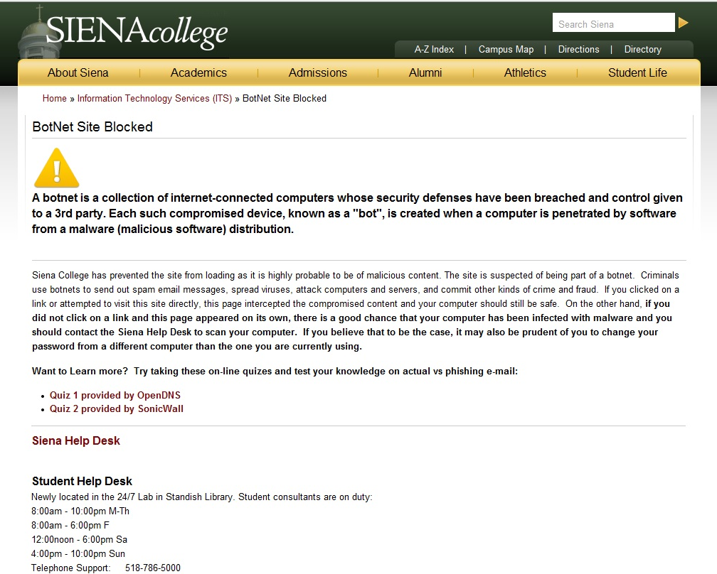
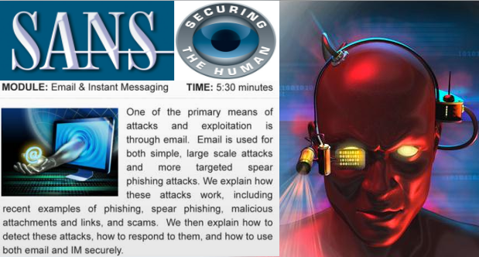
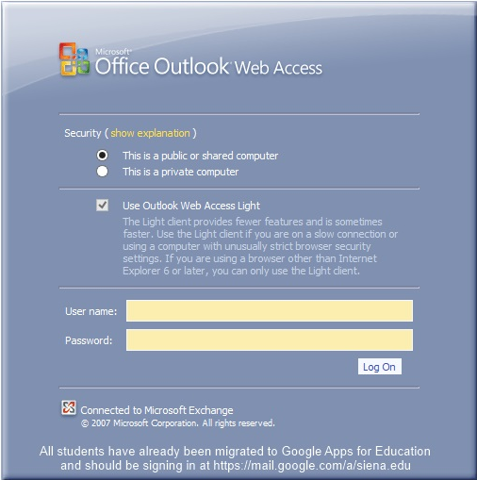
Phishing, Spear Phishing, and what to do about it.
Mark Berman | Angelo Santabarbara March 13, 2013
Education During Phishing Activity
In the event the user falls for a phishing scam and that phishing site is blocked by OpenDNS:
Utilize custom page to also educate about what was blocked
Provide ITS help desk contact information for concerned user assistance/clarification
Provide some type of self test such as the OpenDNS Phishing Quiz or SonicWALL Phishing IQ Test
If a user DOES get compromised
User’s Account is immediately DISABLED!
In order to have a compromised account re-enabled, require formal completion of phishing training
Acquired SANS Securing the Human training that provides quick security training modules that are tracked by our training management system
On site completion of training module required to re-enable account
New Phishing Prevention/Education Model Results
9/12-10/12
Email from CIO educating community
Started New Hire Orientation Malware/Phishing training
11/12
Implemented OpenDNS
12/12
Began using PhishTank submissions
All Users required to change passwords for Google Apps migration (Population expecting change more apt to fall for phishing attacks)
Started intercepting BotNet pages w/internal warning and education page
1/13 Migrated students to Google
It Doesn’t End Here…
Unfortunately this is a cat and mouse game
Users forget, make mistakes, and continue to get tricked by very realistic looking spear phishing attempts customized to include actual Siena elements so continuous education is required. Look at the very well created spear phishing attack we received in December that fooled many in our population.
Participate in anti-phishing efforts and information sharing to foster a community that helps security vendors block and take down these criminal operations
Very well crafted e-mail asking for user to follow link displayed as actual Siena e-mail login to prepare for migration to Google (as we were)
Page setup on Google forms to look exactly like our OWA login page
Only indication of phishing was page was hosted on Google Form.

