Slide 1
eTerns: What Every Campus Needs to Pull Off a Technology Revolution
Beth Gordon Klingner, Samantha Egan, Megan Burke | 3/12/2013
Notes:
All
How many of you use students to support your technology projects? Beyond hardware support? IN a more collaborative, innovative, eduational way?

Slide 2
Copyright [Beth Gordon Klingner (Ph.D.), Samantha Egan, and Megan Burke] [2013]. This work is the intellectual property of the authors. Permission is granted for this material to be shared for non-commercial, educational purposes, provided that this copyright statement appears on the reproduced materials and notice is given that the copying is by permission of the author. To disseminate otherwise or to republish requires written permission from the author.

Slide 3
Overview
Academic Technology History
How our ePortfolio Program led to eTerns
Our Student “Army”
Funding
KPIs
Responsibilities
Impact
Future goals
Take-aways for your student team
Resources and Contact Info.
Questions
Tweet about this session!
#NERCOMP2013
Notes:
BGK

Slide 4
About Academic Technology
Established in 2011 as the newest branch of ITS
Connects the IT department and the academic community
Explores, evaluates, and implements various instructional technologies
Educates faculty and students about the effective use of these technologies through workshops, teaching circles, user groups, and tutorials
Focuses on: learning management systems, web conferencing, lecture capture software, electronic portfolios and more
Notes:
BGK

Slide 5
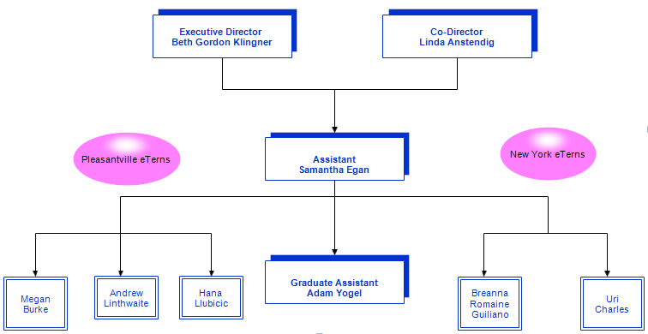
Notes:
BGK

Slide 6
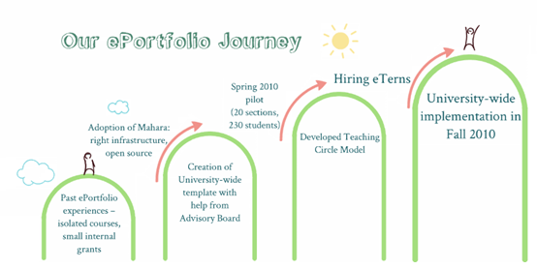
Notes:
BGK

Slide 7
eTern Support
eTern support was critical in educating the Pace community about this new tool
eTern team grew each semester
Led workshops/demos and provided one-on-one assistance
Immerse themselves in the ins and outs of Mahara and provide feedback and guidance for development
Notes:
BGK

Slide 8
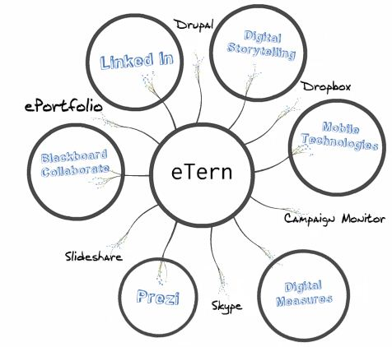
Beyond ePortfolio
Notes:
MEG
As academic technology grows so does the work of our eterns
Graphic to show growth and tools

Slide 9
Funding eTerns
Combination of internal and external grants help us support our growing eTern team
Making Connections (Laguardia Community College)
Thinkfinity: 2010-present
Connect to Learn (national, three-year FIPSE)
ITS support
Notes:
Sam

Slide 10
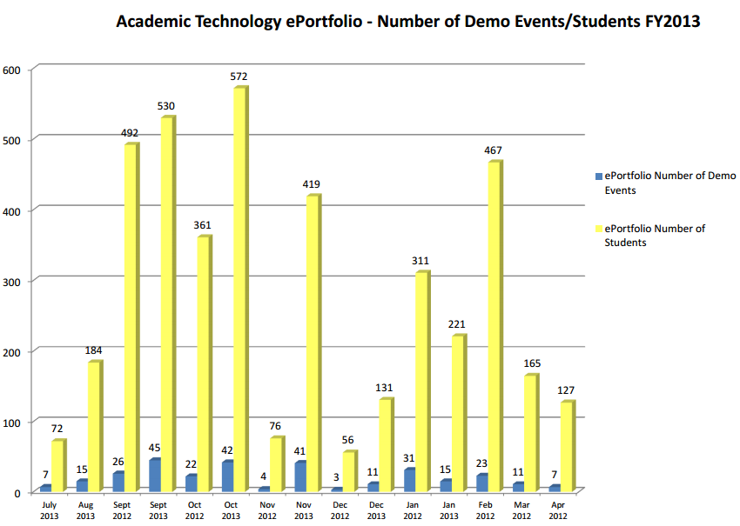
Success Rates
Our students’ success is reflected in our department’s Key Performance Indicators (KPIs) that show growing numbers within each category.
Notes:
SAM

Slide 11
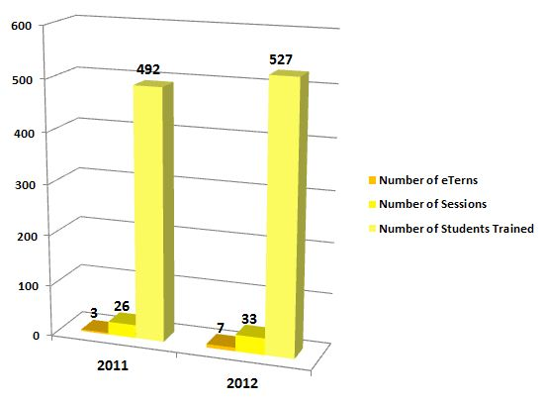
Growth
Notes:
SAM – add percent increase

Slide 12
eTern Innovations
Designed template
Play an essential role in bi-annual teaching circle seminars
Presented at leadership conferences
Conduct on-site research
Co-presented at Board of Trustees meetings
Published in Mahara Newsletter
Use their role as a basis in their academic work
Use their role to network in their field
Design and publish internal communication
Notes:
SAM

Slide 13
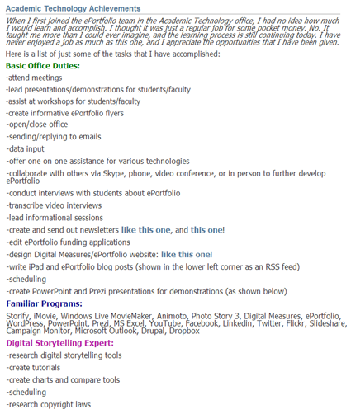
eTern Testimonials
“I had the opportunity to work alongside dedicated faculty and staff members, who have become great mentors and friends.”
-Jemma York, ‘13
“I gained a lot of perspective and organization skills that I can apply to classwork.”
-Breanna Romaine Guiliano, ‘13
“What I learned from being an eTern will help me be an innovative and technologically savvy educator.”
-Hana Ljubicic, ‘14
“These are skills I will carry with me throughout anything I do in life and I am grateful for the opportunity to be here.”
-Adam Yogel, ‘14
Notes:
MEG

Slide 14
eTerns at Work: Meeting the Needs of Faculty
Situation: An eTern received a call from a frustrated professor with a web conferencing issue
Kept the professor calm by answering quickly, collecting information, & troubleshooting the issue. Helped connect with the people who would be able to solve the problem
Although she could not solve the technology problem alone, she was able to document information to keep the issue from escalating.
Notes:
BGK

Slide 15
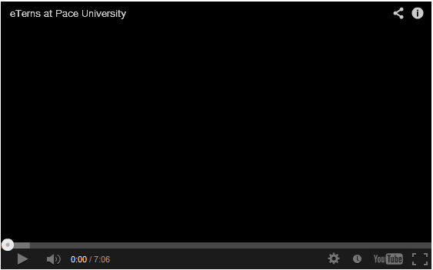
Notes:
MEG

Slide 16
Looking Forward
Exit survey
Develop department eTerns
Increase eTern decision making
Refine Reports
Continue to increase transferable skills
Notes:
SAM-

Slide 17
Your Student Team: Recruiting Students
Think about the skills your department truly requires
Outline your department’s tasks
Require students to demonstrate competency
Seek referrals from faculty
Notes:
BGK

Slide 18
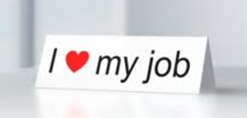
“Hello Team!”: Creating a Positive Environment
A team atmosphere brings greater job satisfaction.
We work hard to develop a team-like structure by having students partner-up on projects, holding check-in meetings & using shared resources in Dropbox & ePortfolio.
Small end-of-the-semester celebrations also help build a camaraderie that helps students feel connected to the department.
Notes:
MEG

Slide 19
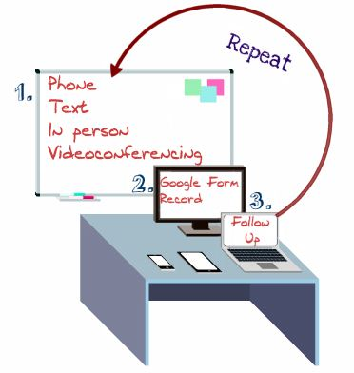
Your Student Team: Managing the Workflow
Recruit students who are up for the challenge of working independently
Be receptive to eTern ideas
Utilize technology to strengthen communication and efficiency
Notes:
SAM Our multi-campus structure gave us the unique challenge of managing half of our students from a distance
-no investment in additional software

Slide 20
Links
Academic Technology page
ePortfolio
Tutorials
eTern Video
ePortfolio Blog
Notes:
MEG

Slide 21
Contact Us
Beth Gordon Klingner: bklingner@pace.edu
Samantha Egan: segan@pace.edu
Megan Burke: mb91342p@pace.edu
Notes:
MEG

Slide 22
Thank you for attending! Please remember to fill out this session’s evaluation by going to the daily agenda on the conference website. Your feedback directly affects future events.
Notes:
BGK
What are the questions?
Does this give you any ideas about using students to advance your technology initiatives?

