Slide 1
The Open Education Initiative @ UMass Amherst
Taking a Bite Out of High-Cost Textbooks
Curriculum Redesign Symposium | Shrewsbury, MA
Marilyn Billings| Scholarly Communication Librarian, University Libraries Sarah Hutton | Head, Undergraduate Teaching and Learning Services, University Libraries

Slide 2
The UMass-Amherst Open Education Initiative: Genesis
February 2011: Temple University’s Teaching, Learning and Technology Roundtable launches e-text project
March 2011: Director of UMass Libraries and Provost establish a fund of $10,000 for open education initiative grants
March 2011: The University Libraries Open Educational Resources LibGuide is created http://guides.library.umass.edu/oer
March 2011: Workshops held for librarians to learn about OERs
April 2011: Round one of the Open Education Initiative Begins
April 2011: Workshops, consultation sessions held for faculty
Notes:
Director of Libraries Jay Schafer and Scholarly Communication and Special Initiatives Librarian Marilyn Billings speak with Temple’s Stephen Bell about the program.
Provost and Director of Libraries each contribute $5,000 to the fund with the goal of making free or inexpensive textbooks for students. Faculty could do this by using any combination of OERs and library resources.
Liaisons had to learn about available OERs in their subject fields and Scholarly Communication librarians had to learn how the available OERs could work with library resources

Slide 3
Workshop & Consultation Process
Two one-hour workshops reviewing available Open Educational Resources and library resources
Individual consulting sessions for faculty with Scholarly Communication librarians and subject liaisons
Topics covered: OER availability, copyright and licensing issues, accessibility concerns, creating a sustainable curriculum with OERs, managing resources in the LMS

Slide 4
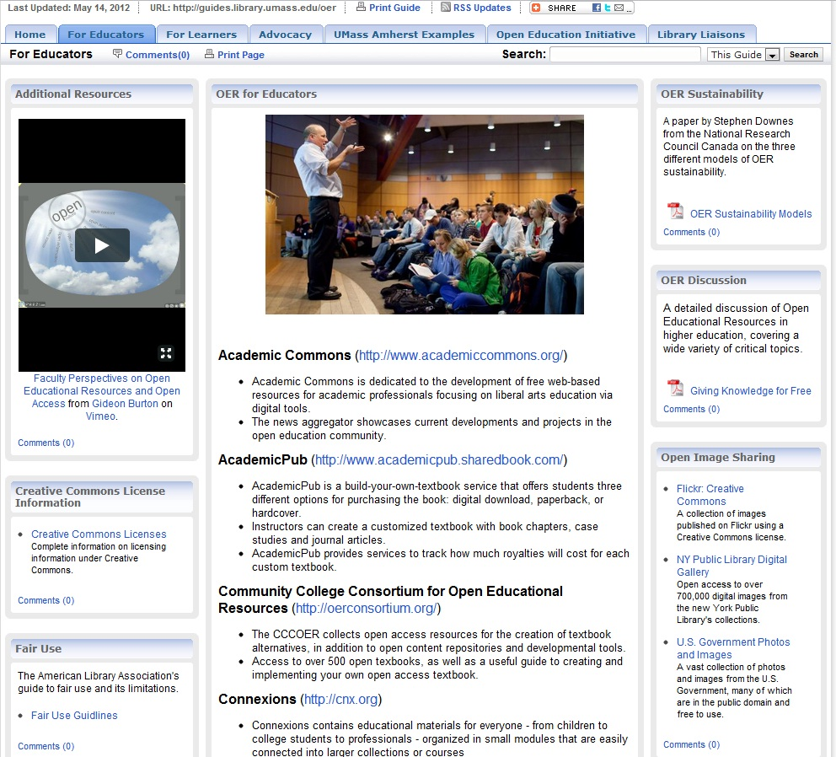
OERs for faculty and students; local examples
General OER information
OER insight
from faculty
Open access images and videos
Copyright resources
Annotated list of available OERs

Slide 5
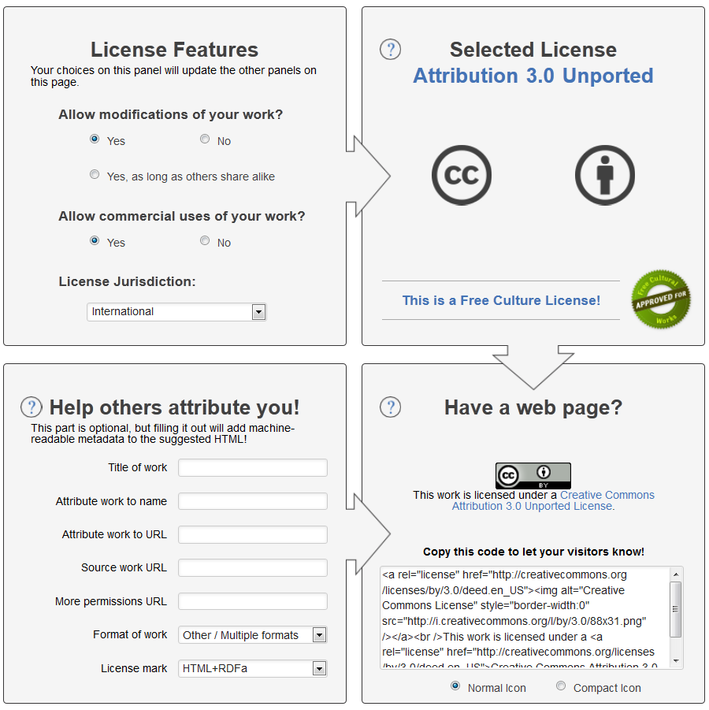
Notes:
Creative Commons Licensing Process

Slide 6
The Open Education Initiative: Round One
April 2011: OEI grant review team established
Faculty, librarians, and support staff
May 2011: Deadline for OEI grants. Review team awards 11 grants to 8 faculty members.
July 2011: Money allocated to faculty through the Libraries’ business office
Faculty Member | Course Offered | Number of Students | Savings for Each Student
Maria Botelho | Education 615 | 30 | $105
Leda Cooks | Comm. 620 & 694 | 12 & 8 | $150 & 175
Carlos Gradil | Animal Sciences 421 | 30 | $80
Sanjiv Gupta | Sociology 212 | 40 | $90
Miliann Kang | Women’s Studies 187 | 300 | $75
Shona Macdonald | Art 697 | 12 | $50
Charlie Schweik | Env. Conserv. 409 & 592 | 80 & 30 | $50 & $50
Pam Trafford | Management 630 & 797 | 120& 40 | $200 & $200

Slide 7
The Open Education Initiative: Round Two
September 2011: Based on the success of the OEI the Provost and Director of Libraries co-found a second round of 15 grants
October 2011: Round two launched during Open Access Week faculty panel presentation
December 2011: OEI review team awards 15 grants to 13 faculty members
November 2011: Workshops and consultations offered
Faculty Member | Course Offered | Number of Students | Savings for Each Student
Allen Barker | Plant, Soil Sciences 530 | 25 | $60
Patricia Bianconi | Chemistry 342 | 45 | $235
Sergio Brena | Civil & Envir. Eng. 433 | 80 | $120
Briankle Chang | Communication 318 &491 | 35 & 45 | $70 & $50
Elizabeth Chilton | Anthropology 396 | 35 | $75
Lisa DePiano | Permaculture 197 | 15 | $200
John Gerber | Plant, Soil Sciences 290 | 75 | $122
Christine Hatch | Geoscience 297 | 58 | $100
HK Hsieh | Statistics 501 | 45 | $150
Laetitia La Follette | Art History 100 & 115 | 400 | $175
Daiheng Ni | Civil & Envir. Eng. 520 | 21 | $150
Nicholas Reich | Public Health 590 | 30 | $130
Barbara Roche | Journalism 397 | 15 | $100

Slide 8
The Open Education Initiative: Summary of Rounds One and Two
Total investment of $26,000
$11,000 in Round One, $15,000 in Round Two
Grants awarded to 21 faculty members teaching 26 courses
8 faculty, 11 courses in Round One; 13 faculty, 15 courses in Round Two
Total of 1,616 students affected
Average savings of ~ $127 per student
Total recurring savings of $205,500

Slide 9
Next Steps for OEI at UMass Amherst
Assessment of OEI courses through the 2012-2013 academic year
OEI Round Three in Fall 2013, 10 grants plus grants for 2 large general education courses
Formation of the Faculty Senate Ad-hoc Committee on Open Educational Resources

