Slide 1
Fair Use or Fair Game?
How one college "solved" fair use...
Emerson College
Jenn Stevens, Director of Instructional Technology
Robert Fleming, Executive Director of Iwasaki Library
Cyle Gage, Systems Architect, IT
Cheryl Schaffer, Head of Media Services
Notes:
Jenn:
Disclaimer: we have not solved it at all. This is not like the signs that restaurants put out advertising "fresh" lobster - we really mean these quotation marks.
We are a small school of about 4300 students and 450 faculty. We are located right in downtown Boston on the corner of Boston Common, so space is always tight. We're a liberal arts school that has a strong concentration in the arts and communication.
Because of that, we have a lot of demand to use media in our classes, so we wrestle with fair use daily. We'll share our process of working together and the questions and issues we face. We would ask that you save questions until we get through our little intro - there will be lots of lively discussion time in a few minutes when we all get to use the tool.

Slide 2
Problem: Fair Use is complicated.
Notes:
Jenn:
... Especially for faculty. No one has black and white answers, and that's really tough for faculty who are busy people and are trying to juggle a million things at once.

Slide 3
Library
Notes:
Bob: Emerson's library was traditionally responsible for assisting faculty with course reserve. As result, library staff often advised faculty on issues of copyright and fair use. In era of print reserves, we were sole gatekeepers in this area.
When Blackboard chosen as Emerson's LMS in 1990s, library staff continued to assist some faculty by scanning and uploading articles and book chapter, or linking to full text in subscription databases. Library continued to advise about copyright but we were no longer sole gatekeepers.
Given Emerson's focus on communication and the arts, and the fact that our film program has one of the largest enrollments on campus, there were many faculty members interested to make full length feature films available through LMS. If they asked librarians for advice,we would refer to copyright policy, which included TEACH act, and pay special attention to the language "reasonable and limited amounts". If they didn't like the answer they got from us, they could continue to ask their question of others on campus....
Turn over to Cheryl...

Slide 4
Media Services
Notes:
Cheryl: Decision making was with 1 senior admin. Concerns about legality of what my staff asked to do. Needed guidance.

Slide 5
IT
Notes:
Cyle: As an undergrad, I built Median: a streaming video service integrated with active directory groups, video limited to classes. Uploading large files used to require staff, now is available to everyone. Discovering 2 hour movies on median. What to do?

Slide 6
Notes:
Cyle: originally we had a very complicated set of options to determine how restrictive uploads should be - the trouble was that even though there was a lot of assessment and cascading permissions going on, people still managed to game it and say yes to whatever they had to say yes to in order to get what they want. Changed it so that the default was that every upload was treated as full copyright (the most restrictive setting), and people still changed it.

Slide 7
Instructional Technology
Notes:
Jenn: We hear a lot from faculty members. No one knew who to go to for a definitive ruling, and people got different interpretations of fair use depending on who was asked. As the newest person on this panel, I got a lot of questions that could be characterized as "how can I get around this”no”?"
Further, changes in the law and announcements of lawsuits and decisions also caused confusion. You can make clips! UCLA “won”!

Slide 8
How do we speak with a consistent voice?
How do we involve faculty members to take responsibility for making copyright decisions?
Notes:
Jenn

Slide 9
"Solutions":
Fair Use FAQ
faculty education
workshops with copyright lawyer
fairuse.emerson.edu
Notes:
Bob

Slide 10
About Fairuse.emerson.edu:
Notes:
Modeled on an American LIbrary Association tool.
We wanted to keep this as simple as possible. People tend to skim over a lot of print. Our copyright policy is very thoughtful, but very... comprehensive.This had to be shorter. We wanted this to be responsive so that it can be used on mobiles, so it’d designed using the Foundations framework.
Another design decision was that we do not keep any info. We do not want any records of who assessed what in which way at what time. We are not interested in having that info anywhere on our servers for legal reasons, and also we want to put the onus on the faculty member to assess and keep their own records.
For that reason, the tool itself is just a flat html page with a very visible print button. We want faculty to be conscious that it is important to not only do a fair use analysis, but to keep your results and justifications so that you can later prove that you were acting in good faith.

Slide 11
Promotion and Use:
Notes:
How we promoted it: posters, faculty assembly, faculty focus newsletter, blog posts, individual consultations.
Spikes are: faculty assembly, blog post.
Usage: not gigantic. Faculty do not always like the answers they get, but luckily that sparks conversations, and that's been the most valuable part of this whole process.

Slide 12
Scenario 1:
You teach Novel into Film. Students need to view each movie and read the novel. A student calculated that showing the movie in class is like asking students to pay for a $155 movie ticket. Students could get the movies from the library, but most find it inconvenient. Netflix is not a reliable source - in the past you've asked students to buy Netflix streaming, only to have the movie pulled halfway through the semester. You think the TEACH Act should allow you to put the full length movie on Median, and restrict it to members of the class.
Notes:
Scenario 1
Right now you have a chance to try it out yourself.
Go to fairuse.emerson.edu on your devices, and rate this scenario. If you are in person, we have post-it notes for you. On this wall, we have the spectrum of fair use. We have blue post-it notes for you to put where on this spectrum fairuse answered. Not everyone agrees with its findings! We also have pink post-its for you to place on the spectrum where you think this use is.
For those of you online, we have polleverywhere set up. Sadly, there is not a spectrum option, so you only get to answer multiple choice.

Slide 13
Scenario 1:
You teach Novel into Film. Students need to view each movie and read the novel. A student calculated that showing the movie in class is like asking students to pay for a $155 movie ticket. Students could get the movies from the library, but most find it inconvenient. Netflix is not a reliable source - in the past you've asked students to buy Netflix streaming, only to have the movie pulled halfway through the semester. You think the TEACH Act should allow you to put the full length movie on Median, and restrict it to members of the class.
What did fairuse.emerson.edu say?
Text to 37607 or submit to http://PollEv.com
Leans TOWARD fair use: 792752
Cannot assess: 792753
Leans AWAY from fair use: 792754
What did you think?
Text to 37607 or submit to http://PollEv.com
Leans TOWARD fair use: 792749
Cannot assess: 792750
Leans AWAY from fair use: 792751
Notes:
Scenario 1
Right now you have a chance to try it out yourself.
Go to fairuse.emerson.edu on your devices, and rate this scenario. If you are in person, we have post-it notes for you. On this wall, we have the spectrum of fair use. We have blue post-it notes for you to put where on this spectrum fairuse answered. Not everyone agrees with its findings! We also have pink post-its for you to place on the spectrum where you think this use is.
For those of you online, we have polleverywhere set up. Sadly, there is not a spectrum option, so you only get to answer multiple choice.

Slide 14
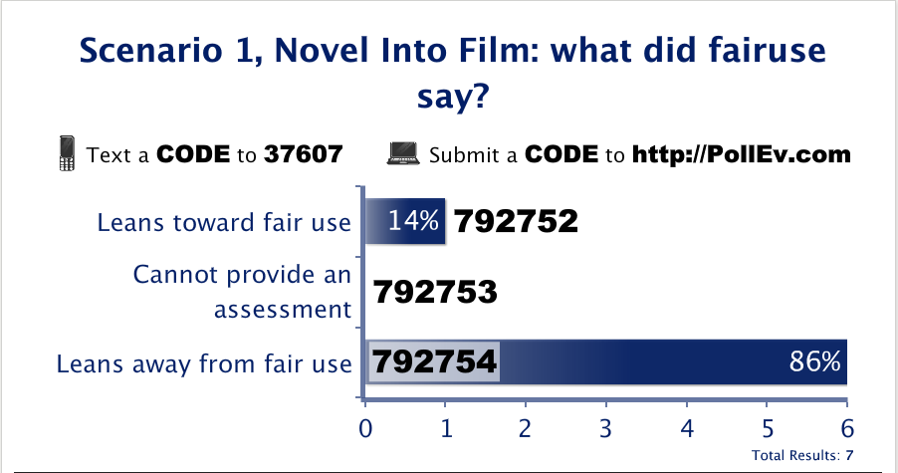
Notes:
<?xml version="1.0" encoding="ISO-8859-1" ?>
<poll url="http://www.polleverywhere.com/multiple_choice_polls/PaIeERUqsja2E17">
<!-- This snippet was inserted via the Poll Everywhere Mac Presenter -->
<!-- The presence of this snippet is used to indicate that a poll will be shown during the slideshow -->
<!-- TIP: You can draw a solid, filled rectangle on your slide and the Mac Presenter will automatically display your poll in that area. -->
<!-- The Mac Presenter application must also be running and logged in for this to work. -->
<!-- To remove this, simply delete it from the notes yourself or use the Mac Presenter to remove it for you. -->
<title>Scenario 1, Novel Into Film: what did fairuse say?</title>
</poll>

Slide 15
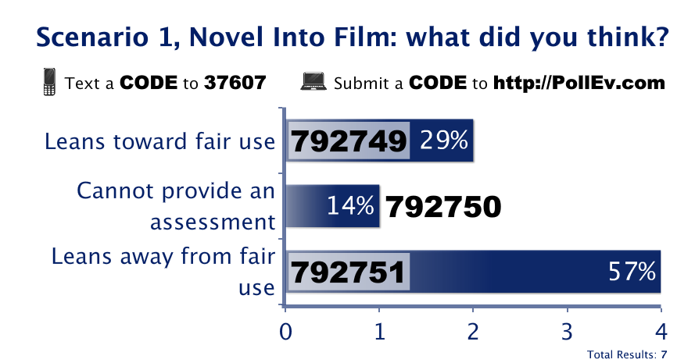

Slide 16
Scenario 2:
You teach History of Music. Your students need to hear samples of many different types of artists and musical styles. You have a pile of CDs. You want to take one song off each cd, digitize it and stream it. Students can access them outside of class to study for finals. Fair use?
Notes:
Scenario 2:

Slide 17
Scenario 2:
You teach History of Music. Your students need to hear samples of many different types of artists and musical styles. You have a pile of CDs. You want to take one song off each cd, digitize it and stream it. Students can access them outside of class to study for finals. Fair use?
What did fairuse.emerson.edu say?
Text to 37607 or submit to http://PollEv.com
Leans TOWARD fair use: 792841
Cannot assess: 792842
Leans AWAY from fair use: 792843
What did you think?
Text to 37607 or submit to http://PollEv.com
Leans TOWARD fair use: 792848
Cannot assess: 792849
Leans AWAY from fair use: 792840

Slide 18
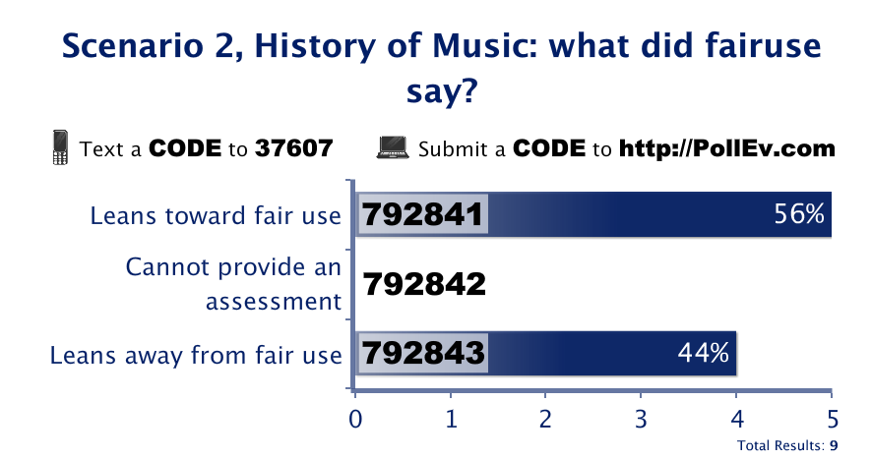
Notes:
<?xml version="1.0" encoding="ISO-8859-1" ?>
<poll url="http://www.polleverywhere.com/multiple_choice_polls/sozW0mCaIqjTZZz">
<!-- This snippet was inserted via the Poll Everywhere Mac Presenter -->
<!-- The presence of this snippet is used to indicate that a poll will be shown during the slideshow -->
<!-- TIP: You can draw a solid, filled rectangle on your slide and the Mac Presenter will automatically display your poll in that area. -->
<!-- The Mac Presenter application must also be running and logged in for this to work. -->
<!-- To remove this, simply delete it from the notes yourself or use the Mac Presenter to remove it for you. -->
<title>Scenario 2, History of Music: what did fairuse say? (1)</title>
</poll>

Slide 20
Scenario 3:
You teach the History of World Drama. You usually show a performance of a Lysistrata in the original Greek. It was performed in 1965, and is not available streaming or for sale. The library owns a VHS copy, and it is deteriorating. Is it okay to digitize it and stream it to students?

Slide 21
Scenario 3:
You teach the History of World Drama. You usually show a performance of a Lysistrata in the original Greek. It was performed in 1965, and is not available streaming or for sale. The library owns a VHS copy, and it is deteriorating. Is it okay to digitize it and stream it to students?
What did fairuse.emerson.edu say?
Text to 37607 or submit to http://PollEv.com
Leans TOWARD fair use: 792860
Cannot assess: 792861
Leans AWAY from fair use: 792862
What did you think?
Text to 37607 or submit to http://PollEv.com
Leans TOWARD fair use: 792863
Cannot assess: 792864
Leans AWAY from fair use: 792865

Slide 22
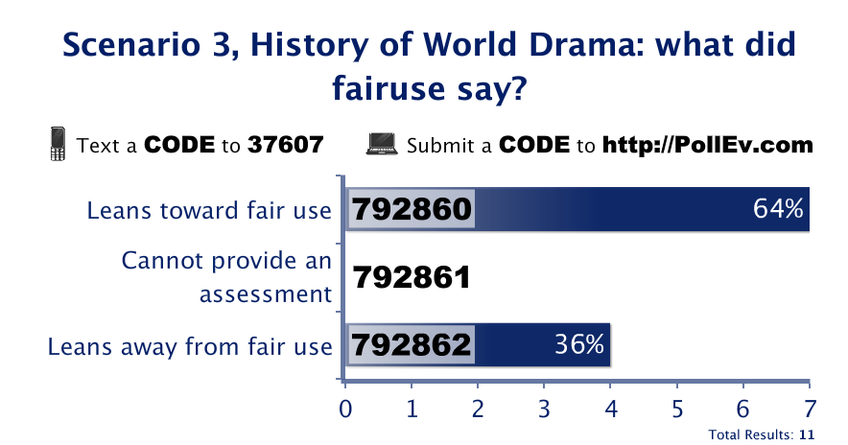

Slide 24
Scenario 4:
You teach a seminar on the narrative structure of Lost. Assignments are things like "examine the performance of Michael Emerson over the course of the series", or "how does location play into the narrative?" You feel that students need to have the entire work. Buying it costs ~ $200, whether on DVD or streaming. The library has one copy, but that's not enough for all 25 students. A student wrote on your evaluation that you are "encouraging torrenting". Is it okay to break the DRM and stream all 81 hours for the students?

Slide 25
Scenario 4:
You teach a seminar on the narrative structure of Lost. Assignments are things like "examine the performance of Michael Emerson over the course of the series", or "how does location play into the narrative?" You feel that students need to have the entire work. Buying it costs ~ $200, whether on DVD or streaming. The library has one copy, but that's not enough for all 25 students. A student wrote on your evaluation that you are "encouraging torrenting". Is it okay to break the DRM and stream all 81 hours for the students?
What did fairuse.emerson.edu say?
Text to 37607 or submit to http://PollEv.com
Leans TOWARD fair use: 792765
Cannot assess: 792766
Leans AWAY from fair use: 792877
What did you think?
Text to 37607 or submit to http://PollEv.com
Leans TOWARD fair use: 792878
Cannot assess: 792879
Leans AWAY from fair use: 792880

Slide 28
Resources:
fairuse@github
ALA's Fair Use Evaluator
median.emerson.edu
Median's transcoding farm @ github

