Slide 1
Where’s the Paper: Admissions Gone Paperless at Bowdoin & Wellesley
Presented by:
Ganesan Ravishanker and Peter Wiley
March 13, 2013

Slide 2
Agenda
Context
Why go paperless?
Technology
Recommendations
Benefits
What to watch out for

Slide 3
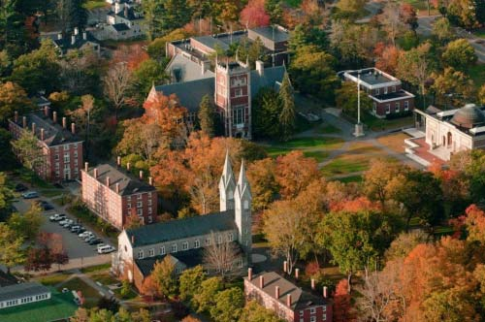
Bowdoin College
Private 4-year liberal arts college
1,775 students
7,042 apps
for FY Fall 2013
50% growth in apps
in last 10 years
12 counseling &
9 operational staff

Slide 4
Why go paperless?

Slide 5
Why else go paperless?
More apps every year, but
same calendar and same
staff
Need to process/read faster
Move forward with applicant checklist portal
Need to improve customer service to applicants

Slide 6
Context for Bowdoin implementation
June 1, 2012: The day the world changed
Goodbye, Recruitment Plus…
Hello, Banner!
BRM (CRM)
Custom travel management module
Goodbye, MS Access…
Hello, IBM Cognos & Operational Data Store (ODS)!

Slide 7
Bowdoin Timeline
Long ramp up…aggressive implementation
2010
2011
2012
Spring 2010: Multi-dept effort
Fall/winter 2011: vendor research/selection
Jan 2012: Enterprise license purchased for NOLIJ Web
Sept 1, 2012: Started implementation
Nov 5, 2012: Admissions went live

Slide 8
Technology: NOLIJ Web
Document imaging, reading online, and workflow all in one
100% web-based, zero footprint, JAVA-based
Real-time connection to database
Sql used to build business logic
Auto import utility/custom feeder to automate delivery from Common App to student folders

Slide 9
Four recommendations:
Determine scope early
Discuss: what exactly does it mean to be paperless?
Ensure executive sponsors to end users are clear about scope
Split implementation into phases
Phase A for Nov 2012:
Scan, store, and retrieve
Read online
Manual workflow
Phase B for Oct 2013:
Automated workflow

Slide 10
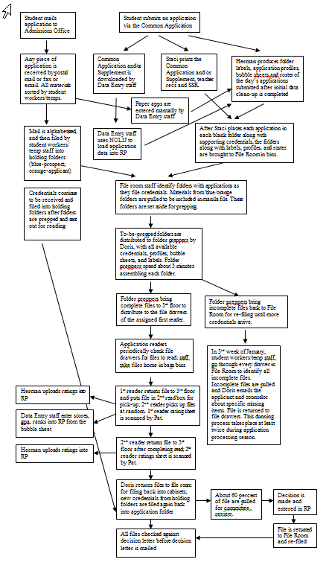
4 recommendations (contd):
Complete thorough business process analysis in advance of consultant visit
Current State
Ideal state
Gap analysis
Savings: 2 days consulting time!

Slide 11
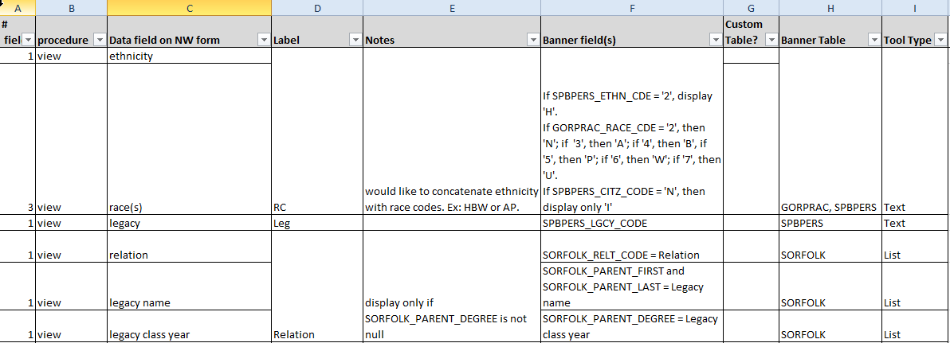
4 recommendations (contd):
Encourage the functional and technical folks to learn each other’s language
Functional lead: Know thy database!
Work side-by-side, agile development-style

Slide 12
4 recommendations (contd):
Focus as much on guiding/training staff as you do on deploying.
Address the fear of yet another change
Emphasize the benefits to be gained
Training in different formats & access to
test environment post-training class
Set up monitors at work stations several weeks prior to go live
Make a backup plan, just in case

Slide 13
Benefits of going paperless:
Beyond the benefits you’d expect…
Streamlined data corrections and changes
Cleaner data, more up-to-date data
Better security
Improved evaluation of applicants
Can read faster (but not everybody can)
Bought back operational staff time for recruitment of juniors (mailings, email inquiries)

Slide 14
What to watch out for…
Be prepared for shifts in job responsibilities (“that’s not my job”)
Ergonomic issues (seriously!)
Staff love and trust paper
What are your metrics for success? Baseline?

Slide 15
What’s next?
Automated workflow for Admissions
Late spring implementation for Oct ’13 go live
Registrar to adopt NW in spring 2014

Slide 16
Summary
Going paperless is your chance to…
optimize business processes
cross-train staff
save time and resource savings (yes!) and
money (in a couple years)
model collaboration between IT and departments

Slide 17
Thank you for attending! Please remember to fill out this session’s evaluation by going to the daily agenda on the conference website. Your feedback directly affects future events.

