Slide 1
Designing for Accessibility
Cindy Poore-Pariseau, Ph.D.
Coordinator Disability Services (Bristol Community College)
Online Instructor (BCC and Kaplan University)
Notes:
Hello and welcome to this session where we’ll discuss the importance of designing your course materials with accessibility in mind. Although there isn’t enough time for me to walk you through, step by step, how to make each element of your course accessible, I’ll give you easy to understand and easy to access resources that’ll guide you through the process of making a variety of elements you may include in your courses accessible. We all know that accessibility is the law. Whether we are aware of it or not, most of us use Learning Management Systems that contain elements of accessibility such as text enlargers or color contrasts. What we, as instructors or instructional designers, must consider however, is the accessibility of the material that we, ourselves place into our course spaces.

Slide 2
Outcomes
In this presentation you will
Learn what Accessibility is and is NOT
Gain an understanding of the impact of inaccessibility
Obtain valuable, easy to use resources on how to make your documents accessible
Learn how to “eat an elephant”
Notes:
My goal for today is that, at the end of this presentation, you’ll have learned what what Accessibility is and what it is NOT; you will have Gained an understanding of the impact of inaccessibility; you will have Obtained valuable, easy to use resources on how to make your documents accessible and, finally, you will have Learned how to “eat an elephant”.

Slide 3
Accessibility is more than “just another law”
Powerful video from the government of Australia
(please click on the link above to see this video and then return to the presentation)
Notes:
The following 3 minute video, from the government of Australia, includes many of the elements we’ll touch upon today; Please note that, although there are about 10 seconds of statistics that apply only to Australia, the rest of the video is applicable world wide. At this point, I would like you to make sure your speakers are turned on and then click on the link on your screen titled “powerful video”

Slide 4
What’s it all about?
Designing for Accessibility is NOT:
Hard (small changes make big differences)
Only for those with disabilities (impacts several audiences)
Someone else’s problem (we’re in this together)
An option (it’s a legal requirement)
Notes:
So, what is accessibility all about? First, let’s talk about what it is NOT. As you learned from the Australian video, accessibility is not Hard; really, it’s not difficult at all and it’s important for you to know that small changes can and often do make big differences. You may have heard the joke about how to eat an elephant. The answer is “one bite at a time”. This is also true in making your course materials accessible. When I talk about the various elements of your course materials that need to be accessible, it may seem like a daunting, elephant sized task, but I urge you to not look at it as a whole. Instead, break it down into bite sized, manageable tasks and tackle it, one bite at a time.

Slide 5
What’s it all about?
Designing for Accessibility is NOT:
Hard (small changes make big differences)
Only for those with disabilities (impacts several audiences)
Someone else’s problem (we’re in this together)
An option (it’s a legal requirement)
Notes:
Designing for accessibility is not Only for those with disabilities –it impacts several audiences. For example, I wouldn’t have made it through my PhD program if I hadn’t been able to convert my course materials into audio. And that was a matter of my preferred learning style rather than any kind of disability. So, had my instructor’s course materials not been accessible to a screen reader, I probably would not have been very successful in my program. Later on we will talk more in-depth about what screen readers are and how they are used.

Slide 6
What’s it all about?
Designing for Accessibility is NOT:
Hard (small changes make big differences)
Only for those with disabilities (impacts several audiences)
Someone else’s problem (we’re in this together)
An option (it’s a legal requirement)
Notes:
Next, Designing for accessibility is not Someone else’s problem (we’re in this together). If we all work together, share ideas and resources, the task is much more manageable.

Slide 7
What’s it all about?
Designing for Accessibility is NOT:
Hard (small changes make big differences)
Only for those with disabilities (impacts several audiences)
Someone else’s problem (we’re in this together)
An option (it’s a legal requirement)
Notes:
And designing for accessibility is not An option (it’s a legal requirement). When an instructor tells me they don’t need to caption their videos because they’ve never had a student who is deaf in their course, I want to scream “hey, this isn’t optional, it’s the law” and why not be prepared rather than waiting until the issue arises, causing your to have to backtrack, and scramble to make your videos or other materials accessible?
I’ll add, however, that I know many of you are very busy adjuncts or full time faculty who wear many hats and have limited time and limited resources. For this reason, I will once again emphasize “one bite at a time”
And for those of us who are visual learners:

Slide 8
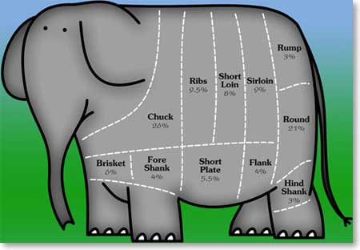
How to eat an Elephant
One Bite at a Time
Notes:
This is how to eat an elephant or work through what seems to be a daunting task: one bite at a time.

Slide 9
Defining Accessibility
Accessibility can be defined as: the ability for one to effectively access or utilize a product, service, or facility with or without accommodations.
Notes:
So, now that we’ve reviewed what accessibility is not, let’s define what, exactly, it is: Accessibility can be defined as: the ability for one to effectively access or utilize a product, service, or facility with or without accommodations.

Slide 10
Online Accessibility
-involves the ability to use online content without vision, without hearing, without pointing or manipulation, and without speech by persons with cognitive limitations, with language disabilities, with low vision and limited or no hearing, and with alternative languages.
(Vanderheiden, Harkins, & Barnicle as quoted by Schwartz, 2004, p. 1)
Notes:
And, Online accessibility-as the screen says, involves the ability to use online content without vision, or without hearing, or without pointing or manipulation, or without speech, or by persons with cognitive limitations, with language disabilities, with low vision and limited or no hearing, and with alternative languages. (Vanderheiden, Harkins, & Barnicle as quoted by Schwartz, 2004, p. 1). As you are creating documents for your course rooms, think about whether or not someone who can use only their keyboard or someone who cannot see or someone who cannot hear, can access the information you are trying to convey.

Slide 11
Why is designing for accessibility important?
Experience what it is like for a person who is
Visually impaired (0-1:17 minute)
(click on the link above and watch the first 1:17 minute of the video, then return to the presentation)
Notes:
Because we tend to remember more if we can visualize what we are hearing and seeing, I want to spend the next 4 or so minutes allowing you to see and hear the experiences of students with disabilities trying to utilize non accessible learning environments. After viewing the videos, I’ll give you resources that will help you to ensure your documents are accessible.
First is a student who is visually impaired. (please click on the link on your screen called “visually impaired” and view and listen to the first minute and 17 seconds.) (after video) So, if our materials are not designed properly, this student’s screen reader, called JAWS or Job Access Without Sight, cannot read the page, rendering the information inaccessible to the student.

Slide 12
Why is designing for accessibility important?
Experience what it is like for a person who is
Hearing impaired (2:20-2:39)
(click on the link above and watch minutes 2:20-2:39 of the video, then return to the presentation)
Notes:
Now from a student who is hearing impaired. (please play the hearing impaired video and watch minutes 2:20 through 2:39) (after video) For this student, captions and/or transcripts are a must for anything that is presented with sound, like a video or audio file.

Slide 13
Why is designing for accessibility important?
Experience what it is like for a person who is
Physical Disability (4:43-6:04)
(click on the link above and watch minutes 4:43-6:04 of the video, then return to the presentation)
Notes:
Next is a student who cannot use a mouse due to a physical disability. Please view minutes 4:43-6:04 of the physical disability video.

Slide 14
Why is designing for accessibility important?
Experience what it is like for a person who is
Reading based disabilities (1:12-2:05)
(click on the link above and watch minutes 1:12-2:05 of the video, then return to the presentation)
Notes:
And finally a student who may have a learning disability, including one that is reading based. (please click the link on this page and watch minutes 1:12 through 2:05) (after the video) Many student with reading based disabilities use screen readers to read text, so, as is the case with a student who is blind or has a visual impairment, our documents must be accessible to a screen reader. And I’ll give you hints in a bit on how to tell if a screen reader can access your document.

Slide 15
What’s an instructor to do?
Understand that:
People with a variety of disabilities utilize screen readers to access their course material. A screen reader is software that processes text and reads it aloud.
Accessible Power Point tutorial
Notes:
So, given what may seem like a monumental task, what’s an instructor to do? First and foremost is to gain an understanding of the issues. This is what I hope to assist you with today. It’s important for each of us to understand that People with a variety of disabilities utilize screen readers to access their course materials. A screen reader is piece of software that processes text and reads it aloud. However, in order for this software to process the text, it must first be able to access the text. One way to tell if the text you’re going to post in your course space is accessible is to see if you are able to highlight and copy the text. If the answer is yes, then the text of your document is accessible for a student who uses a screen reader. If the answer is no, then a student who uses a screen reader, such as a student who has a visual impairment or is blind or a student with a reading based disability or someone like me whose primary learning style is auditory, will not be able to access your document. If you find this to be the case, you can correct this by following the instructions on the tutorials on this slide.
On the website you’ll find from the link above, you will find a fund of easy to understand information you can access to assist with making your documents accessible and also to check whether or not documents you have already made are accessible. The next slide is a screenshot of this website. At the end of this presentation there’s a slide that includes all of the links that are in this presentation. On that slide you will also find my email address; feel free to send me an email if you’d like for me to send that slide so you do not have to wait until this presentation is archived.

Slide 16
Notes:
Here you’ll see a wealth of information, including very short clips on how to make your PP presentation accessible.

Slide 17
What’s an instructor to do?
Understand that:
People with a variety of disabilities utilize screen readers to access their course material. A screen reader is software that processes text and reads it aloud.
Accessible Word document tutorial
Notes:
And on the next screen is a screen shot from the link on your screen of how to make word documents accessible

Slide 18
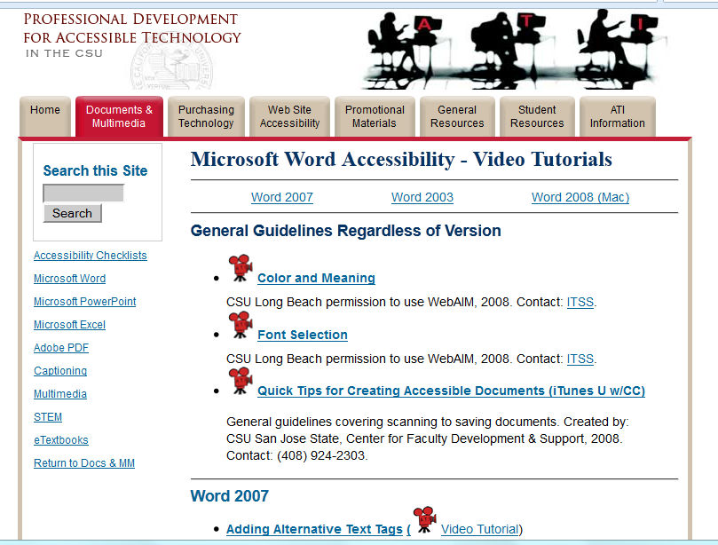
Notes:
On this site, once again, you’ll find a wealth of easy to understand and follow instruction on how to make word documents accessible

Slide 19
What’s an instructor to do, cont’d
Understand that:
People with a variety of disabilities utilize screen readers to access their course material. A screen reader is software that processes text and reads it aloud.
Checking your Word document for accessibility
Notes:
From the link that is now on your screen, you can find easy to follow instructions for how to ensure that documents you have already created are accessible; and if they are found to be inaccessible, how to fix them. And on the next slide is a screen shot of what this site looks like.

Slide 20
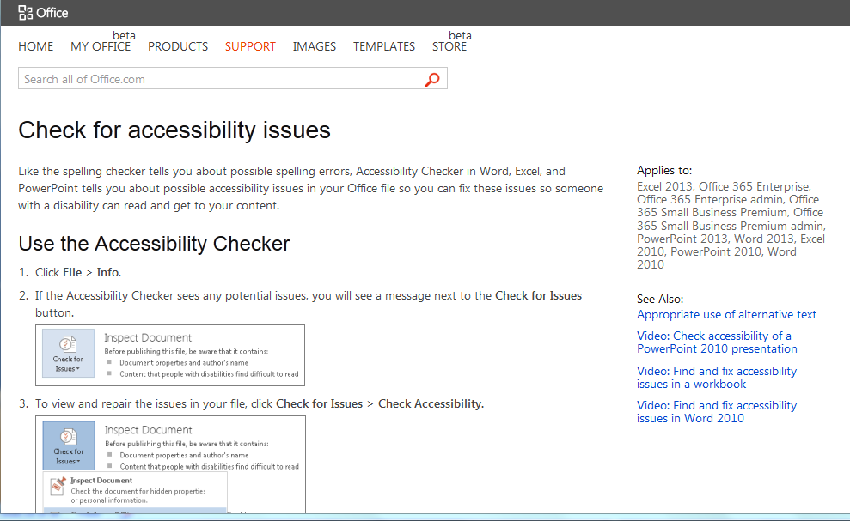
Notes:
How to check your documents for accessibility

Slide 21
What’s an instructor to do, cont’d
3. Look for captioned videos and/or provide transcripts of videos: how to make captioned videos
(Open the link above and view from 1:00 to the end)
Notes:
As an instructor You should also understand that, for people who cannot hear or who may be reviewing your material in a noisy environment, captions are necessary. There are many videos available on the Internet that already have captions. Whenever I search Google or YouTube for a video, I always include the topic for which I am searching along with the word “captioned” to increase my chances of finding a video that is already captioned. If you can’t find a captioned video for your purposes, please provide at least a transcript. Another option is to produce your own video and load it onto YouTube. Please open the link above and view from 1:00 through the end of the video

Slide 22
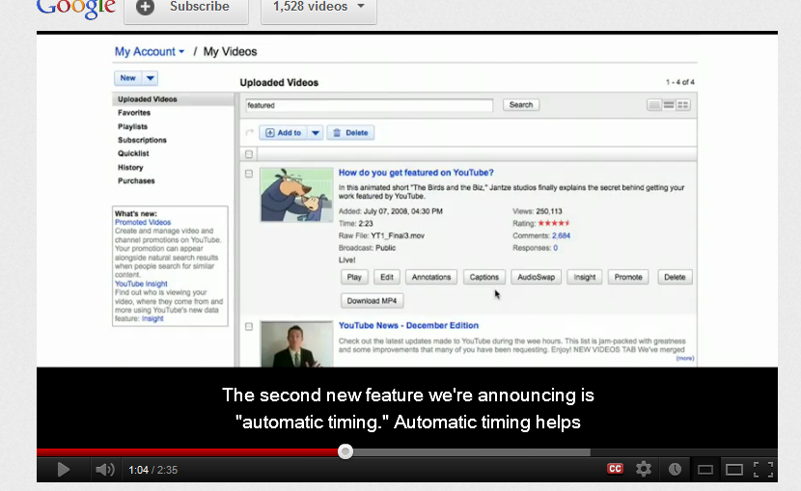
Notes:
This is a screen shot of the video you should have just listened to

Slide 23
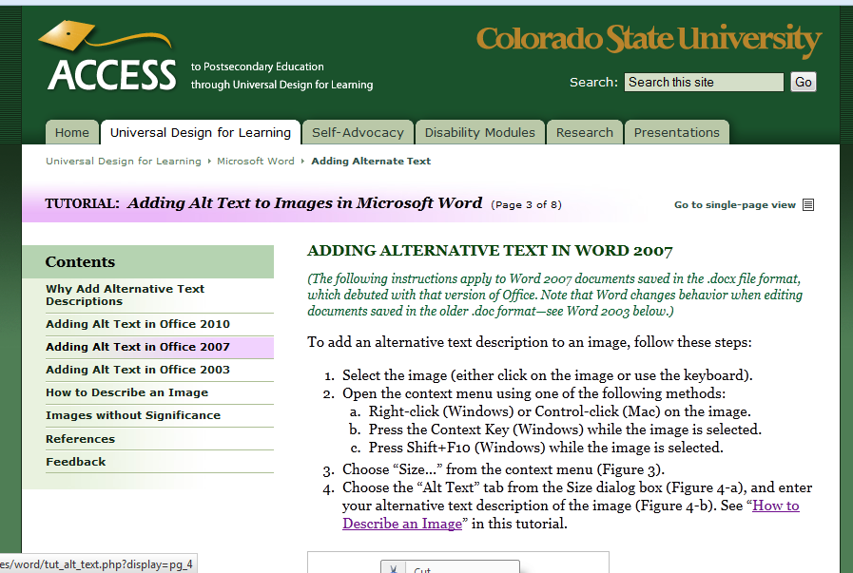
What’s an instructor to do, cont’d
4. Provide “meaningful alt tags” on graphics/pictures: how to add “alt tags”
Notes:
Although there are many, many more elements necessary to make documents accessible, the final one that I want to review is adding meaningful alternative tags, also known as “alt tags” to your graphics; and alt tag allows a person who cannot see or visualize your graphic to still access the message you are trying to convey with the graphic. I want to emphasize “meaningful” ; this is important so that the student who cannot see the image you are presenting can still benefit from the image as much as the person who can see it. Typing out the word “graphic” or “picture” as the alt text, for example, will hold no meaning for the person trying to interpret what, exactly, your picture or graphic is trying to convey. (This screen shot is from the site you will find if you were to click on the link on this screen called “alt tags”

Slide 24
Other Considerations
Good course design benefits all learners, not only those with disabilities.
Concentration should be placed on content rather that flashy graphics or audio.
Following are some simple guidelines to meet the needs of various users.
From http://www.fresnostate.edu/academics/tilt/documents/Tips_on_creating_accessible_course_content.pdf
Notes:
Along with the previous hints and suggestions, I’d like to add a few more: Good course design benefits all learners, not only those with disabilities.
Concentration should be placed on content rather that flashy graphics or audio.
Following are few more simple guidelines to meet the needs of various users.

Slide 25
Screen layout
Maintain a simple, standard page layout. Buttons, links and logos should appear in the same place throughout the site and not move position from page to page.
Notes:
Screen Layout
Maintain a simple, standard page layout. Buttons, links and logos should appear in the same place throughout the site and not move position from page to page. This concept applies more to our learning platform, but it is also important for those of us who upload many documents. If we keep our format similar, the documents are easier for everyone to navigate.

Slide 26
Background
Keep backgrounds simple and make sure that there is adequate contrast between the background and the text.
Notes:
Background
Keep backgrounds simple and make sure that there is adequate contrast between the background and the text. This is another tip that can make documents, overall, easier to view, not only for those with disabilities, but also those who may be in environments that have poor lighting or light sensitivities. For example, I am currently working with a student who has frequent migraines and wears sunglasses whenever she is on the computer. When there is not enough contrast on a slide or document, the words tend to blend into the background.

Slide 27
Buttons
Make sure that buttons are large enough to be accessed by someone with limited fine motor skills using a standard mouse.
Notes:
Buttons
Make sure that buttons are large enough to be accessed by someone with limited fine motor skills using a standard mouse. This is something to consider if you are using surveys.

Slide 28
Graphics
Provide alternate text for each graphic and include descriptive captions for pictures.
Notes:
Graphics
Provide meaningful alternate text for each graphic and include descriptive captions for pictures. This increases the chances of someone who cannot see your graphic to still be able to access the meaning you are trying to convey.

Slide 29
Link Descriptions
Make links descriptive so that they are understood out of context. Label links to embedded documents – instead of www.elearning/assign1/css101/, try: Assignment 1.doc
Notes:
Link Descriptions
Make links descriptive so that they are understood out of context. Give web links meaningful names. For example– instead of www.elearning/assign1/css101/, try: Assignment 1.doc / This is important so that a person using screen reading software can easily identify what is contained in the link they are about to access. It is also nice for a person who is simply looking at the link to know the purpose of the link.

Slide 30
Audio
Be sure to provide captioning and transcription for video or sound clips.
Notes:
Be sure to provide captioning and transcription for video or sound clips. Again, not only will this benefit the person who is deaf or hard of hearing, but also for a person who is in a noisy environment or second language learners.

Slide 31
And plan ahead
Learning platforms are usually accessible
But it is up to you to insure the materials you post to the platforms is accessible . . .
One bite at a time
Notes:
And finally, plan ahead.

Slide 32
Resources
Powerful video from the government of Australia
Student experiences
Accessible Power Point tutorial
Accessible Word document tutorial
Checking your Word document for accessibility
How to make captioned videos
“Alt Tags”
More Tips
cpoorepariseau@kaplan.edu
Notes:
Each resource on this page contains valuable, easy to understand information. You will have access to this presentation at some point, but if you’d like me to email this presentation today, so you have quick access to these resources, please email me at the address below.

Slide 33
References
Fresno State. (n.d.). Tips on Creating Accessible Course Content. Retrieved From http://www.fresnostate.edu/academics/tilt/documents/ Tips_on_creating_accessible_course_content.pdf
Schwartz, L. (2004). Using Internet audio to enhance online accessibility. International Review of Research in Open and Distance Learning, 5(2), 1-7.

