Slide 1
Faculty Perspectives on Information Literacy
What they want, and what we can do about it
Laura Saunders
NERCOMP 2014
Providence, RI
Notes:
Culture: values, understandings, assumptions held in common, guide decision making and behavior
Institutional and Organizational Culture
Faculty vs. Administration vs. Librarians vs. Students
Inter- and Intra departmental/discipline cultures
Why is this so important?

Slide 2
Information Literacy: What and Why
Wide recognition of importance of IL
Relevance
Collaboration
Integration
Mission alignment
Stakeholders
Image from http://www.speedofcreativity.org/2014/01/14/you-must-watch-this-we-need-educational-change-but-not-high-stakes-accountability/

Slide 3
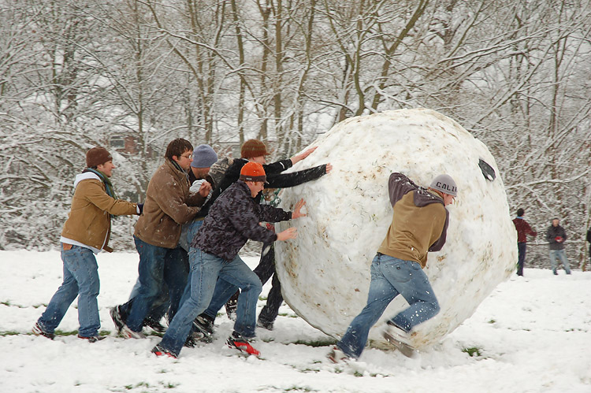
Information Literacy: The Reality
One shot courses
General education
Lack of assessment
Image from http://upload.wikimedia.org/wikipedia/commons/2/23/Giant_snowball_Oxford.jpg

Slide 4
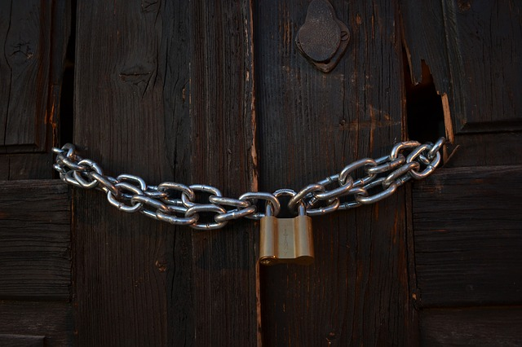
What are the barriers?
Image from http://pixabay.com/en/chains-lock-doors-protection-23041/

Slide 5
Faculty Perspectives
Similarities & Differences

Slide 6
“I can’t think of anything you can do in the world today that you can do without this… no task that doesn’t involve information. Every person in the world today at every level needs it.”
Image from http://www.flickr.com/photos/heathbrandon/3187207970/sizes/m/in/photostream/

Slide 7
Faculty Perspectives: Common Concerns
Searching
Sources
Evaluation
Image from http://pixabay.com/en/search-to-find-magnifying-glass-276746/; http://revolution689.deviantart.com/art/Googie-Google-217276500; http://openclipart.org/detail/544/balance-scale-by-gerald_g

Slide 8
The idea of digital natives is such a lie
Image from http://www.flickr.com/photos/dumfstar/8553473662/sizes/m/in/photostream/

Slide 9
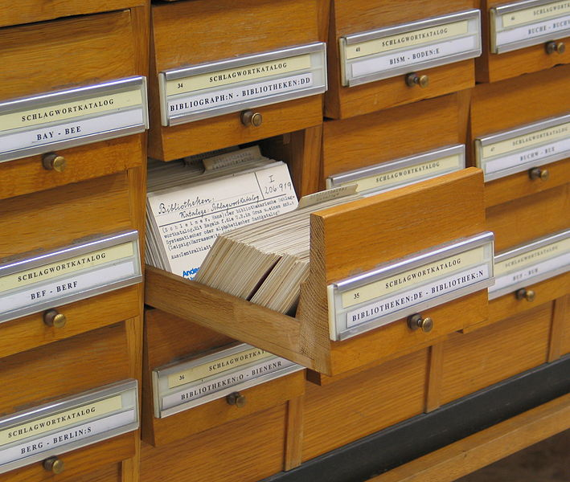
The art of thinking like a cataloger is lost
Image from http://en.wikipedia.org/wiki/File:Schlagwortkatalog.jpg

Slide 10
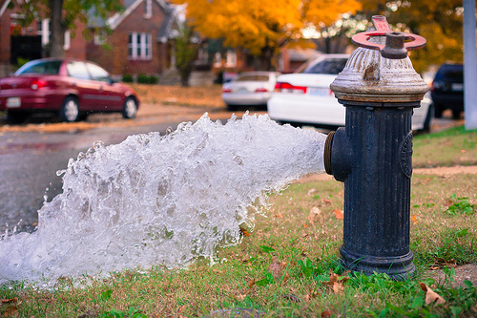
The more information is available, the less students seem to use it
Image from http://www.flickr.com/photos/95269083@N00/10656812015/sizes/m/in/photostream/

Slide 11
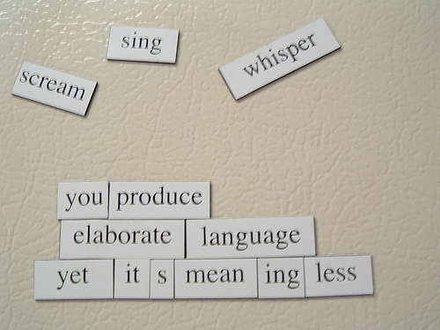
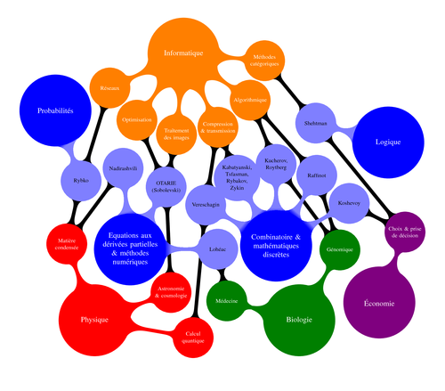
Disciplinary Differences: Sources & Evaluation
Images from:1) http://en.wikipedia.org/wiki/Project_4.1 2) http://www.texample.net/tikz/examples/scientific-interactions/

Slide 12
Librarian Perspectives
Challenges & Opportunities

Slide 13
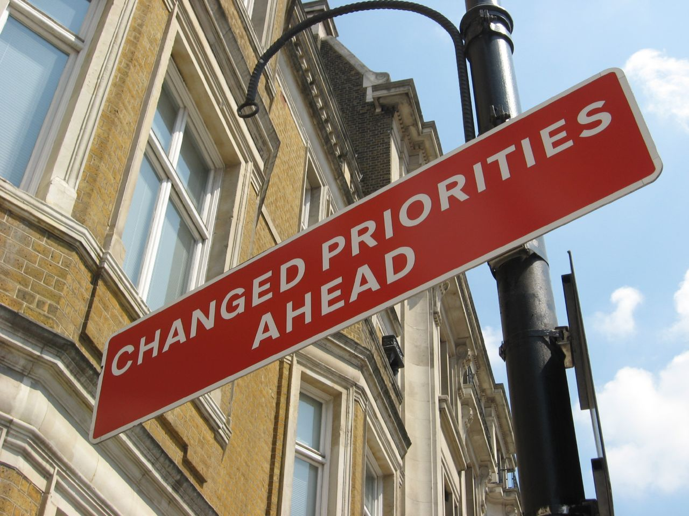
How Do We Accommodate?
Image from http://acreelman.blogspot.com/2014/03/only-connect.html; Image from http://www.flickr.com/photos/redvers/532076662/
Notes:
Recognize and acknowledge discipline differences among faculty- some disciplines more interested/responsive
But also comes down to the individuals
But how do we vary our instruction?
Adapt to course or assignment: Mostly through
Subject-specific databases
Focus is heavily on searching and sources (esp. articles/peer –review)
Minimal variation in how we reach out to faculty: I treat all faculty equally

Slide 15
What the experts say
Collaboration is key
Move past search and retrieval
Threshold concepts
Define and demonstrate relevance
Importance of assessment

Slide 16
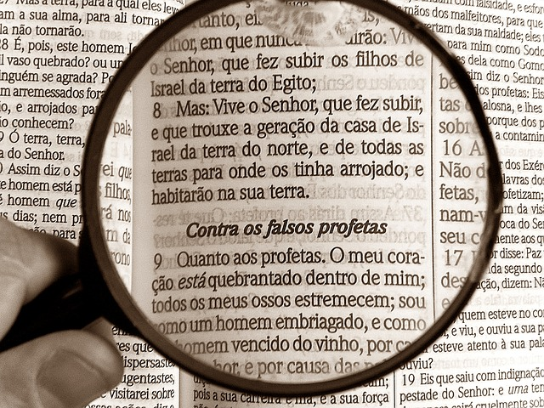
The role of the librarian is to turn students into skeptics
Image from http://pixabay.com/en/magnifying-glass-bible-bibliology-162887/

Slide 17
Of Librarians and Languages
Image fromhttp://www.flickr.com/photos/53370644@N06/4976497160/
Notes:
What steps can we take to improve communications? Understand faculty’s respect for us (change the narrative!)
Talk to them in their own language
Target faculty more than students?

