Slide 1
IdM Building Walls while Breaking Down Barriers
By Bry-Ann Yates and Kim McDonnell

Slide 2
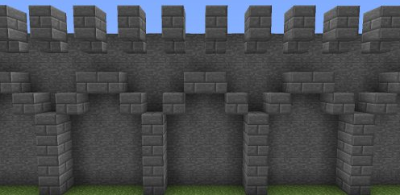
Building Walls

Slide 3
What is IdM?
A security discipline enabling the right individuals to access the right resources
-Gartner.

Slide 4
Foundation for Success
Define and support of IdM Policy from the top down
Well-rounded team

Slide 5
Benefits of our Initiatives
Strengthen internal controls
Educate University on IdM
Adherence & enforcement of IdM Policy
Strengthen collaborative relationships

Slide 6
The Trigger
Forced Automated Provisioning & De-provisioning
40,000 _
30,000 _
20,000 _
10,000 _
34,000
UAlbany
Mail
Accounts
BEFORE
AFTER
5,000

Slide 7
Albany EduPerson Codes
Foundation of automated processes
Implementation
Based on Internet2’s EduPerson Schema
Data from System of Record
63 Customer identification codes and growing!

Slide 8
Albany EduPerson Code Example
UAlbany Eduperson Definition
CREG Current Registered Students
FULL Full Time Employees
FUHS Former Univ. HS Students
ELIG Eligible to Enroll
PROF Professional Employees
STMP State Operations Employees

Slide 9
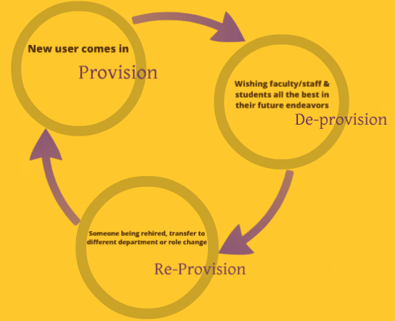
Account Lifecycle
Automation of creation & removal of access based on status at the University

Slide 10
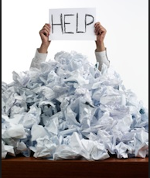
Termination Process
Before UAlbany Mail Conversion
Manual
After UAlbany Mail Conversion
Automation Crucial

Slide 11
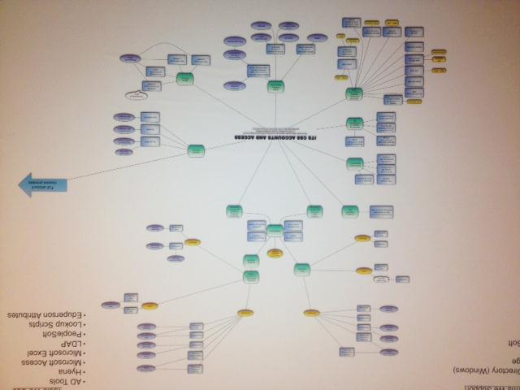
Complexity of Manual Termination

Slide 12
De-Provisioning Notification Automated notification to departments when user’s access level has decreased

Slide 13
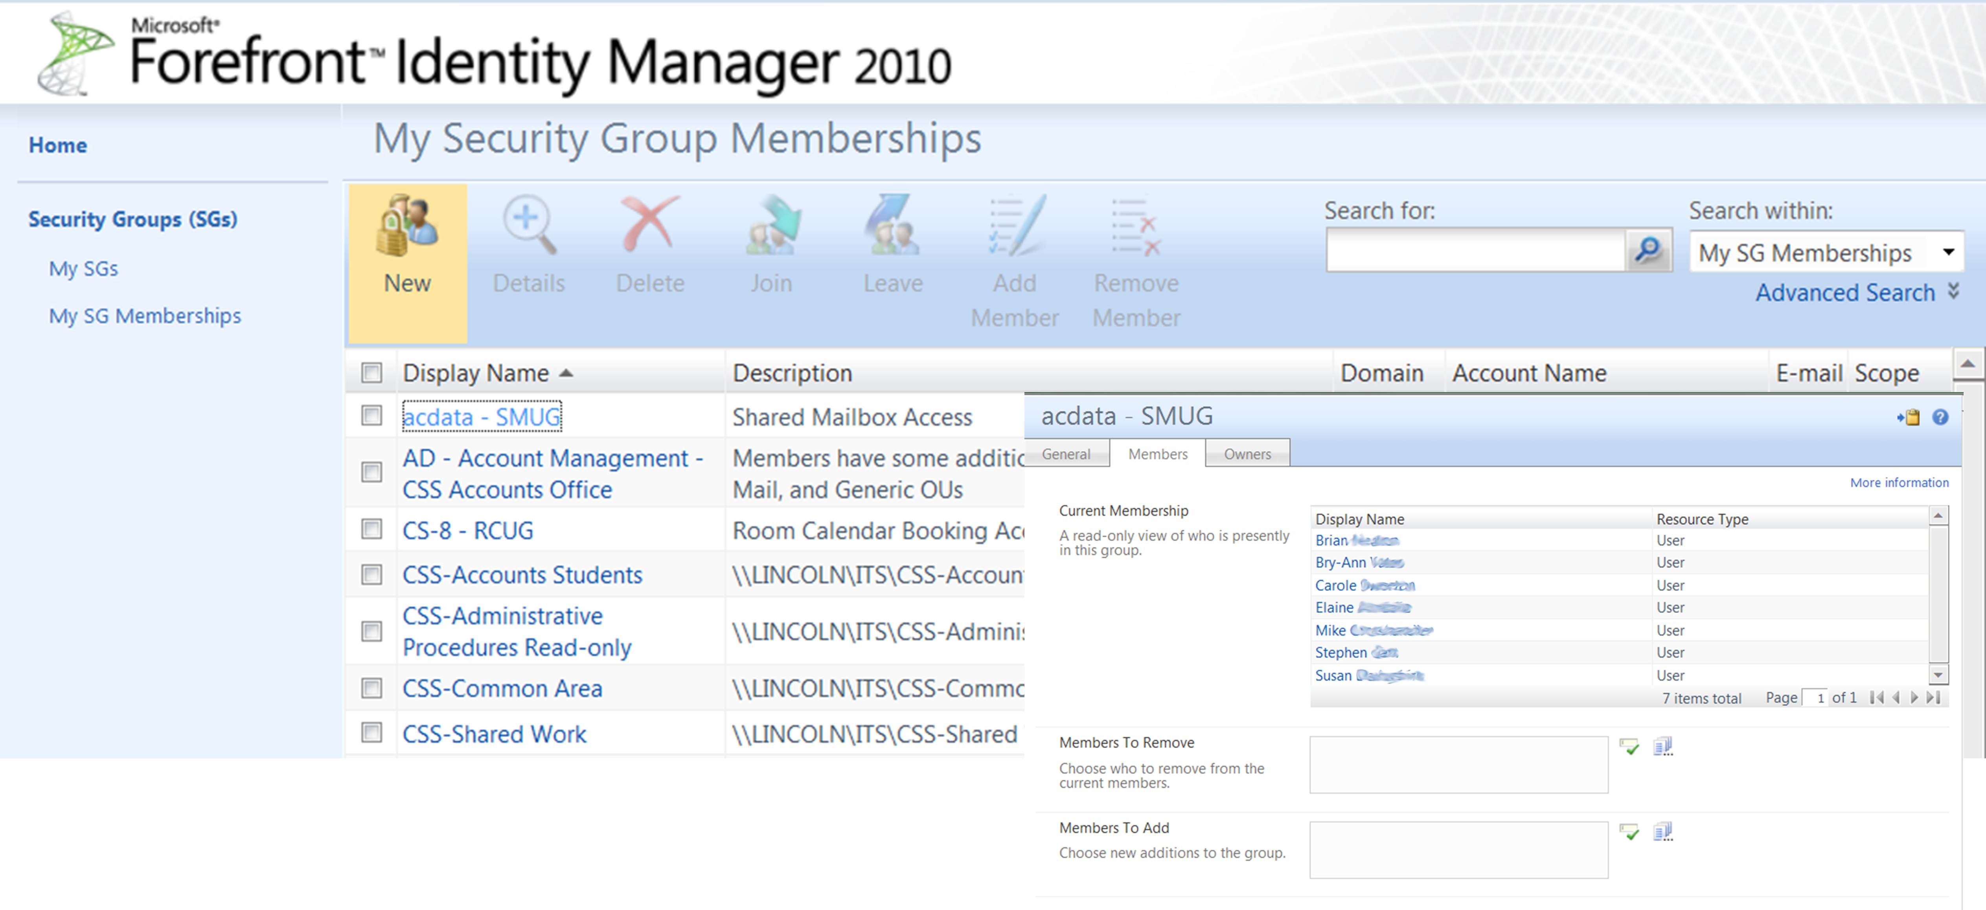
Group Access Manager Portal
Managers update and review users’ access

Slide 14
Breaking Down Barriers

Slide 15
Identify Your Stakeholders
Data Stewards – 3 HR Departments
Customers/Departments
Some departments are “more special” than others

Slide 16
Benefits of our Initiative
Collaboration
Helped achieve buy-in from stakeholders
Developed better understanding of HR’s processes
Worked with other IT groups

Slide 17
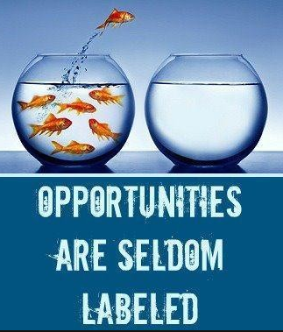
A Seized Opportunity
HR participated in our de-provisioning sessions
Gave HR venue to reach mutual stakeholders
Combined efforts of HR & IT gave customers extra incentive to attend informational sessions

Slide 18
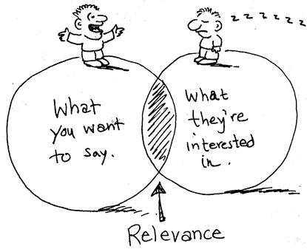
Reach Your Audience
Talk in language your audience understands
Conform/tailor presentation to audience
Create Wiki FAQ/documentation
Positive approach to change is important

Slide 19
After Go Live: Breathe… But Don’t Think You’re Done
Continue outreach months after “Go Live”
Additional de-provisioning follow-up notifications to customers
Refinements of de-provisioning FAQ based on customer feedback

Slide 20
Lessons Learned
Training within system(s) of record department is very important
EduPerson codes are a valuable resource for restricting access to services. Problems can occur without IdM guidance.
Impossible to incorporate every scenario into an Albany EduPerson code
Exception code
Do not assume you know everything about a department

Slide 21
Recipe for Success
Ingredients:
1 Part Senior Leadership Commitment (IdM Policy)
Mix 1 Cup Technical & Non-Technical Individuals
Blend Well with Communication
Add 1 Pound Teamwork
Add 1 Pound Collaborative Venture with Human Resources (Data Steward)
Mix in Motivation to Foster New Relationships (In Person, Phone, Email)
Add 1 Pint Positivity Projected to Customers & Audience
Fold in 1 Pint Communication & Respect of Other IT Staff
Mix in 1 Cup Enthusiasm
Add Several Generous Cupfuls of Organization
Add Dash of Persistence & Flexibility
Blend 1 Cup Patience & Identification with Customers (Walk a Mile in their Shoes)
Add 1 Heaping Tablespoon Caring & Empathy Toward Customers
Mix 2 Cups Listening to Customer Feedback (Even if it Entails Additional Work)
Mix All Ingredients & Blend Well Again with Communication!
✓
✓
✓
✓
✓
✓
✓
✓
✓
✓
✓
✓
✓
✓
✓

Slide 22
Questions?
Copyright Bry-Ann Yates/Kim McDonnell 2014. This work is the intellectual property of the author. Permission is granted for this material to be shared for non-commercial, educational purposes, provided that this copyright statement appears on the reproduced materials and notice is given that the copying is by permission of the author. To disseminate otherwise or to republish requires written permission from the author.
CONTACT: Bry-Ann Yates: byates@albany.edu
Kim McDonnell : kmcdonnell@albany.edu

