Slide 1
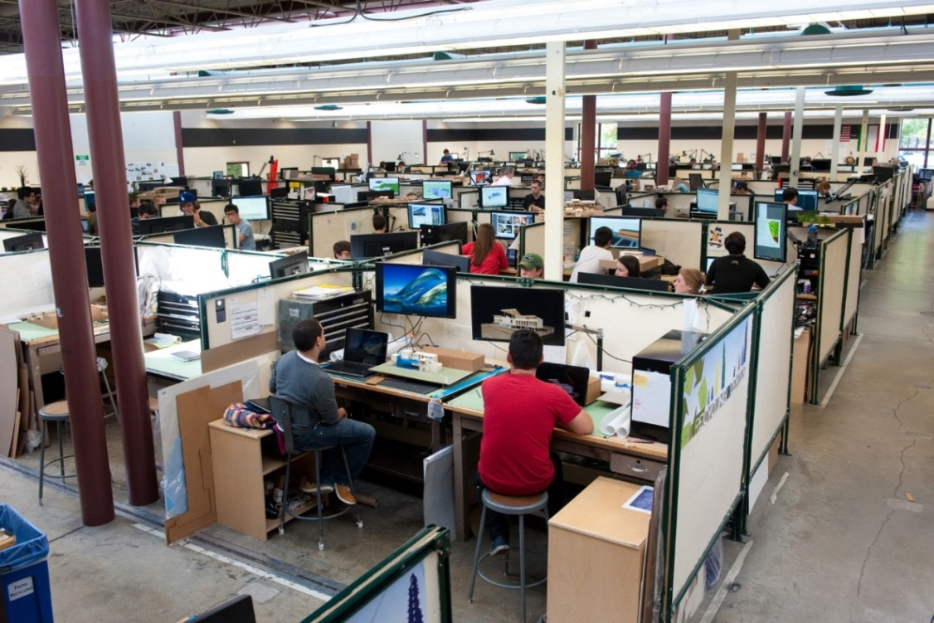
Transforming Design Studio with VDI
(And They Said It Couldn’t Be Done….)
NERCOMP ANNUAL CONFERENCE– MARCH 25, 2014
Roger Williams University
Notes:
We’re going to share some technology-enabled, often online, collaboration strategies in operation at RWU.

Slide 2
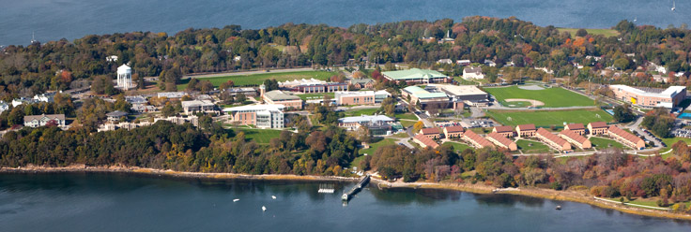
About Roger Williams University
Private Residential Liberal Arts University in Rhode Island
3700 undergraduate , 1500 graduate students
Roger Williams University

Slide 3
2012: The Dilemma
School of Architecture, Art and Historic Preservation
Roger Williams University

Slide 4
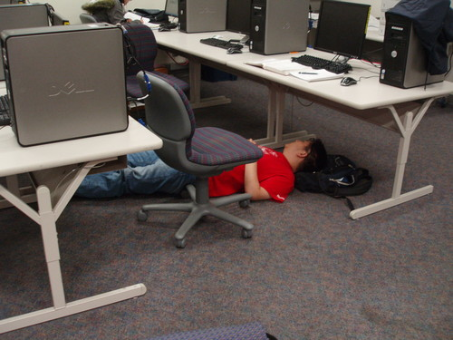
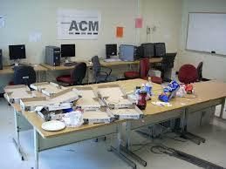
Inadequate equipment
58 computers ≠ 500 students
Slow Rendering Speeds
Rendering DO NOT TOUCH!
Roger Williams University

Slide 5
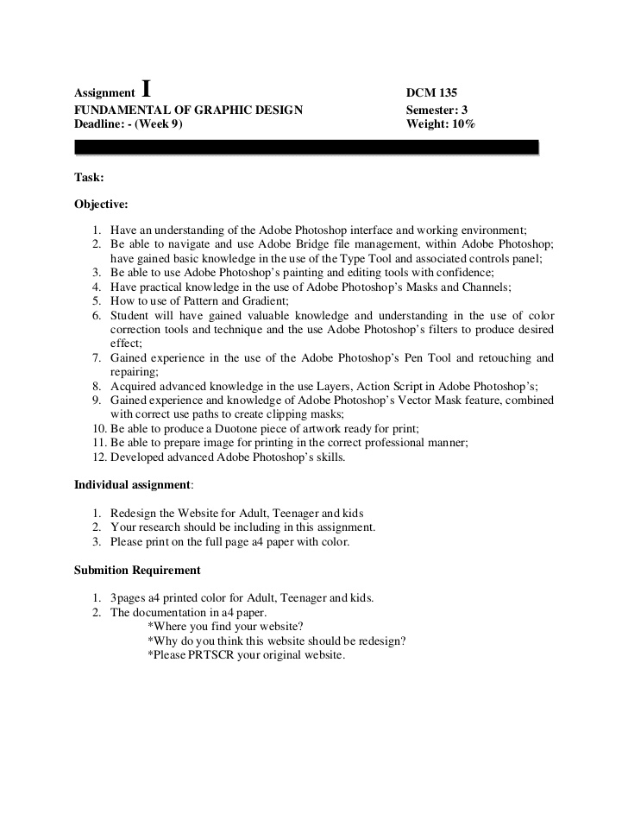
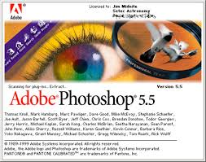
Inflexible Lab Imaging
Annual lab imaging ≠ course software version updates
Roger Williams University

Slide 6
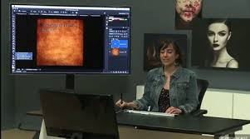
Student And Faculty Software Access
Different software versions between faculty and student labs/classrooms
Licensing restrictions for providing expensive specialized software required for courses to adjuncts
Roger Williams University

Slide 7
Shared and Private Network Space
Only accessible from the labs
Temporary storage
Frequent loss of files
Roger Williams University

Slide 8
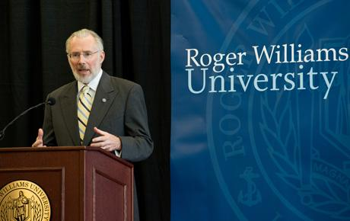
Affordable Excellence Initiative
Launched October 2012
President Donald Farish’s charge:
Seek excellence resourcefully, to allow high
quality education to be accessible to many
Roger Williams University

Slide 9
Finding a Solution
Our Goals:
Allow a diverse computing environment. Transform Architecture studio culture through by providing professional quality in a liberal arts university
All students have access at each workspace to highest quality computing capacity and software
Computing is one tool among many for individual and collaborative work
Roger Williams University

Slide 10
What were other Universities doing?
Some VDI implementations at other institutions
None attempting high-end graphic applications and rendering
Roger Williams University

Slide 11
So what was the profession doing?
or
More questions than answers
Expensive solutions
Roger Williams University

Slide 12
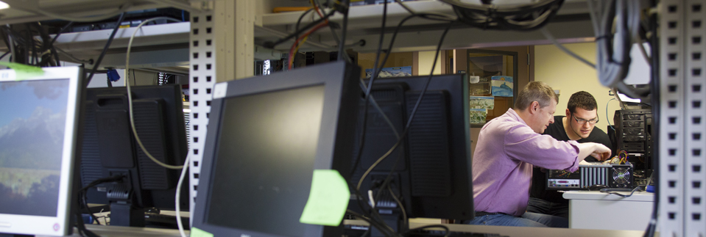
Forensics, Advanced Networking and Security (FANS) VDI - Spring 2012
Dr. Doug White - Jon Gabriel
Roger Williams University
Notes:
In 2011 the director of this program, Dr. Doug White, was frustrated with dealing with students who were unable to download and install the myriad applications needed to participate in their courses. There were many different types of operating systems across Mac and Windows versions that really complicated the process. In Spring 2012 he piloted the use of virtual desktops using VMWare to allow his students to simply log in to his server and utilize the applications virtually. Problem solved.

Slide 13
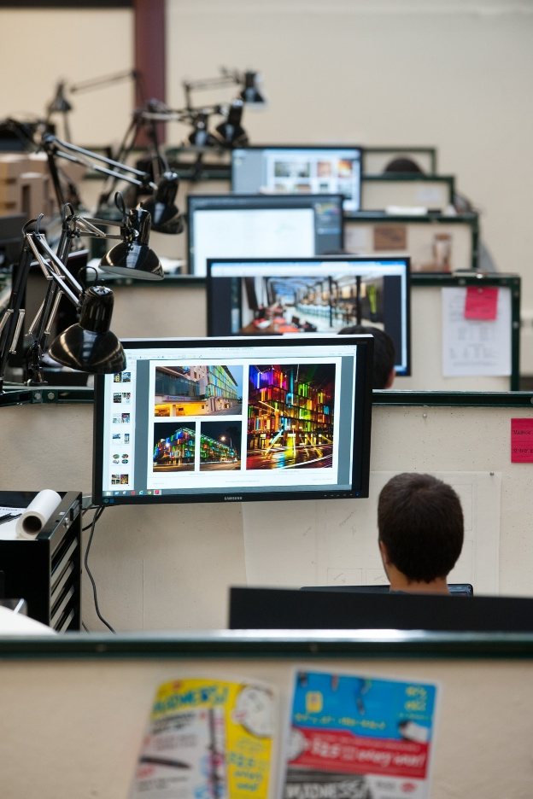
SAAHP/FANS Pilot – Fall 2012 / Spring 2013
36 students Comprehensive Project Design Studio
2 faculty
Roger Williams University
Notes:
NAS Storage/VMWare VIEW
HP Enterprise Server
Teridici graphic accelerator cards
100 Samsung monitors on rotating mounts
Custom desktops by course

Slide 14
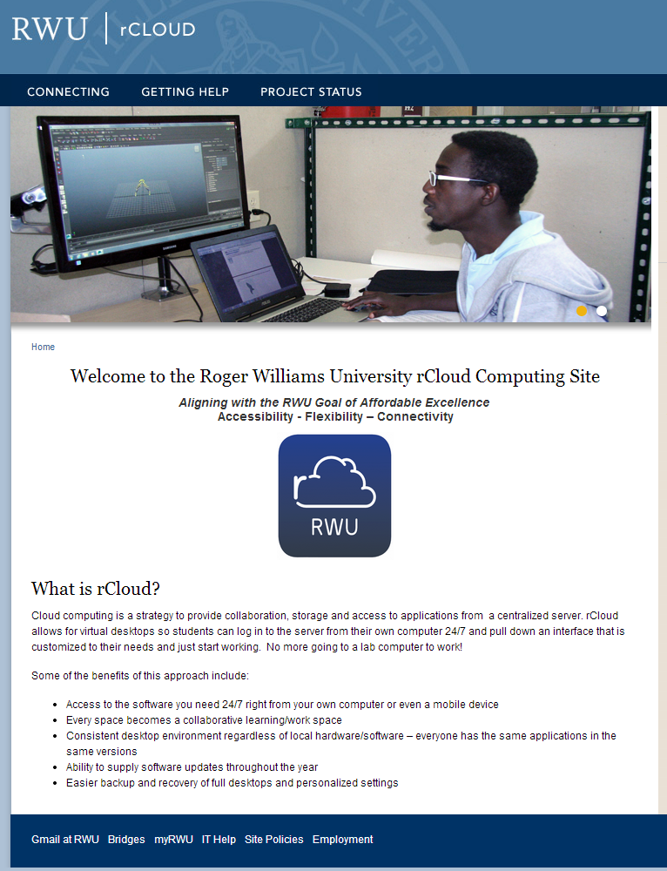
Phase 2 – Fall 2013 – RCloud is Born
Two Schools
School of Architecture, Art and Historic Preservation
School of Continuing Studies
Roger Williams University
Notes:
Using the information learned from Spring pilot, vendors were interviewed and plans were made to roll out VDI to the entire SAAHP school as well as the School of Continuing Studies and our distance programs. The VDI project was named rCloud.

Slide 15
Phase 2 – Switch Hardware/Software
Contract with Logical Front for Implementation – August 2013
Roger Williams University
Notes:
Based on cost comparisons as well as performance a decision was made to switch to a Dell/Citrix solution using the newest nVidia graphics accelerator cards. Because time was short, contracted with Logical Front to implement for Fall.
Hardware
12 Dell R720 Servers
12 nVidia K2 grid GPU
2 Dell R620/Dell EquaLogic Ps6510X Storage
Citrix Netscaler
Software
Citrix XenDesktop 7.1 Enterprise Education
Citrix Receiver 4.1

Slide 16
Fall 2013: Samsung Design Studio
375 Studio Desks with 27” Monitors
9 65” interactive Touch Screens in Collaborative Learning Spaces
Digital Signage
Roger Williams University

Slide 17
Transforming Learning Spaces--SAAHP
Increased software access to all
500 students
Custom virtual desktops – 3 tiers
Consistent platform
Roger Williams University
Notes:
Key Serve software to 500+ SAAHP students & Faculty

Slide 18
Transforming Learning Spaces--SAAHP
Increased rendering speed and file sharing
Re-purpose lab computers for rendering farm
Shared and individual cloud storage
Roger Williams University

Slide 19
Transforming Learning Spaces - SCS
Increased Access: created virtual desktops for 700+ distance students and faculty
Samsung Collaborative Learning Lab - trade hardware refresh for thin clients
Access lab software from all classrooms with BYOD
Roger Williams University

Slide 20
Transforming Learning Spaces Increased Collaboration / Learning Together
Roger Williams University
Notes:
Collaboration in the studios has increased significantly. The large monitors are visible throughout the studios and have encouraged discussion and comments across studios. The ability to use the shared space on the server to store files allows students to pull up each other’s work on their monitor and work together and with their faculty on projects.

Slide 21
Transformation of Learning using Samsung Displays and Cloud Technology Video

Slide 22
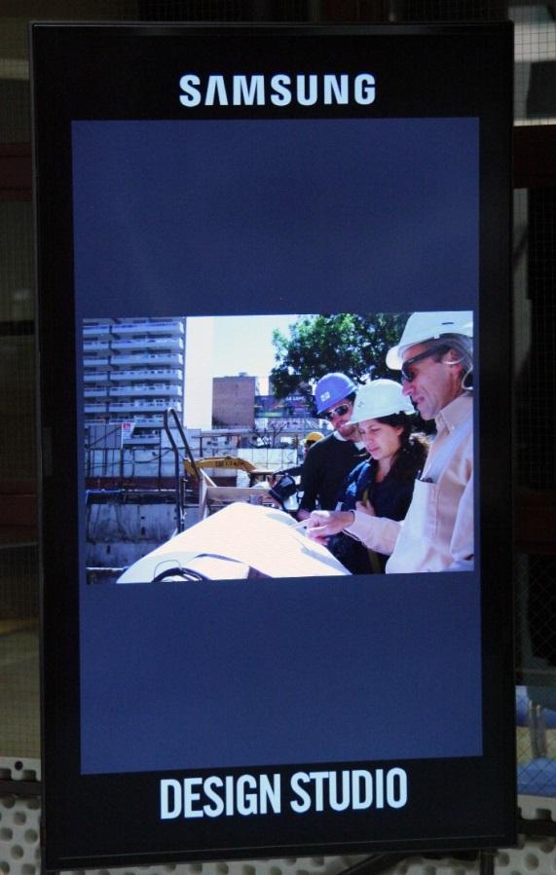
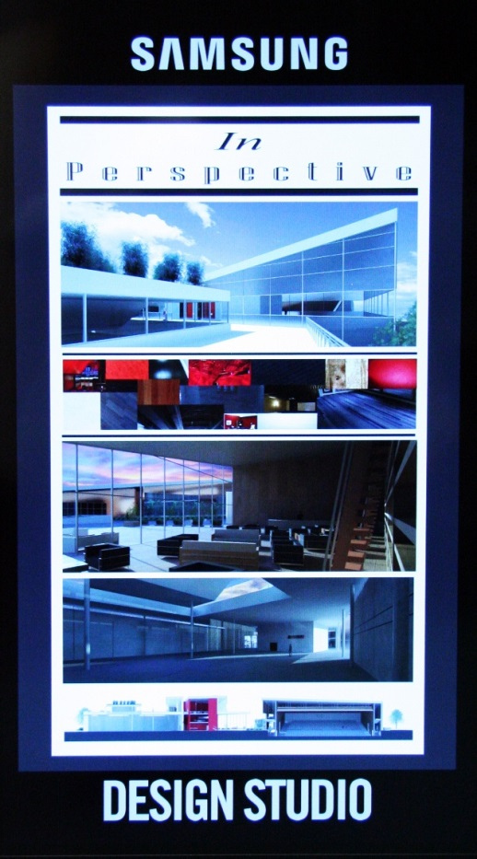
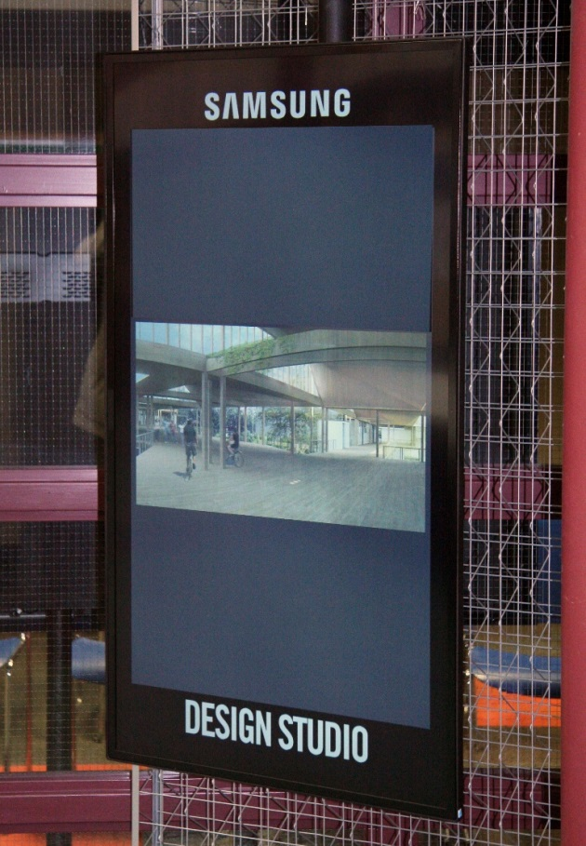
Transforming Learning Spaces Showcasing Student Work and Events
Digital Signage picture
Roger Williams University
Notes:
All faculty and students have the same software images which greatly facilitates instruction and also makes every classroom a lab. We have even taken down a lab and recycled the computers into a rendering farm.

Slide 23
Next Steps/Challenges
Increase network bandwidth from 1Gb to 10 Gb
Automate custom desktop creation
Phase in VDI to entire University
Explore teaching strategies to leverage VDI
Roger Williams University

Slide 24
University Goals: 2014-2016
Increase Project-Based Collaborative Learning Spaces
Transform Teaching Labs to Cloud based system
Unified Digital Display System
Transform faculty and staff computing – performance, efficiency, mobility, affordability
Roger Williams University

Slide 25
University Goals: 2014-2016
Extend University Outreach to HS, Community and Workforce Development Groups
Establish Demonstration Center
Evolve Partnership + Case Study Publications
Re-imagine IT goals and Support structure
Roger Williams University

Slide 26
RWU Contacts
Andy Workman, Provost and Sr. Vice-President for Academic Affairs – aworkman@rwu.edu
Stephen White, Dean, School of Architecture, Art and Historic Preservation – swhite@rwu.edu
Greg Laramie, Assistant Dean – glaramie@rwu.edu
DJ Alexander, Portfolio and Documentation Manager – dalexander@rwu.edu
Linda Beith, Director of Instructional Design – lbeith@rwu.edu
Roger Williams University

Slide 27
Transforming Design Studio with VDI
(And They Said It Couldn’t Be Done….)
NERCOMP ANNUAL CONFERENCE– MARCH 25, 2014
© Roger Williams University – 2014. This work is the intellectual property of the authors. Permission is granted for this material to be shared for non-commercial, educational purposes, provided that this copyright statement appears on the reproduced materials and notice is given that the copying is by permission of the authors. To disseminate otherwise or to republish requires written permission from the authors.
Roger Williams University

