Slide 1
Designing for Engagement
Community of Inquiry in Practice
John McCormick | Senior Instructional Designer | @JohnLearnDesign
Sarah Krongard | Instructional Designer | @sk7790
NERCOMP Annual Conference 2014

Slide 2
Conditions to Support Deep Learning
Community
of Inquiry
Personal
Application
Challenges
In Action

Slide 3
Think of something you understand well.
How did you develop this deep understanding?
What conditions supported your learning?
http://tinyurl.com/coinercomp

Slide 4
What are the challenges of designing for deep understanding in an online learning environment?
http://tinyurl.com/coinercomp

Slide 5
Workshop Goals
To explore the Community of Inquiry model
as a framework to guide design & facilitation of deep learning experiences online
To examine concrete examples of the COI model
in practice

Slide 6
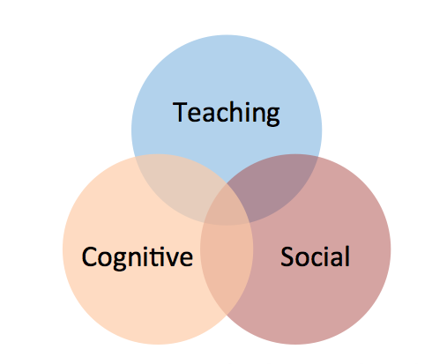
Community of Inquiry Framework
Teaching +
Social +
Cognitive Presences
= Online Learning Experience

Slide 7
Relationships Among the Presences
Teaching Presence
Cognitive Presence
Social Presence
Notes:
.

Slide 8
Social Presence
Climate & Culture

Slide 9
Social Presence
Interpersonal Communication

Slide 10
Social Presence
Interpersonal Communication
Open Communication

Slide 11
Social Presence
Interpersonal Communication
Open Communication
Cohesive Communication

Slide 12
Teaching Presence
Management and Facilitation
Notes:
http://cde.athabascau.ca/coi_site/documents/Anderson_Rourke_Garrison_Archer_Teaching_Presence.pdf

Slide 13
Teaching Presence
Organization / Design
Notes:
http://cde.athabascau.ca/coi_site/documents/Anderson_Rourke_Garrison_Archer_Teaching_Presence.pdf

Slide 14
Teaching Presence
Organization / Design
Facilitation
Notes:
http://cde.athabascau.ca/coi_site/documents/Anderson_Rourke_Garrison_Archer_Teaching_Presence.pdf

Slide 15
Teaching Presence
Organization / Design
Facilitation
Direct Instruction
Notes:
http://cde.athabascau.ca/coi_site/documents/Anderson_Rourke_Garrison_Archer_Teaching_Presence.pdf

Slide 16
Cognitive Presence
Connections and Meaning
Notes:
http://cde.athabascau.ca/coi_site/documents/Garrison_Anderson_Archer_CogPres_Final.pdf

Slide 17
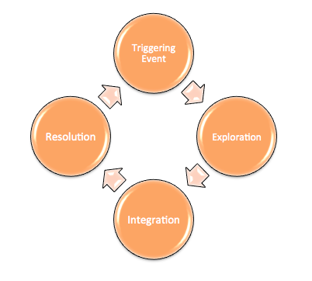
Cognitive Presence
Practical Inquiry Cycle
Notes:
http://cde.athabascau.ca/coi_site/documents/Garrison_Anderson_Archer_CogPres_Final.pdf

Slide 18
COI: 3 Presences
Examples of Learning Activities
How do examples illustrate presences?
What conditions support presences?
What is evidence of presences?
Notes:
(John END)

Slide 19
Example: Cyberbullying Course
8-week fully online course
Graduate, ed tech program
Integration of social media

Slide 20
Example: Cyberbullying Course

Slide 21
Example: Cyberbullying Course
#ecomp6012
Notes:
*how it is scaffolded

Slide 22
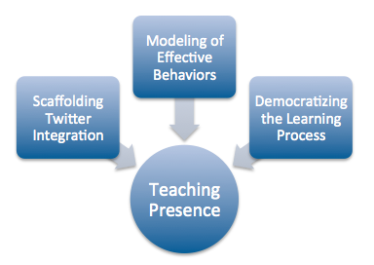
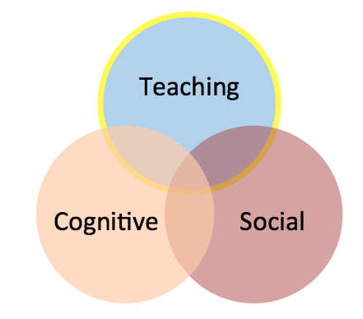
Example: Cyberbullying Course

Slide 23
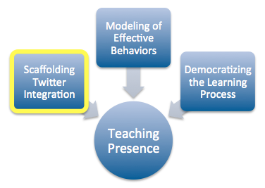
Example: Cyberbullying Course
Shared Definitions
Research Base
Personal Connections
Cyberbullying
Inside the Technology
Legal Implications
Personal Action

Slide 24
Example: Cyberbullying Course
Shared Definitions
Research Base
Personal Connections
Cyberbullying
Inside the Technology
Legal Implications
Personal Action

Slide 25
Example: Cyberbullying Course

Slide 26
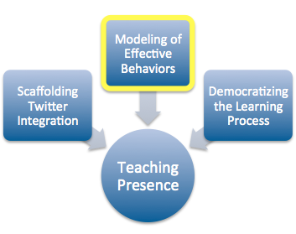
Example: Cyberbullying Course

Slide 27
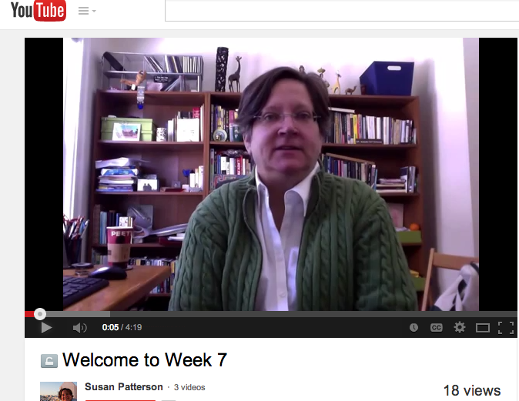
Example: Cyberbullying Course

Slide 28
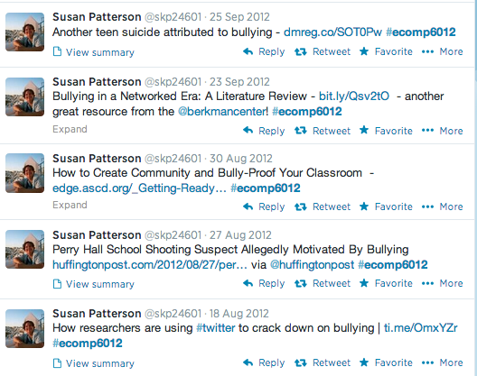
Example: Cyberbullying Course

Slide 29
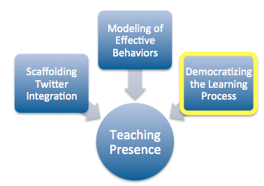
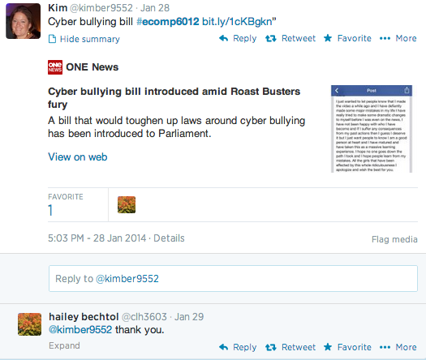
Example: Cyberbullying Course

Slide 30
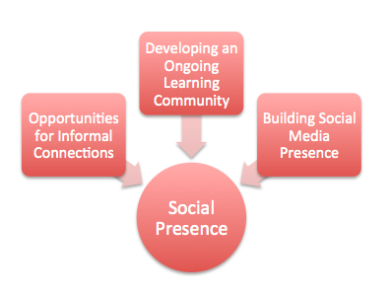
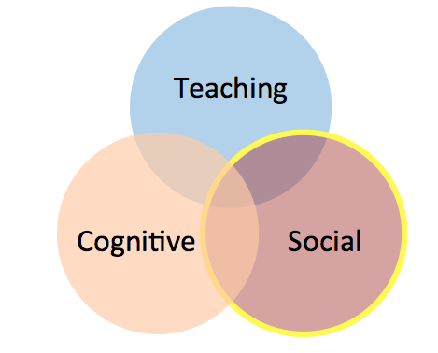
Example: Cyberbullying Course

Slide 31
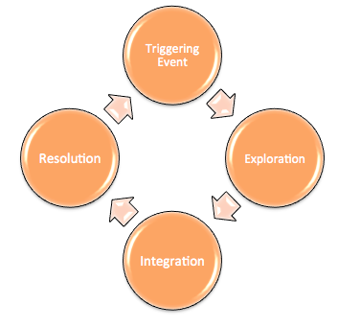
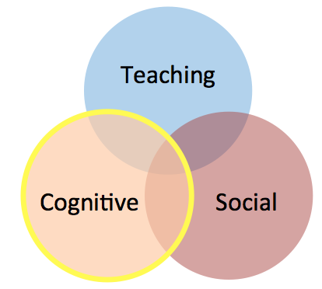
Example: Cyberbullying Course

Slide 32
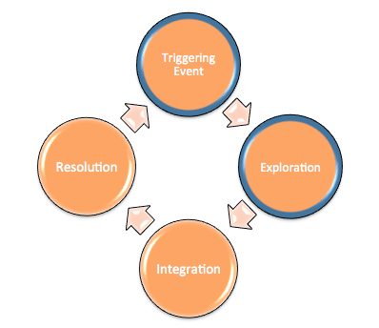
Example: Cyberbullying Course

Slide 33
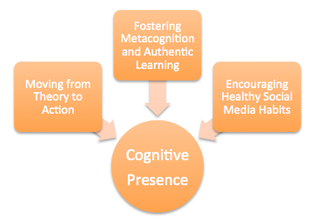
Example: Cyberbullying Course
Practical Inquiry Cycle

Slide 34
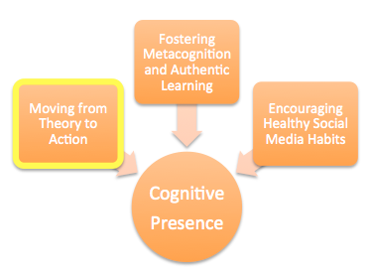
Example: Cyberbullying Course
Practical Inquiry Cycle

Slide 35
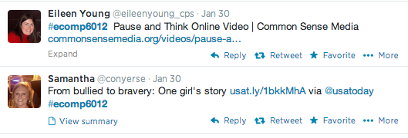
Example: Cyberbullying Course
Practical Inquiry Cycle

Slide 36
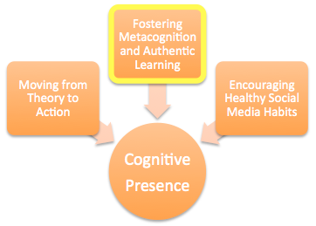
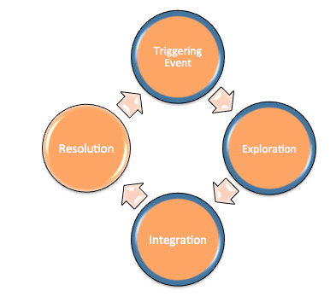
Example: Cyberbullying Course
Practical Inquiry Cycle

Slide 37
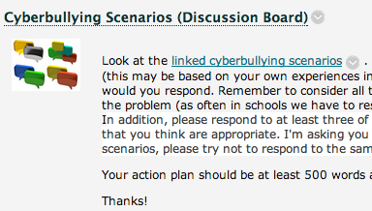
Example: Cyberbullying Course
Practical Inquiry Cycle

Slide 38
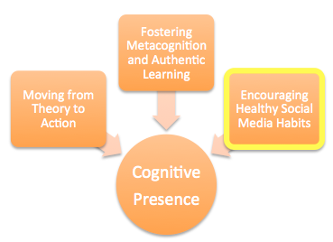
Example: Cyberbullying Course
Practical Inquiry Cycle

Slide 39
Cyberbullying: COI Summary
Scaffolding process skills & content knowledge
Empowering students with agency & ownership
Building opportunities for peer-learning
Ensuring sound pedagogy drives tech integration

Slide 40
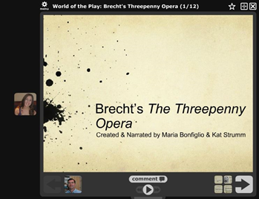
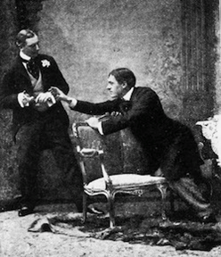
Example 2: Collaborative Presentation in Drama
“World of the Play”

Slide 41
Learning Activity
Research, analyze and report on the historical and cultural contexts of the time of the play and the “world of the play” itself (setting, characters, language and style).

Slide 42
Sequence of Learning
Collaborate with partner on project plan.
Receive feedback on plan from instructor.
Research and analyze play.
Create presentation, presenting findings to class.
In peer review, receive feedback from classmates and instructor.

Slide 43
Cognitive Presence
“Construct meaning through sustained engagement”
- Garrison

Slide 44
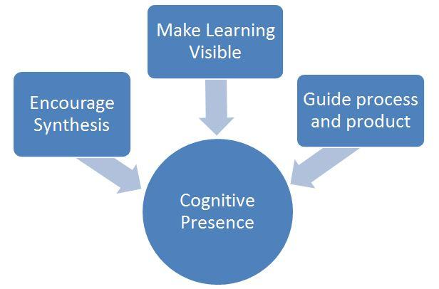
Conditions for Cognitive Presence
Reward via assessment
Highlight desired behavior
Setting expectations
Guidance for group planning
Performance criteria (rubric)
Feedback- process/product
Transparency of process- Draft plan in wiki
Spaces: Works in progress, communication, presentation
Public sharing of work
Learning approach
Notes:
3 Areas Encapsulate the conditions/supports
Guide process and product (includes feedback and other supports- rubrics, setting expectations - group process, peer feedback. Feedback on project plan (instructor), presentation (students and instructor)
Make learning visible -transparency of knowledge- building process (wiki), product shared, support for metacognition- how students should approach learning made explicit by instructor.
Synthesis - Guides students to make connections - rubric criteria rewards “building on and synthesizing ideas of others”, and communications from instructor in feedback highlight these behaviors. Assessment rewards this -collaborative slides

Slide 45
Conditions for Cognitive Presence:
Peer feedback guidance
You will provide feedback to your peers on the ‘World of the Play’ Group Presentations and the Creative Project, and critique peers’ Research Paper drafts. Focus your comments on the particular assignment’s grading criteria provided in the assignment (and the syllabus) to critically analyze your peers’ work, and communicate clearly about how effectively they accomplished the goals of each assignment.

Slide 46
...If you have not yet commented…., please do so, and again, these projects are meant to be part of our course materials and may be used in discussions and papers, as any other text.
…D., I specifically appreciate how you explore an idea about language and idiomatics (that arose from watching their project) in your own discussion post. That is an excellent way of connecting what we learn from assignment to assignment, rather than seeing each in isolation. I encourage all of you to do this kind of ‘cross-pollination’ and integrative thinking.”
Conditions for Cognitive Presence:
Guidance to students during facilitation

Slide 47
Evidence of Cognitive Presence:
Feedback to peers

Slide 48
Personal Application
Think about your context. How might you integrate the Community of Inquiry Model to support your environment?
What challenges might you face moving forward? How might you address these challenges?

Slide 49
Resources: https://sites.google.com/site/nercompcoi/
Keep in Touch:
John McCormick | jmccormi@lesley.edu | @JohnLearnDesign
Sarah Krongard | krongard@lesley.edu | @sk7790

