Slide 1
Apple TV and iPads in the Classroom: Hand them out and everything just works, right?
Adam Hauerwas - Ed Morin - Siobhán Ross
Providence College
NERCOMP Annual Conference March 26, 2014 Providence, Rhode Island

Slide 2
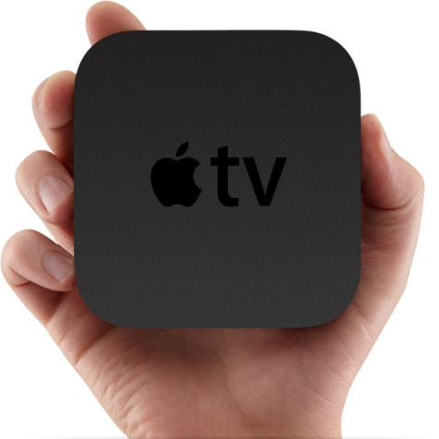
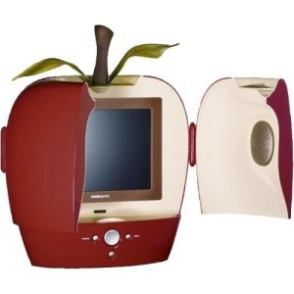
Roadmap
Background
Pilot
Rollout
Fallout
Academic use scenarios
Non-academic uses
Summer changes
http://techcrunch.com/2011/02/18/apple-job-posting-asks-for-tv-power-supply-engineer-apple-hdtv-in-the-works/
http://www.idownloadblog.com/2013/02/14/how-to-jailbreak-ios-6-1-5-2-apple-tv-2/
http://blogs.wpri.com/files/2011/08/Providence_subway_map.jpg

Slide 3
Providence College is a primarily undergraduate, liberal arts, independent, not-for-profit, Catholic institution of higher education.
Located in historic Providence, Rhode Island
Founded in 1917, PC is the only college in the nation operated by the Dominican Fathers of Saint Joseph
~3,900 undergraduate students
~1,800 graduate and continuing education students
Highlight Program: Development of Western Civilization, 4-semester lecture- and seminar-based courses required of all first and second year students
Image courtesy of: http://www.unigo.com/explorer/photos/photodirectory.aspx?collegeid=239

Slide 4
Definitions
AMS = Academic Media Services -- the classroom tech folks
IT = Information Technology -- the connectivity folks
ITDP = Instructional Technology Development Program -- the instructional technology folk
Enrollment Services = the “this is the classroom you’re teaching in” folks
CTE = Center for Teaching Excellence
ITeC = Instructional Technology Committee -- comprised of faculty, administrators, staff, students
Faculty = the “I’d like to try [insert impossibility here]” folks

Slide 5
Ahh, thinking back to 2011
Handful of faculty using iPads with VGA cables or document cameras
Tethered
VGA cables falling out of iPads because so heavy
Duct taping VGA cables
Did I mention, TETHERED?!

Slide 6
Hey, why not use an Apple TV to connect to the projector? It works at home.
Um, yeah, but this isn’t your home. It’s a college campus with layers of bureaucracy and complicated infrastructure intended to thwart your desire to create a dynamic classroom.
Idea brought to ITeC
Approved a pilot program, mid-fall 2012 semester

Slide 7
Thus begins the story of
CC licensed image courtesy of: http://www.flickr.com/photos/richevenhouse/
COLLABORATION

Slide 8
The pilot for spring 2013
Formal application process
Explained, and explained again, what an Apple TV allows an instructor to do in a classroom
Wanted faculty who were committed to trying new technology
Supplied loaner iPads for those without their own devices

Slide 9
Are you interested in using an iPad with wireless projection in your classroom?
The Instructional Technology Committee (ITeC) has asked the Information Technology Department, Academic Media Services and the Instructional Technology Development Program to offer faculty the opportunity to use an iPad synched with the classroom projector for the spring 2013 semester. IT will purchase approximately five Apple TV units, which allows the iPad to “speak” to the projector in the classroom with no wired connection.
What does this mean?
You can walk around the classroom, writing on the iPad with a stylus, as screen images are projected for the entire class to view. Outline maps, highlight artwork and texts, draw models and equations, work with discipline-specific apps, hand the iPad to a student for group brainstorming—everything you can do on the iPad can be seen by everyone in the room. If you don’t have an iPad, one will be available for loan for the duration of the semester.
This sounds great! How do I apply?
Due to the limited nature of this project, we are requesting the following information:
§ Brief summary of how you might use the iPad with wireless projection capabilities
§ Which course(s)
§ Course schedule (days/times)
§ How many students in the courses
§ Do you have your own iPad?
§ Email information to itdp@providence.edu
§ Deadline is Tuesday, November 20
We will make every effort to maximize the number of faculty participants for this pilot. Please note that the Apple TV units are not portable so we need to limit usage to classrooms that are configured.
Hmm, I’m interested but don’t know how I could use this my courses.
Contact Siobhán Ross (srosshum@providence.edu / ext. 1832) to arrange an ideas session.

Slide 10
The pilot: who & where
More than 20 faculty applied; 13 accepted
Physics
Theology
Accountancy
Development of Western Civilization
Global Studies
Chemistry
Italian
History
Used who applied to determine which classrooms to outfit
driven by pedagogy first, then ease of installing technology
collaboration among ITDP, IT and Enrollment Services to decide which 5 classrooms
AMS reviewed classrooms for installation issues
selected different types of rooms (tiered seating, movable furniture, small, large) and academic buildings to try out different configurations

Slide 11
The pilot: how
IT purchased 5 Apple TVs and wireless routers
Each classroom had its own ad hoc wireless network
AMS reprogrammed Crestron panels to reflect “iPad/iPod” as an option
Can I tell you how many conversations took place to decide what to call the input button?!
[hint: this may be foreshadowing]

Slide 12
The pilot: training
ITDP created/maintained Sakai site for faculty and support staff
shared app list
connection video
discussion forums
tech notes
ITDP and AMS created “how to connect” video
Staff in IT, AMS and the Library trained by ITDP on how to connect
Faculty required to attend brief training sessions in early January by ITDP

Slide 13
The pilot: in process
Not one issue with connectivity
Relaxed get-together of active participants on March 1
discussed favorite apps
ways they’re using it to increase student engagement
things they’d like changed
IT gave ITDP one unit for demonstrations and presentations
advertise what Apple TV can do at large functions with heavy faculty presence
specific presentation in conjunction with Center for Teaching Excellence

Slide 14
So this iPad button, can I use that?
Faculty NOT in the pilot, but in Apple TV equipped classrooms, delighted at their good fortune
Finance faculty used dual projectors to display content and work through problems on her iPad
Education faculty used AirPlay with her MacBook instead of worrying about dongles for VGA connection

Slide 15
But wait, I have a PC tablet. Why the Bill Gates hate?
Campus-wide solution is going to have to support multiple platforms
Pedagogical reasons for using a PC/Windows device
Accountancy faculty need “real” Excel
Computer Science faculty need to run SQL queries
Purchased a PC to HDTV device to connect PC tablet and projector for a willing Accountancy faculty member to “check it out”
It worked, but would it be a viable solution?

Slide 16
Hacking the hockey puck
Consumer device is problematic
Intended to be used by an Apple ID for purchases
Lockdown to become a simple AirPlay receiver
Did not want to leave remotes in the classrooms (walkies!)
Could not “save and restore” config for mass rollout
Had to touch every unit
Everyone on campus who supports Apple TV given a remote

Slide 17
Pilot configuration
How do you get a consumer device…
to something that works in the classroom?

Slide 18
Pilot configuration: Settings
Parental Controls > Hide all icons (channels)
Sleep After > Never
Screen Saver > 30 minutes
assure device is always accessible
Password > Yes
ipadvideo (real original, eh?)
Onscreen Code > No
Update Software > Hack DNS! (see next slide)

Slide 19
Pilot configuration: Stopping updates
HOW DO YOU STOP THIS?
Updates could have interrupted class
Required remote to answer the question!
Changed DNS settings to block Apple Update Servers
Unfortunately STILL REQUIRED despite iOS change to turn off Automatic Updates

Slide 20
Stopping updates with a custom DNS Server
Set up forwarding DNS server “Dual DHCP DNS Server” from SourceForge (http://sourceforge.net/projects/dhcp-dns-server/) in a few steps
Disabled DHCP server (didn’t want, didn’t need)
Set the forwarding servers (to allow resolution of other hosts)
Put in fake DNS_HOSTS entries for Apple update servers
Also had to set LISTEN_ON interface and DNS_ALLOWED_HOSTS – but you’ll figure it out, it’s easy
Then set Apple TVs to use our “custom” DNS server (General > Network > Ethernet > Configure DNS > Manual)

Slide 21
March 2013
Great feedback from faculty
Money available in soon-to-end grant
Let’s try to move this campus-wide
Proposal written and presented to grant funder
decided not interested in funding the initiative
This made me sad
AMS, Academic Affairs, ITDP, IT started turning over couch cushions to fund initiative (end of fiscal year approaching)
CC licensed image courtesy of: http://www.flickr.com/photos/s2art/

Slide 22
What did the students have to say?
The iPad was really effective. It allowed for better note taking, since it was easier to see than the blackboard. Additionally, the wide range of colors proved vital in organic chemistry. Lastly, the notes could be saved on the iPad and posted online to review. I'm yet to see a downside to using the iPad in class.
I think that the occasions of student involvement with the iPad were nice, and definitely better than a keyboard, but only slightly better than having students get up to use the chalkboard.
Everyone wanted to get to use the iPad and write on the board. It encouraged students to work effectively and efficiently, afraid to put up a wrong answer in front of peers, but enthusiastic to use the technology.

Slide 23
Meetings (pre-summer)
Enrollment Services – which classrooms?
List given to AMS and IT
Can these rooms even support Apple TV? How much will it cost?
AMS generated modest budget request for updating classrooms
DMC-HD
HDMI to VGA
Extron auto switches
IT
How are we going to do this?! We can’t have ad hoc wireless networks all over campus!
What about other types of tablet users?

Slide 24
Classroom request forms for fall 2013 to include Apple TV as a selection
Standard email sent to faculty from Enrollment Services
ITDP sent additional email clarifying what Apple TV can do, and why an instructor may want it

Slide 25
Fall 2013 classroom request forms have just been sent to faculty by Enrollment Services. You will notice a new addition in the Instructional Technology section … Apple TV.
Apple TV is hardware that lets you connect some Apple iOS (iPad, iPod Touch, MacBook Air) and Windows (Surface Pro, Tablet PC) devices wirelessly to the projector. This means you can walk around the room with the device and not be tied to the podium or front of the room. Students with Apple iOS devices can also project their work for all to see.
Academic Media Services and IT are equipping additional classrooms with Apple TVs after the success of this spring’s pilot program where five rooms have the devices installed.
If you have questions about this technology and how it could work for you and your students, please contact me.

Slide 26
Rollout: Fall 2013
18 classrooms scattered across campus
included four in new academic building
one in renovated building
Use standard campus wireless to connect
Purchases made across departments
AMS classroom upgrades
IT wireless network upgrades and AirParrot licenses
ITDP and VPAA Apple TVs

Slide 27
Getting the campus network to work to with Apple TVs
Enter Aruba AirGroup, baked into current Aruba OS for wireless networking equipment
Allows corporate networks and Bonjour to play well together
Apple products use Bonjour protocol to discover each other on the same network
Allows IT to control what would otherwise be a broadcasting nightmare

Slide 28
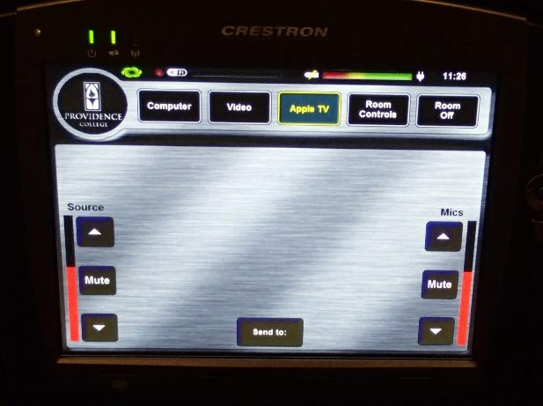
Fall 2013 connecting to Apple TV with iPad running iOS 7

Slide 29
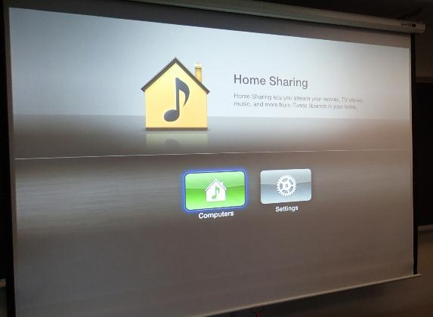
Fall 2013 connecting to Apple TV with iPad running iOS 7

Slide 30
Fall 2013 connecting to Apple TV with iPad running iOS 7

Slide 31
Fall 2013 connecting to Apple TV with iPad iOS 7

Slide 32
Fall 2013 connecting to Apple TV with iPad iOS 7

Slide 33
Fall 2013 connecting to Apple TV with iPad iOS 7

Slide 34
Fall 2013 connecting to Apple TV with iPad iOS 7

Slide 35
Fall 2013 connecting to Apple TV with iPad iOS 7

Slide 36
Fall 2013 connecting to Apple TV with iPad iOS 7

Slide 37
Fallout
Issues with Aruba AirGroup not broadcasting list of Apple TV’s correctly
Issues with iPad 2s dropping AirPlay
Faculty frustration at lack of “works every time”
Stopped using in new building lecture classrooms
Wireless would drop, disconnecting AirPlay
3 classrooms reverted to ad hoc wireless networks
all 3 rooms used by pilot faculty
needed a quick fix
long-term fix is additional wireless access points / software updates
IT (obsessively) monitored AirGroup
reboot resets system within 30 minutes
On a good note…AirParrot working great for our PC tablet users

Slide 38
What is really going on? Spring 2014
When troubleshooting things would magically work
Items addressed
Aruba software update
Apple software update (iOS 7.1)
DHCP pools increased
Only one classroom still running ad-hoc solution
AP needs to be moved to resolve
iPad 2 issue solved by BOTH Aruba and Apple updates

Slide 39
Spring 2014 Apple TV Configuration
Configuration on current software
Main Menu > Hide all icons (channels)
Screen Saver > 30 minutes
assure device is always accessible
current screen saver is default; want to change to PC images
General > Sleep After > Never
General > AirPlay
Security > Onscreen Code > Yes
prevents a wayward student from logging on to Apple TV in another classroom
user must disable mirroring before another user can take control in same classroom
Conference Room Display > On
Updates blocked by custom DNS server

Slide 40
Physics: classroom set-up

Slide 41
Physics: connecting to Apple TV

Slide 43
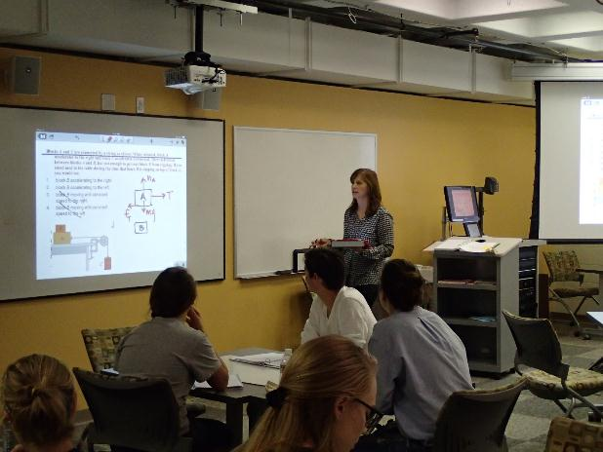

Slide 44
Theology: classroom set-up

Slide 45
Theology: close reading of text

Slide 46
The seminar as sacred circle

Slide 47
Theology: after-class student conference

Slide 48
Accountancy: classroom set-up

Slide 49
Accountancy: classroom set-up

Slide 50
Accountancy: classroom set-up

Slide 51
Accountancy: homework review

Slide 52
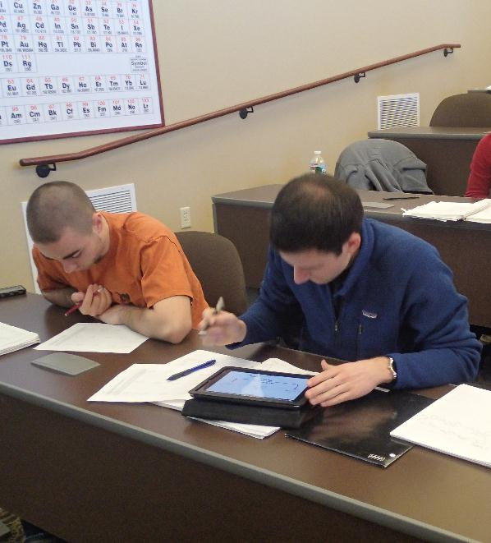
Chemistry

Slide 55
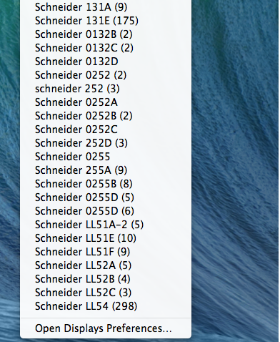
Non-academic use: athletics!
Just like the commercial – our hockey teams are using iPads to capture and annotate plays!

Slide 56
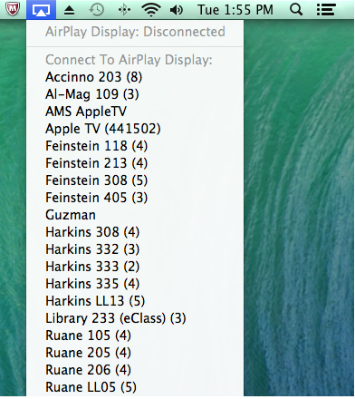
Anticipated Summer 2014 Changes
Aruba ClearPass
Will tame the “long list” or “scroll of death”
Allows “geofencing” so that a request from Feinstein would only show Apple TV’s in Feinstein
Screensaver images updated to PC pictures

Slide 57
Can’t do AirGroup?
Mirror at PSU (http://mirror.psu.edu/)
Set up a web server with your list of Apple TVs
Mirror iOS app pulls the list down
Mirror “advertises” the Apple TV to the iPad

Slide 58
Questions? Siobhán Ross Instructional Technology Development Program Providence College siobhan.ross@providence.edu
Background images courtesy of:
http://llnw.wbez.org/blog/insert-image/2011-June/2011-06-10/flickr-loper.jpg
http://bachiles.files.wordpress.com/2011/10/red_apples473.jpg
http://4.bp.blogspot.com/_dMsJVGjP_bg/TMTmyorpPoI/AAAAAAAAABY/IzS3Qj1J6CY/s1600/Green+Apples!.jpg
http://www.wallseemly.com/wp-content/uploads/2013/04/Apples-yellow-delicious-fruit-healthy.jpg

