Slide 1
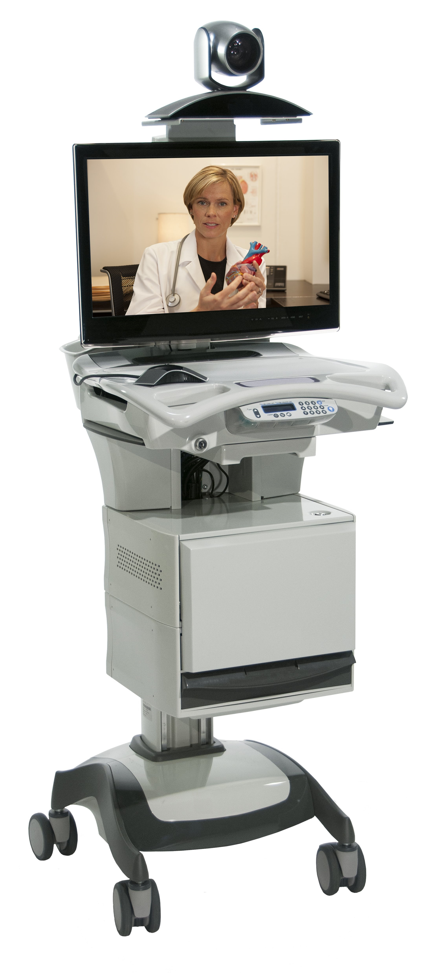
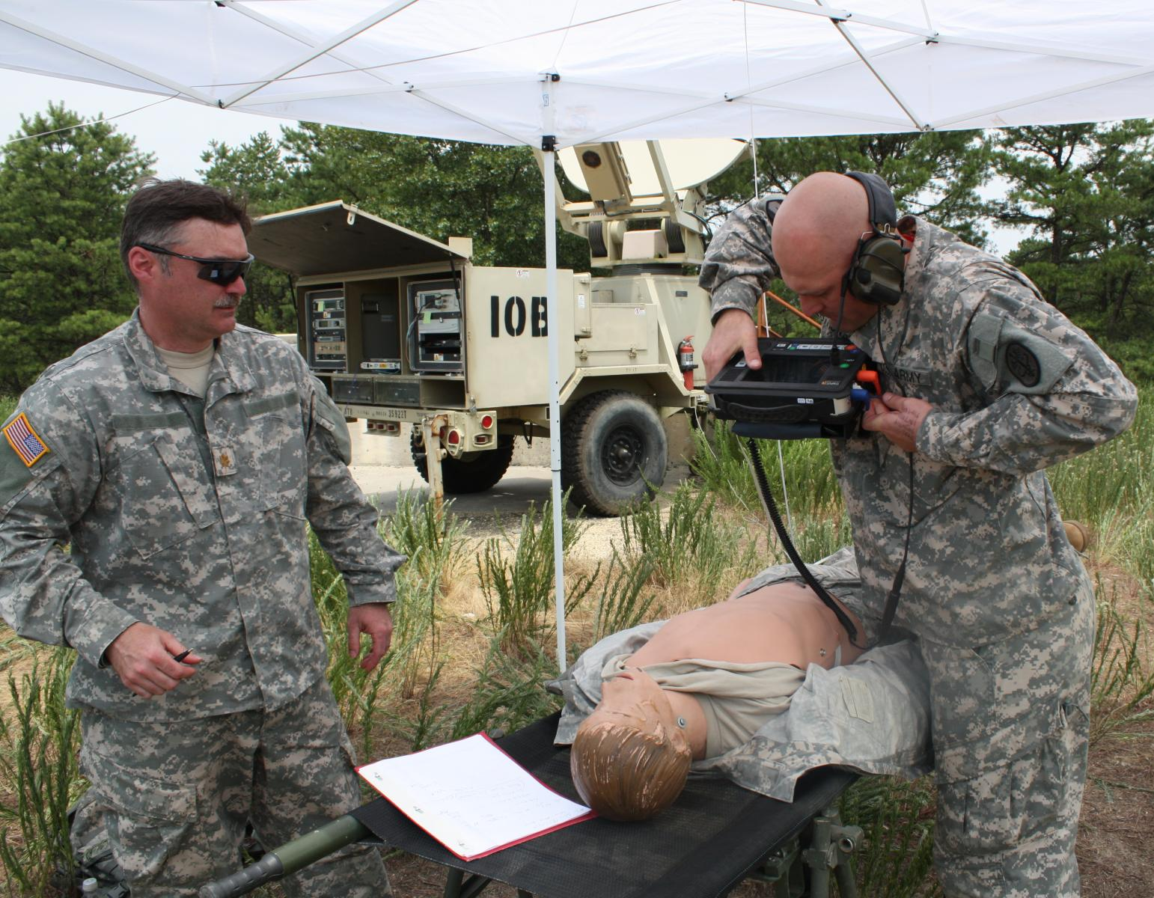
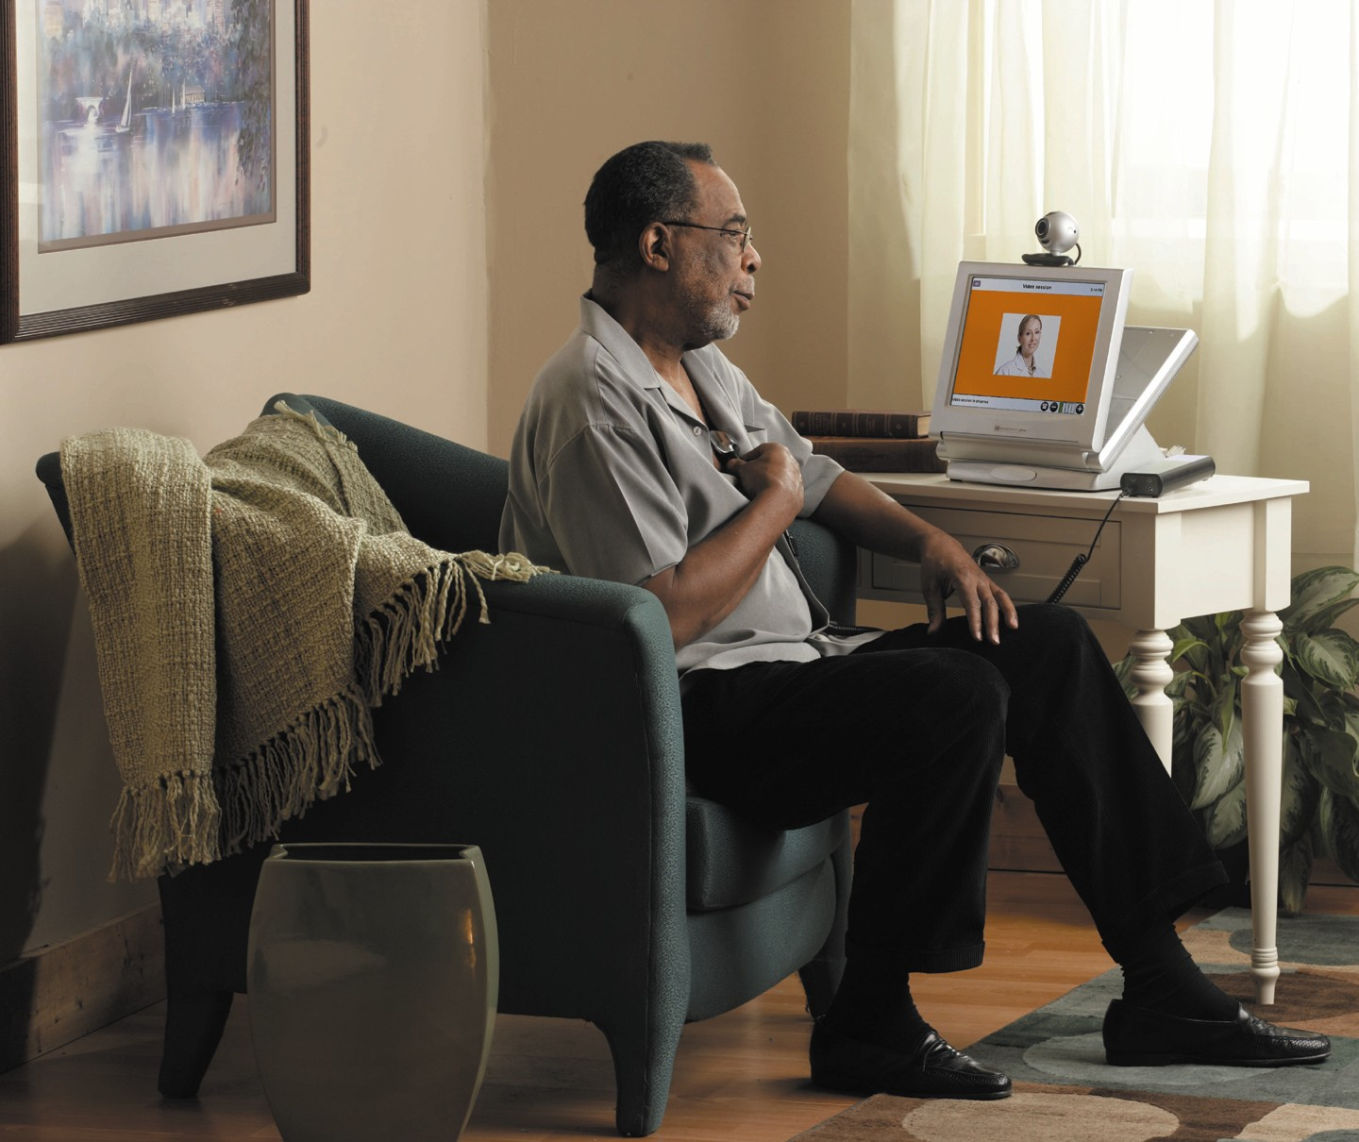
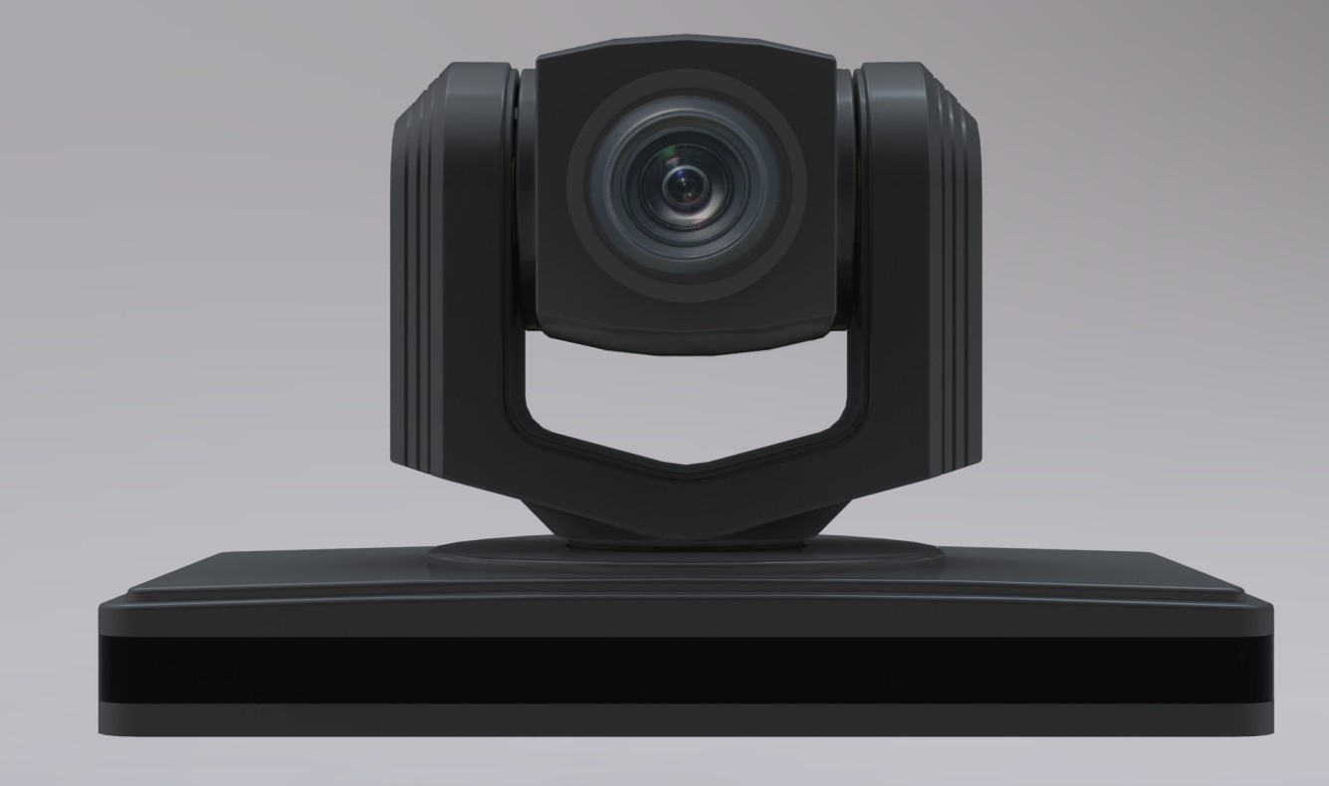
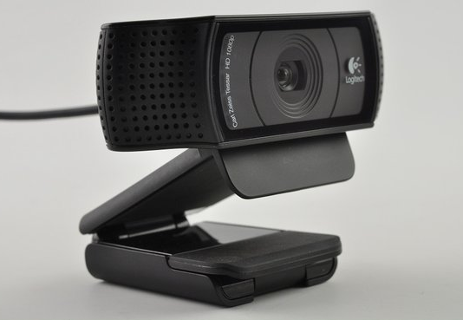
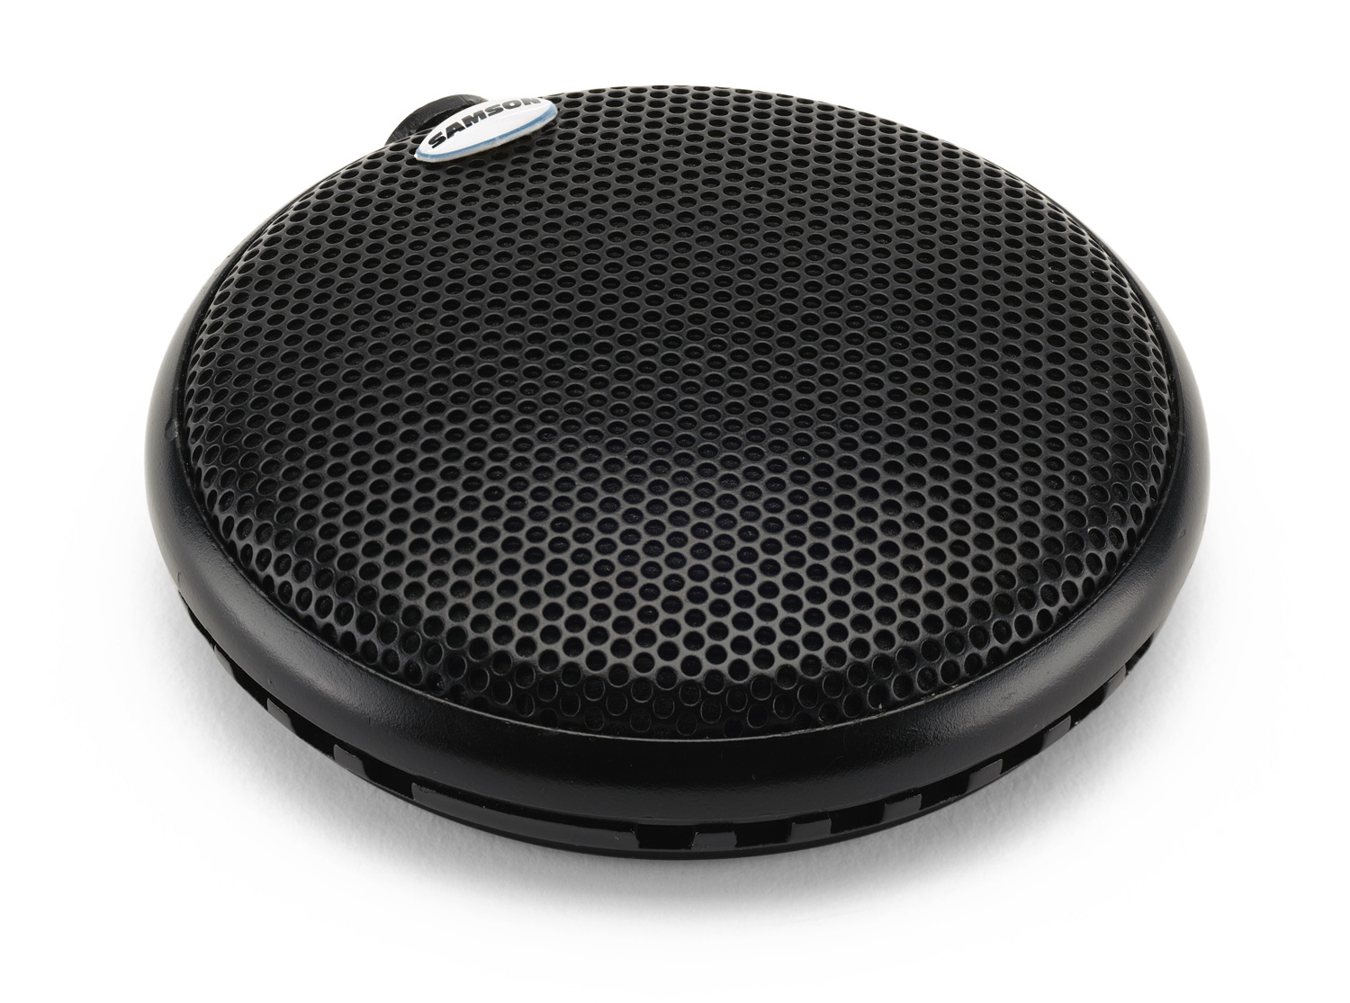
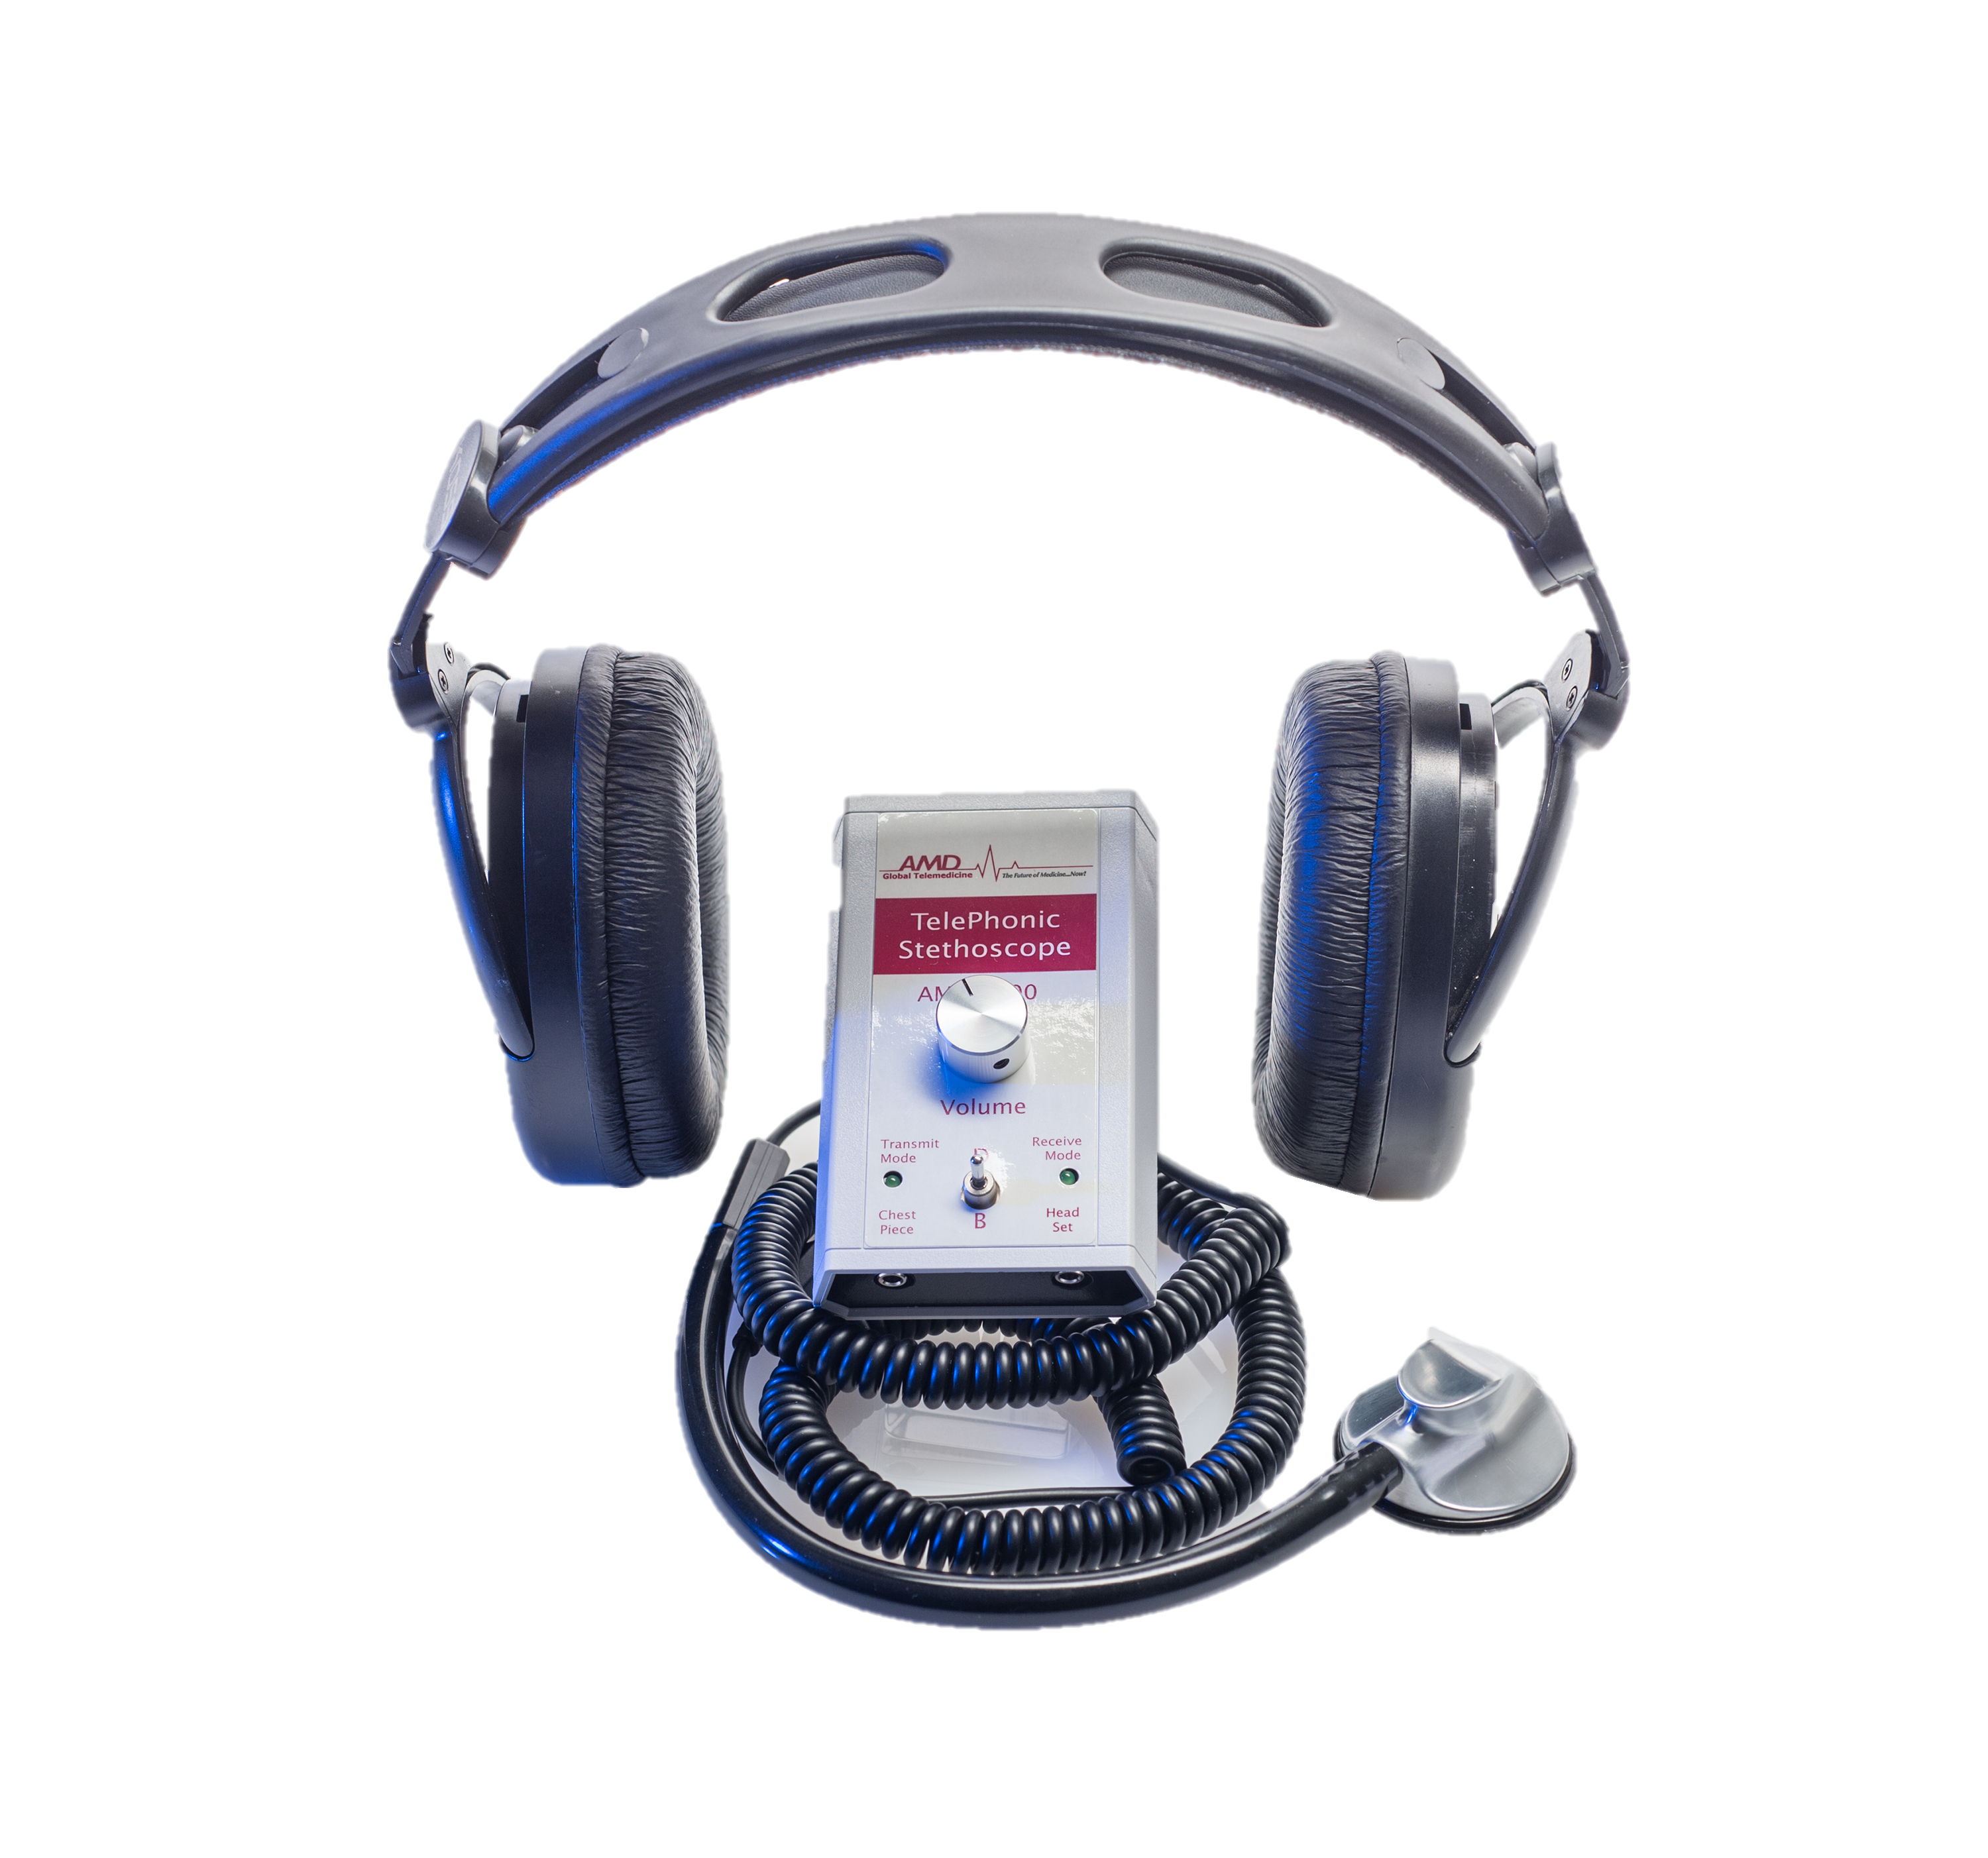
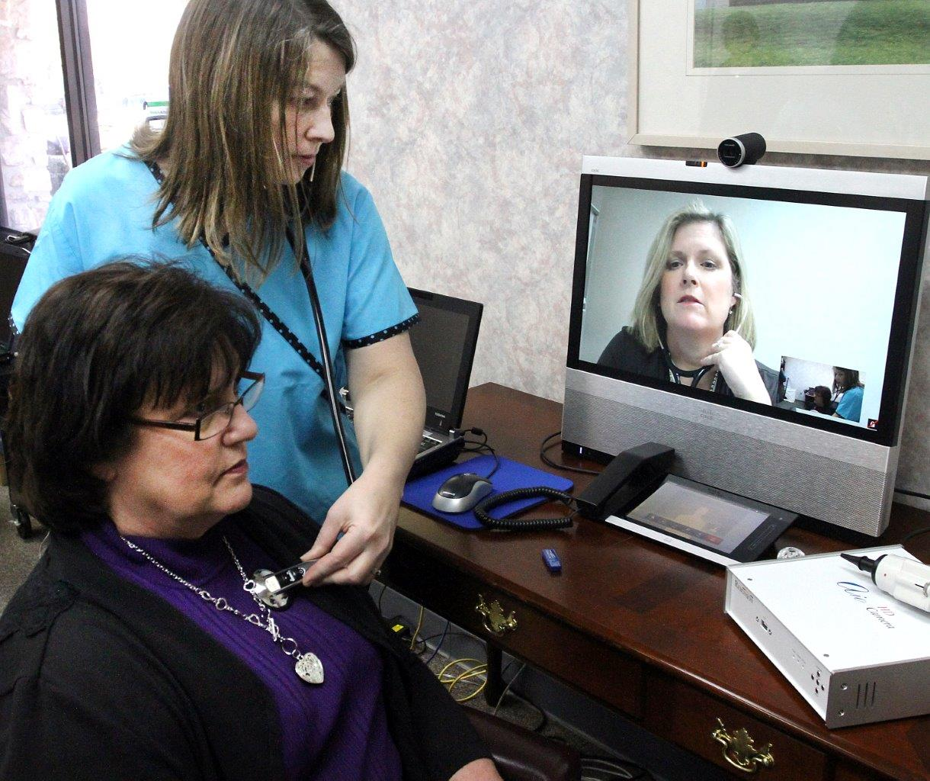
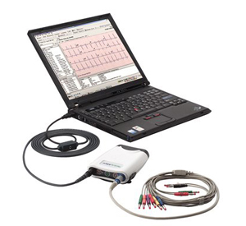
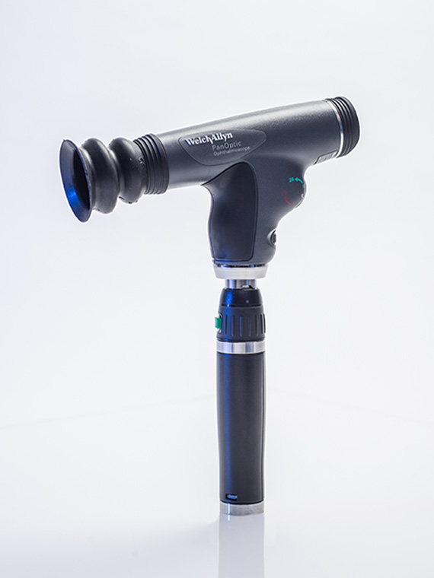
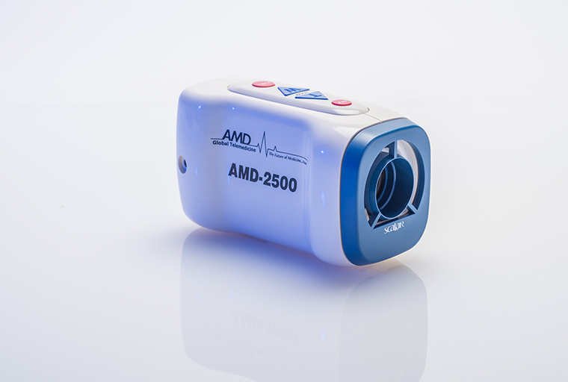
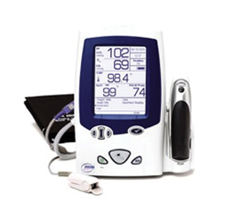
Considerations for Implementing a Telehealth System
Jeremy Anderson, Patrick Carley, Dina Ditmar A collaboration between the Departments of Academic Computing (IT), Nursing, and Physical Therapy
Telehealth: Remote Medical Practice
Telehealth, or telemedicine, is the remote diagnosis and treatment of patients through the use of information and telecommunications technology. There are a number of models for delivering health services in this fashion.
Field medicine
A health technician visits a field
location, such as a disaster zone,
a battlefield, or remote/rural area
where clinicians do not typically
travel.
Homebound medicine
A homebound patient connects
to a clinician who is unable to
make house calls. The patient
will need proper training on all
technical layers of the system.
Clinic medicine
A patient travels to a clinic with
technicians and a telemedecine
system. During the consultation,
the clinician and technician collab-
orate to deliver health services to
the patient.
Video Hardware
High definition video sources on both sides of a
consultation is a vital component of telehealth.
Patient system
The primary camera should be wide angle
to capture the full room. A camera with IP
controlled PTZ functions is preferable, but
a high definition webcam may suffice.
Additional USB cameras – ENT otoscope,
dermascope, etc. – can be added to fit
the needs of the academic program.
Clinician system
An HD web camera set to a wide angle
can be used as long as the patient can
see any training delivered by the clinician.
Audio & Peripheral Hardware
Patient audio
The primary mode of capturing audio from the patient
location will be an omnidirectional USB microphone. It
should be positioned to capture the voice of the
consulting technician and the patient.
An additional audio source could include a USB
stethoscope.
Peripheral devices
A host of USB devices have been designed
to interface with telehealth systems, such as
vital signs monitors, ultrasound wands, and
EKG machines.
Clinician audio
A web cam’s built in microphone or a table top
microphone are sufficient for clinician audio.
Educational Applications
Interprofessional education (IPE)
In the clinic model and some instances of homebound care, a variety of different health professionals may offer services. A nursing student may provide the local care and patient support, for example, while a remote physical therapy or occupational therapy student could direct the course of treatment.
Service trips & alternative spring break
Implementing a telehealth system would allow students to travel abroad to perform health services in remote or underserved areas. They would retain access to expert faculty or clinicians who remain on campus.
Clinical check-ins
Health sciences programs require students to complete clinical hours, typically at sites away from the main campus. Telemedicine would enable clinical coordinators to observe students working alongside preceptors.
Non-technical Considerations
Room size
If simulating a clinic or field practice, a space of roughly 10x15 feet is needed. The patient may need room either to ambulate or to recline in a bed.
Room design
Walls of light blue or gray will achieve the best white balancing for video feeds. If designing a teaching environment, rugs and ceiling baffles will improve audio.
Lighting
Diffused overhead lighting is recommended on both ends of the teleconference. Many peripheral devices include their own focused lighting, as necessary.
Telephone
Having telephone service at both endpoints is helpful for assisting patients in connecting to the telecommunication system. If internet service is interrupted, phones will also provide a backup for completing a consultation.
Technology Layers
A number of technology layers are required at both the patient and clinician sites to achieve an integrate tele- medicine system.
Hardware
Both sites will need, at the minimum, a computer and devices to capture and play audio and video. Source quality is vital to a successful consult, so high definition devices are recommended. Additional peripheral USB tools are available to interface with telehealth systems.
Telecommunication software
Many vendors have begun to develop live meeting platforms specifically for telemedicine applications. A key feature of these systems is being able to share a number of device inputs and content while optimizing bandwidth.
Network
Use a wired high-speed internet connection at both sites, when possible. Upload and download bandwidth needs will depend upon the chosen software platform, but should be 1.5Mbps U/D at a minimum. Bandwidth will need to be higher if content is to be shared or additional audio and video peripheral devices are added.
Telecommunication System
Basic needs
The telecommunication system must transmit audio and video feeds with minimal bandwidth, latency, and dropped packets. The user interface must be intuitive and mobile for patients and clinicians.
Software or hardware?
Hardware and software solutions both meet all of the needs of telehealth systems, but hardware tools have costly infrastructure and endpoints. It is also difficult and costly to make a mobile hardware solution.
Tool | Form | HIPAA | Cost | Band. | Flexibility | Key Benefit
Polycom | Infrastructure & endpoints needed | Yes | $$$$ | | | | | Requires proprietary endpoints | Established quality; Centrally managed
Vidyo | Infrastructure needed | Yes | $$$ | | | | | | Works on PC, Mac, and mobile OSs | Flexible & mobile; Centrally managed
VSee | Software | Yes | $ | | | | Works on PC, Mac, and mobile OSs | Low cost, bandwidth; Ease of use
Skype | Software | No | Free | | | | | | Works on PC, Mac, and mobile OSs | Wide adoption; Ease of use

