Slide 1
Starting From Zero
Marketing & Recruitment
Student
Support
Welcome!
Your guides today are:
Amber L. Vaill, Ph.D
Colleen L. Bielitz, ABD
Getting an Online Education Program Off the Ground

Slide 2
Who We Are
Amber L. Vaill, Ph.D.
Instructional Designer
Colleen L. Bielitz, ABD
Dean, Accelerated & Professional Studies

Slide 3
Who We Are
1772 – Fall 2010
2021 - Fall 2014

Slide 4
Road Map for Today
Introduction
Why Online Learning?
Buy-In
Getting your campus on board
Financial Plan
Finding monetary resources
to make it happen
Organizational Structure
Structuring administration of
Programs and support services

Slide 5
Road Map for Today
Support Services
Providing support services for
for faculty and students
Outsourcing
Considering when to outsource services
Marketing and Recruitment
Getting the word out there
Questions and Conclusions
Wrap-Up

Slide 6
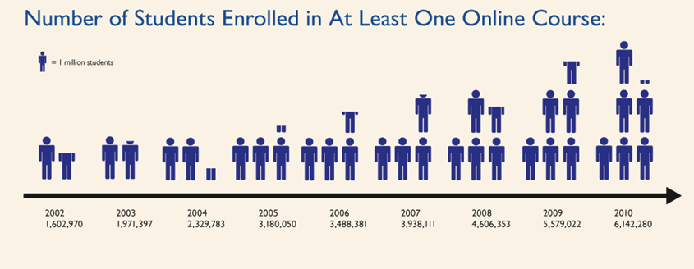
History of Online Learning
Allen, I. E., & Seaman, J. (2011). Going the distance: Online education in the United States, 2011. Retrieved from Babson Survey Research Group website: http://sloanconsortium.org/publications/survey/going_distance_2011

Slide 7
College Online Enrollment 2013 vs. 2012
Public 4.6% Growth
Private NP 12.6% Growth
Private FP -7.9%
Allen, I. E., & Seaman, J. (2014). Grade change: Tracking online education in the United States. Retrieved from Babson Survey Research Group website.

Slide 8
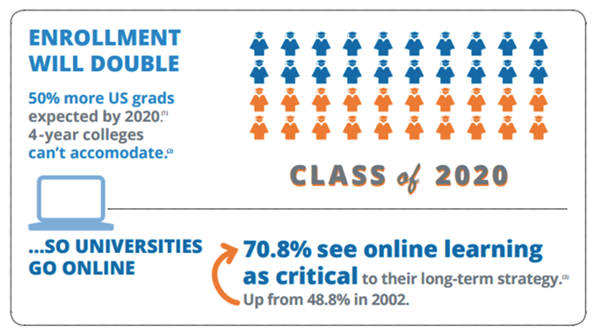
Why Online?
U.S. Department of Education, Meeting the Nation’s 2020 Goal, 2011, https://www.isac.org/dotAsset/8469ef53-433f-4863-a827-56c131d5f79f.pdf 2
Christensen Institute, Hire Education, Mastery, Modularization, and the Workforce Revolution, 2014 http://www.christenseninstitute.org/wp-content/uploads/2014/07/Hire-Education.pdf
3. Babson Survey Research Group and Quahog Research Group, LLC, Grade level - Tracking online education, 2015, http://onlinelearningconsortium.org/read/survey-reports-2014/

Slide 9
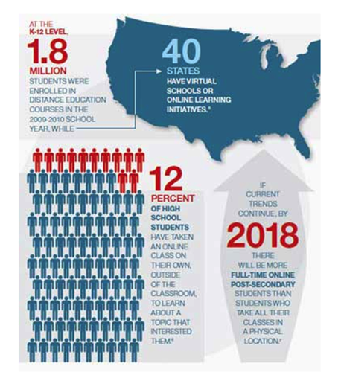
K-12 Market
Watson, Murin, Vashaw, Gemin and Rapp, November 2011, Keeping Pace with K-12 Online Learning, iNACOL
www.KPK12.com.

Slide 10
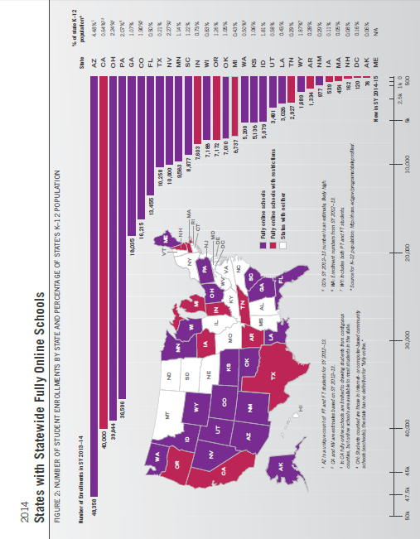
Watson, J., Pape, L., Murin, A., Gemin, B., Vashaw, L. (2014). Keeping pace with k-12 digital learning: An annual review of policy and practice. Evergreen Education Group. Kpk12.com

Slide 11
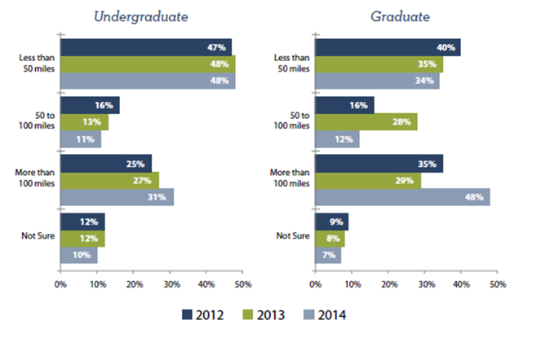
Proximity to Institution of Enrollment
Clinefelter, D. L. & Aslanian, C. B., (2014). Online college students 2014: Comprehensive data on demands and preferences. Louisville, KY: The Learning House, Inc.

Slide 12
Where Are You?
What is your institution doing currently with online courses and programs?

Slide 13
Getting Started
Where do we go from here?

Slide 14
Areas to Discuss
What we did at our institution and how it worked.
What do you need to do? Ask yourself these questions.
Literature and
Best Practices.

Slide 15
Buy In

Slide 16
Financial Plan

Slide 17
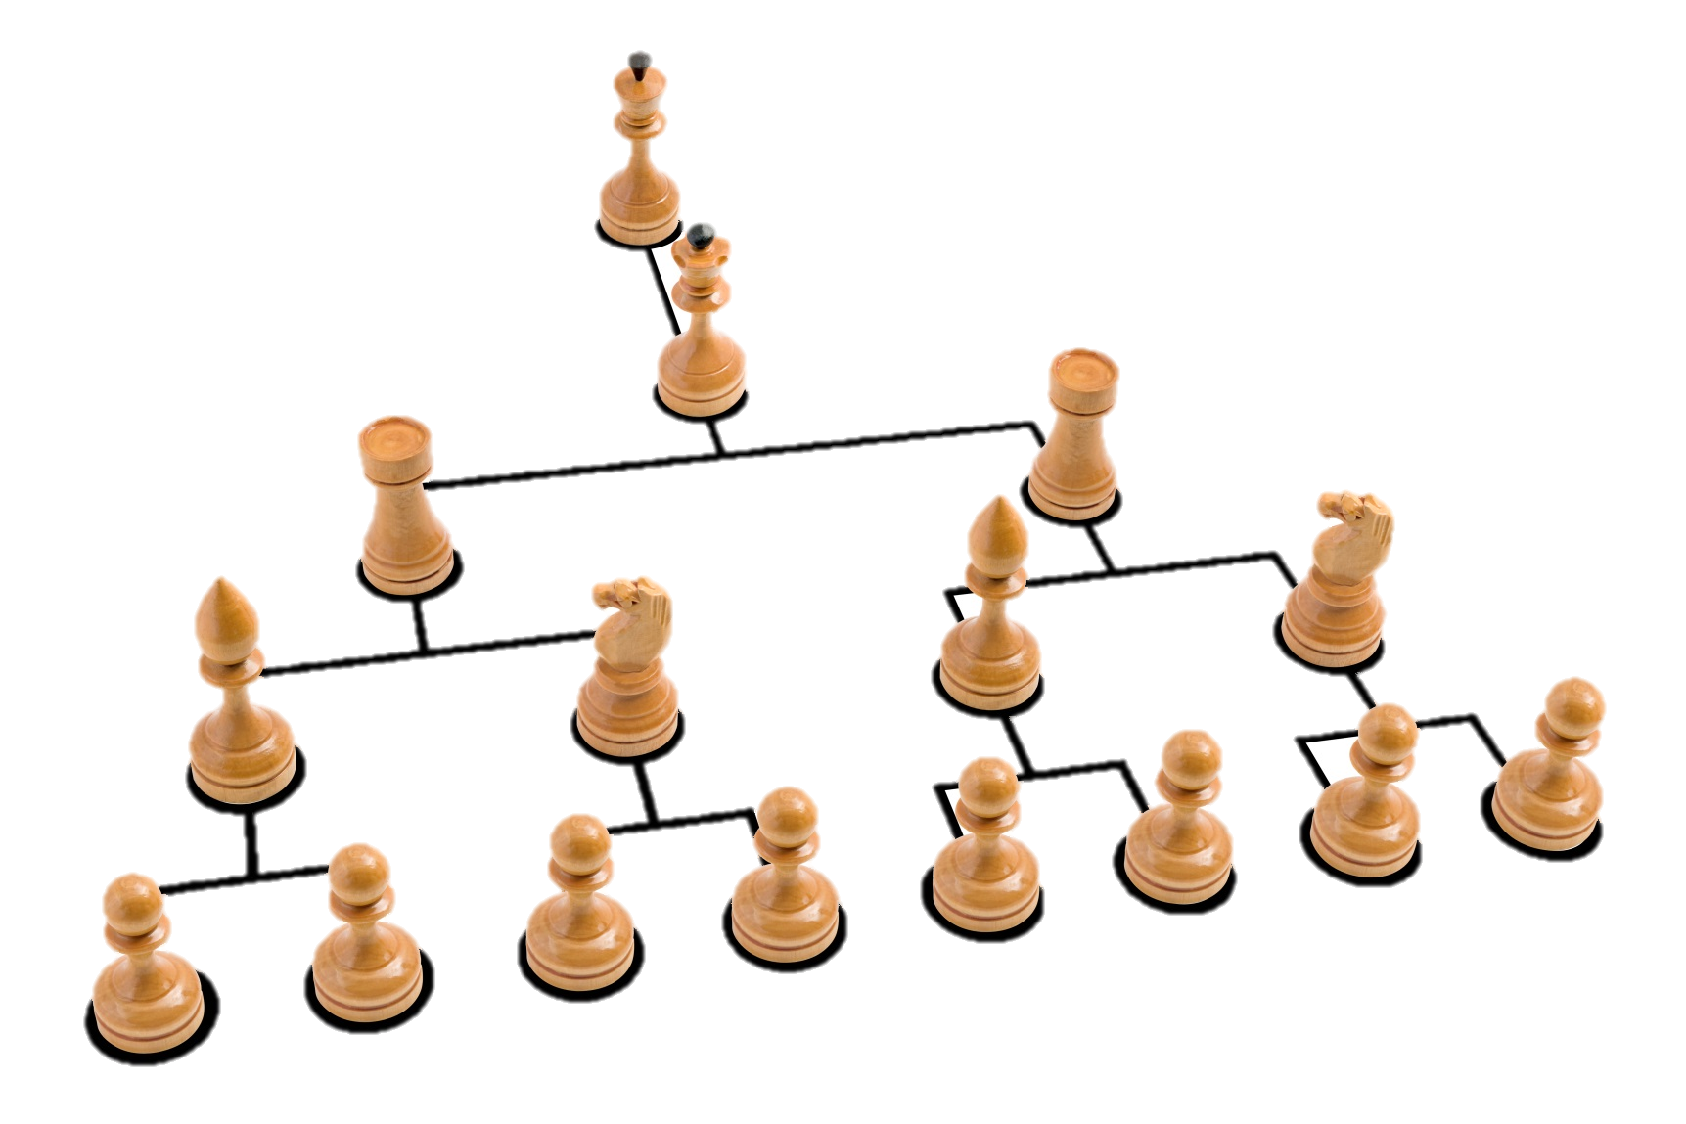
Organizational Structure

Slide 18
Support Services

Slide 19
Outsourcing

Slide 20
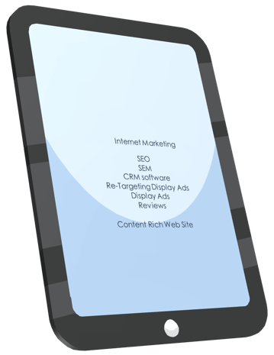
Marketing and Recruitment

Slide 21
This choice is yours… which direction is best for your institution?

Slide 22
More Information?
QUESTIONS?
Amber L. Vaill, Ph.D.
Amber.vaill@becker.edu
Colleen L. Bielitz, ABD
Colleen.bielitz@becker.edu
Resources available:
http://goo.gl/Zd5qon

