Slide 1

Implementing Preferred Name in Banner ERP
Jean Dailey, AVP of Enterprise and Technical Systems
Mary Vona, Sr. Programmer Analyst
Connecticut College
April 1st, 2015
Room 553

Slide 2

Rules of Etiquette
Please turn off your cell phone/pager
If you must leave the session early, please do so as discreetly as possible
Please avoid side conversation during the session
Thank you for your cooperation!
This presentation leaves copyright of the content to the presenter. Unless otherwise noted in the materials, uploaded content carries theCreative Commons Attribution-NonCommercial-ShareAlike license, which grants usage to the general public with the stipulated criteria.

Slide 3
Agenda
Connecticut College – Who Are We?
Why Preferred Name?
Our Roadmap
Technical Solution
Lessons Learned

Slide 4
Small, Private, Liberal Arts
Founded in 1911 with the belief that all qualified students deserve an opportunity to secure an education
Academic Excellence, Diversity & Education of the Entire Person
750-acre arboretum campus in historic seaport town of New London
Enrollment: 1922 students

Slide 5

Why Preferred Name?
Voice of LGBTQ Community Leaders
Protect gender identity of students where needed
Accommodate diversity of student population
When students return to campus for the fall semester…their preferred name will appear in the campus [systems].
-President Higdon , May 2012

Slide 6
Requirements
Preferred First, Middle and Last Names
Preferred Name = Primary Name (i.e., not “option”)
Banner “Nick” was insufficient
Preferred Name unless Department had “need to know” Legal name
Provide both Legal and Preferred if required Legal
Department Training

Slide 7
Our Roadmap
Preferred Only
SSB - Class Lists
SSB - Advisor Lists
Roommate Lists
Campus ID Card
Moodle
CamelWeb Portal
Student Activities
Print Management, etc.
Legal and Preferred
Payroll
Campus Safety
Financial Aid
Payment Plans
Health Center
Identity Vault

Slide 8
TECHNICAL SOLUTION
THE SOLUTION: FOUR PARTS
BUILD CUSTOM VIEW that mirrors the SPRIDEN table
BUILD a PREFERRED NAME for every Active Student and Employee
BUILD FUNCTIONS and TRIGGERS & use known Oracle Functions
BUILD CHANGES IN BUSINESS PRACTICE

Slide 9
BUILD CUSTOM VIEW that mirrors the SPRIDEN table
VIEW vs TABLE
DB SCHEMAS
BANINST1 vs SATURN
views & rules vs base and repeating student tables
Oracle DB rule: For any object, look inside it’s own schema before using Public Synonym to tap any other same-named object.

Slide 10



PIVOTAL CHANGE
SPRIDEN VIEW
Faculty
Student
Employee
Class
Joey Sat
Jane Do
Adv
Joey Sat
Jane Do
Student
Joey Sat
Jane Do
Tim Bo
Sam Ce
Tim Bo
Sam Ce
Tim Bo
Sam Ce

Slide 11
BUILD a PREFERRED NAME for every Active Student and Employee
Now that we figured out how we were going to show the data starting with Self Service using SPRIDEN view object,
We had to figure what data we were going to show and how that data was going to be stored

Slide 12

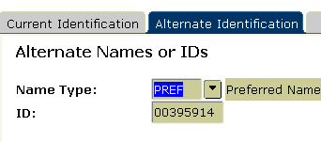
Inserted Preferred First, Middle (if exists) , and Last

Slide 13
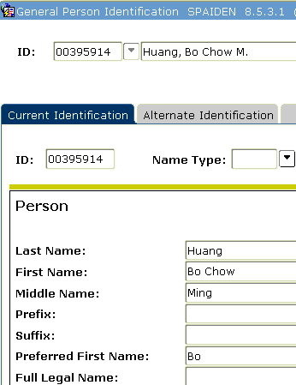
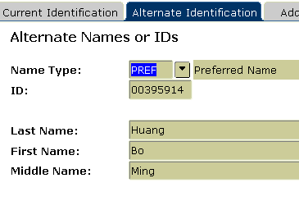
13
If BIO table had a pref first name,
Then inserted that “nickname”, else inserted spriden_first_name, spriden_mi, spriden_last_name into a new row in spriden for same unique identifier for the person, with ntyp = PREF and NCHG_IND = N
Inserted Record for Pref using SPBERS_PREF_ FIRST_NAME

Slide 14
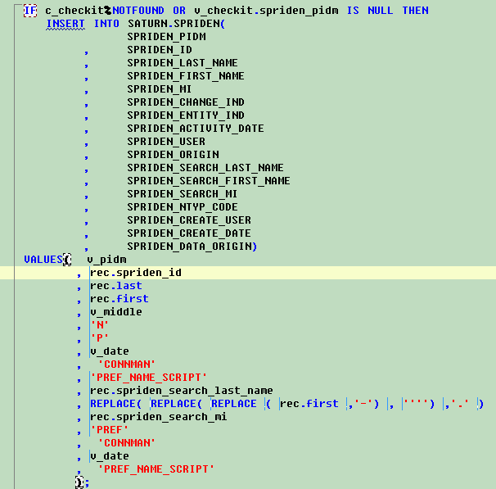
If
spbpers_pref_first_name
exists then write it
to new row for pref
For Middle and Last, we inserted the Common Middle and Last Names.

Slide 15
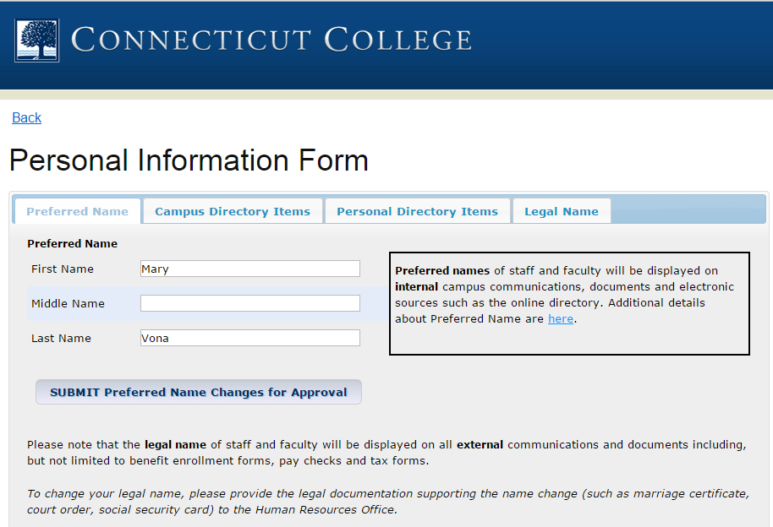
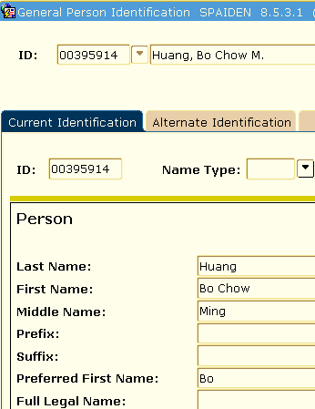
Bo
Ming
Huang

Slide 16

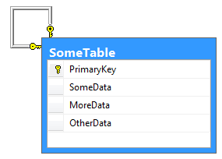
BUILD FUNCTIONS and TRIGGERS & use known Oracle Functions

Slide 17

USE ORACLE FUNCTIONS
USER
(try it: select user from dual;)
ALL SELF SERVICE USERS RESOLVE TO WWW_USER
Notes:
SHOW USER: LOOKING FOR WWW_USER and STREAMSADMIN. All SSB users resolve to the user = WWW_USER.
STREAMSADMIN is the user for BEIS which pushes data to the Vault.
In the CASE statement inside the View, if the incoming user is either one of these
Two, the Preferred Name is fetched from the Spriden Table as a generated row
In the table, else if any other user, then the row in the View will resolve to spriden legal (common name)

Slide 18
USE ORACLE FUNCTIONS
try it:
CREATE OR REPLACE FUNCTION CONNMAN.CC_F_GET_CALLING_PKG
RETURN VARCHAR2
AS
cowner VARCHAR2(50);
cname VARCHAR2(50);
clineno NUMBER;
ccaller VARCHAR2(50);
BEGIN
OWA_UTIL.who_called_me (cowner, cname, clineno, ccaller);
RETURN cname;
END CC_F_GET_CALLING_PKG
WHO_CALLED_ME
Notes:
Had to have View process another piece of intelligence:
Who was the calling package that was using the View itself?
Enabled us to have the View suppress Pref Name and display Legal Common
Name from the Spriden table on to the row for the unique identifier.

Slide 19
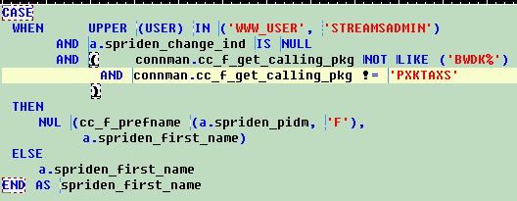
CUSTOM SPRIDEN VIEW
Notice the call to custom function to fetch PREF Name
Safety Net: If pref doesn’t exist, use Common
Notes:
View Code in Action.
WWW_USER -- user coming from within SSB
STREAMSADMIN – user coming from within INBanner and pushing to IAM Vault
AND a.spriden_change_ind
If the calling process was using one of our other Spriden Alternate Names where NTYP = TRANS for transcript name or MAID for Maiden Name, then the Case Statement would return false, and logic would drop out and cause the Spriden TRANS or MAID name to appear in the View and be rendered on screen or print from the calling package.
NVL – if ever there was a chance someone did not get a Preferred Name, the view would return Common Legal Nmae.
Custom functions were used so that we wouldn’t have to reiterate logic in this View or anywhere else we wanted to render Preferred Name.
CC_F_GET_CALLING_PKG – on prior slide
NOTICE: CC_F_PREFNAME

Slide 20
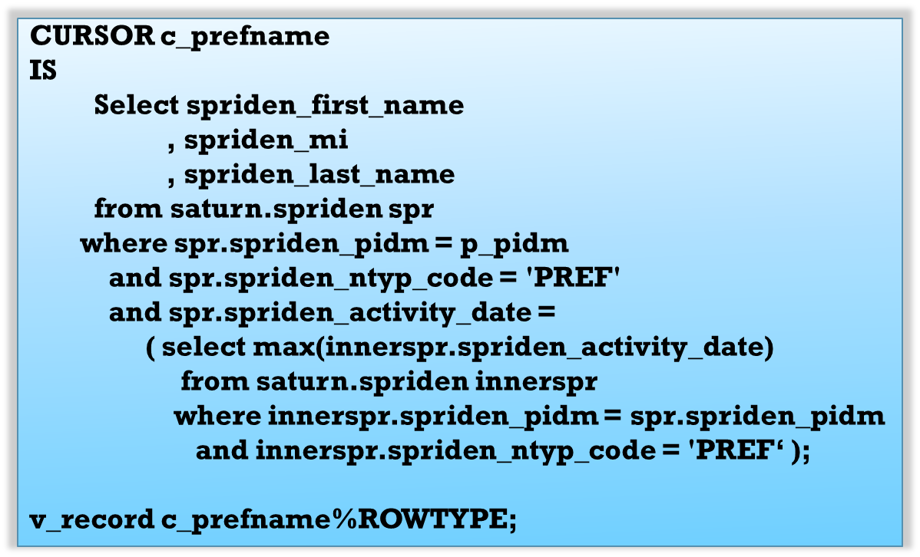
CUSTOM FUNCTION: CC_F_PREFNAME
Notes:
LOOK INSIDE THE CC_F_PREFNAME function
P_pidm = incoming
Ntyp = refer back to beginning
Activity_date = possibility of more than one PREF Names for a person…
This is ONLY the cursor ( the sql fetch )
Function takes two input parameters, a pidm and a local “definition” such as F, M, L, FML, or FMIL.
The Program will RETURN 1 FIELD OF DATA depending on the input parameter.
This function allows us to fetch pref name in all our custom code without redefining the logic. It created for us much needed consistency.

Slide 21
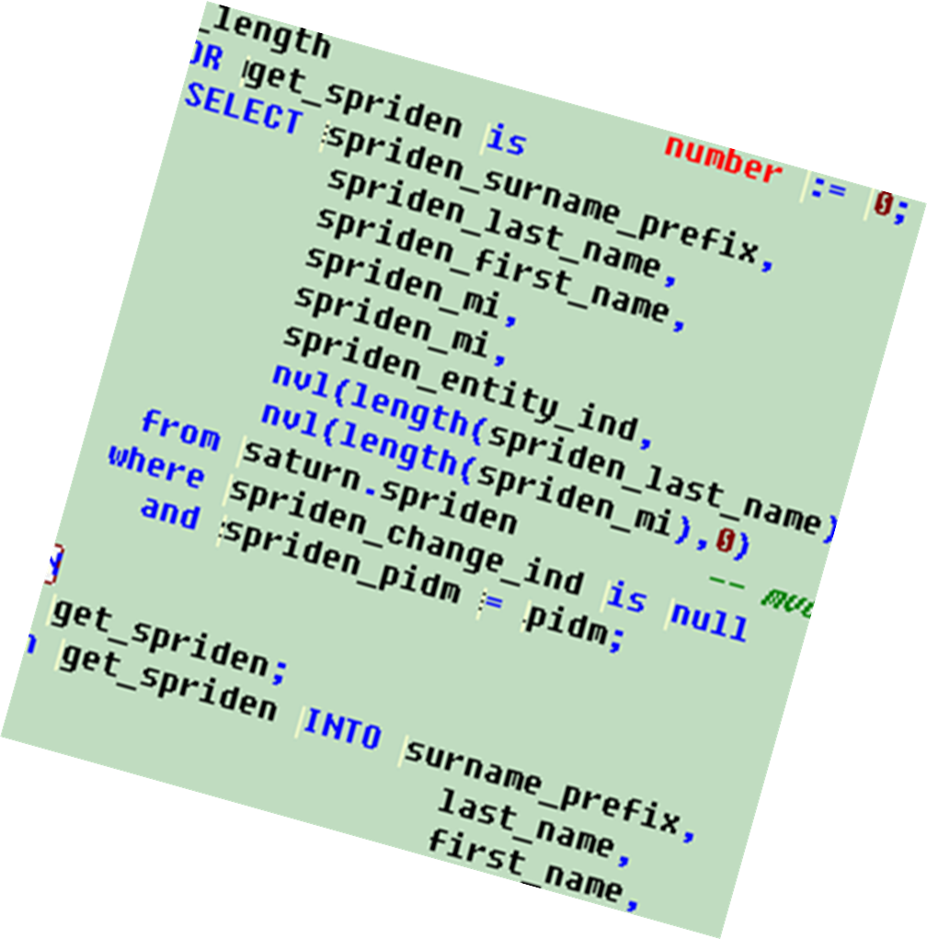
CUSTOM FUNCTION: CC_F_FORMAT_NAME
Notes:
Exact copy of Banner Vanilla F_FORMAT_NAME
Renamed and forced to use the SATURN table
From anywhere in Banner, including BANINST1 packages if modified.

Slide 22
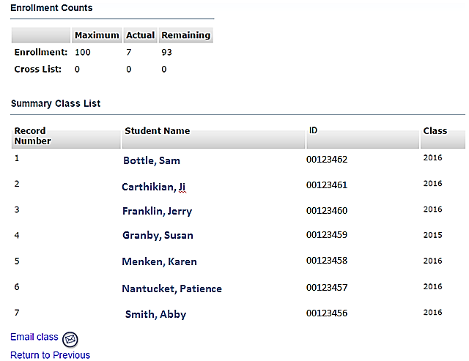
SELF SERVICE @ CONNCOLL
Faculty only see names.
Lists are seamless.
Is it Pref or Legal?

Slide 23
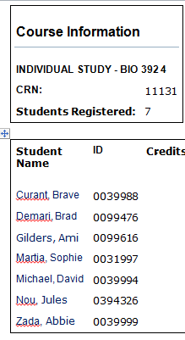
more… Self Service
Faculty only see names.
Lists are seamless.
Is it Pref or Legal?

Slide 24
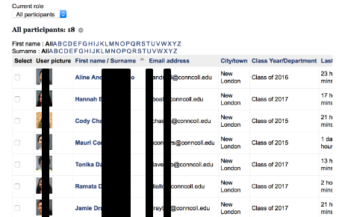
MOODLE @ CONNCOLL

Slide 25

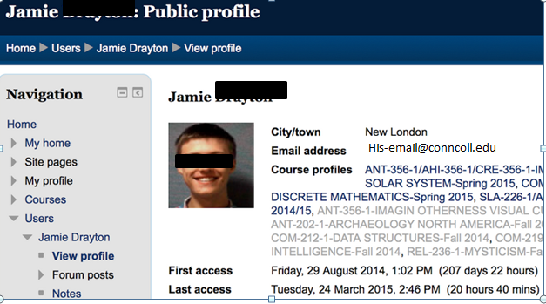
more… MOODLE
Seamless to Faculty !

Slide 26
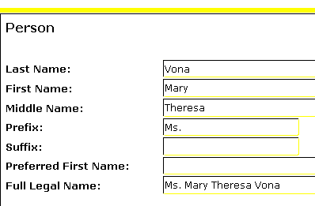
Review: Legal – Common Name
What does the constituent see in SSB for themselves?
Here is my SPAIDEN record in Banner…

Slide 27
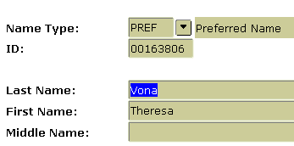
Review: Preferred Name
Here is my SPAIDEN Alternate Name…

Slide 28

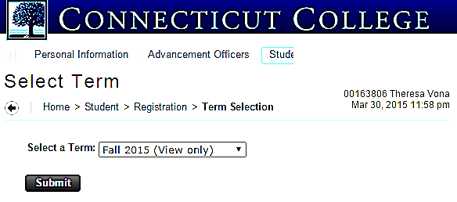
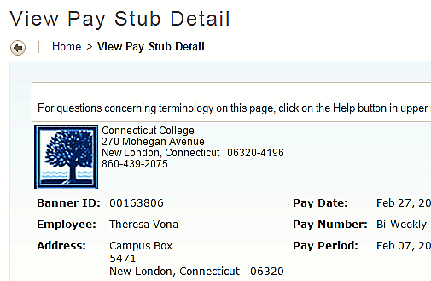
Review: Self Service
What do student, staff , faculty see in SSB?

Slide 29
CHANGE BUSINESS PRACTICES
Employed the use of custom triggers to insert the initial Preferred Name of a person to be their Legal Name in Spriden table.
Presented person with custom webForm to change it.
Owning Departments have to approve for data standards through the use of workflows.
Notes:
Next slide… to look at the critical triggers that create the pref name after go-live.

Slide 30
TRIGGERS
CC_PEBEMPL_AIR
Triggers on New Employee record
CC_SGBSTDN_AIR
Triggers on New Student record
Both triggers…
Check for the presence of spriden, where ntyp=PREF
If not exists, inserts the pref name for ntyp=PREF

Slide 31
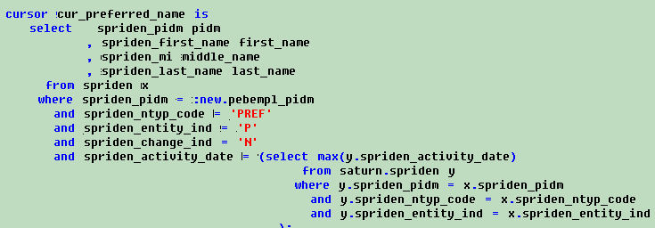
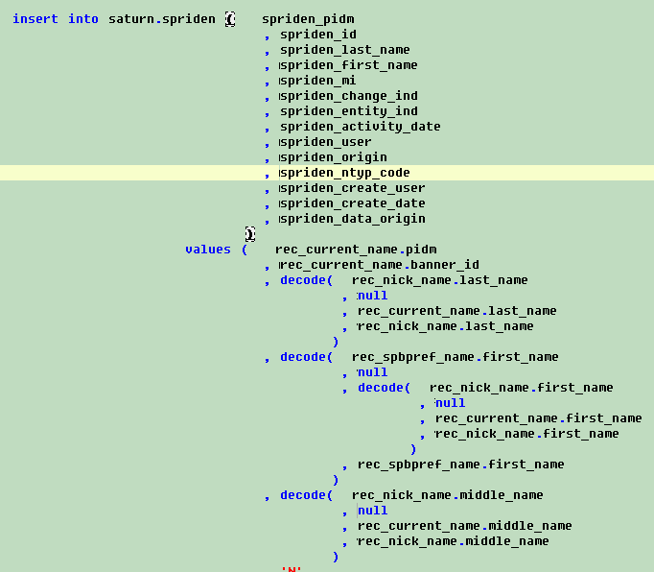
TRIGGER

Slide 32
GOT UPGRADES?
We learned going into this there may be a snag with upgrades and prepared for it during testing once we had an upgrade to test. This is what we found…

Slide 33
UPGRADES
The upgrade did not impact the custom functions and triggers. It did impact the AIDEN forms and Spriden View in BANINST1.
Formula:
Apply upgrade
Compile all Oracle AIDEN forms
Compile baninst1.SPRIDEN view
RE-Compile all Oracle AIDEN forms

Slide 34
TECHNICAL SUMMARY
Leveraged what Oracle offers in rules and functions
Treated everyone equally with all having Pref Names
Built custom view, functions, triggers to push and pull data
Used best practice – where coding re-iterative logic would have been good ‘nuf, we built two stellar functions for developers to use across the board in all areas to pull names.
Notes:
FAQ – ellucian has functions to format name why not use it?
99% of ellucian code uses the public synonym, not qualifying the tablename.

Slide 35
Results
Positive feedback from campus community
Students, faculty and staff
  International Names
  Nicknames (Tom, Beth, Jon)
  Preferred Middle Names (W. Lee, F. Ann)
Enrollment and New Hire Processes
Accessible in CamelWeb Portal
Over 400 people utilized Preferred Name

Slide 36
August 2014 - For the second consecutive year, Campus Pride and the Huffington Post have named Connecticut College as one of the nation’s friendliest campuses for LGBTQ students.

Slide 37
CLOSING
Easier than anticipated
Technical solution enabled on-time completion
Few people need access to legal name
Added preferred name Transcript for campus use
Offer preferred name on Diploma
Special consideration for Upgrades

Slide 38

Thank You!!
More Info and FAQs:
https://www.conncoll.edu/academics/registrar/student-information-changes/preferred-name-information/
Jdailey@conncoll.edu
Mvona@conncoll.edu
PLEASE COMPLETE THE SESSION EVALUATION (ONLINE THROUGH APRIL 17TH)
Mobile app or online

