Slide 1
Happy Endings: Reengineering Wesleyan’s Software Deployment to Labs and Classrooms
Kyle Tousignant
03/22/2016

Slide 2
Agenda
Wesleyan’s Previous Environment
Goals for the New(Current) Environment
Implementation of the New Environment
Supporting the Environment
Moving Forward

Slide 3
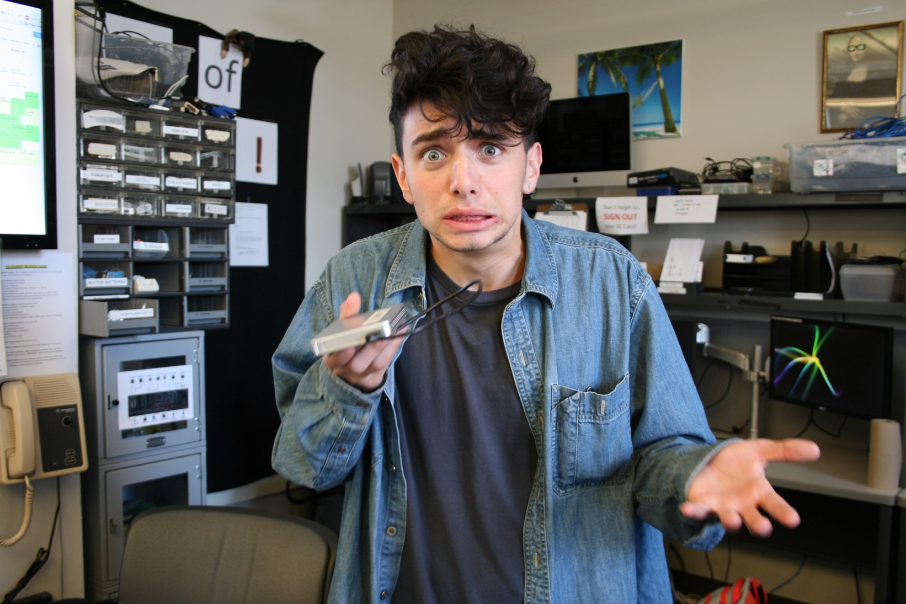

Slide 4
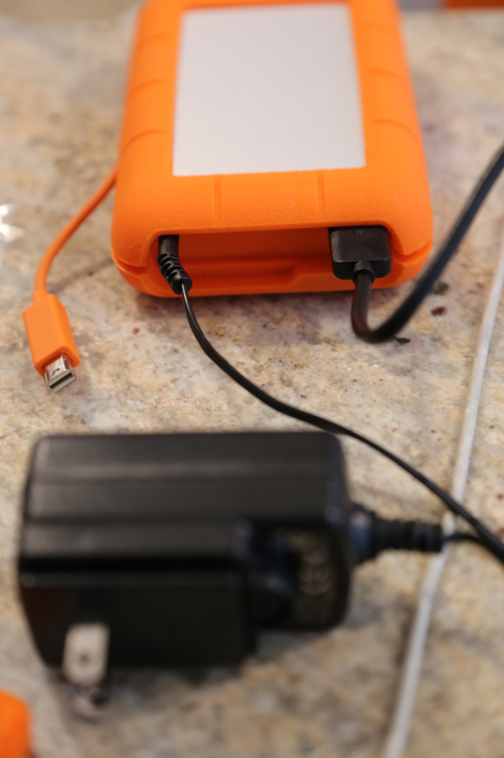
The Previous Environment
80Gb Base Image for both PC and Mac.
New User Profiles would start at 5Gb.
Logon Times were 3+ minutes.
Network related problems lead to one by one machine imaging via USB HDD.
Machines being reimaged frequently due to updates or free space issues.

Slide 5
Goals:
Reengineer Wesleyans methodology for managing its labs and classrooms
Deploy operating systems to any hardware make/model.
Make certain applications available in only certain locations due to licensing restrictions.
Deliver roughly 170 applications across both Windows and Mac in a timely manner.
Reduce user logon times.
Complete all these tasks in 4 months!

Slide 6
Benefits of Desktop Management
Reduce hands on support.
Faster Delivery of Applications.
Better insight into your environment.
Ability to Change Settings across all. computers centrally when needed.
Automated OS and Software Updates.

Slide 7
Benefits of Application Management
Automated installations.
Configure the Installation one time, get consistent installs every time after.
No need to have installations tested every for every image build.
Removes need for hands on installations per computer for applications or updates.
Removal of Update prompts in applications.

Slide 8
The Breakdown for Implementation:
Image Deployment
Pushing Windows and Mac OS’s from a centralized Server.
Application Deployment
All application installs automated and pushed.
Configuration Management
Computer settings configured and managed centrally.
System Status Reporting
Getting insight into the environment through admin consoles.

Slide 9
Server Needs
1 Windows Server 2012 R2(VM)
16Gb Ram
3 HDD Partitions – OS, Database, File Repository
2 Mac Mini’s
16Gb Ram

Slide 10
The Tools
Windows
Microsoft Systems Center Configuration Manager(SCCM) 2012 R2
Microsoft Group Policy
Windows Server Update Services(WSUS)
Mac
Munki 2
Deploy Studio
Centrify
Parallels Mac Management for SCCM**

Slide 11
Image Deployment Types
Thin Image
Thick Image
Applications are layered on through Task Sequences during/after deployment.
Manage a single Windows and Mac Image.
Base Image rarely needs to be updated.
Image is hardware independent.
Relies on application management to handle all application installations.
Large “One Size Fits All” Images or multiple images for different install scenarios.
New Image has to be deployed every time there are major updates or changes.

Slide 12
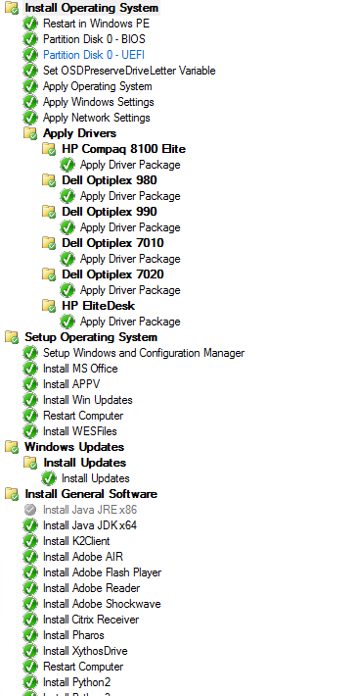
Example of an Image Task Sequence in SCCM
Automated Workstation Imaging handles all defined aspects. You can define Pre-Install, Install, and Post-Install actions ranging from driver deployment, application installs, or running windows updates.

Slide 13
Limitations of SCCM
Cannot deploy system images for OSX, Android, Linux, or IOS on it’s own.
Third party vendor plugin solutions are available to help address this.
Is dependent on client side agents functioning properly.
SCCM 2012 introduced self health checking agents for client workstations, but there are still scenario’s where that may fail and desktop support is required to get it working.
Application Management for OSX requires repackaging mac .dmg or .pkg files into an sccm custom extention called .cmmac.

Slide 14
Final Product
Applications and updates delivered quickly without the need to reimage or have someone visit every workstation.
User Logon times reduced to less than 1 minute due to smaller default profile, which also saves on hard drive space.
Image deployment time reduced to an hour per machine.

Slide 15
Supporting the Environment
Student Support Staff reduced from 90 to around 30.
Scripts provided to aid Student Support in fixing problems with SCCM Agents and other problems.
Scheduled reports give insight into trouble areas that may need hands on support.

Slide 16
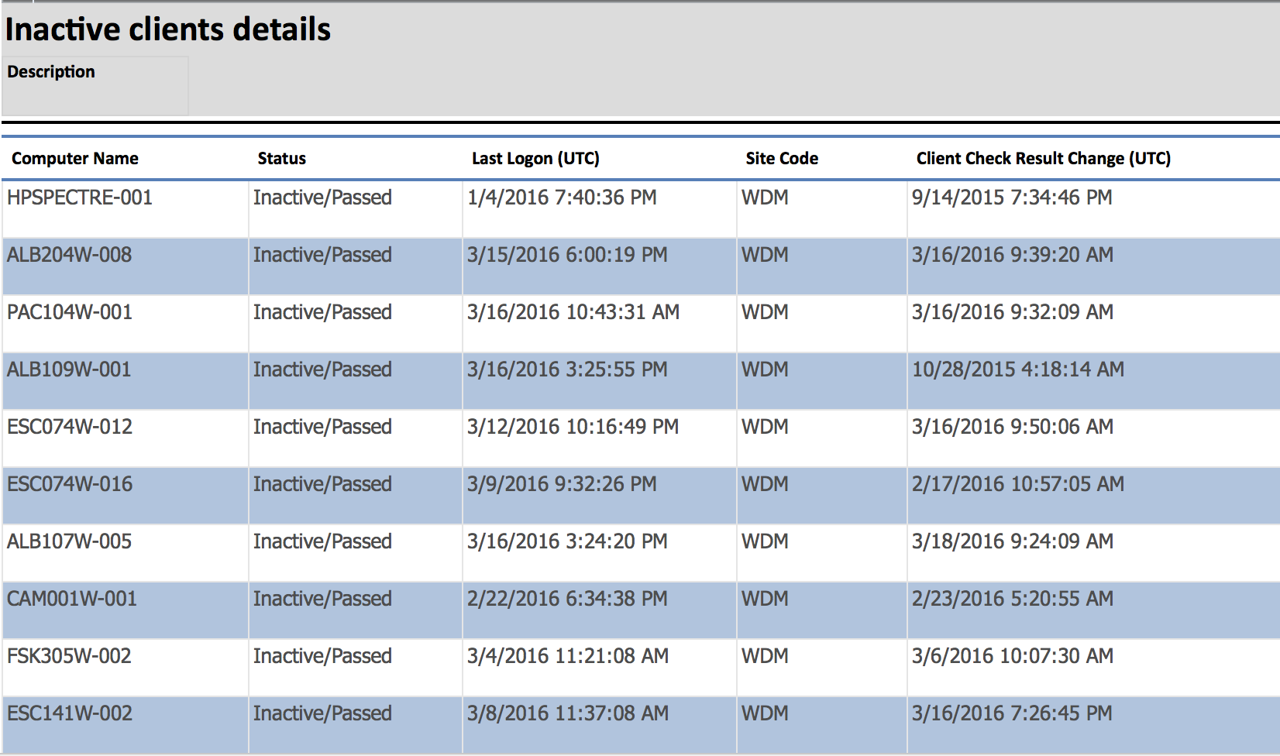
Email Report Example

Slide 17


Slide 18
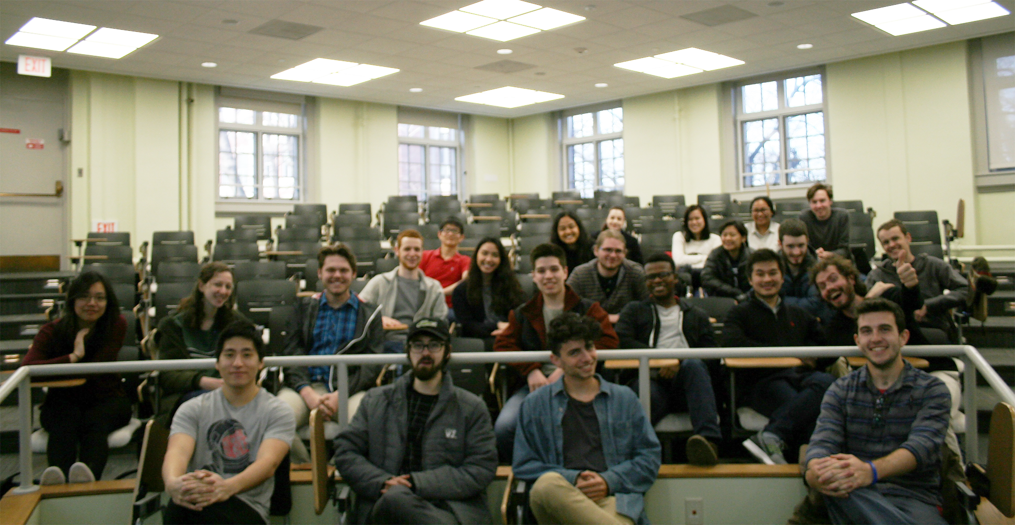

Slide 19
Next Steps
Leverage Citrix XenApp to deliver cross platform applications.
Move all Mac application and Image deployment over to SCCM via the Parallels plugin.
Deploy Windows 10 and OSX 10.11 for the 2016/2017 school year.

