Slide 1
The Technology and Pedagogy of Group Work: Strategies for Success
Erin DeSilva
Instructional Designer Dartmouth College
erin.desilva@dartmouth.edu
Rebecca Taub
Instructional Designer
Brown University
rebecca_taub@brown.edu

Slide 2
What we’ll do today
Define and discuss the parameters of group work.
Consider learning theories that support successful group work strategies.
Review four group work case studies.
Workshop and reflect on your own group assignment.

Slide 3
What’s the opportunity in your course?

Slide 4
The 6 Essential* Questions When
Considering Group Work
Why are you doing this? What is the purpose?
Who are your partners in designing and executing?
What do you want to assess & evaluate? How?
How will groups get formed?
Identify the time on task and context.
Which technology will best support the task(s)?
*According to our own experience and understanding of the research.
Seriously. Tell us what we’re missing.

Slide 5
Purpose
Why use a group assignment?

Slide 6
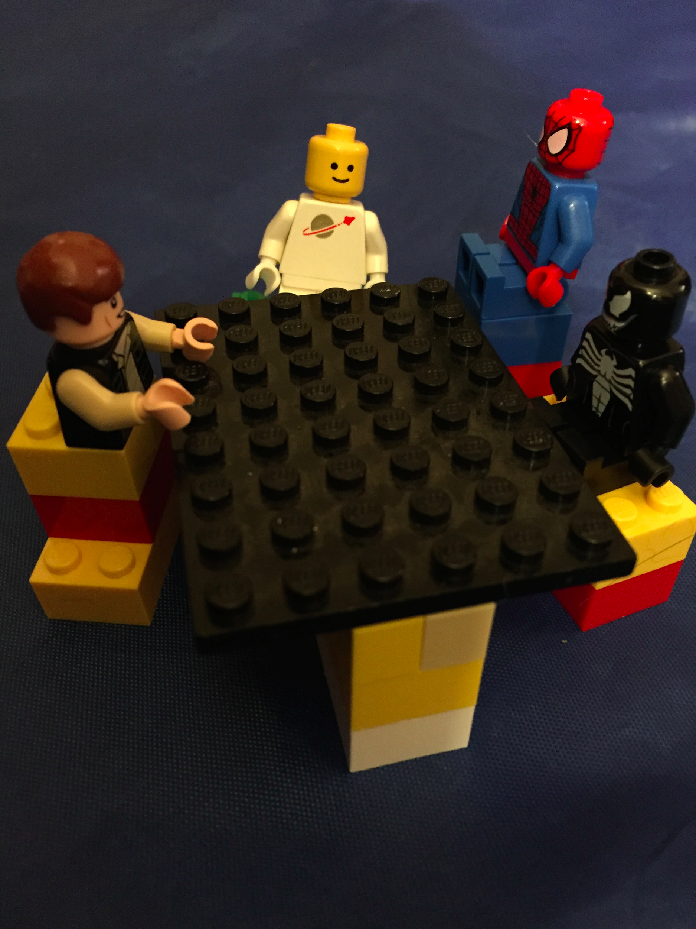
People

Slide 7
Assessment & Evaluation
How group work is assessed and evaluated “can make the difference between students’ feeling that they are just going through their paces and the sense that they are engaged in a powerful exchange of ideas.”
(Brookfield & Preskill, 1999, p. 107)

Slide 8
Group Structure
How many students per group?
How will we form groups?
Fixed vs. changing membership?
Assigned Roles?
Rules of engagement?

Slide 9
Context

Slide 10
Technology
Social Text Annotation
Learning Management System
Survey Tool
Collaborative Writing
Webinars/Conference Calls

Slide 11
Four Case Examples
Face-to-Face Course
Blended Course
Massive Open Online Course
Fully Online Course
Jot down the ideas you like for your own group work activity as we go!

Slide 12
Face-to-Face Course:

Slide 13
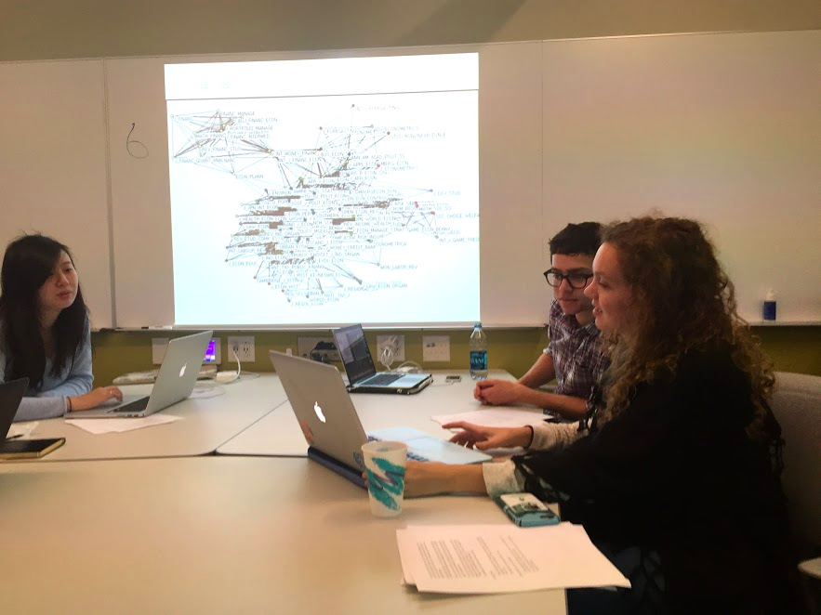
Face-to-Face Course: Genetics

Slide 14
Blended Course: Healthcare Leadership

Slide 15
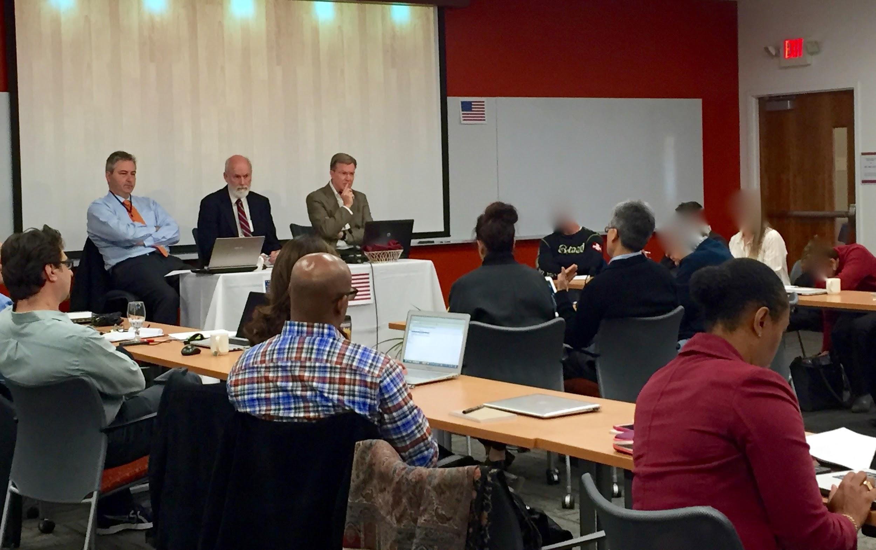
Blended Course: Healthcare Leadership

Slide 16
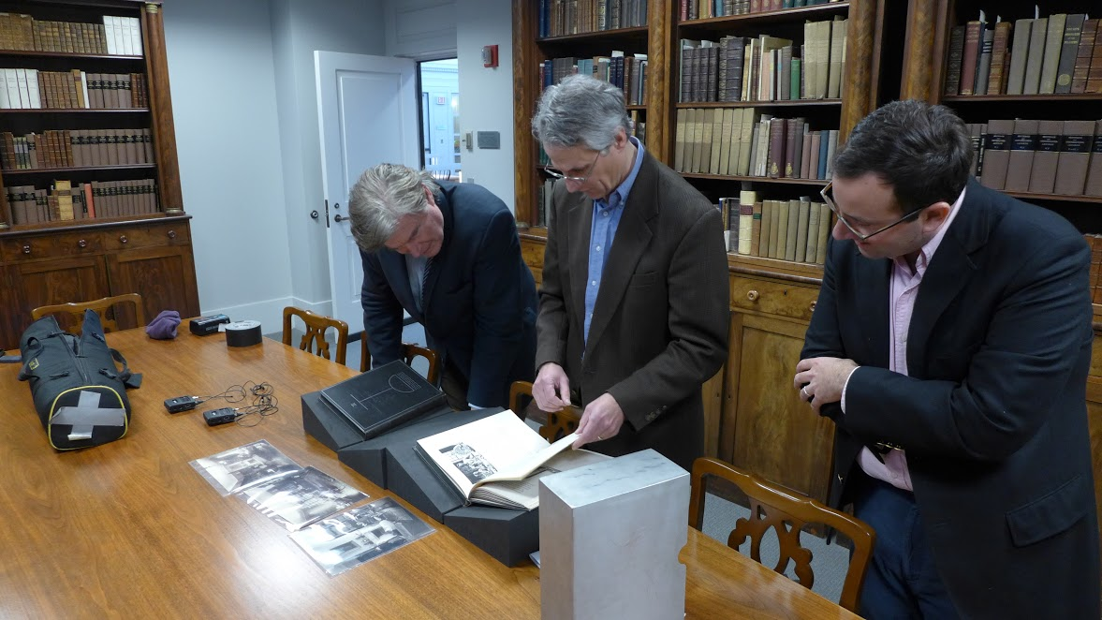
MOOC: American Renaissance

Slide 17
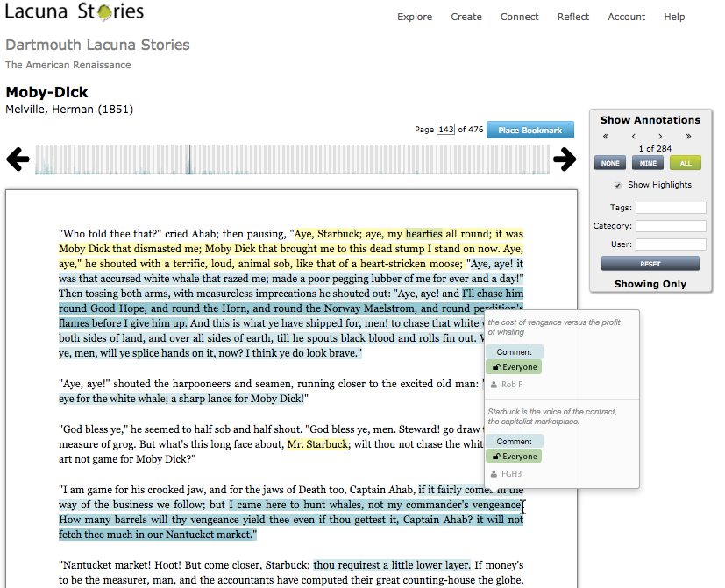
MOOC: American Renaissance

Slide 18
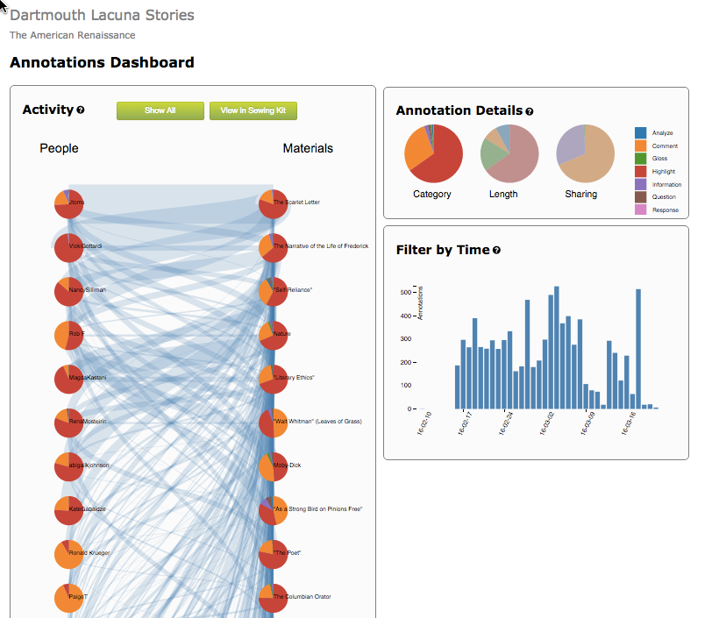
MOOC: American Renaissance
http://www.lacunastories.com/

Slide 19
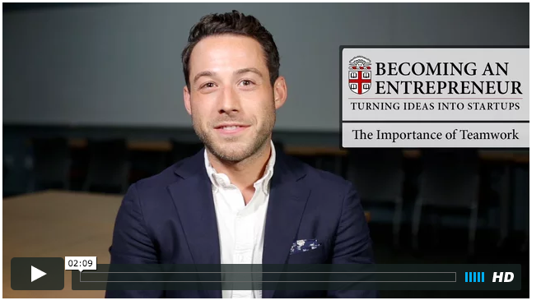
Online Course: Entrepreneurial Ideas

Slide 20
Online Course: Entrepreneurial Ideas

Slide 21
Let’s talk: Six Essential Considerations
Try This!
Partner with 1-2 people around you
For which considerations were you easily able to identify your own ideas? Which of these considerations require more thought?
Offer ideas for those challenges!
Purpose
People
Context
Group Structure
Assessment & Evaluation
Technology

Slide 22
Thank you for participating…please remember to complete the evaluation.
Let us know if you have questions
as you dive in!
Erin DeSilva
erin.desilva@dartmouth.edu
Rebecca Taub
rebecca_taub@brown.edu

