Slide 1
Leadership Competencies that promote Change
John K. Lewis, D.M.; J.D
Salve Regina University

Slide 2
What is a competency?
knowledge, skills & abilities
other personal characteristics
what you know, and how you apply what you know.
key behaviors in the workplace.
Competencies are frequently grouped together into competency models.

Slide 3
Change leadership
Takes responsibility for leading, directing, and managing organizational change.
Understands and supports the need for change.
Accurately assesses the potential barriers and resources
Envisions and articulates the intended result of the change process.
Provides direction and focus during the change process.

Slide 4
Change leadership
Acts as a catalyst for organizational change.
Helps to generate support of the changes throughout the organization
Identifies and enlists allies who support the change process.
Provides resources, removes barriers, and acts as an advocate

Slide 5
Resistance to change
actions taken by individuals and groups when they perceive that a change is a threat to them.
My employees don’t like change!
The secret to avoiding resistance to change and to leading a successful change process!!!

Slide 6
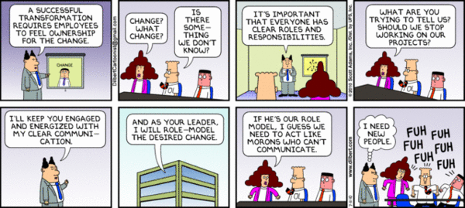
Dilbert by Scott Adams

Slide 7
Competency 1 - Leadership
Transformational Leadership
Transactional leadership
Emotional intelligence
Systems thinking
Culture change
Self-leadership

Slide 8
Competency 2 - communication
comfortable using a broad range of communication styles
communicate in a respectful tone
Cross-cultural communication
Written communication
Listening
Being articulate
Being persuasive

Slide 9
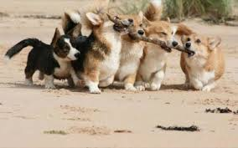
Competency 3 - collaboration
Co-operative effort
Teamwork
Teambuilding
Consensus building
Share information
Respect for others

Slide 10
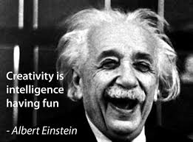
Competency 4 - creativity
New & useful ideas
Innovation
Problem solving
Identify opportunities

Slide 11
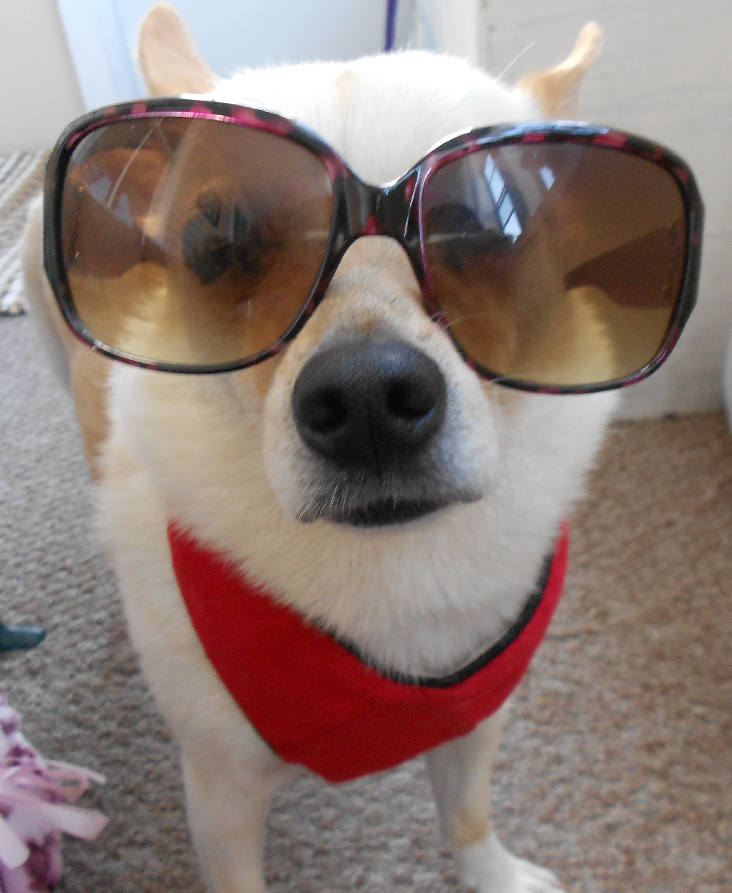
Competency 5 - visionary
Developing a vision
Building a shared vision
Inspires others
What is the future?

Slide 12
Competency 6 – assessment
investigate
Measure the right things
Evaluation
analytics
Evidence based decision-making
‘There is nothing like first-hand evidence.’
-A Study in Scarlet

Slide 13
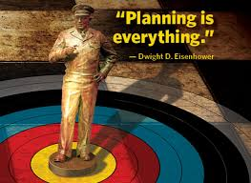
Competency 7 - planning
Strategic planning
Set direction
Action planning

Slide 14
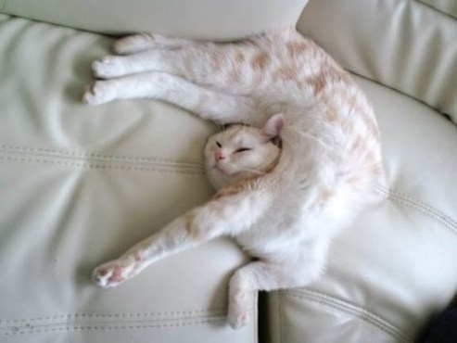
Competency 8 - flexibility
Adaptability
More than one way to do things
Agility
open to new methods, ideas, or approaches

Slide 15
Competency 9 - inspiration
Inspires others
Motivates others
Challenges
Creates excitement
Builds momentum

Slide 16
Competency 10 – interpersonal competence
Social skills
personality
Accessible
Approachable
Self-management/self-awareness
Manners
Valuing diversity

Slide 17
Test Time!

Slide 18
Rate your score
36 – 40 Change Master
30 – 35 change leader
26 – 30 change manager
20 – 25 Kinda changy
16 – 20 Needs improvement
10 – 15 Fears change
Below 10 YIKES!!!!

Slide 19
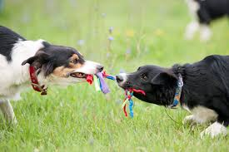
Resistance to change
“one of the most widely accepted mental models that drives organizational behavior: the idea that there is resistance to change and that managers must overcome it”
Dent & Goldberg (1999)
Perceived truth
Bankrupt self defeating mental model

Slide 20
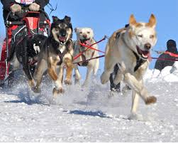
The resistance to change myth
Employees do not resist change
Employees resist bad change

Slide 21
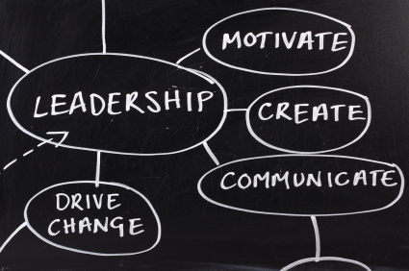
using competencies to promote change
Be a leader not a dictator
Communicate why change is good
Collaborate - Share information on the change
Be creative & open to others ideas
Build a shared vision of the change

Slide 22
using competencies to promote change
Create & explain the Plan
Be flexible & Open to input
Inspire & build momentum
Be accessible & approachable
Assess the change

Slide 23
Competency model Assessment Associates international 2016

Slide 24
The end
Questions & discussion
Please fill out the evaluation mobile app
Educause.edu/nc16/agenda

