Slide 1
Taking Systematic Approaches to Reducing Barriers for All Students
NERCOMP ANNUAL CONFERENCE
March 22, 2016

Slide 2
Greet your neighbor!
Who said “hi”?
Who said “hello”?
Who said “____”?
A young girl smiling at someone/thing.

Slide 3
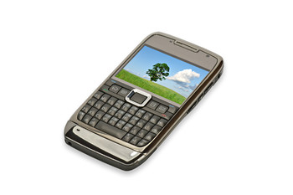
Outcomes
Identify the three principles of UDL
Identify three different applications of UDL in an online environment
Poll-get your phones/tablets out

Slide 4
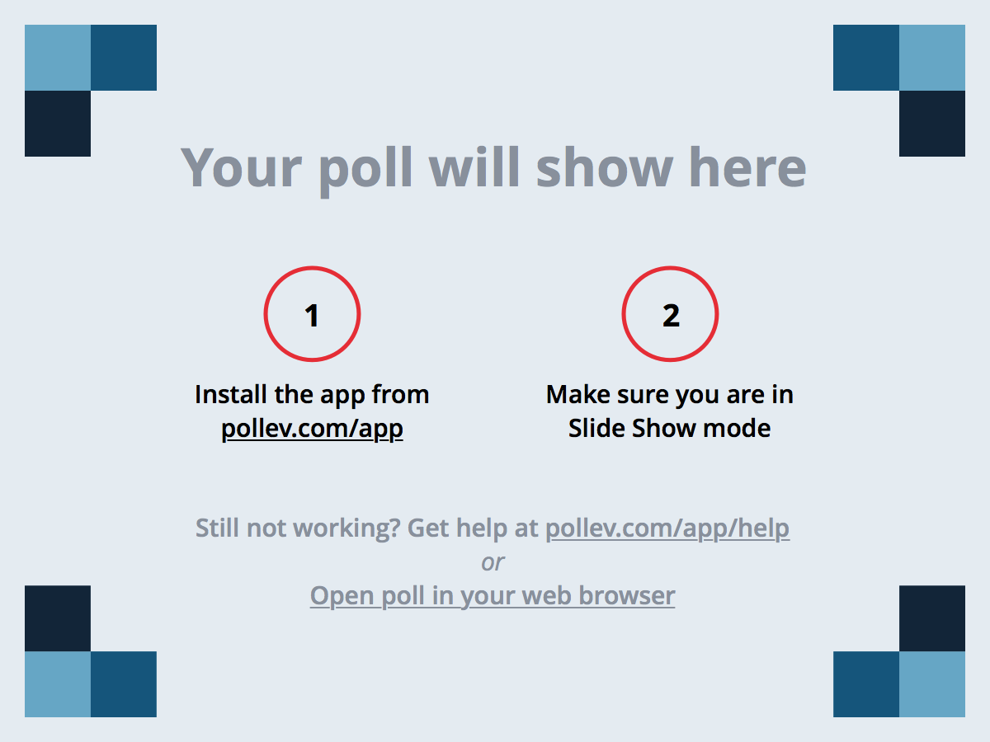
Notes:
Poll Title: Universal Design is the design of products and environments to be usable by everyone, to the greatest extent possible, without the need for adaptation or specialized design. https://www.polleverywhere.com/multiple_choice_polls/3nB0jaPL7PNAji5

Slide 5
Poll: Feedback
True is correct since UDL is for ALL learners without the need for adaptation, specialized design, or accommodation.

Slide 6
Notes:
Poll Title: Applying Universal Design for Learning (UDL ) Principles requires high the use of high-cost technologies. https://www.polleverywhere.com/multiple_choice_polls/tKaiWuEgQkaMbuj

Slide 7
Poll: Feedback
False is the correct answer since UDL does not require the use of high-tech/cost technologies.
video with cc = no $
Syllabus a few weeks prior to course beginning = no $
Allows time to set up for note taker
E-book from publisher
Braille

Slide 8
Notes:
Poll Title: One of the three principles of UDL is: https://www.polleverywhere.com/multiple_choice_polls/NbMkmNQNDvg3tbw

Slide 9
Poll: Feedback
Multiple means of expression allows for multiple ways for students to express what they know using their own strength/comfort to express what they know.

Slide 10
What is UDL?
Universal Design for Learning (UDL) is a teaching concept that implements teaching strategies to meet the needs of all learners. “UDL provides a blueprint for creating flexible goals, methods, materials, and assessments that accommodate learner differences.”
UDL
Multiple means of:
Representation
Multiple forms of content representing the same materials
E-book vs. textbook,
More graphics vs. more text
Expression
Options to express what students learn and know
Written presentation vs. oral presentation.
Engagement
Provide different ways to engage learners’ interests
Allowing student-directed learning
(Center for Applied Special Technology, CAST, 2009)

Slide 11
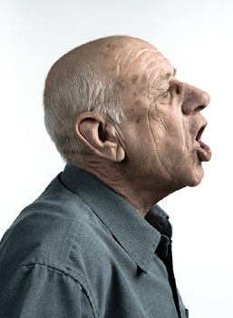
Questions?
Do your instructional materials allow students to choose or adjust how they learn?
Or, do you present your instruction using only one teaching method, like lecture?
Male speaking as in a lecture mode.

Slide 12
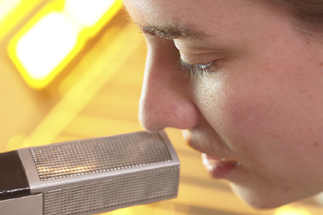
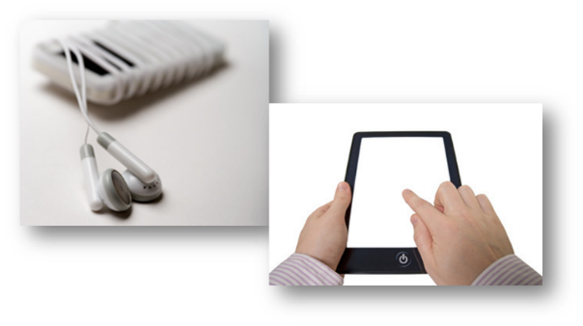
UDL: Three Principles-Multiple Means of:
Representation
Multiple forms of content representing the same instructional material
ex. e-book and textbook, balance of graphics and text
Woman speaking in a microphone
Phone with earbuds and tablet device
Example of Guided notes with blanks within the context
Recorded Lectures
Keeping lectures brief and digestible
Transcripts/captions
Use with recorded audio/video
Additional Audio
Supplement content:
Webinar audio
Podcasts
Narrated audio files (mp3 format)
Guided Notes
Students take notes
Graphic rep of text
Pause Procedure
Notes:
Universal design for learning (UDL) is a framework to improve and optimize teaching and learning for diverse students, based on cognitive science. The goal of UDL is to reach the widest audience possible and to provide all students equal opportunities to learn. UDL informs the accessibility of your instructional materials, as well as how you develop your course.

Slide 13
Questions?
Have your students ever struggled with test anxiety or communication skills?
Do your assignments and assessments allow students to choose how they demonstrate what they have learned?
Woman staring at her laptop with expressing frustration.

Slide 14
UDL: Three Principles-Multiple Means of:
Expression
Provide options for learners to express what they’ve learned and know; ex. Written presentation vs. oral presentation.
Presentations
Asynchronously or synchronously
Multimedia tools
Self-recording or illustration
Roleplay
Modeling of ideas and act out problems or knowledge
Creating a movie to “retell” or demonstrate their skills
Notes:
Universal design for learning (UDL) is a framework to improve and optimize teaching and learning for diverse students, based on cognitive science. The goal of UDL is to reach the widest audience possible and to provide all students equal opportunities to learn. UDL informs the accessibility of your instructional materials, as well as how you develop your course.

Slide 15
Questions?
Have your students ever had difficulty connecting your instructional content to the “real world?”
Are you teaching a subject on which students have no prior experience to build?
People with confused expressions

Slide 16
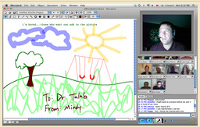
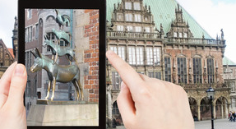
UDL: Three Principles-Multiple Means of:
Engagement
Provide different ways to engage learners’ interests; offering choices that optimize investment and autonomy that address students’ differing interests and ability levels.; ex. Allowing student-directed learning
Synchronous session with instructor on a webcam and whiteboard instruction.
Student using a tablet for a virtual fieldtrip
Virtual fieldtrips
Removes the boundaries of where (or when) students can visit
Debates/Brainstorming
Independent modules
Instructor/student assignment creation
Generate ideas, suggestions, feedback
Reflection journals
Connect prior knowledge
Notes:
Q: Have your students ever had difficulty connecting your instructional content to the “real world?” Are you teaching a subject on which students have no prior experience to build?

Slide 17
Scenario Activity
Options for individual presentation
Group project/student panels
Instructional material for online course (lecture video, YouTube video, readings, etc.)
UDL
Multiple means of:
Representation
Multiple forms of content representing the same materials
e-book vs. textbook,
more graphics vs. more text
Expression
Options to express what students learn and know
Written presentation vs. oral presentation.
Engagement
Provide different ways to engage learners’ interests
Allowing student-directed learning
(Center for Applied Special Technology, CAST, 2009)

Slide 18
Tracie Ortiz, Instructional Designer
Old Dominion University
Norfolk, VA
tortiz@odu.edu

Slide 19
Resources
Universal Design for Learning Guidelines (CAST) – PDF http://www.udlcenter.org/sites/udlcenter.org/files/updateguidelines2_0.pdf
What is UDL? (National Center On Universal Design For Learning) http://www.udlcenter.org/aboutudl/whatisudl
UDL module: http://udlmodule.weebly.com/home.html
Notes:
Universal design for learning (UDL) is a framework to improve and optimize teaching and learning for diverse students, based on cognitive science. The goal of UDL is to reach the widest audience possible and to provide all students equal opportunities to learn. UDL informs the accessibility of your instructional materials, as well as how you develop your course.

