Slide 1
SUSTAINABLE MODELS FOR CREATING OPEN AND AFFORDABLE COURSE MATERIALS: PARTNERSHIPS AMONG LIBRARIANS, FACULTY, AND INSTRUCTIONAL DESIGNERS
Speakers from:
North Shore Community College
University of Massachusetts, Amherst
University of Connecticut
Boston College
Moderator: Susan Stearns, Boston Library Consortium [BLC]

Slide 2
Open Textbook Initiative
at North Shore Community College
Torrey Dukes, Lance Eaton, Andrea Milligan

Slide 3
Cross-campus collaboration is key - not just a library or instructional technology initiative
Educational Technology Innovation Group
Faculty, Instruction Technology and Design, Instructional Media, Library
LibGuide on OER
Open Textbook Initiative (OTI) Group
Library, Instruction Technology and Design, Faculty
Support faculty OER projects and Student Guide to OER
OER Working Group
Administrators, Bookstore, Registrar, Faculty, Advising, Library, Information Systems, Instruction Technology and Design
Course note and Bookstore opportunities
Notes:
Campus Wide 18 faculty to date working in OER projects

Slide 4
Sustaining the project - find ways to build it into already existing opportunities
Campus Innovation Grant ($5000)
OER theme for one of our Faculty Technology Summer Institute
Funded 10 faculty projects
Technology Across the Curriculum (TAC) Grant Process
Added OER as a faculty project
Affordability Model
OER, free, affordable, and/or library resources
Source
Notes:
Campus Wide 18 faculty to date working in OER projects

Slide 5
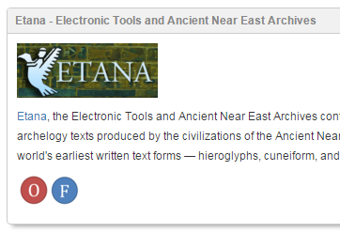
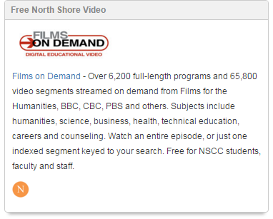
Faculty OER Projects
Larry Davis - Sabbatical Project
Irene Fernandez - Sabbatical Project

Slide 6
Savings to Date for Students
OER Courses
Introduction to Child & Adolescent Behavioral Health Care
World History 2
African American History
History of Sexuality
Database Theory and Applications
Intermediate Spanish 1
Composition 2: Mass Media in Communications
Introduction to Mental Health Work
Introduction to Statistics
Semester | Courses | Savings
Spring 2015 | 2 courses | $3,596.00
Summer 2015 | 2 courses | $5,978.00
Fall 2015 | 5 courses | $12,800.55
Spring 2016 | 6 courses | $14,548.90
Summer 2016 | 3 courses
 | Total: | $36,923.45

Slide 7
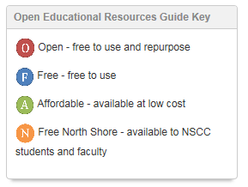
Resources
Background of Open Textbook Initiative at NSCC
http://nscclets.blogspot.com/2015/09/the-open-textbook-initiative-at-north.html
North Shore Community College OER LibGuide
http://libguides.northshore.edu/open
North Shore Community College Student Guide to Open Educational Resources
https://goo.gl/k3wlFh

Slide 8
THE OPEN EDUCATION INITIATIVE AT
SEEKING ALTERNATIVES TO HIGH-COST TEXTBOOKS
Jeremy Smith
Based on Marilyn Billings’ OER Summit Presentation (October 2013)

Slide 9
SEEKING SOLUTIONS
The OEI is a faculty incentive program that encourages:
the creation of new teaching materials and models
the use of existing open (free) information resources to support student learning
the use of library subscription materials
development of open technologies
Notes:
Success Story: Tidewater Community College Z Degree in 21 course associate of science in business admin.

Slide 10
SUCCESS STORIES
Carlos Gradil
Miliann Kang
Hossein Pishro-Nik
Animal Sciences 421:
Fundamentals of Reproduction
Cost Savings to date: $7,680
Women's Studies 187: Gender, Sexuality and Culture
Cost Savings to date: $8,475
Electrical and Computer Engineering 314: Introduction to Probability and Random Processes
Cost Savings to date: $25,833
Notes:
Carlos Gradil
Animal Sciences professor.
Digitized unique clinical teaching material to be used online in a non-linear format for use outside of class time to enhance learning.
Miliann Kang
Women’s Studies Professor
Created an introductory Women’s Studies textbook
Downloaded over 4,351 times worldwide, far over the initial class of 113 students
Hossein Pishro-Nik
Electrical and Computer Engineering professor.
Created an introductory textbook on probability and random processes.
Used his book in 6 courses, representing 6 times for a projected savings of ($87,700); other
Professors are using it as well.

Slide 11
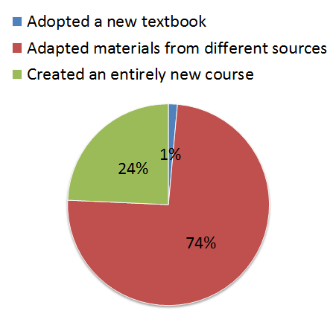
OUTCOMES

Slide 12
OUTCOMES
Total Savings Over Time By College
COLLEGE | # OF STUDENTS PER COLLEGE | SAVINGS PER COLLEGE OVER TIME
College of Natural Sciences | 4,471 | $762,643.00
College of Social and Behavioral Sciences | 1,248 | $163,307.00
College of Humanities & Fine Arts | 870 | $119,473.00
College of Engineering | 724 | $132,677.00
College of Education | 703 | $74,283.00
College of Nursing | 38 | $2,470.00
Honors College | 187 | $7,835.00
Stockbridge School of Agriculture | 275 | $37,058.00
Isenberg School of Management | 103 | $20,600.00
School of Public Health and Health Sciences | 175 | $38,699.00
TOTAL | 8,794 | $1,359,045.00
Notes:
Intended Outcomes
50 faculty + over 100 classes taught = over $1 million saved for students. Average of $128 saved per student, per class.
Course evaluations show the same quality of student satisfaction, if not better
Service points on campus are partnering for student success
Unexpected Outcomes
Instructors are using new teaching styles and flipping their classrooms
Increased awareness on campus and queries from instructors about OERs
Professors report students are better prepared for class and more engaged
The open education community: Created resources that can be added to available open education resources for everyone.
Relationships between service point partners are stronger
Student involvement and passion

Slide 13
LIBRARY.UMASS.EDU/SERVICES/TEACHING-AND-LEARNING/OER/
Open Educational Resources Website at UMass Amherst
Notes:
Click on website and tour various resources

Slide 14
University of Connecticut
Affordable Textbook Initiative
Grassroots Movement/Kathleen Labadorf
March 22, 2016

Slide 15
Grassroots movement
The UConn Story
Student Government and UConn PIRG (2014)
Campus-Wide Committee (2015)
In-House Working Group (2015)
Faculty Champion (Spring, 2017)

Slide 16
Team Formation – Important Voices
Campus-Wide Task Force
Students
Faculty
Administrators
Center for Excellence in Teaching and Learning
Librarians
Co-Leaders
Bookstore
In-House Working Group
Librarians (3)
IT specialist
LMS integration staff
Collections Head

Slide 17
Looking for Funding
Student Groups Support
Book revision
Symposium
Presentations – you never know
Department Heads meeting
Foundation member in audience
Connection!
Davis Educational Foundation Grant possibility
Wait for it – Administration, Vice Provost for Academic Affairs
Faculty Course buyout for Spring 2017 semester

Slide 18
Grant Proposal
Budget!
Funds needed
In-kind funds from UConn
18 month plan
Faculty Survey (IRB)
Workshops
Incentives
Symposium
In person support of grant
Our faculty, CETL, and students are Champions!

Slide 19
So far
Ups and Downs
Dr. Ed Neth
Successes so far
Chemistry, 2 classes
Psychology, 1 class
Not
Sociology
Lessons Learned
Revising to ‘Atoms First’ for UConn.

Slide 20
Affordable Course Materials
Boston College Libraries
Margaret Cohen

Slide 21
Overview:
Affordable Course Materials Initiative
Grant Process
Faculty perspective

Slide 22
Task force members:
Jane Morris, Scholarly Communication & Special Initiatives Librarian
Margaret Cohen, Educational Resource Center
Judith Gordon, Professor of Management and Chairperson, Management and Organization Department
Adaline Mirabal-Camacho, Learning to Learn, Montserrat Coalition
Clare O’Connor, Biology Department
John Rakestraw, Center for Teaching Excellence
Kit Baum, Professor of Economics and Social Work
Notes:
Issue raised by:
Boston College student government
Monserrat Task Force (1/3 of high financial need students do not buy the textbook)
October 2014- Jane Morris and I approached University Librarian and asked to put together a small task force to plan an initiate to address the high cost of textbooks by making greater use of open access and subscribed resources- we felt because of the libraries' expertise and mission we were the appropriate people on campus to lead the initiative
Looked at what others were doing- thankful for the focus/trend/conversations in Open Educational Resources and the assistance of Marilyn Billings and UMASS Amherst

Slide 23
Task force charge:
In order to address the escalating cost of academic textbooks, this group will approach the issue in two distinct ways. First, the group will explore the establishment of an initiative to support faculty who revise their curriculum to include only high quality materials that can be accessed at minimal cost to individual students. The group should propose a funding model, application process, award criteria, support infrastructure and criteria by which the effectiveness of the program may be assessed. A proposal should be forthcoming by January 1, 2015, and should set target time frames for applications, awards and implementation of the revised curricula. Second, the group will gather data about the effect of the cost of course materials on Boston College students and plan to inform faculty about these costs.
Notes:
Two distinct ways.
First, the group will explore the establishment of an initiative to support faculty who revise their curriculum to include only high quality materials that can be accessed at minimal cost to individual students.
Second, the group will gather data about the effect of the cost of course materials on Boston College students and plan to inform faculty about these costs. - some students spending over 1000.00 /semester
funding to support a pilot initiative aimed at supporting faculty in the creation of Affordable Course Materials-
Support of the Provost and University Librarian

Slide 24
Grant Process
Competitive application process
Savings per student over the previous course materials/projected number enrolled
Preference for courses to be implemented by Fall semester, 2016, at the latest
The new curriculum resources may be:
newly-created teaching materials,
publicly accessible materials and
subscribed resources (from the Boston College Libraries)
or any combination of the three
Newly created materials must be made publicly accessible in eScholarship@BC
Strength of the application
Notes:
After gaining support from the Provost and University Librarian
Grant Process announced in March 2015- completed by early May
Sent notices to the Academic Departments from the Vice Provost for Faculties; presented at the Provost Advisory Committee (Dean and faculty support)
Competitive Application process:
What are your goals regarding this change in curricular materials? What are your intended outcomes for your students’ learning?
Please give a brief description of the plan for which you seek support. How do you plan to identify resources and how will they be accessed? What types of resources do you expect to use or create and how sustainable will the resulting curriculum be?
What challenges do you anticipate in implementing your goals? (for instance, access challenges for students, technology barriers, time constraints, etc.)
What library, CTE or other support will your project require? (Choose all that apply.)
How do you plan to assess the effectiveness of the new curricular materials? Will you be willing to participate in follow-up assessment?
Strength of application:
expected outcomes from the new curriculum,
expected challenges of creating/assembling low cost materials,
sustainability of the resulting curriculum,
planned method of assessing the success of the resulting curricular materials.

Slide 25
Support for faculty
Workshop given jointly by the University Libraries and the Center for Teaching Excellence (CTE).
Subject specialist librarian
CTE staff will be available for Canvas and other technology consultations and curriculum design support.
Resulting open access products may be hosted in eScholarship@BC, the institutional repository administered by the Libraries
Notes:
Workshop In April 2015 :
overview of the initiative and grant availability
availability of open educational resources
copyright and licensing issues/Creative Commons licenses
accessibility concerns
creating a sustainable curriculum
managing resources in Canvas
assistance with creation of new content
Library Resources
Role of the Subject specialist librarians will be available to provide consultation and support in finding appropriate resources.

Slide 26
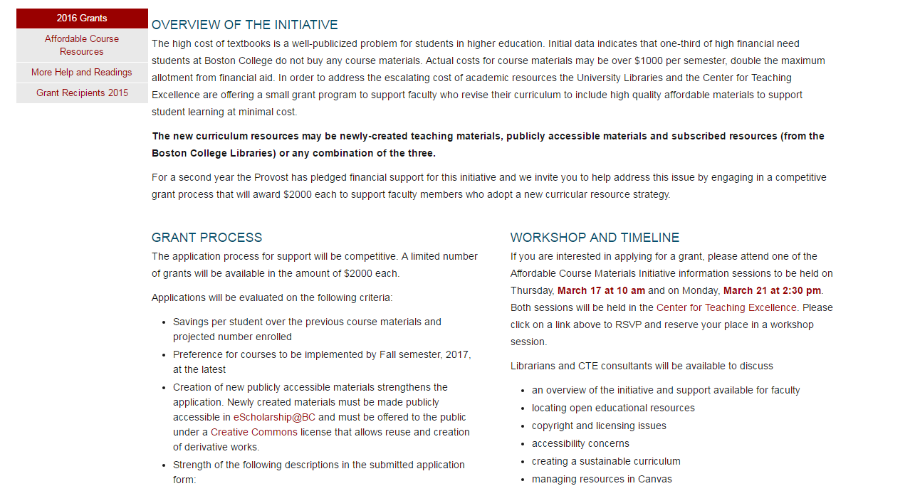
Affordable Course Materials Initiative Guide

Slide 27
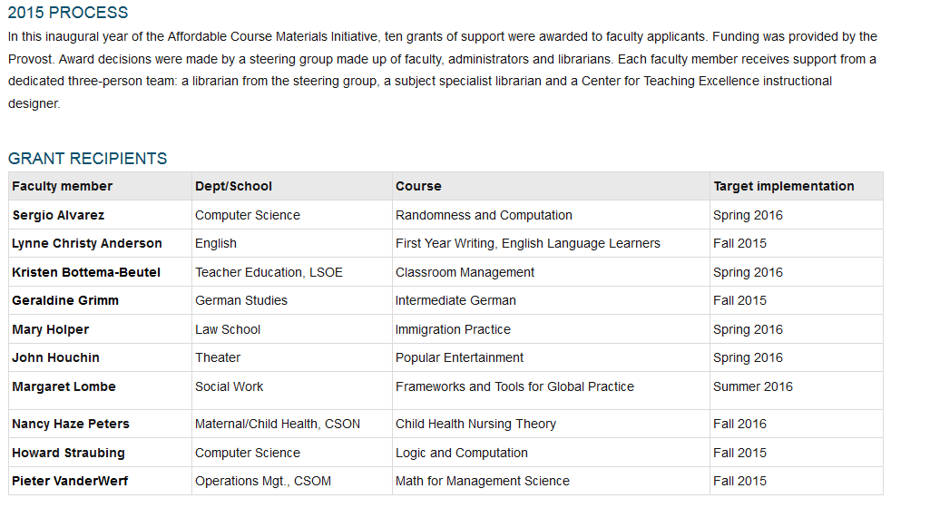
Notes:
10 grants- awarded in May 2015
Grants decided by a small subset of the task force
Jane and I were the project managers
Each faculty member was assigned a team: staff from Instructional Designer and a subject liaison met at the initial stages of development after award of the grant

Slide 28
Faculty Perspective

Slide 29
Thank You. And, now please join us for discussion and Q&A
Susan Stearns, BLC - sstearns@blc.org
Torrey Dukes, NSCC - tdukes@northsore.edu
Lance Eaton, NSCC - leaton@northshore.edu
Andrea Milligan, NSCC - amilliga@northshore.edu
Jeremy Smith, UMass-Amherst - jlsmith@library.umass.edu
Kathy Labadorf, UConn - kathy.labadorf@uconn.edu
Margaret Cohen, BC - cohenlm@bc.edu

