Slide 1
From the Basement to the Cloud
Practical lessons in migration
to hosted infrastructure services

Slide 2
Some Reasons
Distributed Access
Control
Performance increase
Data protection
Encryption
Scalability
Access from anywhere
Device agnostic
Ease of use
Support
Prevention
Security
Flexibility

Slide 3
The Basement (not for the faint of heart)

Slide 4
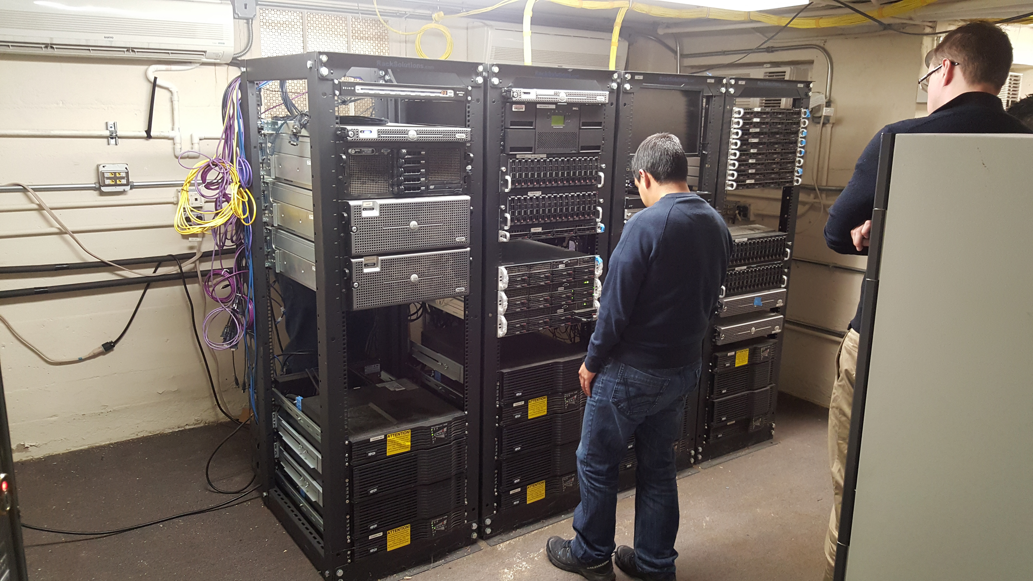

Slide 5
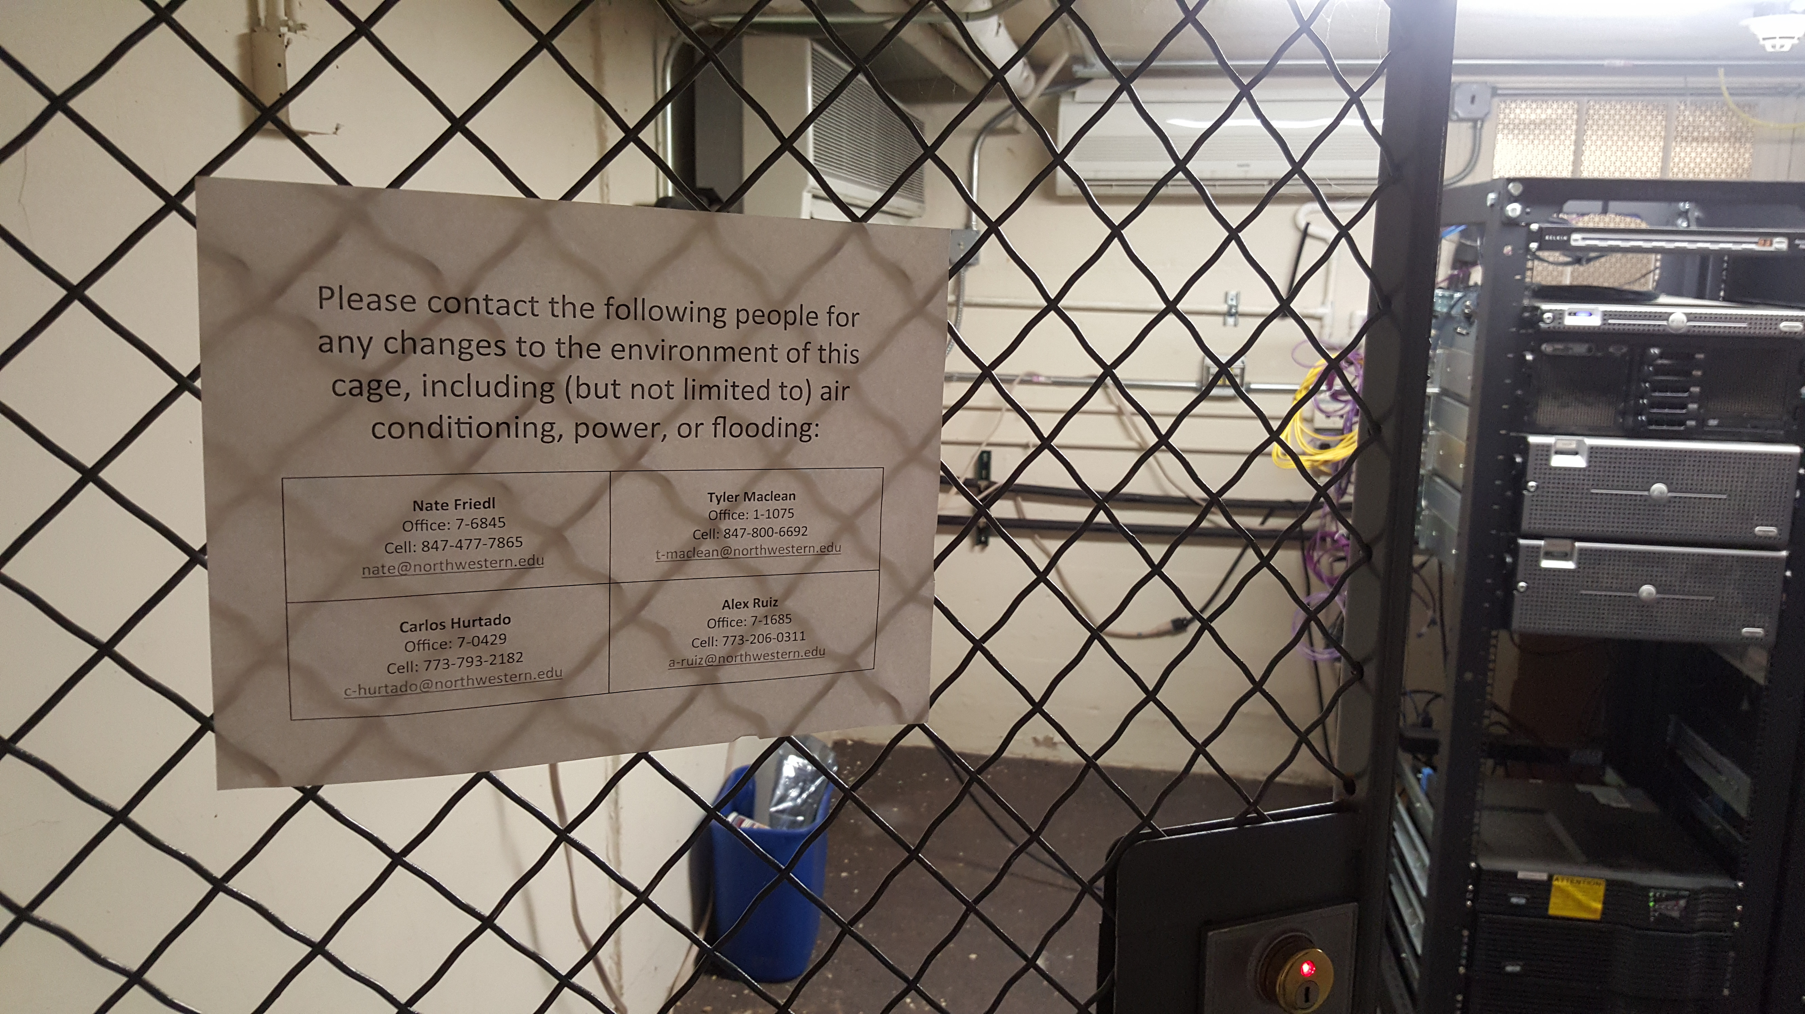

Slide 6
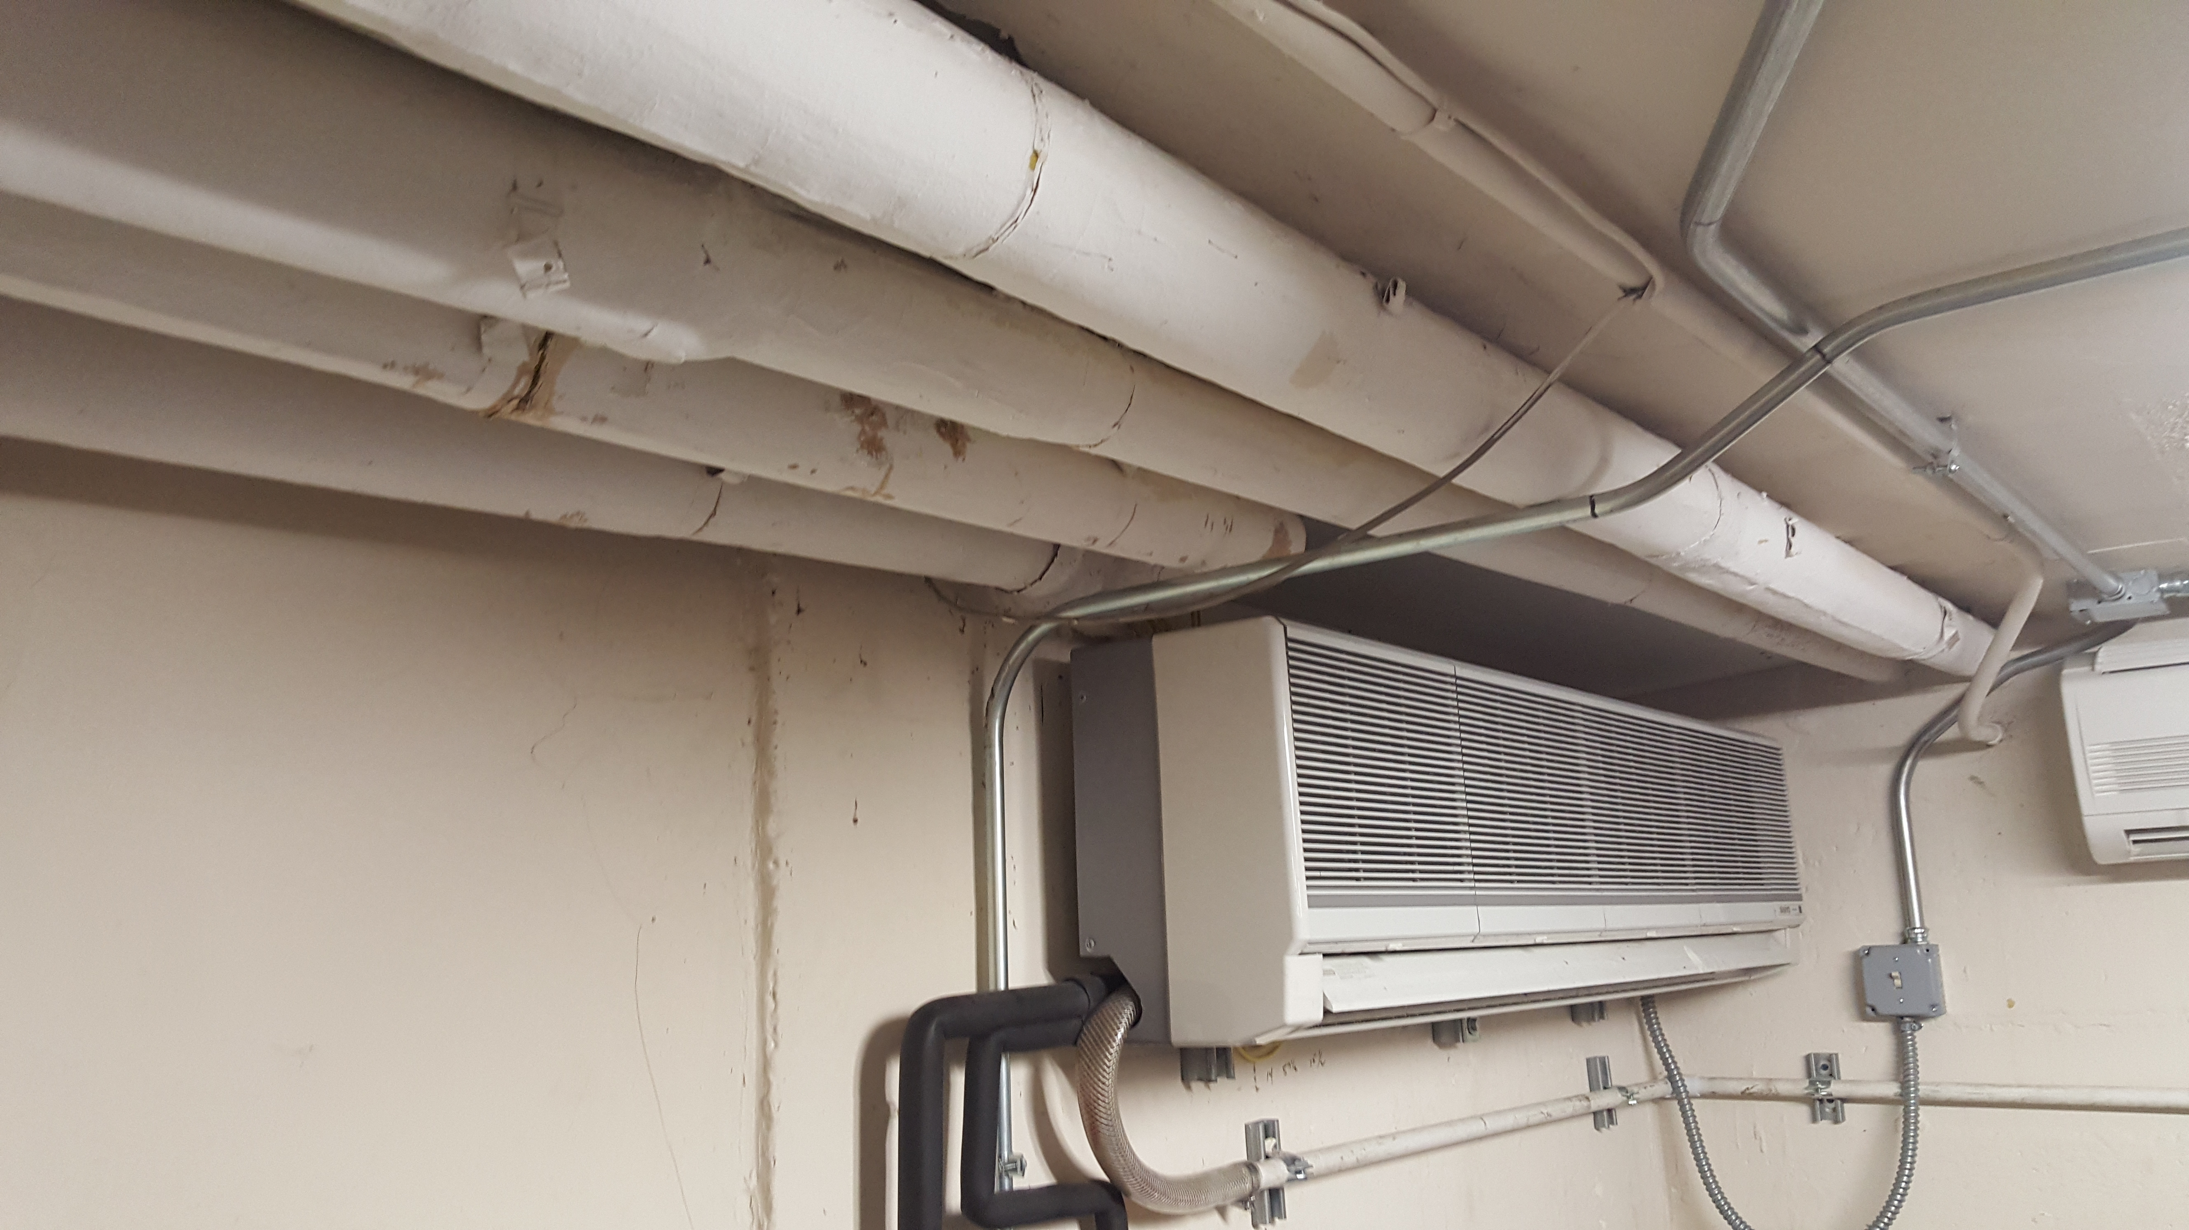

Slide 7
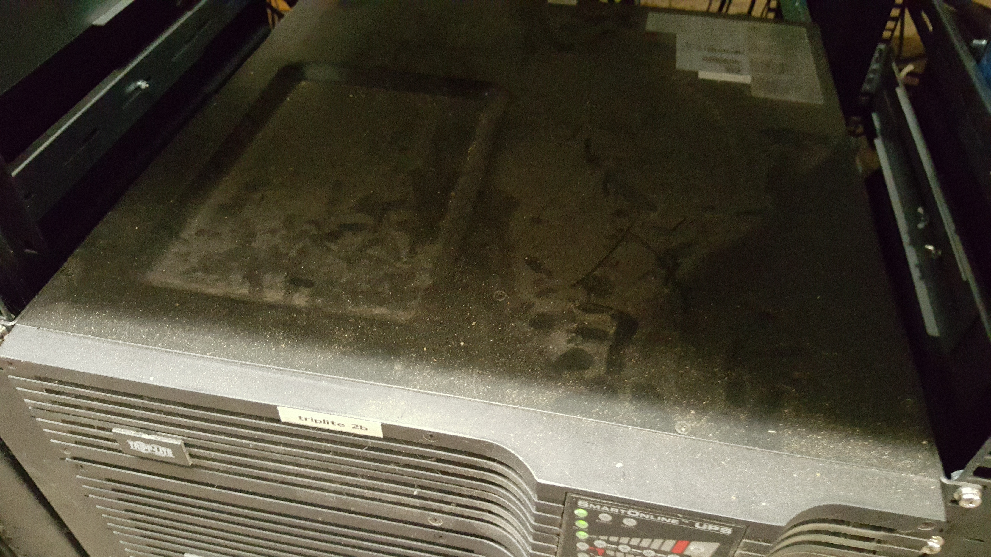

Slide 8
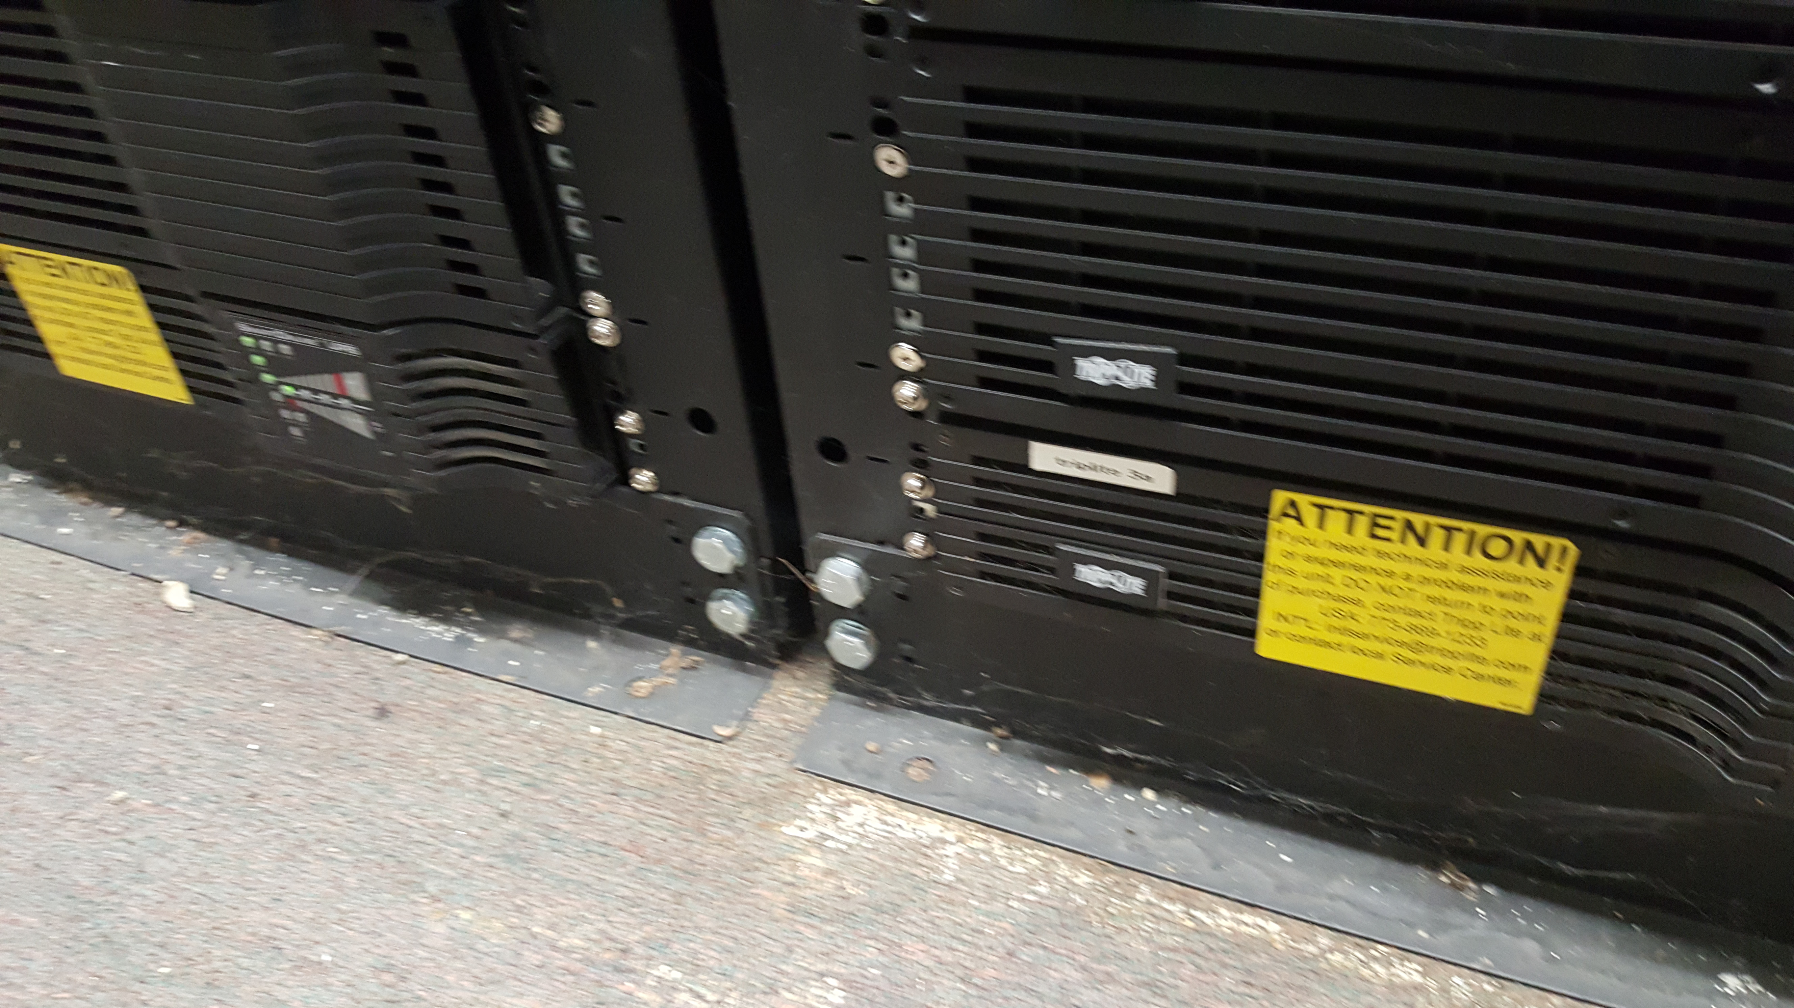

Slide 9
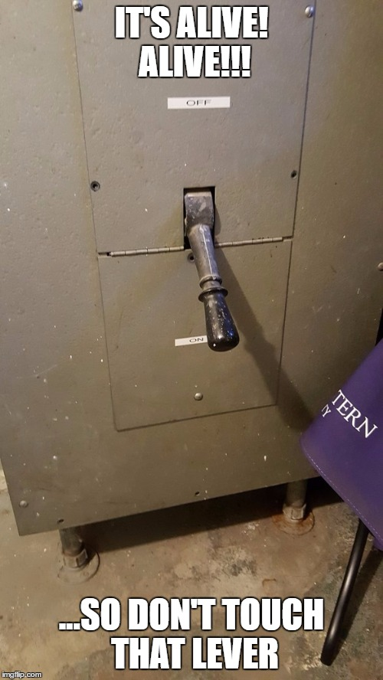

Slide 10
YER DOIN IT WRONG (what we had down there)
Web servers (RHEL, apache, php web apps)
File servers (RHEL, Samba)
Virtual desktop environment (Citrix)
Database servers (MySQL)
Various special purpose servers
Tape backup system

Slide 11
On Premise Private Cloud (NUCloud)
Web and database servers (RHEL)
Active Directory
Hosted Infrastructure as a Service
VDIs (NUworkspace)
File Services (Northwestern Box)
Future: Public Cloud VDCs
Amazon Web Services
Microsoft Azure

Slide 12
Virtual Desktops - NUworkspace

Slide 13
Project and vendor management
Technical problem solving and testing
Communication

Slide 14
Application Virtualization Working Group
The Graduate School
Medill School of Journalism
Northwestern IT
Pritzker School of Law
School of Education and Social Policy
University Library

Slide 15
4-5 months

Slide 17
Timeline
Event | Completed
Box contract signed | Spring 2014
Application Virtualization Working Group begins pilot process | Summer 2014
Box migration for department/program administrative data | Summer 2014
Dean’s Office migrated to Box | Winter 2014/2015
Last research share moved to Box | Spring 2015
NUworkspace rollout | Spring 2015
Last individual share moved to Box | Summer 2015

Slide 18
File Services - Box

Slide 19
Communication, documentation, and follow up
Planning
Technical
problem solving

Slide 21
Up front
Migration announcement
Schedule of migration (flexed as needed)
Migration day reminders
Weekly demonstration and Q/A sessions
Begin weekly Box Update emails
FAQ built
Migration days
In person visits to every department and program on migration day
Fast response to support requests
Continued Box Update emails
FAQ kept “live”
Follow up
How’s it going? calls
Ongoing FAQ updates
Communicate well-vetted service improvements
[Future] Adoption surveys and log analysis

Slide 22
Is this thing on?
(see https://www.youtube.com/watch?v=tmq0GL_doRA)

Slide 23
Results

Slide 24
Happiness is a de-racking

Slide 25
Success? It’s a process.
Enhance
Promote
Measure and inquire

Slide 26
Lessons

Slide 27
Relationships matter – a lot
Department Administrator
Department staff
Graduate students
Faculty
Other departments

Slide 28
Less stick, more…

Slide 29
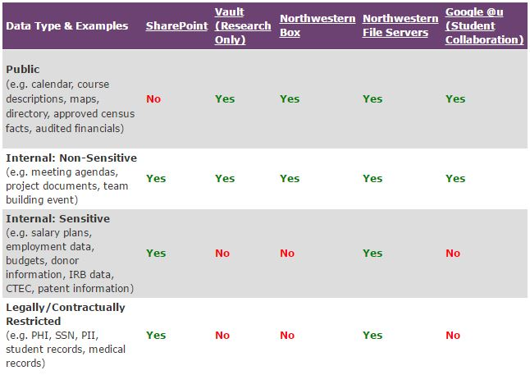
Non-unified messaging

Slide 30
Summarized lessons
Be present
Emphasize follow up
Seek partners
Be positive, but take care in proselytizing
Work with administrative staff to gain adherents
Have detailed, tested project plan
Respect faculty and staff workflows
Keep learning about the product, and make adjustments to increase adoption
Coordinate as much as possible

Slide 31
More resources
Box FAQ
Box Update emails
Full deployment schedule
Migration scripts
Application Virtualization Working Group report
I’d be happy to engage in follow up discussions. All of the above documents will be uploaded shortly.
lotus@northwestern.edu

