Slide 1
LEADING CHANGE: BUILDING TOWARD A STRATEGIC VISION OF INNOVATION
Brian Gardner Columbia University, Business School
March 23, 2016

Slide 2
191 Years of Diet Science
1825: A low-carbohydrate regimen unveiled
1830: Graham's high-fiber diet
1903: Chew each bite 32 times
1917: World introduced to calorie counting
1925: The cigarette diet
1928: The Inuit diet
1950: The cabbage soup diet
1960: The Zen macrobiotic diet
1981: The Beverly Hills diet
1994: Dr. Atkins says fat is our friend
2003: The South Beach Diet
2010s: The Paleo Diet
1930: The grapefruit diet
1961: Weight Watchers launched
1985: The caveman diet
1995: The Sugar Busters diet
Notes:
In 1825, a low-carbohydrate regimen was unveiled in "The Physiology of Taste," by Jean Brillat-Savarin. Take a step back. Make room for the unknown future.

Slide 3
Agenda
Execute a vision while tackling daily challenges
  Implement strategies for operational effectiveness
Stop triaging and execute on your strategic plans
  Lead academic and information technology
Build an organization ready for tomorrow
  Advocate for change and innovation

Slide 4
Maslow
Self-transcendence
Self-actualization
Esteem
Love & Belonging
Safety
Physiological
Metamotivation
Deficiency Needs

Slide 5
Know Your Environment
Market/Sector
Institution
Core Competencies
Differentiators & Culture

Slide 6
Understand Your Constraints
Disruption
Fiscal
Physical
Political

Slide 7
Aspirations – Current State = Innovation Potential

Slide 8
What is the Role of IT?
Strategy
Execution
Vision
Operations
Driver
Supporter

Slide 9
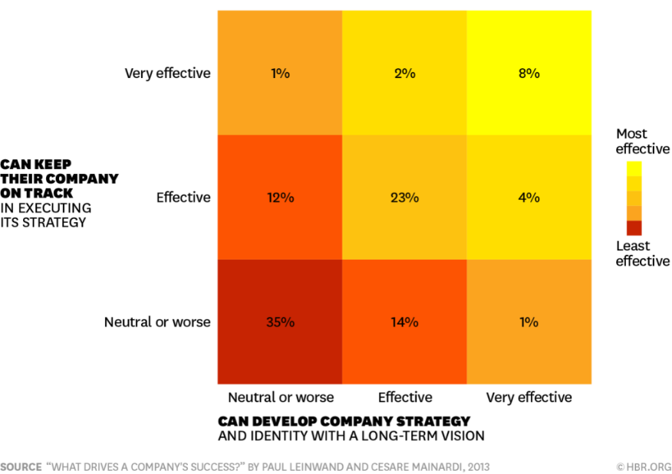
Only 8% of Leaders
Notes:
39% are effective or better at both.

Slide 10
Operations
First
Enterprise Architecture
Management Operating System
Key Performance Indicators
Communication Plan
Key Activities
Controls/Governance
Exception Management
Service Catalog
Service Level Agreements
Standard Procedures
Stage 1: Business Silos
Stage 2: Standardize Technology
Stage 3: Optimized Core
Stage 4: Business Modularity

Slide 11
Being a Driver:
Know the People & Processes
“Having a seat at the table does not mean you have a voice.”
-Virginia Gambale
Notes:
Molly Worthen, Assistant Professor of History at the University of North Carolina, Chapel Hill

Slide 12

Leading Change Internally: People
“IT personnel tend to struggle with organizational change.
IT personnel are generally motivated workers, and yet they do not feel they have much impact on the group or organization for which they work.
The level of trust people have in their supervisors is a critical component in the relationship of employees to the organization as a whole.”
Dr. Nathan Culmer, Penn State University

Slide 13
Leading Change Externally: Politics
Negative
Neutral
Positive
Machiavellian
Responsible
Leader
Manipulator
Looks Out for #1
Obligation
Comes with Territory
Play Maker
Impact Player
Initiates
Protector
Speculator
Advisor
File Builder
Defensive
Grapeviner
Counselor
Predicts
Cynic
Fatalist
Spectator
I told you so
Gossip
Que Sera Sera
Fan
Encourager
Responds

Slide 14
Emotional Intelligence (EQ) – Gaps?
You often feel like others don’t get the point and it makes you impatient and frustrated.
You’re surprised when others are sensitive to your comments or jokes and you think they’re overreacting.
You think being liked at work is overrated.
You weigh in early with your assertions and defend them with rigor.
You hold others to the same high expectations you hold for yourself.
You find others are to blame for most of the issues on your team.
You find it annoying when others expect you to know how they feel.

Slide 15
Leading Change Globally: GQ
Adaptability
Awareness
Curiosity
Empathy
Alignment
Collaboration
Integration

Slide 16
But Brian, what about academic technology?
What academic technology trends can we see?

Slide 17
Boiling Down All the Lists
How do we teach both knowledge and wisdom?
How do we know if learning has occurred?
How do we ensure resultant skill sets are equivalent?
How do we help the maximum number of people advance/succeed?
What is the X factor in academia (this cycle)?
How do you not go bankrupt in the process?

Slide 18
An IT Hierarchy of Needs(?)
Client Services
Delivery Mechanisms
Security & Legality
Infrastructure
Metamotivation
Deficiency Needs

Slide 19
Recap
Execute a vision while tackling daily challenges
  Implement strategies for operational effectiveness
Stop triaging and execute on your strategic plans
  Lead academic and information technology
Build an organization ready for tomorrow
  Advocate for change and innovation

Slide 20
“Five hundred years ago, everybody knew the Earth was flat, and fifteen minutes ago, you knew that humans were alone on this planet. Imagine what you'll know tomorrow.”
–Kay, Men in Black
Thank You!
SESSION EVALS! Online or in the app by April 8th!
Brian R. Gardner, CTS
Director of Academic Technologies
212.854.8092 | brian.gardner@columbia.edu
@_bgardner

Slide 21
References
http://www.latimes.com/health/la-he-diet-timeline-20150228-story.html
Langer, Arthur M. Information Technology and Organizational Learning: Managing Behavioral Change through Technology and Education. Boca Raton: Taylor & Francis Group, 2011.
DeLuca, Joel R. (1999). Political Savvy: Systematic Approaches to Leadership Behind the Scenes. Berwy, PA: Evergreen Business Group.
Ross, J. W., Weill, P., & Robertson, D. C. (2006). Enterprise Architecture as Strategy. Boston: Harvard Business School Press.
http://www.performancedrivers.com.au/knowledge-centre/technical/what-is-mos.shtml
http://er.educause.edu/articles/2016/1/top-10-it-issues-2016
http://chronicle.com/article/An-Executive-Summary/235454?cid=cp32
http://er.educause.edu/articles/2015/12/leading-change-in-higher-ed-it
https://hbr.org/2014/12/signs-that-you-lack-emotional-intelligence
George, Bill. “Discover Your True North”, Wiley 2015

