Slide 1
Learn How to Build a Culture of Security Awareness Anywhere
Presenters:
Steven Frechette, Bristol Community College
Micah Nelson, Harvard University
March 23, 2016
Notes:
Steve

Slide 2
Welcome and Introduction
How C-Suite Viewed Information Security
How We Approached the Problem
Strategy and Results
Next Steps
Notes:
Steve

Slide 3
Welcome and Introduction
Steven Frechette, Information Security Officer
  Bristol Community College
Micah Nelson, Information Security Awareness Officer
  Harvard University
Notes:
Steve and Michah

Slide 4

Problem We Are Trying to Solve

Slide 5

Problem We Are Trying to Solve

Slide 6
Problem We Are Trying to Solve
219810445

Slide 7
Key Stat
59% of all data breaches are caused by end user negligence
Source: “2013 Cost of Data Breach Study: Global Analysis,” Ponemon Institute, May 2013.

Slide 8
Problem We Are Trying to Solve
Information Security Awareness
  First place to start
Two very different schools, similar challenges
  Awareness - identifying a problem
  Compelling reason why change is needed
  Need tools to facilitate the change
  What does “right” approach look like

Slide 9
Awareness leads to new behaviors and that’s what we’re after.

Slide 10
Awareness in Simple Terms
Awareness illuminates long embedded habits (or routines) that:
  No longer useful
  Detrimental to a person, group, or business
We are all products of our habits
  Respond to cues through routines for perceived rewards (or outcomes)

Slide 11
Real change only occurs when:
There is a compelling reason to do so
Understand Perceived Rewards vs. Actual Consequences
Have the Tools
What The Model Behavior Looks Like

Slide 12
How C-Suite Views Information Security
BCC
  Mandates don’t work – Unions and CB
  No financial resources available initially
  Senior leadership did not recognize importance
  Never used SANS STH Training

Slide 13
How C-Suite Views Information Security
Harvard
  Compliance != Awareness
  +Budget
  +1 FTE
  +Big Launch Announcement
  - Not Mandatory
Notes:
To micah

Slide 14
How C-Suite Views Information Security
Harvard
  Compliance != Awareness
  +Budget
  +1 FTE
  +Big Launch Announcement
  - Not Mandatory

Slide 15
Two Approaches to Solve the Same Problem

Slide 16
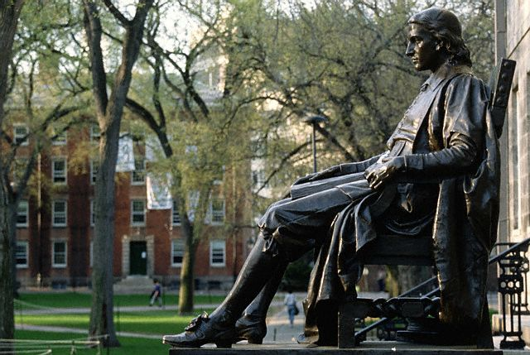
Harvard University Approach

Slide 17
Harvard University Approach
Secure My
People!

Slide 18

Harvard University Approach

Slide 19
Harvard University Approach
Set Your Goals
Build Your Team
Create Your Message
Deliver Your Message
Refine and Repeat

Slide 20
Harvard University Approach
Goals
Team
Create
Deliver
Refine

Slide 21
Harvard University Approach
Goals
Team
Create
Deliver
Refine
Set Your Goals

Slide 22

Harvard University Approach
Goals
Team
Create
Deliver
Refine
Set Your Goals

Slide 23
Harvard University Approach
Goals
Be Secure!
Team
Create
Deliver
Refine
Set Your Goals

Slide 24
Harvard University Approach
Goals
Specific
Team
Create
Deliver
Refine
Set Your Goals

Slide 25
Harvard University Approach
Goals
Specific
Achievable
Team
Create
Deliver
Refine
Set Your Goals

Slide 26
Harvard University Approach
Goals
Specific
Achievable
Measureable
Team
Create
Deliver
Refine
Set Your Goals

Slide 27
Harvard University Approach
Goals
Specific
Achievable
Measureable
Work/Home
Team
Create
Deliver
Refine
Set Your Goals

Slide 28
Micah’s Cheat Sheet
1) Less is more

Slide 29
Harvard University Approach
Goals
Phishing
Passwords
Patching
Staying Informed
Team
Create
Deliver
Refine
Set Your Goals

Slide 30
Harvard University Approach
Goals
Team
Create
Deliver
Refine
Build Your Team

Slide 31
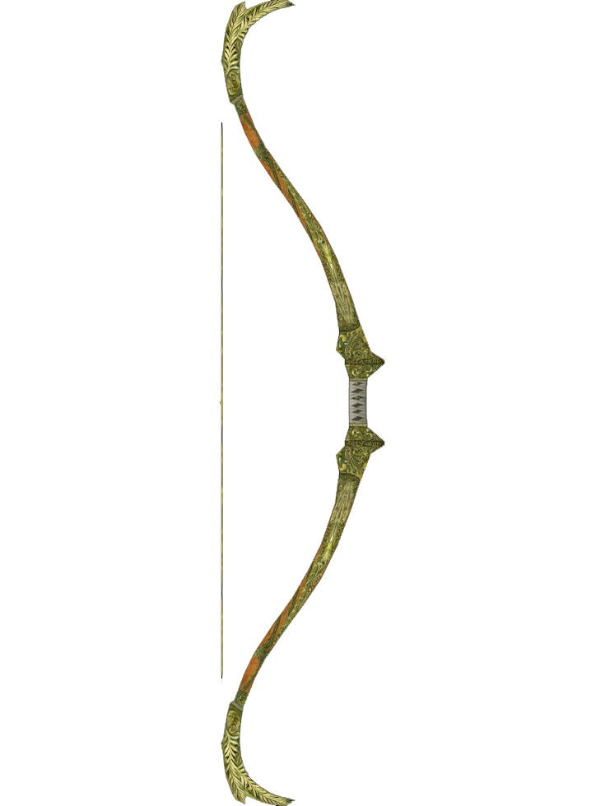


Harvard University Approach
Goals
Team
Create
Deliver
Refine
Build Your Team

Slide 32
Harvard University Approach
Goals
Security
Communications
“People” Person
Stakeholders
Team
Create
Deliver
Refine
Build Your Team

Slide 33
Micah’s Cheat Sheet
1) Less is more
2) Start with IT

Slide 34
Harvard University Approach
Goals
Vendors?
Team
Create
Deliver
Refine
Build Your Team

Slide 35



Slide 37





Notes:
The same applies to information security.
These are small actions you can take which make a big difference for your security….

Slide 38
Harvard University Approach
Goals
Team
Create
Deliver
Refine
Create Your Message

Slide 39

Harvard University Approach
Goals
Team
Create
Deliver
Refine
Create Your Message

Slide 40
Harvard University Approach
Goals
Tell Users What To Do
Team
Create
Deliver
Refine
Create Your Message

Slide 41
Harvard University Approach
Goals
Tell Users What To Do
Better yet, Show
Model Good Behavior!
Team
Create
Deliver
Refine
Create Your Message

Slide 42

Harvard University Approach
Goals
Team
Create
Deliver
Refine
Create Your Message

Slide 43
Harvard University Approach
Goals
Model Good Behavior
Provide the Tools
Team
Create
Deliver
Refine
Create Your Message

Slide 44
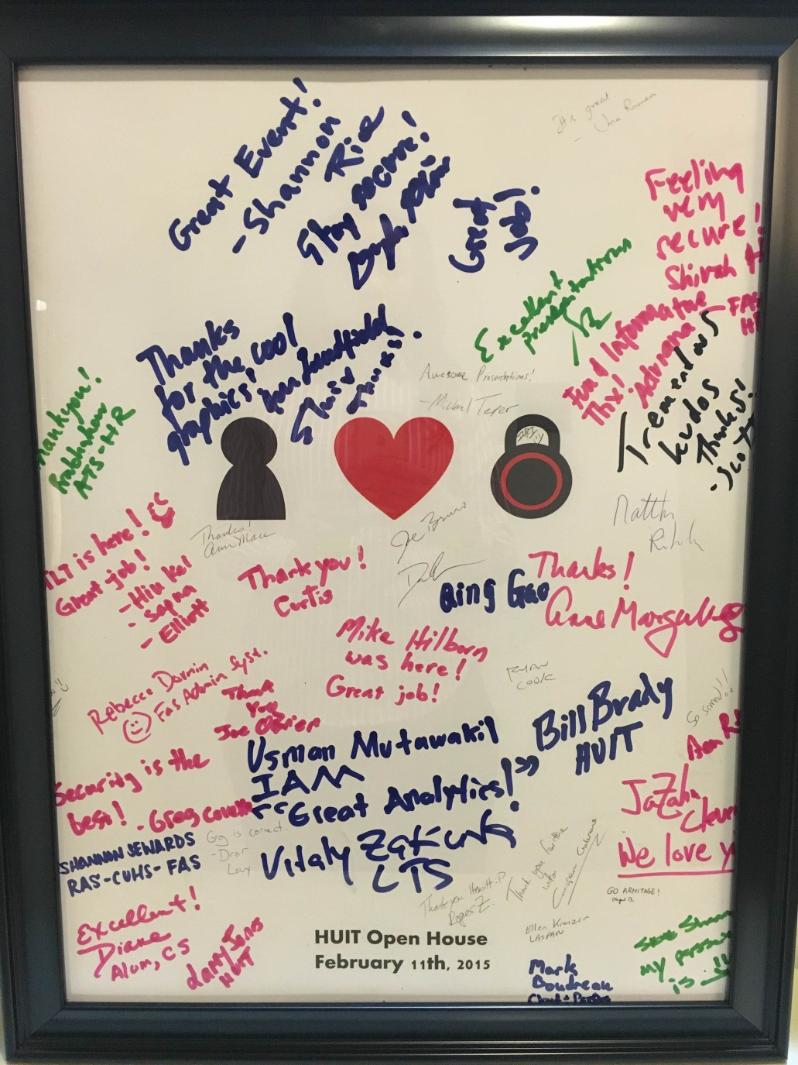

Slide 45
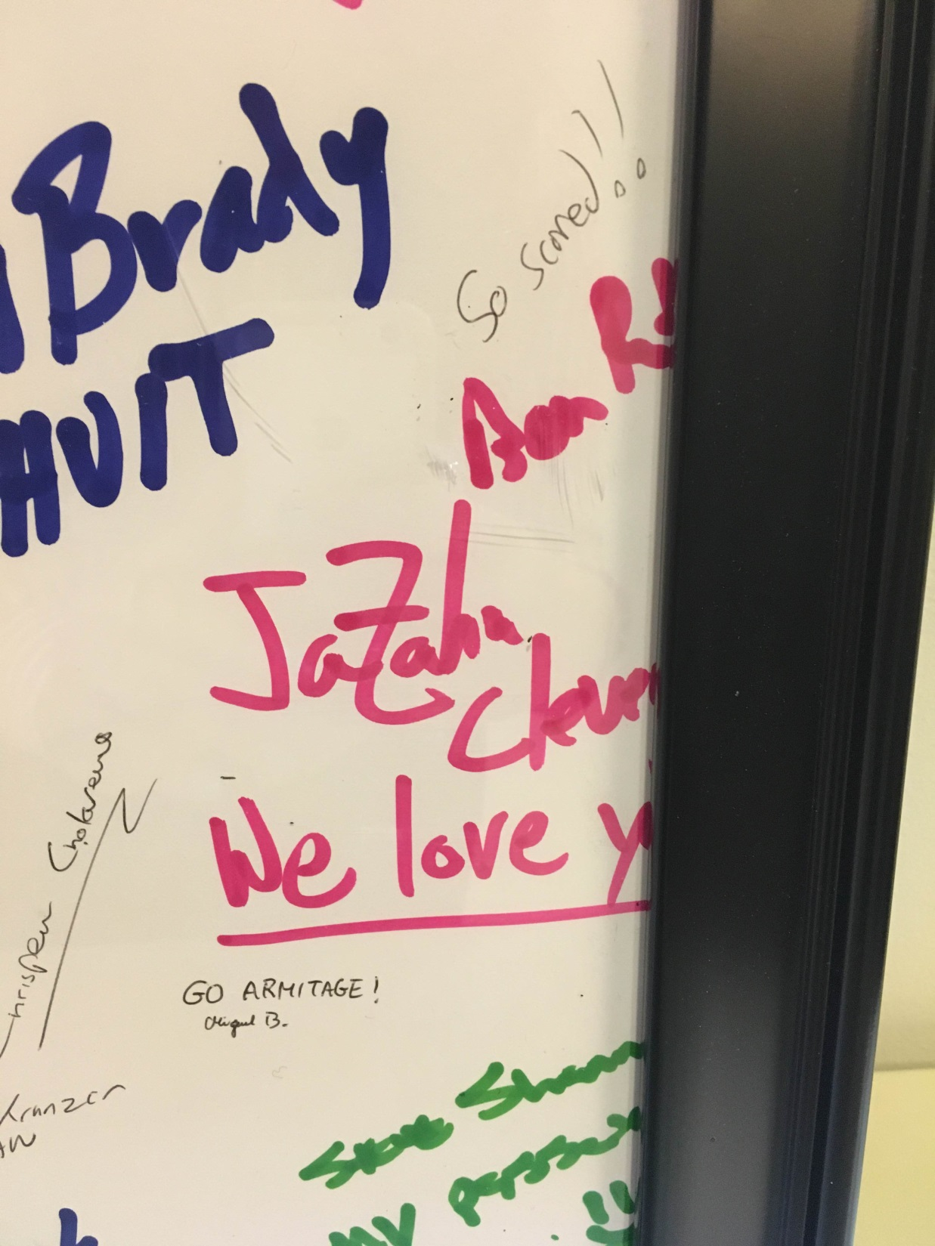

Slide 46
Harvard University Approach
Goals
Model Good Behavior
Provide the Tools
Only Fixable Fear
Team
Create
Deliver
Refine
Create Your Message

Slide 47
Micah’s Cheat Sheet
1) Less is more
2) Start with IT
3) No Fear without a Fix
4) Model Good Behavior
5) Provide the Tools

Slide 48
Harvard University Approach
Goals
Team
Create
Deliver
Refine
Deliver Your Message
Notes:
Scared != Safe
Fear can be paralyzing

Slide 49
Harvard University Approach
Goals
The Fun Part!
Team
Create
Deliver
Refine
Deliver Your Message
Notes:
Scared != Safe
Fear can be paralyzing

Slide 50
Harvard University Approach
Goals
Websites
Newsletters
Emails
Prizes
Events
Games
Demos
Posters
Contests
Workshops
Team
Create
Deliver
Refine
Deliver Your Message
Notes:
Scared != Safe
Fear can be paralyzing

Slide 51
Harvard University Approach
Goals
Intermodal
Videos
In-Person
Quiz
Team
Create
Deliver
Refine
Deliver Your Message
Notes:
Scared != Safe
Fear can be paralyzing

Slide 52
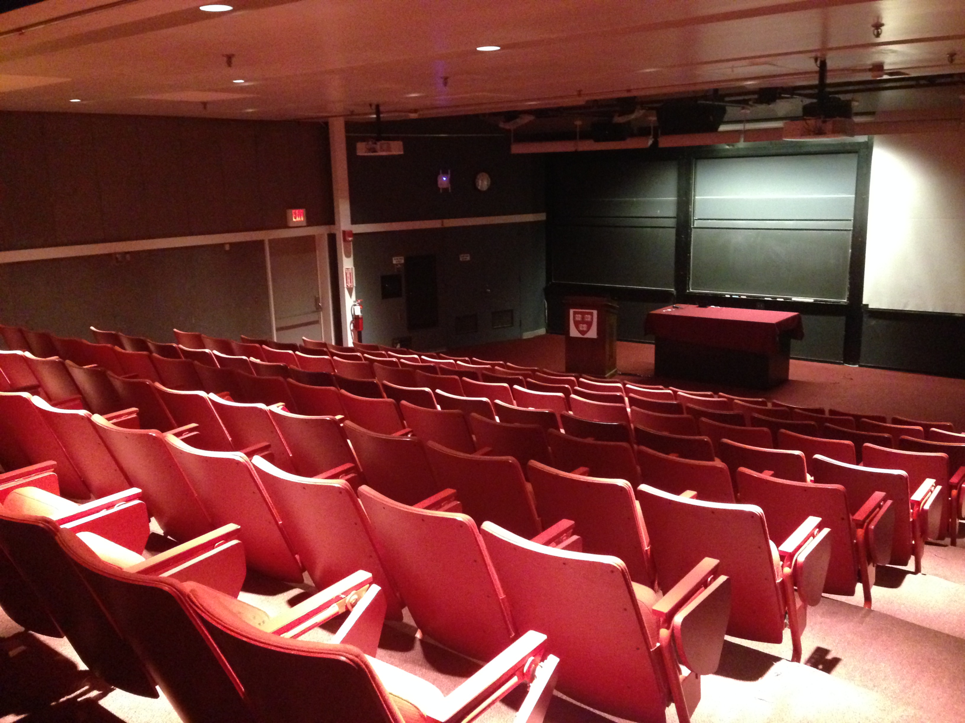
Harvard University Approach
Goals
Team
Create
Deliver
Refine
Deliver Your Message

Slide 53
Harvard University Approach
Goals
What if you throw a
Party and nobody shows up?
Team
Create
Deliver
Refine
Deliver Your Message

Slide 54
Harvard University Approach
Goals
Crash someone else’s
Party.
Team
Create
Deliver
Refine
Deliver Your Message

Slide 55
Micah’s Cheat Sheet
1) Less is more
2) Start with IT
3) No Fear without a Fix
4) Model Good Behavior
5) Provide the Tools
6) Use Existing Channels
Notes:
Communicator’s Toolkit

Slide 56

Harvard University Approach
Goals
Team
Create
Deliver
Refine
Deliver Your Message
Notes:
Being Made Mandatory

Slide 57
Harvard University Approach
Goals
Team
Create
Deliver
Refine
Refine and Repeat

Slide 58
Harvard University Approach
Goals
Know -> Encrypt
Team
Create
Deliver
Refine
Refine and Repeat

Slide 59
Harvard University Approach
Goals
Know -> Encrypt
Better Self Service
Team
Create
Deliver
Refine
Refine and Repeat

Slide 60
Harvard University Approach
Goals
Know -> Encrypt
Better Self Service
Collaborate in Higher Ed
Team
Create
Deliver
Refine
Refine and Repeat

Slide 61






security.harvard.edu

Slide 62
Bristol Community College
Approach

Slide 63
Bristol Community College Approach
Initial Approach – Follow ROE
Develop comprehensive policies to govern behavior
Involved faculty in process through committee
Assumptions of support in key areas by key personnel
“No problem. People will buy in.”

Slide 64

Bristol Community College Approach
Wrong.
Responsible Use Policy – 10 months, no results
No closer to raising awareness on any level
Very limited support
Same roadblocks in place
  Staff-faculty dynamic, no money, no priority, no awareness training

Slide 65
Bristol Community Revised Approach
Start at the End – work backward
What should Enterprise Governance look like
What is the compelling reason to change and why?
What should model behavior look like
What tools do we need
What new strategy could we use to accomplish these goals?

Slide 66
Plan B Strategy – OODA Loop
OODA Loops - produce iterative change in complex environments
OBSERVE | Actively search and collect information on the target audience, including current behaviors and tendencies
ORIENT | The synthesis of multiple inputs, including business and cultural conditions, previous experiences, and new information based on unfolding circumstances.
DECIDE | The implicit step that addresses one’s intuitive understanding of resources (tools) and capabilities (skills).
ACT | Explicit attempt to impose our will and influence to produce the change we wish to see.

Slide 67
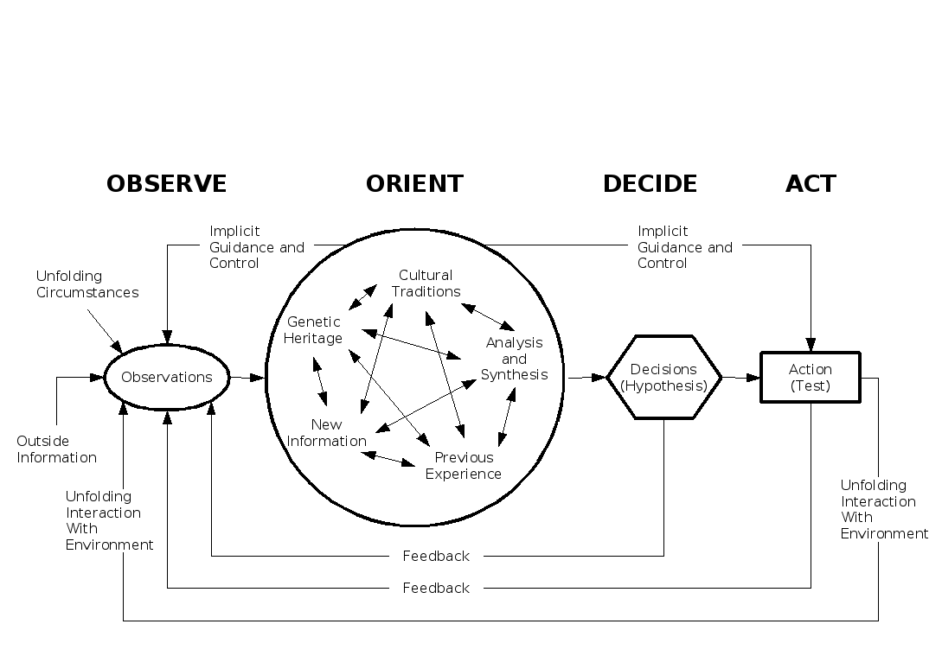
OODA Loop Process

Slide 68
BCC Enterprise InfoSec Governance - Design
Notes:
Hybrid organizational chart that is designed to facilitate information governance based on access to PII

Slide 69
The Compelling Reason to Change

Slide 70
Lesson Learned from OODA Loop
People do not understand
  What information is and how its used for and against them
  Why it’s extremely valuable
  Why criminals want it
  Privacy issues
  Perceived Rewards vs. Actual Consequences
Business does not understand
  How employee habits (lack of awareness) puts them at risk
  Federal and state laws required that information be protected
  Senior executives are often targets
  Entire businesses can be interrupted (or halted) due to poor infosec strategies

Slide 71
What is the Internet?

Slide 72

What is the
Internet?
Everyday corporate networks behind firewalls – “safe”
Everything else…Google, FB, YouTube, Reddit, etc.
“sketchy”
What most people think
Notes:
Two most compelling slides that helped raise security awareness.

Slide 73
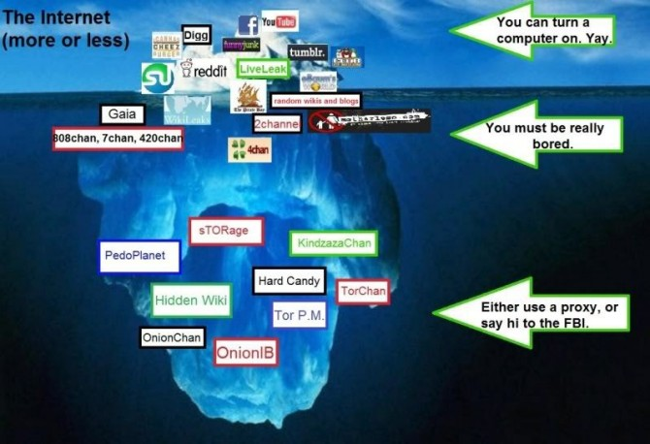
Everyday corporate networks behind firewalls – “safe”
What is the
Internet?
Everything else…Google, FB, YouTube, Reddit, etc.
What most
people think
“Sketchy”

Slide 74
Presentation of Compelling Reasons
Profiling and Correlation
Monetary Value of Data
Facebook and Google
Who’s Following You
Key Person of Influence
Mid-tier managers
Have direct reports
Work with one on one
Impact Slides

Slide 75
Process and Results
Targeted departmental presentations
  Made it about them, set expectations, provided the compelling reasons
  Rolled out SANS Securing the Human Training
    Key Person of Influence and staff
    Provided the model behaviors
    Good discussion on actual consequences
    65.2% Completion Rate
What is the
Internet?
Everything else…Google, FB, YouTube, Reddit, etc.
What most
people think
“Sketchy”

Slide 76
BCC Key Takeaways
Information security is not “exciting”
Most people are just beginning to understand it (including executives)
Top down and bottom up approaches seldom work
Build strategic relationships (you’ll need them to help you govern)
Be persistent – use an OODA loop as a guide
What is the
Internet?
Everything else…Google, FB, YouTube, Reddit, etc.
What most
people think
“Sketchy”

Slide 77
BCC Next Steps
Building an InfoSec blog to keep narrative in the spotlight
Rolled out a defense in depth strategy based around SANS 20 Controls
Secured funding for key software platforms
Continue to work and assist end users

Slide 78



BCC Initial Posture
Blocked
Critical Info
Security gaps in
each layer
Layered Security
5
3rd Party (McAfee , FW)
4
MS-ISAC, SANS Controls
3
Internal Audit /Risk Mgmt
Blocked
2
ITS Operations
1
Business Areas/End Users
(Securing the Human)

Slide 79
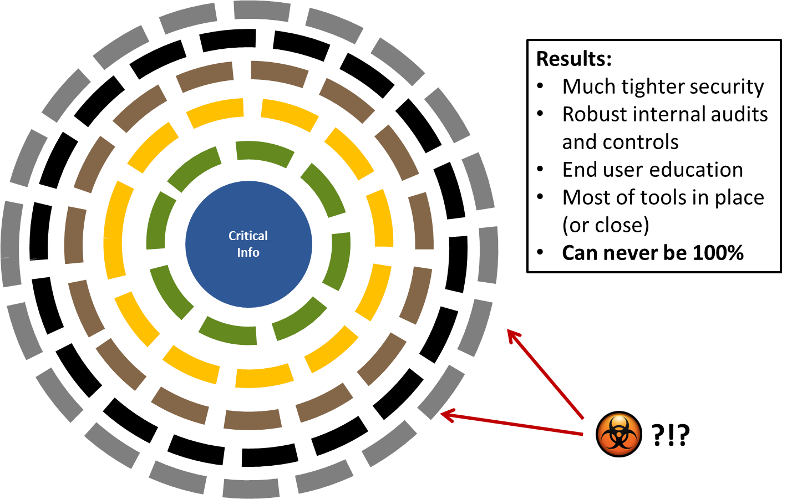
BCC Security Framework – Target Goal

Slide 80
Micah’s
Cheat Sheet
Steve’s
Cheat Sheet
1) Less is more
OODA Loop
2) Start with
IT
2) Build Relationships
3) Only Fixable
Fears
3) Compelling
Reasons for Change
4) Model Good
Behavior
4) Inside Out Approach
5) Provide the
Tools
5) Stay top of mind
6) Use Existing
Channels
6) Be Persistent
Notes:
Communicator’s Toolkit

Slide 81
Thank you.
Contact Information:
Contact Information:
Steven Frechette
Bristol Community College
777 Elsbree Street
Fall River, MA 02720
E: Steven.Frechette@bristolcc.edu
P: 774-357-3971
Micah Nelson
Harvard University
Reminder: Please fill out your questionnaire.

