Slide 1
Course Design: Pedagogical Approaches to Assessing Higher Order Cognitive Skills
Jennipher Murphy, M.S. Ed
Education Technology Senior Administrator
Academic Affairs
jennipher.murphy@tufts.edu
Tofool Alghanem, BDS, MS, DMD
Assistant Professor, Public Health and Community Service
Assistant Director of Advanced and Graduate Education
tofool.alghanem@tufts.edu
Notes:
Presenters introduction
Workshop introduction: It will be composed of activities, presentation, assessment

Slide 2
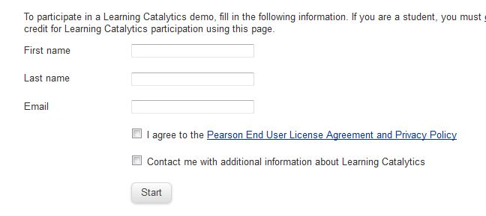
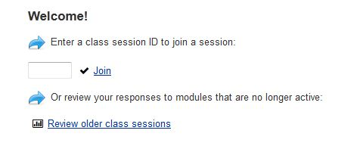
Welcome!
Please login to: https://learningcatalytics.com/demo
1. Fill in your name and email.
2. Check “I agree”, then
click “Start”.
3. Enter session ID 14865860,
then click “Join”.
Wifi access: educauseair Password: educause
Notes:
Learning catalytics is a tool that we will use to collect pre- and post- discussions assessments. To participate, follow the instructions

Slide 3
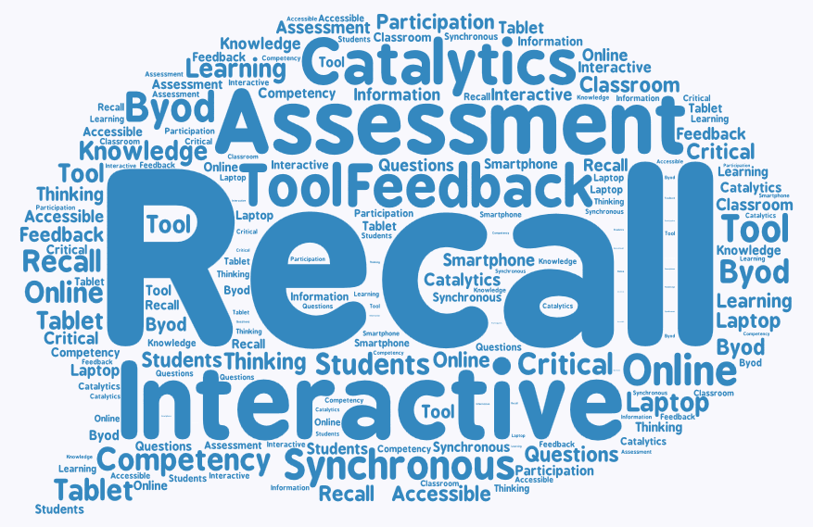
Pre-Presentation Check Point
Please answer the 4 questions and submit.
We will review the results at the end of our session
Session ID: 30433411
Notes:
5 Min
It aims to assess the group understanding of certain topics in this workshop: Teamwork, leadership, critical thinking assessment, and feedback (assessment). This will help us decide on how much information we need to provide about each of these topics.
One word about teamwork
Leadership activities list
How to assess critical thinking
Rank feedbacks appropriateness

Slide 4
Agenda
Activity #1- Check Point
Introduction
Cognitive skills review
Pedagogical Approaches Taken
Course Framework
Assessment Strategies Implemented
Course Outcomes
Activity #2
Results
Discussion
Learning Catalytics: https://learningcatalytics.com/demo Session ID: 30433411
Notes:
4:08 Tofool
It seems that we in general know something about one or more of the terms used in the assessment, so we will not discuss them further and rather try to apply them

Slide 5
Higher Order Cognitive Skills
Critical Thinking
Communication
Leadership
Teamwork
Self-assessment
Notes:
For the purpose of this presentation, we chose 5 standards to work with. The reason for choosing these standards is that they are the standards we focused on in our course. For example: a team will require a leader, to have the work done, you need communication which will stimulate critical thinking and assessment

Slide 6
Higher Order Skills
Teamwork and Leadership
Foster ability to interact face-to-face
Develop interpersonal and small group skills
Create individual and group accountability
Learn that your success is dependent on the contributions, inclusions, and success of others in your group
Communication
Communicate effectively with others while reasoning through problems
Communicate in multi-cultural environment
Effective provider-patient communication

Slide 7
Higher Order Skills (Cont.)
Critical Thinking
Identify problems and formulate questions clearly and precisely
Gather and assess relevant information, weighing it against extant knowledge and ideas, to interpret information accurately and arrive at well-reasoned conclusions
Test emerging hypotheses against evidence, criteria, and standards
Self-Assessment
Assists learners in developing the knowledge, skills, attitudes, and values considered important at their stage of learning (formative assessment)
Self-assessment is indicative of the extent to which students take responsibility for their own learning

Slide 8
Traditional Pedagogical Approach
“Sage-on-the-Stage”

Slide 9
Constructivist Pedagogical Approach
 | Constructivism | Traditional
Responsibility for Learning | Resides with the learner | Rests with the faculty member
Learning Motivation | Intrinsic- authentic experiences | Extrinsic- conform to standards and expected achievements
Role of Faculty | Facilitator- active learning | Lecturer- passive recipients
Interaction | Learn from each other and an awareness of each other’s values | Objective- faculty is the expert
Collaboration | Arrive at a shared understanding of the truth- “scaffolding” | Achieve the content set in the curriculum
Assessment | 2-way process between faculty and student | Process carried out by faculty member
Modified from: Lam, B.H. (2011) Chapter 2 Constructivist perspectives of learning. Learning and Teaching in the Chinese Classroom. Hong Kong: HKU Press.

Slide 10
SPIRAL Pedagogical Approach
Student-driven Pedagogy of Integrated, Reinforced and Active Learning (SPIRAL)
Practice Management
EBD
IPE
The SPIRAL approach offers learning that is not linear but provides opportunities for “deeper” learning and can be achieved through the spiral process. Ideas are repeatedly revisited and built upon.
Revisiting requires students to develop their ability to reflect on their ideas and experiences.
Graduation
4th Year
Clinical Case
3rd Year
Clinical EBD
2nd Year
Abnormal
1st Year
Normal
Entry
Dr. Mark Wolff & Dr. Andrew Spielman, New York
University (NY U) School of Dental Medicine

Slide 11
Basic Science/Clinical Science Spiral Seminar Series (BaSiCSsss)
2 Clinicians
2 Basic Scientists
1 Librarian
Student Pod 1
Student Pod 2
Student Pod 3
Student Pod 8
Student Pod 4
Student Pod 5
Student Pod 7
Student Pod 6
Course Framework:
190 pods (800 students)
23 Faculty groups (72 faculty)
Notes:
Roles:
4th Year: Select case and coordinate team
3rd Year: Evidence-based dentistry (EBD)
2nd Year: Info pertinent to case i.e. medications, risk factors, pathology of dental issues
1st Year: Info pertinent to case i.e. biology, physiology, anatomy etc..

Slide 12
Active Learning & Assessment Strategies
Online Collaboration Space
Evidence Based Dentistry Form
Critically investigate research with support from librarian
Case Study Presentation
Team presents case study and Q & A with peers (other teams) and faculty
Teamwork Action Plan
Students define roles and responsibilities, expectations, conflict prevention, communication plan and timeline
Team Structure
Peer Review
Reflection, constructive feedback
Team Leader Self-Assessment
Allows faculty and librarian to stay connected and give feedback to team before the final presentation
Dynamic, constructivist, supports the SPIRAL pedagogy
Reflection, leadership

Slide 13
Assessment Breakdown
Patient Case Study and Presentation
Soft Skills= grammar, teamwork, eye contact, cooperation, critical thinking, persuasiveness, time management, interpersonal, cultural sensitivity
Higher Order Skills= Critical Thinking, Biomedical Sciences, Behavioral Sciences, Clinical Sciences, Practice Management, Ethics and Professionalism
Peer Review
Softs Skills= grammar, critical thinking, interpersonal, cultural sensitivity, self-directed, reliability, relationship, communication
Higher Order Skills= Critical Thinking, Self Assessment, Ethics and Professionalism

Slide 14
Assessment Breakdown
Self Assessment
Soft Skills= grammar, communication, relationship, cooperation, reliability, self-directed, critical thinking, motivation, time management, interpersonal skills, cultural sensitivity
Higher Order Skills= Critical Thinking, Self Assessment, Ethics and Professionalism
Teamwork Action Plan
Soft Skills= grammar, communication, teamwork, cooperation, motivation, persuasiveness, time management, interpersonal
Higher Order Skills= Practice Management and Health Care Systems, Ethics and Professionalism

Slide 15
Assessment Breakdown
Evidence-Based Dentistry Form (PICO)
Soft Skills= grammar, self-directed, critical thinking, persuasiveness
Higher Order Skills= Critical Thinking, Clinical Sciences
Faculty Mentors
Soft Skills= grammar, communication, relationship, eye contact, reliability, cooperation, motivation, persuasiveness, interpersonal
Higher Order Skills= Critical Thinking, Ethics and Professionalism

Slide 16
Outcomes
“I didn't feel as though this seminar series helped me in any way, I have such a large course load that it was almost an inconvenience.”
“as a first year student i really appreciated having this opportunity to communicate with the upper classman in my basically line and get a nice overview of how the basic science classes and operative will bridge over to clinic”
“I never received any feedback or any comments for my presentation. That is unfair! We worked hard to put a presentation together I think we deserve some comments and feedback!”
“Basics was awesome!! I learned so so much! I'm really glad that I had the opportunity to participate in this before my 4th year - very helpful.”
Notes:
Tofool

Slide 17
“It has an awful acronym.”
“By far the most useful thing was coordinating group activity/research;”
“This was actually pretty cool. I thought it would be a pain at first but I liked it. Good experience.”
“The seminar is great as-is. Strongly promotes learning and communication between the building bridges team. Makes the student reflect back on a patient case and get a better understanding for the decisions they made, why they made them, and things they might do differently in the future. Very valuable experience.”

Slide 18
Challenges
Students are not prepared with the foundational skills for participation in effective teamwork
Students do not have quality experience in peer review or in giving feedback
Faculty are more comfortable being lecturers then facilitating the learning
Condensed curriculum and time
According to a literature review by a panel of dental educators, “ none of the articles found fulfilled all the criteria for critical thinking and none referenced a learning model”. –Johnsen D.C. et al

Slide 19
Next Steps and Best Practices
Improve Assessment: Faculty Calibration
Enhance training and preparation for teamwork activity
Define critical thinking competency
Develop rubric for self-assessment
Train faculty on facilitation techniques
Start simple then expand (one assessment not a whole course)
Both Quantitative and Qualitative
Realize that interactive teaching is hard
Being Open-minded is a key for success
Model life-long learning
Notes:
Jennipher

Slide 20
Putting All Together
Choose Curriculum/ Course
Decide on Cognitive Skills
Choose Pedagogical Approach/ Active Learning Strategy
Design Activity for Integration
How will it be implemented?
How will the standard be assessed?

Slide 21
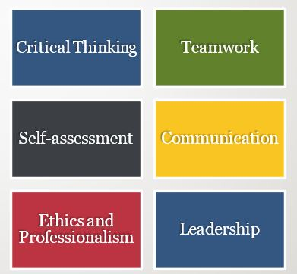
Activity #2
Part 1: Participants will work individually to create a learning activity/assessment for their course or institution that addresses a Higher Order Skill. (10 min)
Part 2: Participants will then enter their assessment into Learning Catalytics for review with the group. (5 min)
Click on “Join another session”
Enter session ID#
47882832

Slide 22
Results & Discussion
Pre-Presentation Check Point
Assessment Activity
Notes:
What differences are we seeing?

Slide 23
Resources
Accreditation standards for dental education programs. Commission on Dental Accreditation. Retrieved from:
Berk, N.W. (2001) Teaching ethics in dental schools: Trends, techniques, and targets. Journal of Dental Education Vol 65 N.(8).
Emerson A. & Williams, G.J. (2012) An innovative approach to encouraging spiral learning for third year undergraduates. Psychology Teaching Review Vol. 18 N(2)
Johnsen, D.C. et al (2015). New dental accreditation standard on critical thinking: A call for learning models, outcomes, assessments. Journal of Dental Education, Vol. 79 N(10).

Slide 24
Resources
Lam, B.H. (2011) Chapter 2 Constructivist perspectives of learning. Learning and Teaching in the Chinese Classroom. Hong Kong: HKU Press.
Quieng, M.C., Lim, P.P. & Lucas, M.R. (2015) 21st century-based soft skills: Spotlight on non-cognitive skills in a cognitive-laden dentistry program. European Journal of Contemporary Education Vol. 11 N (1) pp. 72-81.
Tsay, M. & Brady, M. (2010) A case study of cooperative learning and communication pedagogy: Does working in teams make a difference? Journal of the Scholarship of Teaching and Learning, Vol. 10 N(2), pp. 78-89.
Yorke, M. (2003). Formative assessment in higher education: Moves towards theory and the enhancement of pedagogic practice. Higher Education Vol. 45: p.477-501.

