Slide 1
What is a depression?
A depression in economics may be somewhat hard to define. A standard definition of an economic depression is a significant decline in the gross domestic product (GDP). In order to understand a depression in these terms, one must understand the definition of a GDP.
The GDP consists of the monies spent by consumers, the investments made by private companies and the government, government spending on labor and products, and the net total of a country’s exports. These facts are totaled to determine the gross domestic product of a year. In simpler terms the GDP can be seen as an accounting of almost all the money spent on goods, services, investments, research, and labor in a country.
A depression is thought to occur when the GDP declines by 10% or more in a year’s time. Economists tend to differ over the exact percentage of decline. The Great Depression in the US and in Europe after the Stock Market crash of 1929 showed a steadily declining GDP in the subsequent years.
In the months following the crash, the GDP declined over 30%, and then was marked by a period of increase. However this increase did not equal the previous GDP of the US. So defining a depression entirely by evaluation of a decline in the GDP cannot be fully accurate
http://www.wisegeek.com/in-economics-what-is-a-depression.htm

Slide 2
Depression Era Unemployment Statistics
Source: U.S. Bureau of the Census, Historical Statistics of the United States, Colonial Times to 1957 (Washington, D.C., 1960), p.70.
Year Population Labor Force Unemployed % of Labor Force
1929 88,010,000 49,440,000 1,550,000 3.14
1930 89,550,000 50,080,000 4,340,000 8.67
1931 90,710,000 50,680,000 8,020,000 15.82
1932 91,810,000 51,250,000 12,060,000 23.53
1933 92,950,000 51,840,000 12,830,000 24.75
1934 94,190,000 52,490,000 11,340,000 21.60
1935 95,460,000 53,140,000 10,610,000 19.97
1936 96,700,000 53,740,000 9,030,000 16.80
1937 97,870,000 54,320,000 7,700,000 14.18
1938 99,120,000 54,950,000 10,390,000 18.91
1939 100,360,000 55,600,000 9,480,000 17.05
1940 101,560,000 56,180,000 8,120,000 14.45
1941 102,700,000 57,530,000 5,560,000 9.66
Negative GDP: 1930 -8.6% 1931 -6.4% 1932 -13% 1933 -1.3%.

Slide 3
2 Minute State Financial Overview
Total state $ expenditures are still below 2001 levels (i.e., spending prior to the 2002-2005 recession)
Conservatively, there will be $300-350 billion in state deficits over next 30 months
State Medicaid deficits currently stand at $231.8 billion (stimulus bills only pay $87 million to states for Medicaid)
States have already proposed to cut:
K-12 and pre-K funding and services (25)
Public college and university funding (30)
Their own workforces (36)
There are four actions states can take: 1. draw down reserves; 2. cut expenditures; 3. raise taxes; and, 4. get the money from the feds

Slide 4
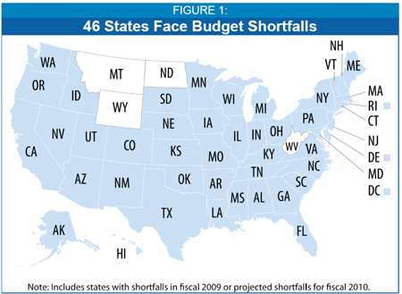
State Budget Troubles Worsen by McNichol & Lav http://www.cbpp.org/9-8-08sfp.htm
Center on Budget and Policy Priorities, January 29, 2009
http://money.cnn.com/pf/features/lists/state_unemployment/
4.9%
3.3%
3.4%
3.2%
4.6%

Slide 5
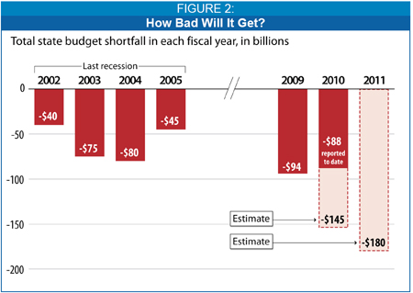
Aggregated State Deficits

Slide 6
SIZE OF TOTAL FY2009 BUDGET GAPS: TOTAL $47.6 b $46.4 b $93.9 b 14.2%
1. Gap before budget was adopted 2. Additional mid-year gap 3. Total Total Gap as % of FY2009 General Fund
Alabama $784 m $1.1 b $1.8 b 22.2%
Alaska $360 m $360 m 6.8% 7.3%
Arizona1 $1.9 b $1.6 b $3.5 b 34.8%
Arkansas $107 m $107 m 2.4%
California $22.2 b $13.7 b $35.9 b 35.5%
Colorado $604 m $604 m 7.7%
Connecticut $150 m $1.3 b $1.5 b 8.5%
Delaware $217 m $226 m $443 m 12.2%
District of Columbia $96 m $131 m $227 m 3.6%
Florida $3.4 b $2.3 b $5.7 b 22.2%
Georgia1 $245 m $2.2 b $2.4 b 11.5%
Hawaii $232 m $232 m 4.0%
Idaho $217 m $131 m 7.4%
Illinois $1.8 b $2.0 b $3.8 b 13.4%
Indiana $763 m $763 m 5.8% 7.6%
Iowa $350 m $134 m $484 m 7.6%
Kansas $185 m $185 m 2.9%
Kentucky $266 m $456 m $722 m 7.8%
Louisiana $341 m $341 m 3.7%
Maine $124 m $140 m $265 m 8.6%
Maryland $808 m $691 m $1.5 b 10.0%
Massachusetts $1.2 b $2.4 b $3.6 b 12.7%
Michigan $472 m $200 m $672 m 2.9% 9.6%
Minnesota $935 m $426 m $ 1.4 b 7.9%
Mississippi1 $90 m $175 m $265 m 5.2%
Missouri $342 m $342 m 3.8
Nevada $898 m $536 m $1.4 b 19.6%
New Hampshire $200 m $50 m $250 m 8.0%
New Jersey1 $2.5 b $2.1 b $4.6 b 14.2%
New Mexico $454 m $454 m 7.5%
New York $4.9 b $1.7 b $6.4 b 11.7%
North Carolina $800 m $800 m 3.7%
Ohio1 $733 m $1.2 b $1.9 b 6.8%
Oklahoma $114 m $114 m 1.7%
Oregon $442 m $442 m 6.6%
Pennsylvania $2.3 b $2.3 b 8.1%
Rhode Island $430 m $372 m $802 m 24.5%
South Carolina $250 m $554 m $804 m 11.7%
South Dakota $27 m $27 m 2.2%
Tennessee $468 m $884 m $1.4 b 12.0%
Utah $620 m $620 m 10.4% 3.7%
Vermont $59 m $66 m $125 m 10.3%
Virginia $1.2 b $1.1 b $2.3 b 13.8%
Washington $509 m $509 m 3.4% 6.4%
Wisconsin $652 m $346 m $998 m 7.1%

