Slide 1
IT Governance…
M. Peter Adler
when you have not been breached.
Patrick J. Feehan

Slide 2
It Should Be an Easy Proposition

Slide 3
IT Departments in Higher Education are Smart and Virtuous.

Slide 4
Why Can’t We All Have a Simple Board Resolution Like Indiana?

Slide 5
1
Resolution of the Trustees of Indiana University Regarding the Leadership, Responsibility, and Security of IU's Information Technology Infrastructure
Notes:
5

Slide 6
1
WHEREAS, the advent of the Internet has significantly transformed the manner in which information is stored on interconnected servers throughout the world; and
Notes:
6

Slide 7
1
WHEREAS, the Internet is an information technology environment in which it is possible to have inadvertent or intentional unauthorized access to Internet sites and related servers; and
Notes:
7

Slide 8
1
WHEREAS, successful intrusions into Internet sites and servers can lead to the disclosure of sensitive personal and institutional information; and
Notes:
8

Slide 9
1
WHEREAS, it is critical that Indiana University protect its institutional information and information technology infrastructure so as to reduce the possibility of unauthorized access to servers holding sensitive information or running mission-critical applications.
Notes:
9

Slide 10
NOW THEREFORE BE IT RESOLVED that the Trustees direct the Office of the Vice President for Information Technology and CIO to develop and implement policies necessary to minimize the possibility of unauthorized access to Indiana University's information technology infrastructure regardless of the Indiana University office involved; and
1
Notes:
10

Slide 11
1
BE IT FURTHER RESOLVED that the Trustees direct the Office of the Vice President for Information Technology and CIO, which may draw upon the experience and expertise and resources of other University offices (including the Office of Internal Audit), to assume leadership, responsibility, and control of responses to unauthorized access to Indiana University's information technology infrastructure, unauthorized disclosure of electronic information and computer security breaches regardless of the Indiana University office involved.
Notes:
11

Slide 12
We All Like to Think…It Takes a Village, and We Are the Smartest People In This Village When It Comes To Information Security
Notes:
12

Slide 13
Or….
Notes:
13

Slide 14
Does It Take A Breach?
Notes:
14

Slide 15
2
A simple but fascinating conversation was held on the Educause Security Listserv in November of 2008. Kathy Bergsma of the University of Florida asked:
Notes:
15

Slide 16
I'm interested in hearing about your success stories engaging senior management support for security initiatives. What methods worked at your institution?
She inquired about several methods:
Notes:
16

Slide 17
Fear, uncertainty and doubt

Slide 18
Metaphors and analogies

Slide 19
Working behind the scenes
Relationship building with key players

Slide 20
Comparison with peer institutions

Slide 21
Financial benefits such as ROI (return on investment)

Slide 22
Metrics

Slide 23
Ask forgiveness rather than permission

Slide 24
Leverage an incident

Slide 25
So what do you suppose was the first response she got back?
Notes:
25

Slide 26
“Kathy: while I don't recommend it, A BREACH certainly helped get upper managements attention! After the clean up and notification, we were able to garner some additional resources.” (Emphasis Added)
3
Notes:
26

Slide 27
Others talked about approaches outside a breach
Notes:
27

Slide 28
4
“In advance, evaluation and testing of new security tools and bringing very colorful graphs to senior management, before ask for anything. (altogether: Working behind the scene and Metrics)”

Slide 29
“Development, adoption, deployment, and compliance monitoring of an IT Security Governance Industry Standard such as ISO 27002:2005.”
5

Slide 30
“1. Policy in place to address HIPAA or other security requirements;
2. Understanding business requirements, being flexible and selling it in a manner that makes sense for whichever audience we're presenting to;
3. Comparisons with peer institutions and industry standards”
6

Slide 31
“On occasion, an audit issue or an incident will also help drive something forward. In my experience though you have to capitalize on those pretty quickly otherwise priorities will shift and they'll be forgotten about.”
7

Slide 32
8
“Create a Business Rationale for Cyber Security”

Slide 33
“Working behind the scenes, lots of 1-1 engagement in the community (even if not defined as 'key' players), incremental steps and not trying to make the issue so big, encompassing, or scary that it loses credibility, or asking for disproportionate funding or level of authority - it helps to work within the culture.”
9

Slide 34
“Performing a risk assessment helps us out. If you can get them to commit a few hours of staff time to an RA then you can provide some assurance that whatever steps you recommend are well reasoned and show a risk-based strategy for identifying solving security problems. This helps me to avoid the impression that an initiative is just the security people being paranoid.”
10

Slide 35
We are required to have guidelines that are compatible with State IT security policies and, as a result, our security officers developed a comprehensive set of guidelines that address risk management, security policy, access controls, network security, nonpublic information, encryption, and other areas.
11

Slide 36
12
“We are engaged in most of the activities listed below with some being more successful than others. Hands down the activity that has shown the most success and has proven the most beneficial to our security cause is our incident response strategy when an incident involved confidential data.”

Slide 37
“Compliance with laws can be a major driver - state data breach law was a motivator here.
13

Slide 38
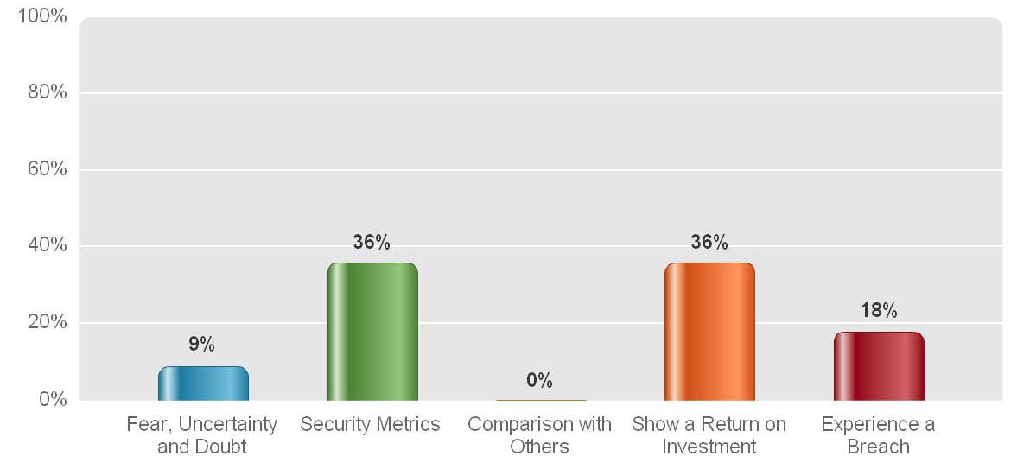
Our Informal Poll Amongst Colleagues

Slide 39
All sorts of ways…..
To make your case.

Slide 40
I prefer charts
and graphs –
I like
making my case

Slide 41
Notes:
41

Slide 42
ISO 27002: 2005
hands down!

Slide 43
No, you have to perform a risk assessment!
You have to
scare them!

Slide 44
Just barge ahead
and ask for
forgiveness later

Slide 45
Think like a
brand manager!!

Slide 46
How does a brand manager think?
They “leverage” the brand.
They use an existing and well known brand name to enter a new product.
Examples?

Slide 49
What “Brands” can we leverage? How about Red Flags? PCI? GLBA? HEAA? HIPAA?
All of these compliance items are well known to our schools and require information security. Can we leverage that?

Slide 50
Summing up, without a breach we have…

Slide 51
∆ Comparison with peer institutions
∆ Metaphors and analogies
∆ Fear, uncertainty and doubt
∆ Working behind the scenes; Relationship Building with key Players
∆ Financial benefits such as ROI (return on investment); Metrics
∆ State breach Laws or State InfoSec Laws
∆ Ask forgiveness rather than permission
∆ Leverage the information security brand

Slide 52
Or, we can always wait for the breach.

Slide 53
IT Governance
Yes We Can!

Slide 54
Questions? Fill Out Your Evaluations!!

