Slide 1
Hot Topic Discussion: Application Security and the SDLC
Discussion Panelists:
Justin C. Klein Keane
Sr. Information Security Specialist
University of Pennsylvania
Jonathan Hanny
Application Security Specialist
The George Washington University
Shannon Ortiz
Director of IT Security
Fordham University
Copyright Jonathan Hanny 2010. This work is the intellectual property of the author. Permission is granted for this material to be shared for non-commercial, educational purposes, provided that this copyright statement appears on the reproduced materials and notice is given that the copying is by permission of the author. To disseminate otherwise or to republish requires written permission from the author.

Slide 2
Hot Topic Discussion: Application Security and the SDLC
Session Format
Panelists will each present for approximately 10 minutes.
Remainder of session will be Q&A.
Copyright Jonathan Hanny 2010. This work is the intellectual property of the author. Permission is granted for this material to be shared for non-commercial, educational purposes, provided that this copyright statement appears on the reproduced materials and notice is given that the copying is by permission of the author. To disseminate otherwise or to republish requires written permission from the author.

Slide 3
Hot Topic Discussion: Application Security and the SDLC
Definitions
Application Security:
Application security encompasses measures taken throughout the application's life-cycle to prevent exceptions in the security policy of an application or the underlying system (vulnerabilities) through flaws in the design, development, deployment, upgrade, or maintenance of the application. -Wikipedia
SDLC:
The Systems Development Life Cycle (SDLC), is the process of creating or altering systems, and the models and methodologies that people use to develop these systems. The concept generally refers to computer or information systems. Systems Development Life Cycle (SDLC) is a logical process used by a systems analyst to develop an information system, including requirements, validation, training, and user (stakeholder) ownership. . -Wikipedia
Copyright Jonathan Hanny 2010. This work is the intellectual property of the author. Permission is granted for this material to be shared for non-commercial, educational purposes, provided that this copyright statement appears on the reproduced materials and notice is given that the copying is by permission of the author. To disseminate otherwise or to republish requires written permission from the author.

Slide 4
Hot Topic Discussion: Application Security and the SDLC
Application vulnerabilities are inevitable
Bugs are guaranteed in software and a certain portion will be security related
Threats to web applications are global
Security is an evolving field
Copyright Justin C. Klein Keane 2010. This work is the intellectual property of the author. Permission is granted for this material to be shared for non-commercial, educational purposes, provided that this copyright statement appears on the reproduced materials and notice is given that the copying is by permission of the author. To disseminate otherwise or to republish requires written permission from the author.

Slide 5
Hot Topic Discussion: Application Security and the SDLC
What can we do?
Intercept malicious traffic
(Web Application Firewall)
Monitor and react
Scan and detect
Standardize to centralize
Regular code review
Proactively audit code in development
Copyright Justin C. Klein Keane 2010. This work is the intellectual property of the author. Permission is granted for this material to be shared for non-commercial, educational purposes, provided that this copyright statement appears on the reproduced materials and notice is given that the copying is by permission of the author. To disseminate otherwise or to republish requires written permission from the author.

Slide 6
Hot Topic Discussion: Application Security and the SDLC
Developer training and safe coding practices
Security review during architecture through development
Final security audit before launch
Commitment to ongoing security review
Copyright Justin C. Klein Keane 2010. This work is the intellectual property of the author. Permission is granted for this material to be shared for non-commercial, educational purposes, provided that this copyright statement appears on the reproduced materials and notice is given that the copying is by permission of the author. To disseminate otherwise or to republish requires written permission from the author.

Slide 7
Hot Topic Discussion: Application Security and the SDLC
Centralizing on one platform
Auditing new and existing components
Ongoing platform review
Auditing old applications
Working with developers to plan applications securely and reviewing applications before launch
Intrusion detection for web applications
Copyright Justin C. Klein Keane 2010. This work is the intellectual property of the author. Permission is granted for this material to be shared for non-commercial, educational purposes, provided that this copyright statement appears on the reproduced materials and notice is given that the copying is by permission of the author. To disseminate otherwise or to republish requires written permission from the author.

Slide 8
So, how do we secure our Application Systems?
Hot Topic Discussion: Application Security and the SDLC
Copyright Jonathan Hanny 2010. This work is the intellectual property of the author. Permission is granted for this material to be shared for non-commercial, educational purposes, provided that this copyright statement appears on the reproduced materials and notice is given that the copying is by permission of the author. To disseminate otherwise or to republish requires written permission from the author.

Slide 9
Hot Topic Discussion: Application Security and the SDLC
Develop an Application Security Program
Select a framework
Integrate into the SDLC
Develop repeatable processes
Copyright Jonathan Hanny 2010. This work is the intellectual property of the author. Permission is granted for this material to be shared for non-commercial, educational purposes, provided that this copyright statement appears on the reproduced materials and notice is given that the copying is by permission of the author. To disseminate otherwise or to republish requires written permission from the author.
Notes:
A Framework gives detailed descriptions of a number of important practices and provides comprehensive checklists, tasks and procedures that any organization can tailor to its needs.

Slide 10
Hot Topic Discussion: Application Security and the SDLC
ISO/IEC 27002
Common Criteria
GLBA
PCI
FISMA
NIST
Select a framework
Consider your organizations needs
Consider regulatory requiremenets
Consider existing best practices
Consider your geographic region
FERPA
COBIT
HIPAA
OCTAVE
Sarbanes Oxley
ISO/IEC 17799
Copyright Jonathan Hanny 2010. This work is the intellectual property of the author. Permission is granted for this material to be shared for non-commercial, educational purposes, provided that this copyright statement appears on the reproduced materials and notice is given that the copying is by permission of the author. To disseminate otherwise or to republish requires written permission from the author.
Notes:
The Financial Modernization Act of 1999, also known as the "Gramm-Leach-Bliley Act" or GLBA, includes provisions to protect consumers’ personal financial information held by financial institutions. There are three principal parts to the privacy requirements: the Financial Privacy Rule, Safeguards Rule and pretexting provisions.
The Safeguards Rule requires all financial institutions to design, implement and maintain safeguards to protect customer information. The Safeguards Rule applies not only to financial institutions that collect information from their own customers, but also to financial institutions "such as credit reporting agencies" that receive customer information from other financial institutions.
The Pretexting provisions of the GLB Act protect consumers from individuals and companies that obtain their personal financial information under false pretenses, a practice known as "pretexting."
The Sarbanes-Oxley Act of 2002 (often shortened to SOX) is legislation enacted in response to the high-profile Enron and WorldCom financial scandals to protect shareholders and the general public from accounting errors and fraudulent practices in the enterprise. The act is administered by the Securities and Exchange Commission (SEC), which sets deadlines for compliance and publishes rules on requirements. Sarbanes-Oxley is not a set of business practices and does not specify how a business should store records; rather, it defines which records are to be stored and for how long. The legislation not only affects the financial side of corporations, it also affects the IT departments whose job it is to store a corporation's electronic records. The Sarbanes-Oxley Act states that all business records, including electronic records and electronic messages, must be saved for "not less than five years." The consequences for non-compliance are fines, imprisonment, or both. IT departments are increasingly faced with the challenge of creating and maintaining a corporate records archive in a cost-effective fashion that satisfies the requirements put forth by the legislation.
ISO/IEC 17799 and 27002 establishes guidelines and general principles for initiating, implementing, maintaining, and improving information security management in an organization. The objectives outlined provide general guidance on the commonly accepted goals of information security management. ISO/IEC 17799:2005 contains best practices of control objectives and controls in the following areas of information security management:
security policy;
organization of information security;
asset management;
human resources security;
physical and environmental security;
communications and operations management;
access control;
information systems acquisition, development and maintenance;
information security incident management;
business continuity management;
compliance.
ISO 17799 / 27002 (27002 is the rename of 17799)
The standard "established guidelines and general principles for initiating, implementing, maintaining, and improving information security management within an organization". The actual controls listed in the standard are intended to address the specific requirements identified via a formal risk assessment. The standard is also intended to provide a guide for the development of "organizational security standards and effective security management practices and to help build confidence in inter-organizational activities".
The basis of the standard was originally a document published by the UK government, which became a standard 'proper' in 1995, when it was re-published by BSI as BS7799. In 2000 it was again re-published, this time by ISO ,as ISO 17799. A new version of this appeared in 2005, along with a new publication, ISO 27001. These two documents are intended to be used together, with one complimenting the other.
ISO's future plans for this standard are focused largely around the development and publication of industry specific versions (for example: health sector, manufacturing, and so on). Note that this is a lengthy process, so the new standards will take some time to appear.
THE CONTENTS OF ISO 17799 / 27002 (27002 is the rename of 17799)
The content sections are:
Structure
Risk Assessment and Treatment
Security Policy
Organization of Information Security
Asset Management
Human Resources Security
Physical Security
Communications and Ops Management
Access Control
Information Systems Acquisition, Development, Maintenance
Information Security Incident management
Business Continuity
Compliance
The Common Criteria, an internationally approved set of security standards, provides a clear and
reliable evaluation of the security capabilities of Information Technology products. By providing
an independent assessment of a product’s ability to meet security standards, the Common
Criteria gives customers more confidence in the security of Information Technology products and
leads to more informed decisions. Security-conscious customers, such as the U.S. Federal
Government, are increasingly requiring Common Criteria certification as a determining factor in
purchasing decisions. Since the requirements for certification are clearly established, vendors
can target very specific security needs while providing broad product offerings.
The international scope of the Common Criteria, currently adopted by fourteen nations, allows
users from other countries to purchase Information Technology products with the same level of
confidence, since certification is recognized across all complying nations.
Evaluating a product with respect to security requires identification of the customer’s security
needs and an assessment of the capabilities of the product. The Common Criteria aids
customers in both of these processes through two key components: protection profiles and
evaluation assurance levels.
Protection Profiles
A protection profile defines a standard set of security requirements for a specific type of product
(e.g. operating systems, databases, firewalls, etc.). These profiles form the basis for the
Common Criteria evaluation. By listing required security features for product families, the
Common Criteria allows products to state conformity to a relevant protection profile. During
Common Criteria evaluation, the product is tested against a specific protection profile, providing
reliable verification of the security capabilities of the product.
Since Information Technology products can be linked to specific protection profiles, customers
can compile a list of critical security features by examining the details of a relevant protection
profile. In addition, since the Common Criteria certification verifies that a product meets the
requirements of a protection profile, customers can rapidly assess the product’s ability to meet
their security needs, and compare the security capabilities of any validated products.
Evaluation Assurance Levels
In addition to protection profiles, a vendor may choose an Evaluation Assurance Level (EAL1-
EAL7), a measure of the depth of engineering review and evaluation of the product lifecycle itself.
Unlike protection profiles, the EAL does not indicate the actual security capabilities of the product,
but independently stipulates the level of evidence reviewed and functionally tested against the
vendor claims.
The Certification Process
The purpose of product certification is to provide customers with a high level of trust, which
requires a thorough, reliable, objective, and globally accepted process. To submit a product for
certification, the vendor must first specify a Security Target (ST). The ST description includes an
overview of the product, potential security threats, detailed information on the implementation of
all security features included in the product, and any claims of conformity against a Protection
Profile at a specified EAL. The vendor must submit the ST to an accredited testing laboratory for
evaluation. The laboratory then tests the product to verify the described security features and
evaluate the product against the claimed Protection Profile. The end result of a successful
evaluation includes official certification of the product(s) against a specific Protection Profile at a
specified Evaluation Assurance Level.
US entities involved in CC is National Information Assurance Partnership NIAP, a partnership between
National Institute of Standards and Technology NIST
National Security Agency NSA
PCI security standards are technical and operational requirements set by the PCI Security Standards
Council (PCI SSC) to protect cardholder data. The standards apply to all organizations that store,
process or transmit cardholder data – with guidance for software developers and manufacturers
of applications and devices used in those transactions. The Council is responsible for managing
the security standards, while compliance with the PCI set of standards is enforced by the founding
members of the Council, American Express, Discover Financial Services, JCB International, MasterCard
Worldwide and Visa Inc.
PCI Data Security Standard (DSS)
The PCI DSS applies to all entities that store, process, and/or transmit cardholder data. It covers
technical and operational system components included in or connected to cardholder data. If you are
a merchant who accepts or processes payment cards, you must comply with the PCI DSS.
PIN Transaction (PTS) Security Requirements
PCI PTS (formerly PCI PED) is a set of security requirements focused on characteristics and
management of devices used in the protection of cardholder PINs and other payment processing
related activities. The requirements are for manufacturers to follow in the design, manufacture and
transport of a device to the entity that implements it. Financial institutions, processors, merchants and
service providers should only use devices or components that are tested and approved by the PCI SSC
(www.pcisecuritystandards.org/security_standards/ped/pedapprovallist.html).
Payment Application Data Security Standard (PA-DSS)
The PA-DSS is for software developers and integrators of payment applications that store, process
or transmit cardholder data as part of authorization or settlement when these applications are sold,
distributed or licensed to third parties. Most card brands encourage merchants to use payment
applications that are tested and approved by the PCI SSC. Validated applications are listed at:
www.pcisecuritystandards.org/security_standards/pa_dss.shtml
The E-Government Act (Public Law 107-347) passed by the 107th Congress and signed into law by the President in December 2002 recognized the importance of information security to the economic and national security interests of the United States. Title III of the E-Government Act, entitled the Federal Information Security Management Act (FISMA) requires each federal agency to develop, document, and implement an agency-wide program to provide information security for the information and information systems that support the operations and assets of the agency, including those provided or managed by another agency, contractor, or other source. FISMA directly relates/utilizes FIPS and NIST Special publications to achieve these requirements.
An effective information security program should include:
Periodic assessments of risk, including the magnitude of harm that could result from the unauthorized access, use, disclosure, disruption, modification, or destruction of information and information systems that support the operations and assets of the organization
Policies and procedures that are based on risk assessments, cost-effectively reduce information security risks to an acceptable level, and ensure that information security is addressed throughout the life cycle of each organizational information system
Subordinate plans for providing adequate information security for networks, facilities, information systems, or groups of information systems, as appropriate
Security awareness training to inform personnel (including contractors and other users of information systems that support the operations and assets of the organization) of the information security risks associated with their activities and their responsibilities in complying with organizational policies and procedures designed to reduce these risks
Periodic testing and evaluation of the effectiveness of information security policies, procedures, practices, and security controls to be performed with a frequency depending on risk, but no less than annually
A process for planning, implementing, evaluating, and documenting remedial actions to address any deficiencies in the information security policies, procedures, and practices of the organization
Procedures for detecting, reporting, and responding to security incidents
Plans and procedures to ensure continuity of operations for information systems that support the operations and assets of the organization.
FISMA, along with the Paperwork Reduction Act of 1995 and the Information Technology Management Reform Act of 1996 (Clinger-Cohen Act), explicitly emphasizes a risk-based policy for cost-effective security. In support of and reinforcing this legislation, the Office of Management and Budget (OMB) through Circular A-130, Appendix III, Security of Federal Automated Information Resources, requires executive agencies within the federal government to:
Plan for security
Ensure that appropriate officials are assigned security responsibility
Periodically review the security controls in their information systems
Authorize system processing prior to operations and, periodically, thereafter
These management responsibilities presume that responsible agency officials understand the risks and other factors that could adversely affect their missions. Moreover, these officials must understand the current status of their security programs and the security controls planned or in place to protect their information and information systems in order to make informed judgments and investments that appropriately mitigate risk to an acceptable level. The ultimate objective is to conduct the day-to-day operations of the agency and to accomplish the agency's stated missions with adequate security, or security commensurate with risk, including the magnitude of harm resulting from the unauthorized access, use, disclosure, disruption, modification, or destruction of information. As a key element of the FISMA Implementation Project, NIST also developed an integrated Risk Framework which effectively brings together all of the FISMA-related security standards and guidance to promote the development of comprehensive and balanced information security programs by agencies.
The Family Educational Rights and Privacy Act (FERPA) (20 U.S.C. § 1232g; 34 CFR Part 99) is a Federal law that protects the privacy of student education records. The law applies to all schools that receive funds under an applicable program of the U.S. Department of Education.
FERPA gives parents certain rights with respect to their children's education records. These rights transfer to the student when he or she reaches the age of 18 or attends a school beyond the high school level. Students to whom the rights have transferred are "eligible students."
Parents or eligible students have the right to inspect and review the student's education records maintained by the school. Schools are not required to provide copies of records unless, for reasons such as great distance, it is impossible for parents or eligible students to review the records. Schools may charge a fee for copies.
Parents or eligible students have the right to request that a school correct records which they believe to be inaccurate or misleading. If the school decides not to amend the record, the parent or eligible student then has the right to a formal hearing. After the hearing, if the school still decides not to amend the record, the parent or eligible student has the right to place a statement with the record setting forth his or her view about the contested information.
Generally, schools must have written permission from the parent or eligible student in order to release any information from a student's education record. However, FERPA allows schools to disclose those records, without consent, to the following parties or under the following conditions (34 CFR § 99.31):
School officials with legitimate educational interest;
Other schools to which a student is transferring;
Specified officials for audit or evaluation purposes;
Appropriate parties in connection with financial aid to a student;
Organizations conducting certain studies for or on behalf of the school;
Accrediting organizations;
To comply with a judicial order or lawfully issued subpoena;
Appropriate officials in cases of health and safety emergencies; and
State and local authorities, within a juvenile justice system, pursuant to specific State law.
Schools may disclose, without consent, "directory" information such as a student's name, address, telephone number, date and place of birth, honors and awards, and dates of attendance. However, schools must tell parents and eligible students about directory information and allow parents and eligible students a reasonable amount of time to request that the school not disclose directory information about them. Schools must notify parents and eligible students annually of their rights under FERPA. The actual means of notification (special letter, inclusion in a PTA bulletin, student handbook, or newspaper article) is left to the discretion of each school.
The Control Objectives for Information and related Technology (COBIT) is a set of best practices (framework) for information technology (IT) management created by the Information Systems Audit and Control Association (ISACA), and the IT Governance Institute (ITGI) in 1996. COBIT provides managers, auditors, and IT users with a set of generally accepted measures, indicators, processes and best practices to assist them in maximizing the benefits derived through the use of information technology and developing appropriate IT governance and control in a company.
The complete COBIT package consists of:
Executive Summary
Governance and Control Framework
Control Objectives
Management Guidelines
Implementation Guide
IT Assurance Guide
Executive summary
Sound business decisions are based on timely, relevant and concise information. Specifically designed for time-pressed senior executives and managers, the COBIT Executive Summary consists of an Executive Overview which provides a thorough awareness and understanding of COBIT's key concepts and principles. Also included is a synopsis of the Framework, which provides a more detailed understanding of these concepts and principles, while identifying COBIT's four domains (Planning and Organization, Acquisition and Implementation, Delivery and Support, Monitoring and Evaluation) and the 34 IT processes.
Framework
A successful organization is built on a solid framework of data and information. The Framework explains how IT processes deliver the information that the business needs to achieve its objectives. This delivery is controlled through 34 high-level control objectives, one for each IT process, contained in the four domains. The Framework identifies which of the seven Information Criteria (effectiveness, efficiency, confidentiality, integrity, availability, compliance and reliability), as well as which IT resources (people, applications, information and infrastructure) are important for the IT processes to fully support business.
Control Objectives
The key to maintaining profitability in a technologically changing environment is how well you maintain control. COBIT's Control Objectives provides the critical insight needed to delineate a clear policy and good practice for IT controls. Included are the statements of desired results or purposes to be achieved by implementing the 215 specific and detailed control objectives throughout the 34 high-level IT processes.
Management Guidelines
To ensure a successful enterprise, you must effectively manage the union between business processes and information systems. The new Management Guidelines are composed of Maturity Models, to help determine the stages and expectation levels of control and compare them against industry norms; Critical Success Factors, to identify the most important actions for achieving control over the IT processes; Key Goal Indicators, to define target levels of performance; and Key Performance Indicators, to measure whether an IT control process is meeting its objective. These Management Guidelines will help answer the questions of immediate concern to all those who have a stake in enterprise success.
IT Assurance Guide
To be certain that the control objectives are being achieved, there is an implicit need to assess the controls linked to them. The Assurance Guide provides the tools to assess the controls in every form needed, from their design to the results. The guide also allows for the assurance initiative planning and scoping in a standardized, repeatable way so that the business and IT can be assessed under a single framework, completely compatible with ISACA's ITAF. There is a misunderstanding that the Assurance Guide is the successor to the Audit Guidelines. The truth is, however, that it is a completely new book, based on the Control Practices. The Audit Guidelines is not part of CobiT anymore, as the Assurance Guide is not part of the book, but a related publication.
The Health Insurance Portability and Accountability Act of 1996 ("HIPAA") and its regulations (the "Privacy Rule" and the "Security Rule") protect the privacy of an individual’s health information and govern the way certain health care providers and benefits plans collect, maintain, use and disclose protected health information (“PHI”).
The law includes administrative simplification provisions to establish standards and requirements for the electronic transmission of certain health care information. It also requires organizations exchanging information for health care transactions to follow national implementation guidelines.
To meet these goals, federal transaction and code set rules have been issued:
Requiring use of standard electronic transactions and data for certain administrative functions
Standardizing the medical codes that providers use to report services to insurers
Creating specific identification numbers for employers (Standard Unique Employer Identifier [EIN]) and for providers (National Provider Identifier [NPI])
OCTAVE was developed by Carnegie Mellon University and is a self-directed information security risk evaluation. This core concept of OCTAVE is defined as a situation where people from an organization manage and direct an information security risk evaluation for their organization.
OCTAVE is an asset-driven evaluation approach. It requires an analysis team to:
• identify information-related assets (e.g., information and systems) that are important to
the organization
• focus risk analysis activities on those assets judged to be most critical to the organization
OCTAVE requires the analysis team to consider the relationships among critical assets, the
threats to those assets, and vulnerabilities (both organizational and technological) that can
expose assets to threats. It requires the analysis team to evaluate risks in an operational context.
In other words, OCTAVE focuses on how operational systems are used to conduct an
organization’s business and how those systems are at risk due to security threats.
The organizational, technological, and analysis aspects of an information security risk evaluation
lend it to a three-phased approach. OCTAVE is organized around these basic aspects, enabling organizational personnel to assemble a comprehensive picture of the organization’s information security needs.
The phases are:
• Phase 1: Build Asset-Based Threat Profiles – This is an organizational evaluation. Staff
members from the organization contribute their perspectives on what is important to the
organization (information-related assets) and what is currently being done to protect
those assets. The analysis team consolidates the information and selects the assets that are
most important to the organization (critical assets). The team then describes security requirements
for the critical assets and identifies threats to the critical assets, creating threat
profiles.
• Phase 2: Identify Infrastructure Vulnerabilities – This is an evaluation of the information
infrastructure. The analysis team identifies key information technology systems and
components that are related to each critical asset. The team then examines the key components
for weaknesses (technology vulnerabilities) that can lead to unauthorized action
against critical assets.
• Phase 3: Develop Security Strategy and Plans – During this part of the evaluation, the
analysis team identifies risks to the organization’s critical assets and decides what to do
about them. The team creates a protection strategy for the organization and mitigation
plans to address the risks to the critical assets, based upon an analysis of the information
gathered.

Slide 11
Hot Topic Discussion: Application Security and the SDLC
FISMA (NIST)
Starting Point
Monitor
Security Controls SP 800-37/SP 800-60
Categorize
Information System FIPS 199/SP 800-60
Select
Security Controls FIPS 200/SP 800-53
Risk Management Framework
Authorize
Security Controls SP 800-37
Supplement
Security Controls SP 800-53/SP 800-30
Security Life Cycle
NIST SP 800-53 rev2
Assess
Security Controls SP 800-53
Implement
Security Controls SP 800-70
Document
Security Controls SP 800-18
Copyright Jonathan Hanny 2010. This work is the intellectual property of the author. Permission is granted for this material to be shared for non-commercial, educational purposes, provided that this copyright statement appears on the reproduced materials and notice is given that the copying is by permission of the author. To disseminate otherwise or to republish requires written permission from the author.

Slide 12
Hot Topic Discussion: Application Security and the SDLC
Integrate into the SDLC
Copyright Jonathan Hanny 2010. This work is the intellectual property of the author. Permission is granted for this material to be shared for non-commercial, educational purposes, provided that this copyright statement appears on the reproduced materials and notice is given that the copying is by permission of the author. To disseminate otherwise or to republish requires written permission from the author.

Slide 13
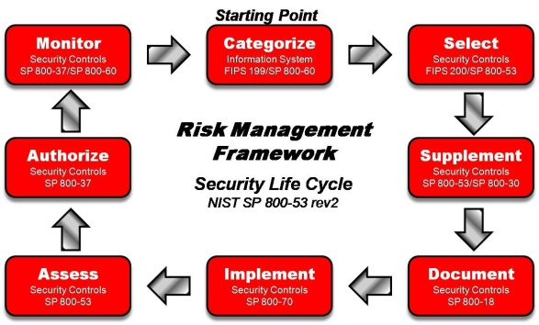
Hot Topic Discussion: Application Security and the SDLC
Develop repeatable processes
Clearly define the processes
Clearly document the procedures
Require every application system to go through the program
Educate, educate, educate
Copyright Jonathan Hanny 2010. This work is the intellectual property of the author. Permission is granted for this material to be shared for non-commercial, educational purposes, provided that this copyright statement appears on the reproduced materials and notice is given that the copying is by permission of the author. To disseminate otherwise or to republish requires written permission from the author.

Slide 14
Hot Topic Discussion: Application Security and the SDLC
We all encounter challenges.
Copyright Jonathan Hanny 2010. This work is the intellectual property of the author. Permission is granted for this material to be shared for non-commercial, educational purposes, provided that this copyright statement appears on the reproduced materials and notice is given that the copying is by permission of the author. To disseminate otherwise or to republish requires written permission from the author.

Slide 15
Our Challenges…
Hot Topic Discussion: Application Security and the SDLC
Competing Constraints: Time, Scope and Cost
Major ERP deployment
In just ONE month
7 Physical (3 application + 4 database servers)
52 Virtual Solaris (12 for Banner 8 + 40 application servers)
5 Oracle database servers + 6 Windows SQL servers
Extended Software Development Life Cycle
4+ years of changes
Threats
SQLI, XSS, bugs, flawed app/web server installs, etc…
Copyright Shannon Ortiz 2010. This work is the intellectual property of the author. Permission is granted for this material to be shared for non-commercial, educational purposes, provided that this copyright statement appears on the reproduced materials and notice is given that the copying is by permission of the author. To disseminate otherwise or to republish requires written permission from the author.

Slide 16
“Do More With Less”
Hot Topic Discussion: Application Security and the SDLC
Accept our limitations and work with them
Find a solution that will help secure our environment but it has to be: affordable, replicable, easy and provide business value
We selected: WhiteHat Sentinel Service
Vulnerability Assessments are done as soon as the last one completes, potentially hundreds of times a year – At no additional cost
IT Security staff is increased by leveraging, System, DBA and Application services resources
Detailed vulnerability descriptions with guidelines on how to mitigate them
Robust reporting with prioritization to help acquire those non-existent funds
Copyright Shannon Ortiz 2010. This work is the intellectual property of the author. Permission is granted for this material to be shared for non-commercial, educational purposes, provided that this copyright statement appears on the reproduced materials and notice is given that the copying is by permission of the author. To disseminate otherwise or to republish requires written permission from the author.

Slide 17
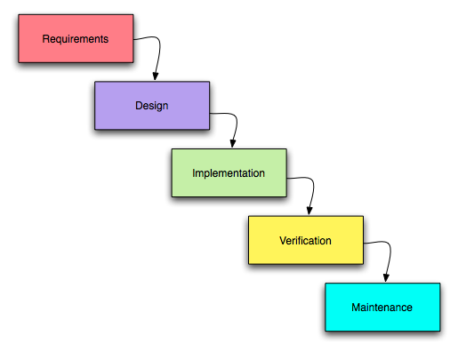
Where does this fit in our SDLC?
Hot Topic Discussion: Application Security and the SDLC
Anywhere from Implementation to Maintenance
en.wikipedia.org/wiki/Waterfall_model
Copyright Shannon Ortiz 2010. This work is the intellectual property of the author. Permission is granted for this material to be shared for non-commercial, educational purposes, provided that this copyright statement appears on the reproduced materials and notice is given that the copying is by permission of the author. To disseminate otherwise or to republish requires written permission from the author.

Slide 18
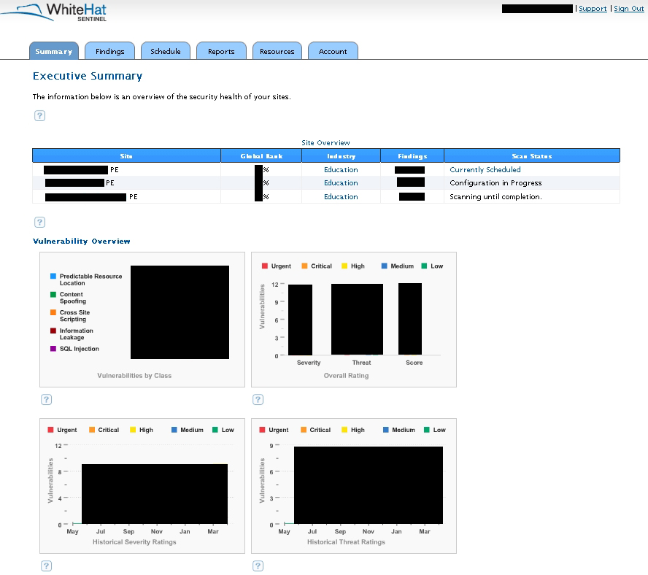
What are our vulnerabilities?
Hot Topic Discussion: Application Security and the SDLC
Copyright Shannon Ortiz 2010. This work is the intellectual property of the author. Permission is granted for this material to be shared for non-commercial, educational purposes, provided that this copyright statement appears on the reproduced materials and notice is given that the copying is by permission of the author. To disseminate otherwise or to republish requires written permission from the author.

Slide 19
WhiteHat Sentinel in Action
Hot Topic Discussion: Application Security and the SDLC
Role Play
Copyright Shannon Ortiz 2010. This work is the intellectual property of the author. Permission is granted for this material to be shared for non-commercial, educational purposes, provided that this copyright statement appears on the reproduced materials and notice is given that the copying is by permission of the author. To disseminate otherwise or to republish requires written permission from the author.

Slide 20
WhiteHat Sentinel Summary
Hot Topic Discussion: Application Security and the SDLC
Service was enabled
Backend database, web server for access and of course application installation and configuration
Launched WhiteHat
Vulnerabilities were found
Application owners notified, risk mitigated and re-tested
We are safer… for now
Copyright Shannon Ortiz 2010. This work is the intellectual property of the author. Permission is granted for this material to be shared for non-commercial, educational purposes, provided that this copyright statement appears on the reproduced materials and notice is given that the copying is by permission of the author. To disseminate otherwise or to republish requires written permission from the author.

Slide 21
What did you think?
Hot Topic Discussion: Application Security and the SDLC
Your input is important to us!
Click on “Evaluate This Session” on the Mid-Atlantic Regional program page.
Thank you!
Panelist Contact Information:
Justin C. Klein Keane
Sr. Information Security Specialist
University of Pennsylvania
jukeane@sas.upenn.edu
(215)898-0236
Jonathan Hanny
Application Security Specialist
The George Washington University
jehanny@gwu.edu
(703)-726-4469
Shannon L. Ortiz
Director of IT Security
Fordham University ortiz@fordham.edu (718) 817-3799
Copyright Jonathan Hanny 2010. This work is the intellectual property of the author. Permission is granted for this material to be shared for non-commercial, educational purposes, provided that this copyright statement appears on the reproduced materials and notice is given that the copying is by permission of the author. To disseminate otherwise or to republish requires written permission from the author.

