Slide 1
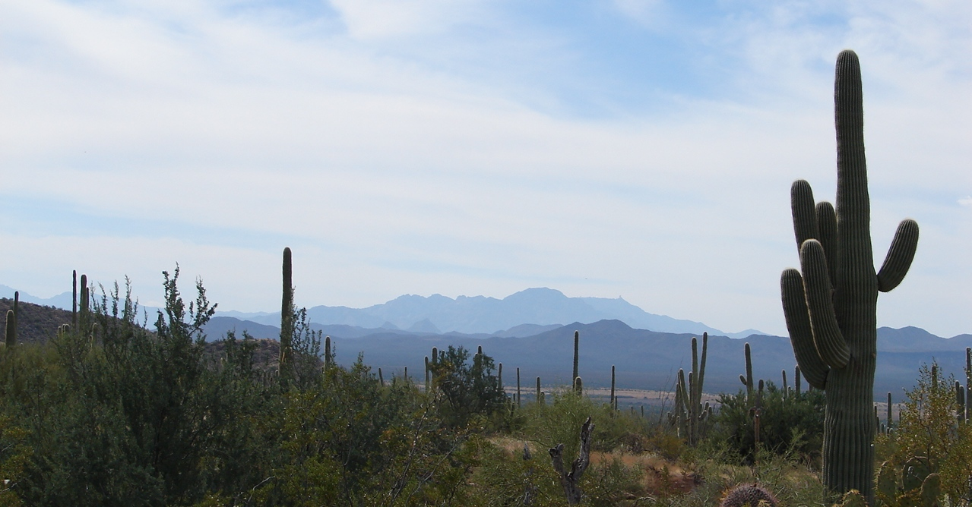
Pressure Cooker: Access Controls in New and Existing ERP Systems

Slide 2
Overview
Introduction: A story of contrasts
Motivations
Lifecycle Stage
Time

Slide 3
Motivations (UA)
Classification of Financial Audit Findings:
Control deficiency: control does not prevent or detect misstatements on a timely basis.
Significant Deficiency: one or a combination of control deficiencies. Written finding. Report to federal agencies.
Material Weakness: one or a combination of significant deficiencies, resulting in more than a remote likelihood of misstatement of financials. Serious concern to Regents.

Slide 4
Motivation (UA)
2009
Deputy CIO
Financial Auditor
2010
UISO
PeopleSoft HR
Legacy System
Ad hoc preparation
IT Auditor
Pre-validation and binder

Slide 5
Motivations (PCC)
Banner implemented in 1999
Variety of high risk issues
Two pronged approach:
Long term planning
Security culture

Slide 6
Lifecycle (UA)
University Information Security Officer
Enterprise Applications Security and HR Technical Teams
Infrastructure
Sys Admin and Environment Teams
Business Analysts
Program Coordinators
Business Intelligence Team

Slide 7
Lifecycle stage (UA)
Auditor Access and Data
NetID
Access Control
Roles
Change Control
Change Management System
VPN
PeopleSoft
Business Intelligence
Initial Access
Access Provisioning Application
Infrastructure Controls

Slide 8
Auditor Access and Data (UA)
NetID and VPN
Secure access on a protected remote connection
PeopleSoft HR
Separate role, read only, restricted to meet requirements
Business Intelligence
Reports limited to requirements and data files run by UA staff

Slide 9
Access Control (UA)
UA Security Policies
Password Policy, Authorization and Control of Access
Role Construction
Roles and access by job functions with audit tables for role security
Access Provisioning
Initial Provisioning, QA and transition to Provisioning Application

Slide 10
Change Control (UA)
Dev
Test
Prod
Stage

Slide 11
Change Control (UA)
User
Ticket system
Bench test
Peer Review
Risk Assessment
Mgmt Approval
Move to Prod
UAT
Fallback Plan

Slide 12
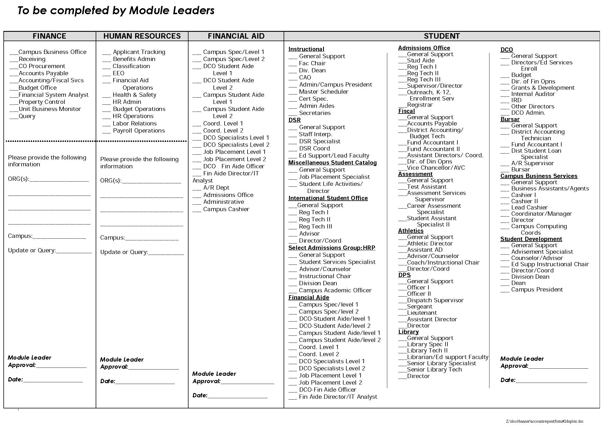
Lifecycle Stage (PCC)

Slide 13
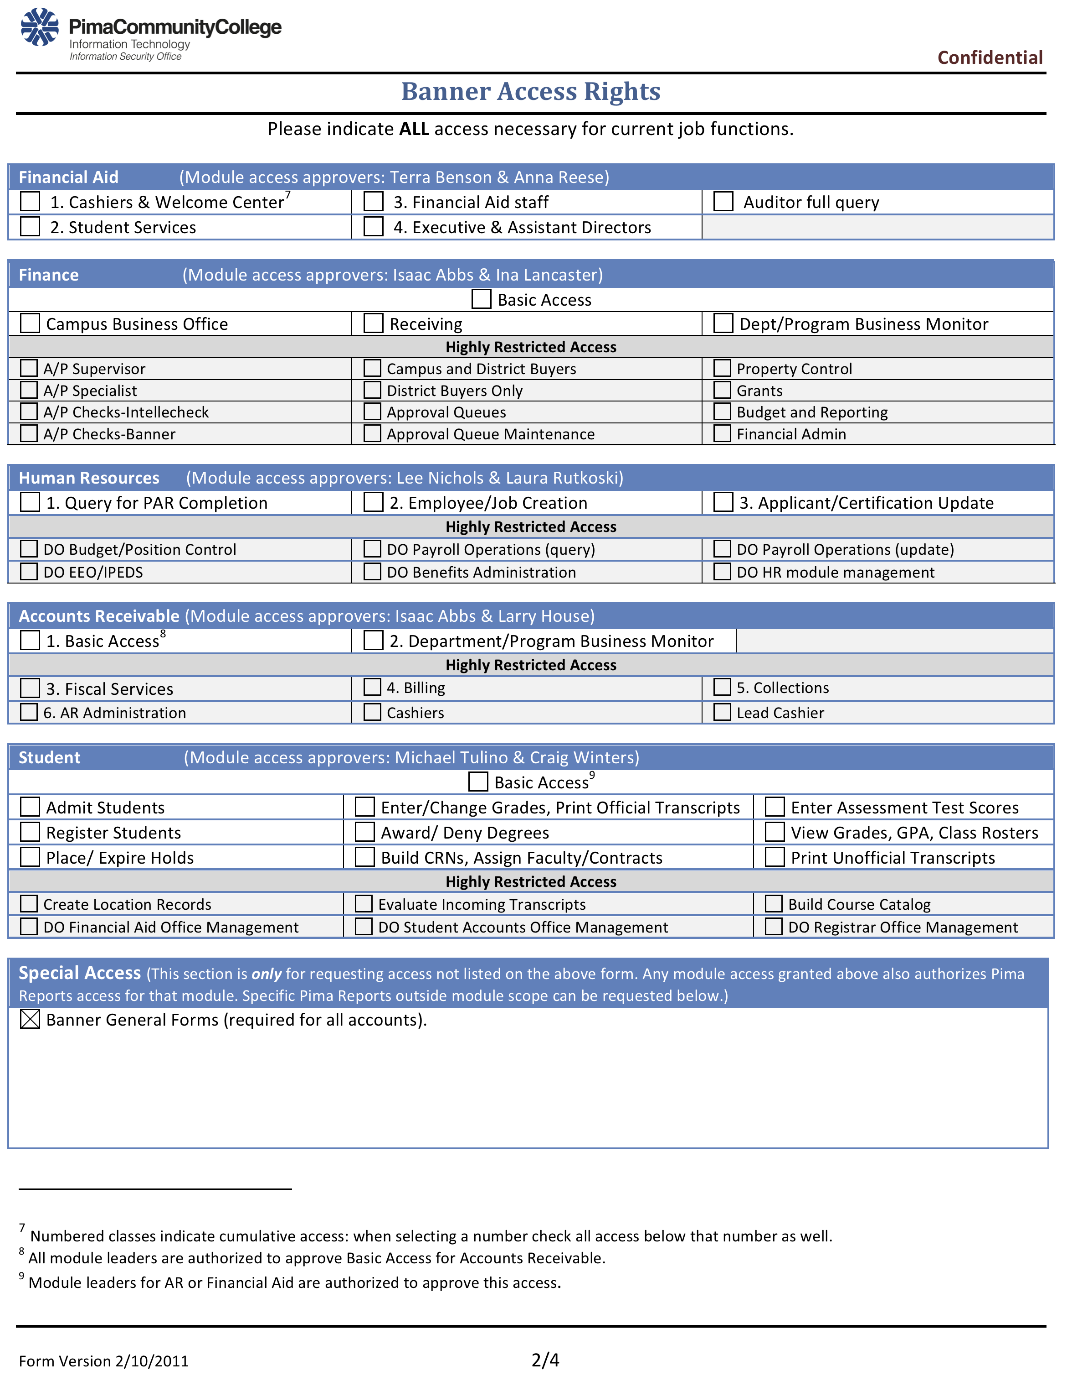
Lifecycle Stage (PCC)

Slide 14
Timeline (UA)
Access Controls
Policies Roles Provisioning
Change Controls
Change Mgmt
Infrastructure
Results
Lessons Learned
Effort Timeline
Setup
Auditor Access

Slide 15
Timeline (UA)
May
June
July
File preparation, process validation
Onsite meeting, web conferences, data feeds
Set up auditor access accounts
Coordination of reports and data feeds
Collection of info for follow-up questions
Onsite meetings, web conferences, conference calls
Web conferences, conference calls
Access control and change management testing
Collection of info for follow-up questions

Slide 16
Timeline (UA) - what worked
Focus preparation on major controls
Pre-validation of control processes
Prepare documentation in advance for auditor
Ensure a team approach
Know where and how to get information
Share out knowledge quickly to teams to begin improvements
Develop rapport with auditors
Be helpful, timely, check in on needs
Keep them in scope while providing access
Learn the standards they use to measure controls
Represent best of what UA is doing and keep a good perspective

Slide 17
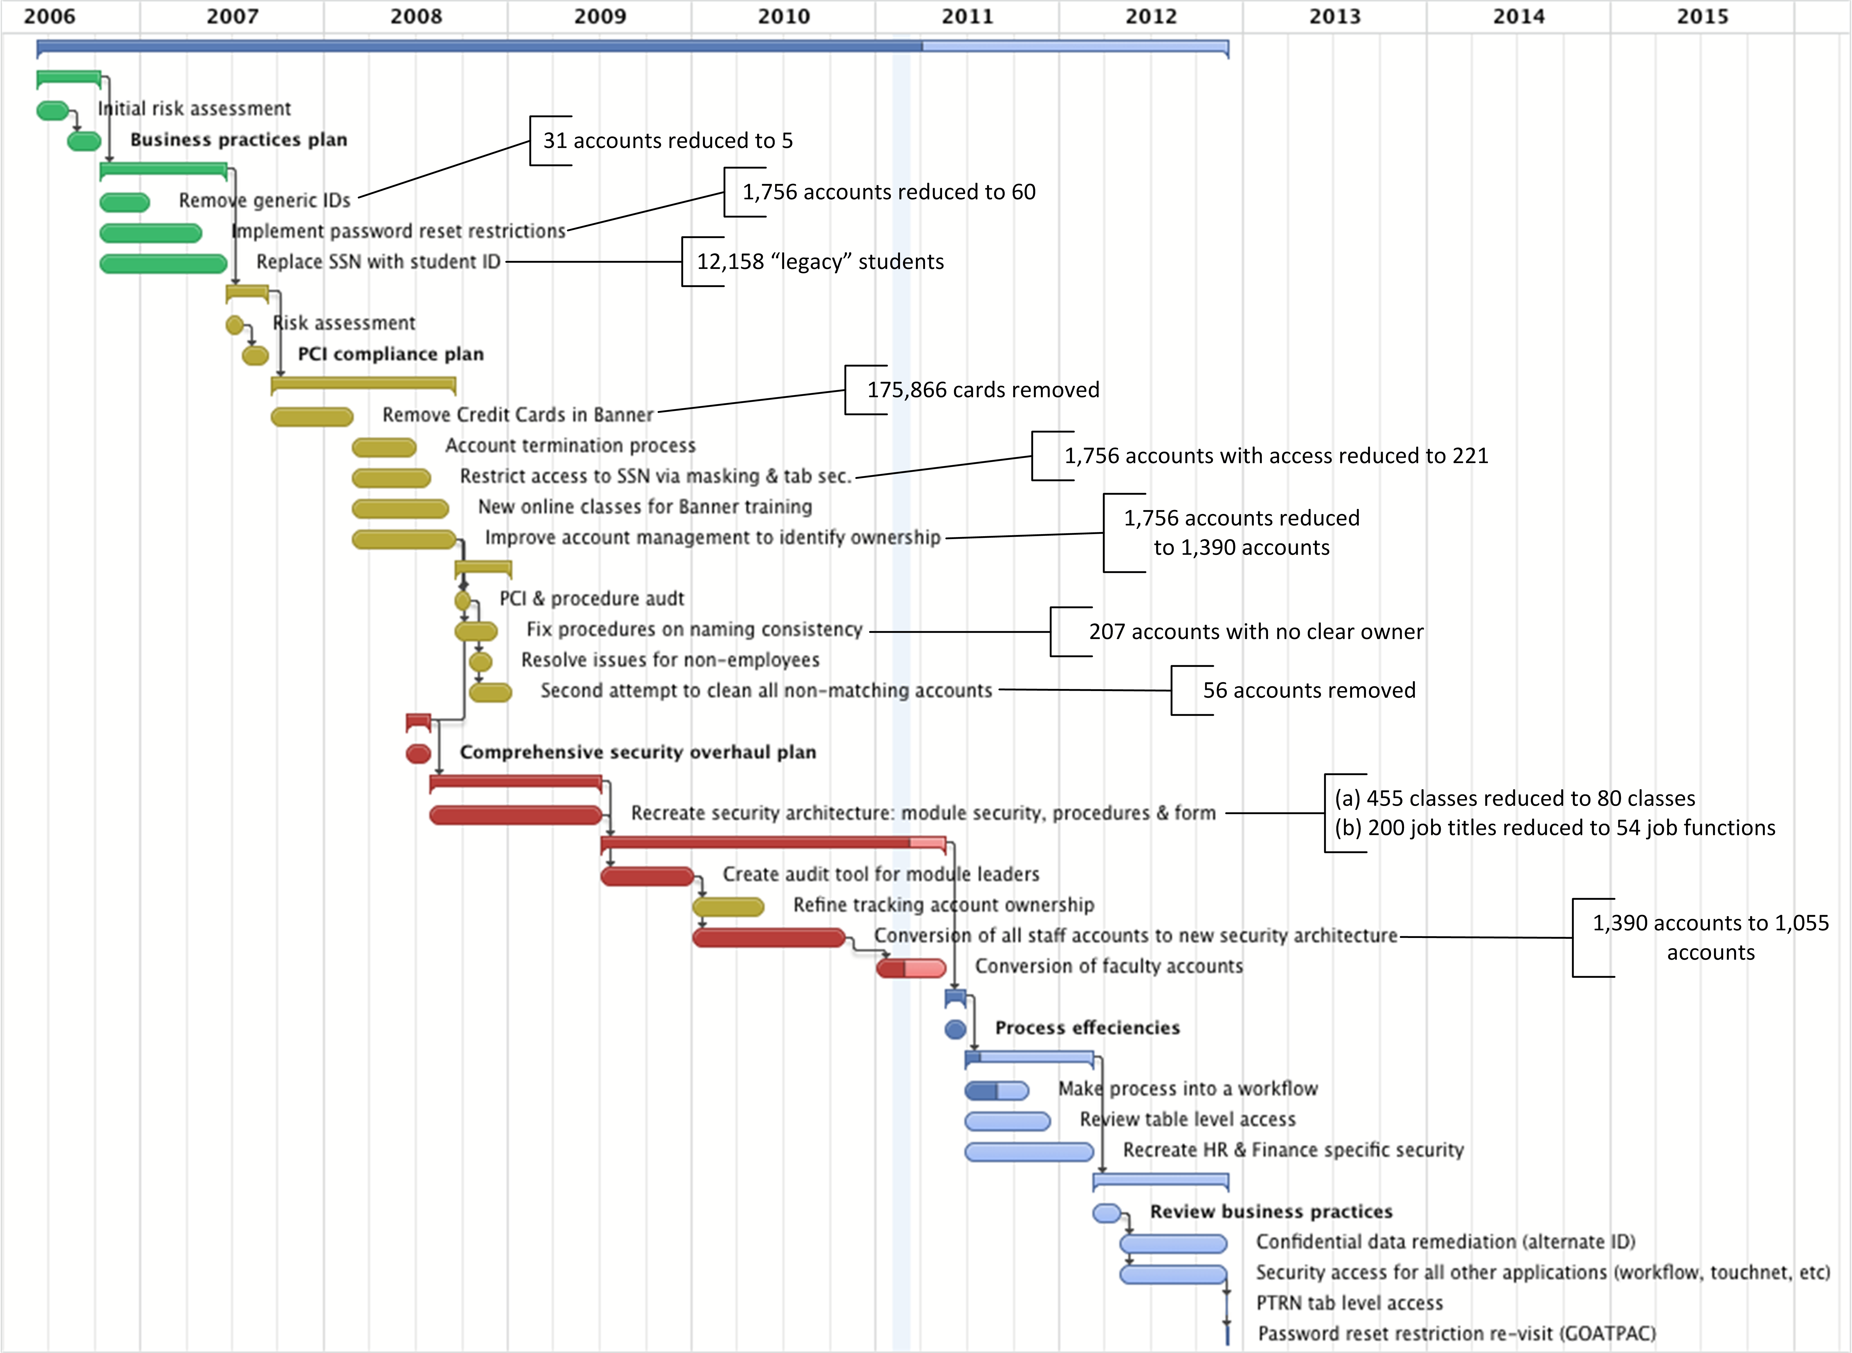
Time (PCC)

Slide 18
Conclusion
Cathy Bates Univ. Information Security Off. University of Arizona cbates@email.arizona.edu 520-626-2399 | Brian Basgen Information Security Officer Pima Community College bbasgen@pima.edu 520-206-4873

